Slide 1
A Self-Stabilizing Algorithm for Finding a Minimal Distance-2 Dominating Set in Distributed Systems
JI-CHERNG LIN(林基成), TETZ C. HUANG(黃哲志), CHENG-PIN WANG(王承斌)
AND CHIH-YUAN CHEN(陳志遠)
JOURNAL OF INFORMATION SCIENCE AND ENGINEERING, Vol. 24, pp. 1709-1718, 2008
Presenter: Dong-Jian Lin
Date: Apr. 13, 2010

Slide 2
Abstract
The study of various dominating set problems is an important
area within graph theory. In applications, a dominating set in a
system can be considered as an ideal place for allocating
resources. And, a minimal dominating set allows allocating a
smaller number of resources. Distance-versions of the concept of
minimal dominating sets are more applicable to modeling real-
world problems, such as placing a smaller number of objects
within acceptable distances of a given population.

Slide 3
Abstract(Cont.)
However, due to the main restriction that any processor in a
distributed system can only access the data of its
direct neighbors, a self-stabilizing algorithm for finding a
minimal distance-k (with k ≥ 2) dominating set is hard to get, and
its correctness is hard to verify. In this paper, a self-stabilizing
algorithm for finding a minimal distance-2 dominating set is
proposed. The algorithm can be applied to any distributed system
that operates under the central demon model. The correctness of
the algorithm is verified.

Slide 4
Distributed System
In a distributed system, each processor has one or more shared
registers and possibly some non-shared local variables, used to
specify the local state of the processor.
Local states of all processors in the system at a certain time
constitute the global configuration(or, simply, configuration) of
the system at that time.

Slide 5
Distributed System(Cont.)
The main restriction of a distributed system is that each processor
in the system can only access the data (i.e., read the shared data)
of its neighbors.
Depending on the purpose of a distributed system, a global
criterion for the global configuration is defined. Those global
configurations satisfying the criterion are called legitimate
configurations.

Slide 6
Dijkstras’s Central Demon Model
Features:
condition part → action part
N₀(x) = ∅ ∧ N₁(x) = ∅ ^ d_{x} ≠ 0 → d_{x} := 0
The condition part (or guard) is a Boolean function over the states of the processor and its neighbors; the action part is an assignment of values to some of the processor’s shared registers.

Slide 7
Dijkstras’s Central Demon Model(Cont.)
the central demon in the system will randomly select exactly one among all the privileged processors to make a move, in a single atomic step. The local state of the selected processor thus is changed and in the meantime results in the change of the global configuration of the system.
An infinite or finite sequence of configurations
Γ = ( γ₁, γ₂, …) of the system is called an execution (of the algorithm in the system) if for any i ≥ 1, γ_{i+1} is obtained from γ_{i} after exactly one processor in the system makes the i^{th} move γ_{i} → γ_{i+1} .

Slide 8
Dijkstras’s Central Demon Model(Cont.)
Under this central demon model, Dijkstra introduced the notion
of self-stabilization of a distributed system.
Self-stabilization is a concept of fault-tolerance in distributed
computing. A distributed system that is self-stabilizing will end
up in a correct state no matter what state it is initialized with.
That correct state is reached after a finite number of execution
steps.

Slide 9
Distributed System to a graph
Let G = (V, E) be a simple connected undirected graph, with each
node i ∈ V representing a processor in the system and each edge
{i, j} representing the bidirectional link connecting processors i
and j.

Slide 10


Minimal Distancd-2 Dominating Set
A subset D of V is called a distance-2 dominating set in G if for
any node x in V, there is a node y in D such that the distance
between x and y is not greater than two.
A distance-2 dominating set D in G is minimal if no proper subset
of D is a distance-2 dominating set in G.

Slide 11
Purpose
In this paper, a self-stabilizing algorithm for finding a minimal
distance-2 dominating set is proposed. The algorithm can be
applied to any distributed system that operates under the central
demon model.

Slide 12
Algorithm
Let G = (V, E) be a simple connected undirected graph. Each
processor has a unique identifier. Moreover, each processor x in
the system maintains a shared register d_{x} whose value is 0, 1 or 2,
and a shared register p_{x} whose value is the identifier of a neighbor
of x.
In all the following:
N(x) = {y ∈ V | {x, y} ∈ E}
N₀(x) = {y ∈ N(x) | d_{y} = 0}
N₁(x) = {y ∈ N(x) | d_{y} = 1}
N₀²(x) = {y ∈ V | d(x, y) = 2 and d_{y} = 0},
where d(x, y) is the distance between nodes x and y.

Slide 13
Algorithm(Cont.)
{For any node x}
R1: N₀(x) = ∅ ∧ N₁(x) = ∅ ^ d_{x} ≠ 0 → d_{x} := 0
R2: N₀(x) ≠ ∅ ∧ d_{x} ≠ 1 → d_{x} := 1; p_{x} := min N₀(x), where
min N₀(x) is the smallest element in the set N₀(x)
R3: N₀(x) = ∅ ∧ N₁(x) ≠ ∅ ∧ [d_{x} = 1 ∨ (d_{x} = 0 ∧ ∃y ∈ N₁(x) s.t. p_{y} ≠ x)] → d_{x} := 2
R4: d_{x} = 1 ∧ N₀(x) ≠ ∅ ∧ p_{x} ∉ N₀(x) → p_{x} := min N₀(x)
The legitimate configurations are defined to be all those
configurations in which no node in the system is privileged.

Slide 14
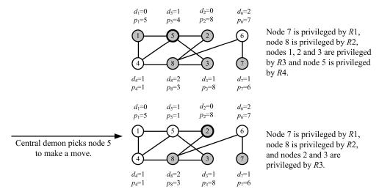
Algorithm(Cont.)

Slide 15
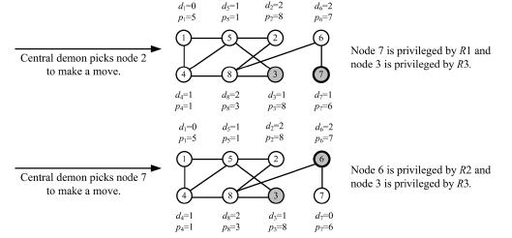
Algorithm(Cont.)

Slide 16
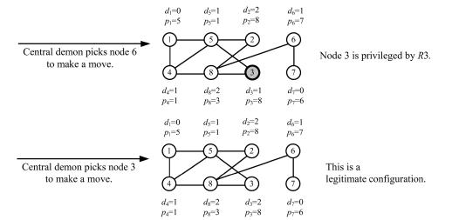
Algorithm(Cont.)

Slide 17
Algorithm(Cont.)
An example to illustrate an execution of Algorithm 1(In the last
configuration, which is a legitimate configuration, a minimal
distance 2-dominating set D = {1, 7} can be identified.)

Slide 18
Conclusion
1.To generalize the results in this paper from the minimal
distance-2 dominating set problem to the minimal distance-k
dominating set problem (k is an arbitrary positive integer).
2. To generalize the results in this paper from the central demon
model to the distributed demon model.
3. To prove that the worst-case stabilization time of the proposed
algorithm in this paper is O(n^{i}) for some constant i, where n is
the number of processors in the system.

