Slide 1
On the Longest Common Parameterized Subsequence
O. Keller, T. Kopelowitz, and M. Lewenstein
Lecture Notes in Computer Science, Vol. 5029, pp. 303-315, 2008
Presenter: Chiou-Ting Tseng
Date: Apr. 13, 2010

Slide 2
Abstract
The well-known problem of the longest common subsequence (LCS), of two strings of lengths n and m respectively, is O(nm)-time solvable and is a classical distance measure for strings. Another well studied string comparison measure is that of parameterized matching, where two equal-length strings are a parameterized-match if there exists a bijection on the alphabets such that one string matches the other under the bijection. All works associated with parameterized pattern matching present polynomial time algorithms.

Slide 3
Abstract
There have been several attempts to accommodate parameterized matching along with other distance measures, as these turn out to be natural problems, e.g., Hamming distance, and a bounded version of edit-distance. Several algorithms have been proposed for these problems. In this paper we consider the longest common parameterized subsequence problem which combines the LCS measure with parameterized matching. We prove that the problem is NP-hard, and then show a couple of approximation algorithms for the problem.

Slide 4
Parameterized Matching
Prog.c
int a,b;
a=1;
a = g(a)*5+f(a);
b=2;
a = func(a,b);
a = a*g(b);
b=1;
b = g(b)*5+f(b);
….
c=1;
c = g(c)*5+f(c);
Pattern

Slide 5
Parameterized Matching
Let S = s₁ . . .s_{n} and T = t₁ . . . t_{n} be strings over alphabet set Σ ∪Π, such that Σ ∩ Π = ∅. We say S and T are a parameterized-match if there exists a bijection f : Π → Π for which, for each i = 1, . . . , n, it holds that:
1. if s_{i} ∈ Σ, then s_{i} = t_{i}.
2. if s_{i} ∈ Π, then also t_{i} ∈ Π, and f(s_{i}) = t_{i}.

Slide 6
Function Matching vs.
Parameterized Matching
P p-matches t_{i} t_{i+1} … t_{i+m-1} iff
1. P f-matches t_{i} t_{i+1} … t_{i+m-1} and
2. # of symbols in t_{i} t_{i+1} … t_{i+m-1} = # of symbols in P
(the function f is a bijection)
f(h) = d
f(e) = a
f(a) = d
f(h) = b
f(e) = c
f(a) = a
P = h e h a e h h e h a e h
T = a b c b a c b a d a b d a d d a d

Slide 7
Indeterminate Matching
1 | 2 | 3 | 4 | 5 | 6 | 7 | 8 | 9 | 10 | ...
a | d | c | a | b | ■ | a | b | c | b | a
c | a | Δ | a | b
 |  |  | c | a | Δ | a | b
Σ | a | b | c | d | ■ | Δ
S | 2 | 1 | 3 | 6 | 3 | 1
■ ={c, d}, Δ={b, c}

Slide 8
我的想法
把變數想成是indeterminate alphabet，只可對應到所有的indeterminate alphabet，再套用local determinate，因為同一個變數在這個window中要對應到同樣的東西，但是只能作functional matching，因為無法保證對應不重複，要加工hctam紀錄已經match的字似乎也不是很直覺

Slide 9
Common Parameterized Subsequence
For two strings B = b₁ . . . b_{n} and C = c₁ . . . c_{m} over Σ ∪ Π, We define their common parameterized subsequence as a pair of two ascending sequences I = i₁, . . . , i_{k} and J = j₁, . . . , j_{k} of locations in B and C respectively (i.e., i ∈ {1, . . . , n} and j ∈ {1, . . .,m} for each = 1, . . . , k), such that B^{I} p-matches C^{J}, where B^{I} = b_{i1}b_{i2} . . . b_{ik} and C^{J} = c_{j1}c_{j2} . . . c_{jk} .
Longest common parameterized subsequence

Slide 10
Longest Common Mapped Subsequence
The specific case of the LCPS problem in which Σ = ∅ (i.e., the only alphabet is the parametric alphabet Π) is denoted the longest common mapped subsequence (LCMS) problem

Slide 11
3D-matching
Let X, Y, Z be three disjoint sets such that |X| = |Y | = |Z| = n, and let S ⊆ X × Y × Z. In the 3D-matching problem, we wish to find a subset S’ ⊆ S which is a perfect matching of X, Y and Z, i.e., every element of X, Y and Z is covered by S’ exactly once.
X={1, 2, 4}, Y={a, b, c}, Z={♣,♦,♥}, S={(1, a, ♦), (4, a, ♣), (1, a,♥), (2, b, ♦), (1, c, ♥)}
S’={(1, c, ♥), (2, b, ♦), (4, a, ♣)}

Slide 12
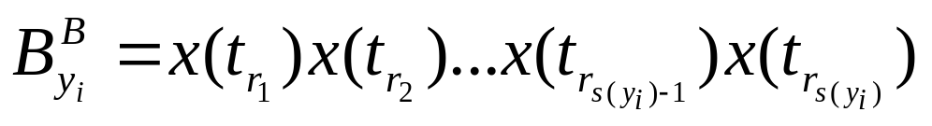
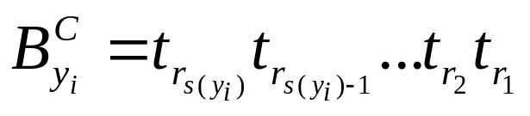
Proof of NP Completeness
3D-matching can polynomial time reduced to LCPS. 3D-matching is NPC.
For 3D-matching of (X, Y, Z, S), we construct Σ = ∅ and Π = X∪S∪{∗},

Slide 13
Example
X={1, 2, 4}, Y={a, b, c}, Z={♣,♦,♥}, S={(1, a, ♦), (4, a, ♣), (1, a,♥), (2, b, ♦), (1, c, ♥)}
Σ = ∅
Π = {1, 2, 4, (1, c, ♥), (4, a, ♣), (1, a,♥), (2, b, ♦), (1, a, ♦), ∗},
B=[1***4***1***2***1***][1***1***4***2***1***][4***1***2***1***1***]
C=[(1, a, ♦)***(4, a, ♣)***(1, a,♥)***(2, b, ♦)***, (1, c, ♥)***][(4, a, ♣)***(1, a,♥)***(1, a, ♦)***(2, b, ♦)***(1, c, ♥)***][(4, a, ♣)***(2, b, ♦)***(1, a, ♦)***(1, c, ♥) ***(1, a,♥)***]
(X, Y, Z, S) ∈ 3DM if and only if (B,C, 3s + 9n) ∈ CPS.
Notes:
42 s=4, n=3 6s+6n=42, 3s+9n=39

Slide 14
Brute Force Algorithm
對於Π小的情況，把每種情況都代入，找出每種代入法的LCS，最長的就是LCPS。
O(|Π|!mn) time
If |Π| ≤ c log n / loglog n，it is O(n^{c+1}m)

Slide 15
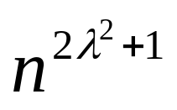
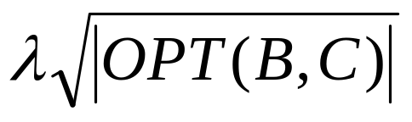
Approximating LCMS
For a given parameter λ > 0, we provide an O( m)-time algorithm, obtaining result with length ≥ where OPT(B,C) denotes the optimal solution.

Slide 16
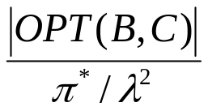
Approximating LCMS
Method 1: Map the i-th unique symbol which appears in B, to the i-th unique symbol which appears in C, for i= 1, . . . , π_{min} will get a CMS of length π_{min}.
Method 2: Find the “λ² symbols most frequent in OPT”. Running the naïve algorithm on the two strings, wherein all symbols not from the λ² most frequent are deleted, will yield a solution of length at least
Use the better among them

Slide 17
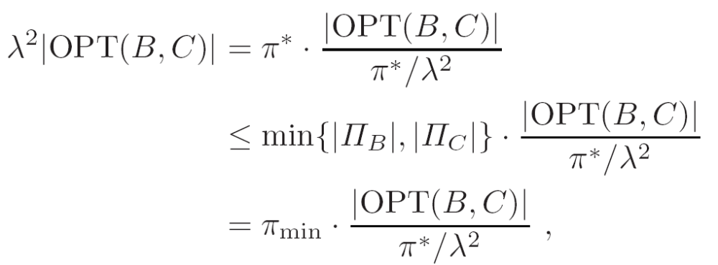
Ratio Analysis

Slide 18
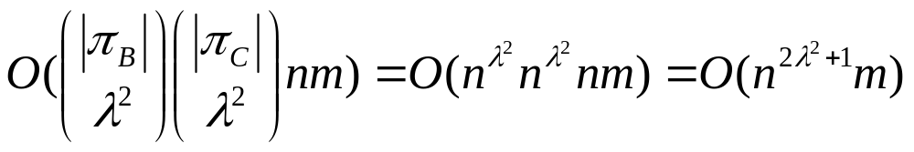
Time Analysis
Test every possible combination of λ² symbols in both strings and choose the combination yielding the maximal result.

Slide 19
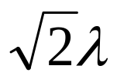
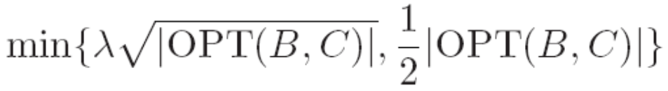
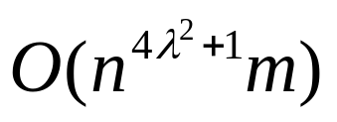
Approximating LCPS
Find the longer among the LCMS with parameter and the LCS of fixed alphabet in B and C.
Approximate ratio:
Time:

Slide 20
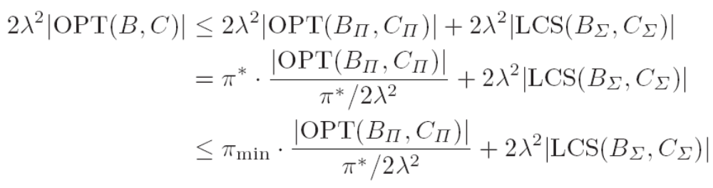
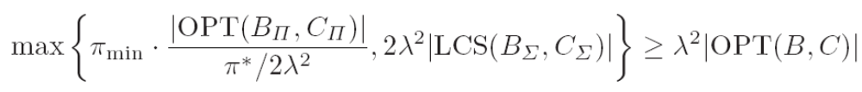
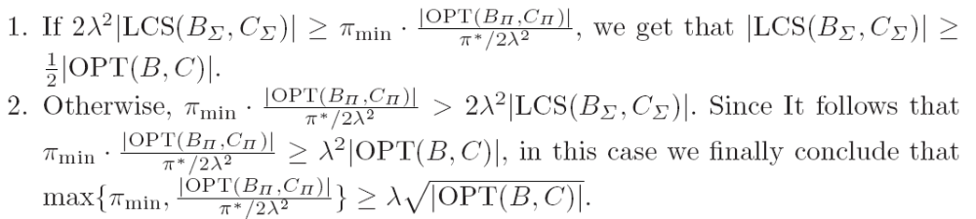
Ratio Analysis

