Slide 1
Forecasting stock market movement direction with support vector machine
Wei Huang, Yoshiteru Nakamori, Shou-Yang Wang
Computers & Operations Research 32 (2005) 2513–2522
Presenter: Siao-ming Jhou
Date: April 21, 2010

Slide 2
Abstract
Support vector machine (SVM) is a very specific type of learning algorithms characterized by the capacity control of the decision function, the use of the kernel functions and the sparsity of the solution. In this paper, we investigate the predictability of financial movement direction with SVM by forecasting the weekly movement direction of NIKKEI 225 index. To evaluate the forecasting ability of SVM, we compare its performance with those of Linear Discriminant Analysis, Quadratic Discriminant Analysis and Elman Backpropagation Neural Networks. The experiment results show that SVM outperforms the other classification methods. Further,we propose a combining model by integrating SVM with the other classification methods. The combining model performs best among all the forecasting methods.

Slide 3
NIKKEI 225
日經平均指數（日語：日経平均株価，英語：Nikkei225，又名日經225，另譯：日經平均股票價格、日經225指數），全名為日本經濟平均指數，是由日本經濟新聞推出的東京證券交易所的225品種的股價指數，1971年第一次發表。

Slide 4
Model input selection
Japanese consumption capacity is limited in the domestic market. The economy growth has a close relationship with Japanese export. The largest export target for Japan is the United States of America (USA), which is the leading economy in the world. Therefore, the economic condition of USA influences Japan economy, which is well represented by the NIKKEI 225 Index. As the NIKKEI 225 Index to Japan economy, the S&P 500 Index is a well-known indicator of the economic condition in USA. Hence, the S& P 500 Index is selected as model input. Another import factor that affects the Japanese export is the exchange rate of US Dollars against Japanese Yen (JPY), which is also selected as model input. The prediction model can be written as the following function:
Direction_{t} = F(S^{S&P500}_{t−1 ，} S^{JPY}_{t−1})
where S^{S&P500}_{t−1} and S^{JPY}_{t−1} are first order difference natural logarithmic transformation to the raw S& P 500 index and JPY at time t−1, respectively.

Slide 5
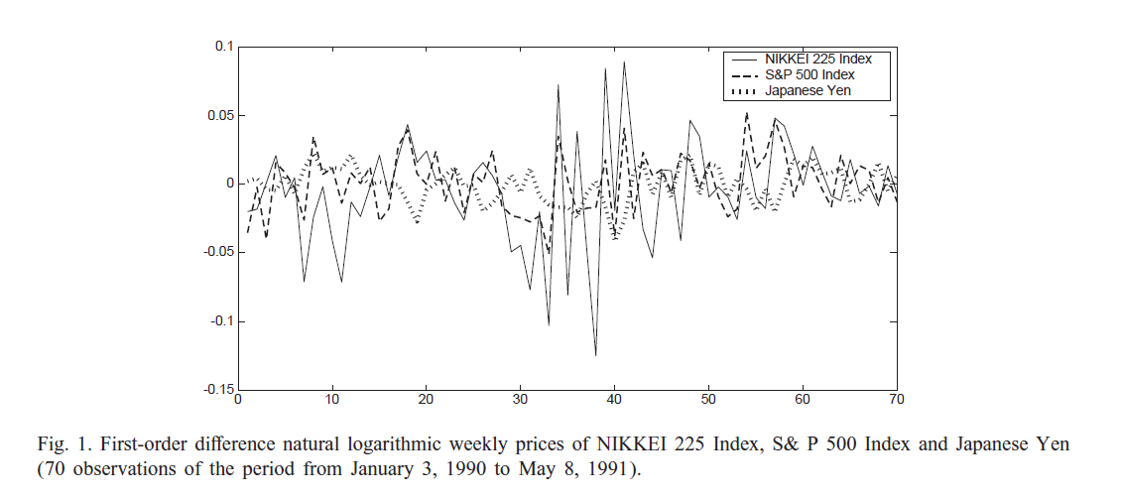


Slide 6
Data collection
The whole data set covers the period from January 1, 1990 to December 31, 2002, a total of 676 pairs of observations. The data set is divided into two parts. The 1rst part (640 pairs of observations) is used to determine the speci1cations of the models and parameters. The second part (36 pairs of observations) is reserved for out-of-sample evaluation and comparison of performances among various forecasting models.

Slide 7
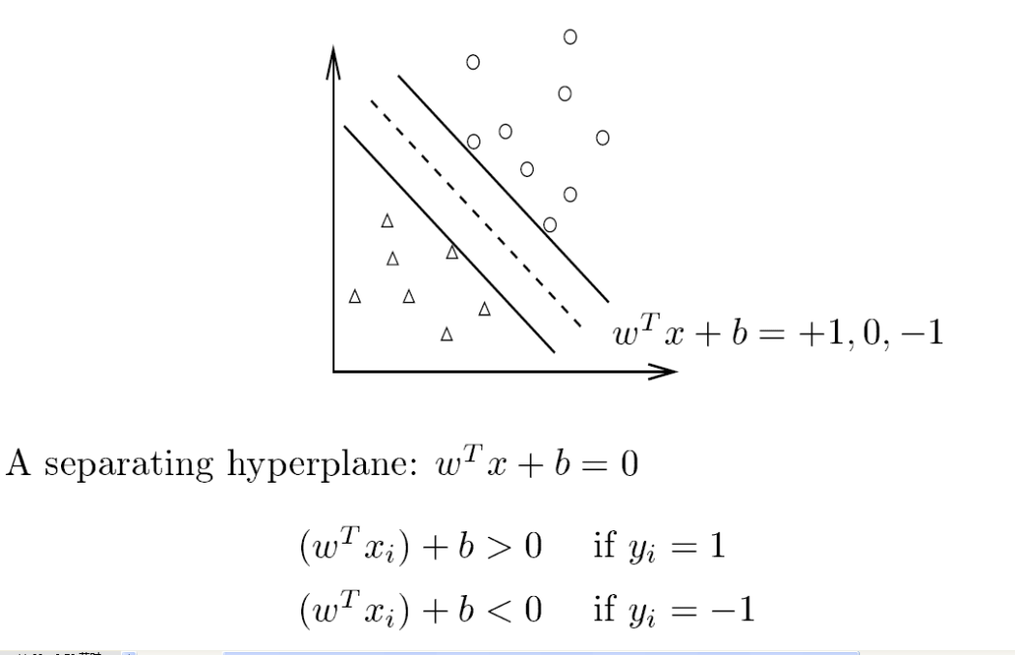
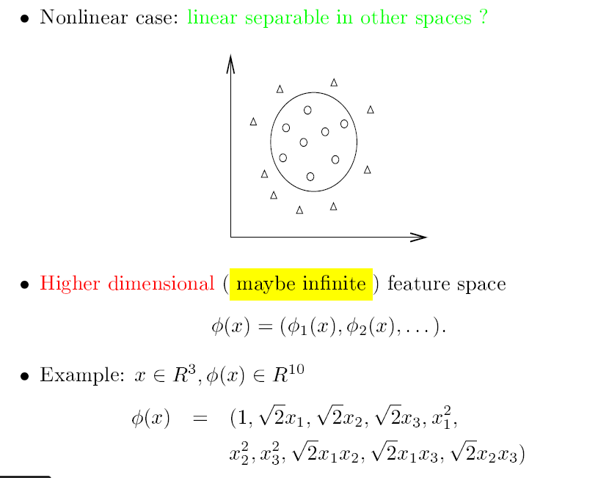
SVM(support vector machine)

Slide 8
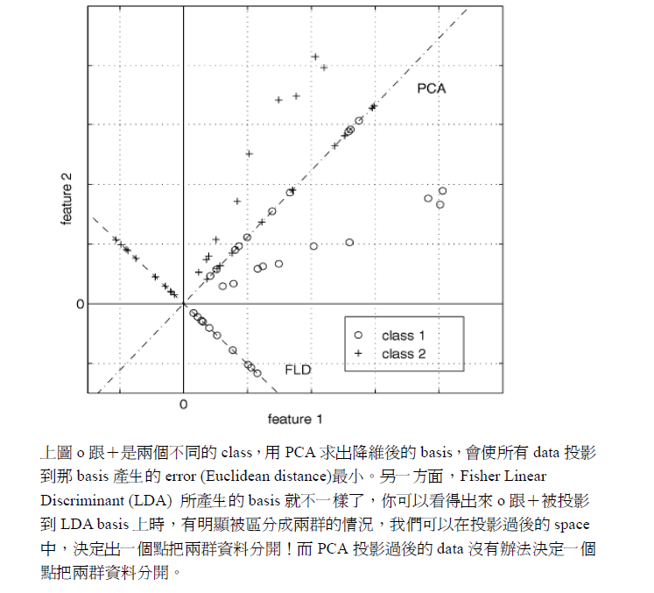
LDA(linear discriminant analysis)
具有把高維的
資料投影到低維空間中，並且讓他們投影過後能夠具備好分辨(分割)的特性。
http://www.cmlab.csie.ntu.edu.tw/~cyy/learning/tutorials/LDA.pdf

Slide 9
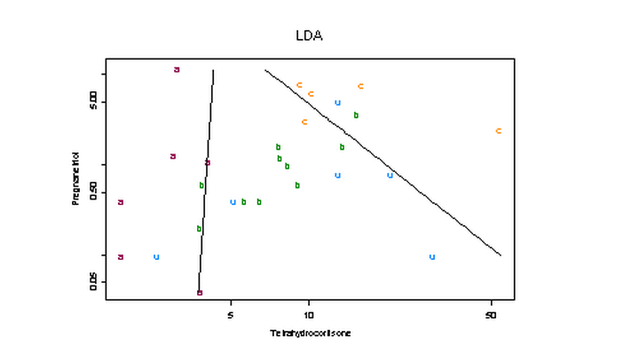
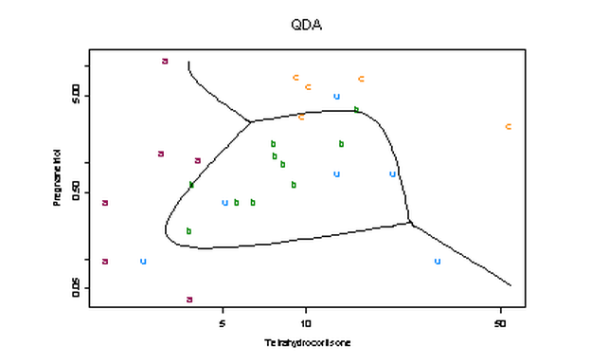
QDA
任意的兩個類別區分的判別邊界(decision boundary)均為二次曲線或曲面
http://www.stat.ncku.edu.tw/faculty_private/sljeng/Datamining/information/predict2.htm

Slide 10
Elman Backpropagation Neural Network
Elman Backpropagation Neural Network is a partially recurrent neural network. The connections are mainly feed-forward but also include a set of carefully chosen feedback connections that let the network remember cues from the recent past. The input layer is divided into two parts: the true input units and the context units that hold a copy of the activations of the hidden units from the previous time step. Therefore, network activation produced by past inputs can cycle back and affect the processing of future inputs.

Slide 11
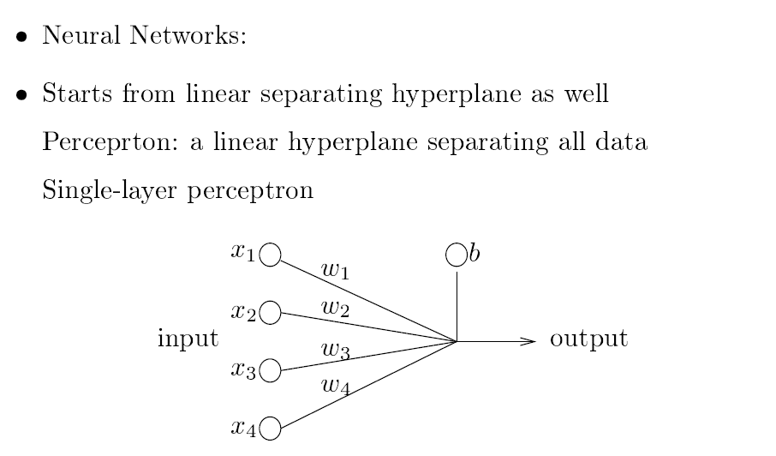
Neural Network(1/2)

Slide 12
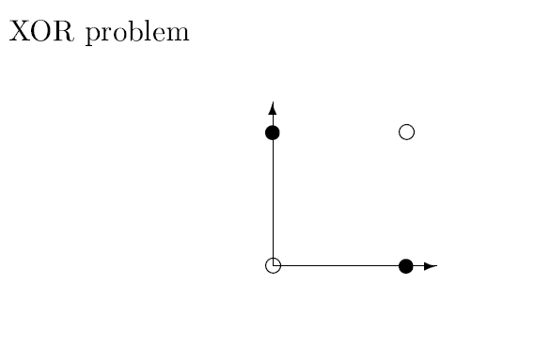
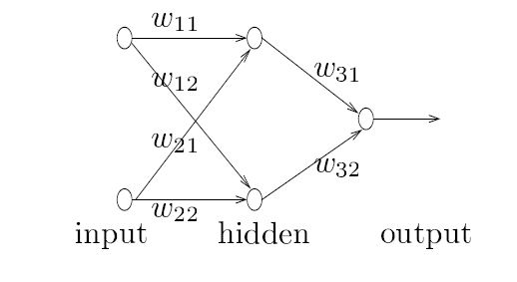
Neural Network(2/2)

Slide 13
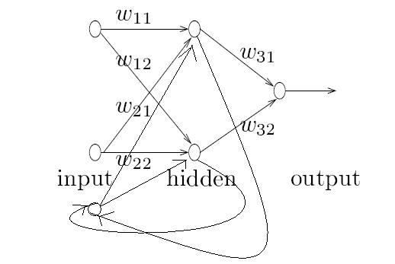
Elman Backpropagation Neural Network

Slide 14
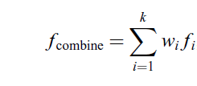

A combining model
where a_{i} is the in-sample performance constructed by forecasting method i.

Slide 15
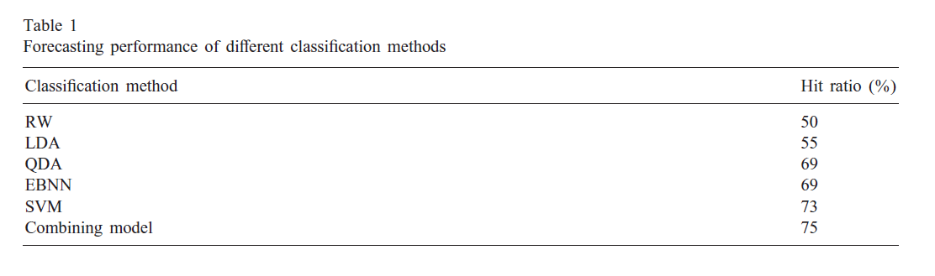
Result

