Slide 1
Predicting subcellular localization of proteins for Gram-negative bacteria by support vector machines based on n-peptide compositions
Chin-Sheng Yu, Chin-Jen Lin, and Jenn-Kang Hwang
Protein Society 13: 1402–1406
Presenter: Chu-Kai Liu
Date: Apr. 20, 2010

Slide 2
Abstract (1/2)
Gram-negative bacteria have five major subcellular localization sites: the cytoplasm (細胞質), the periplasm (週質), the inner membrane (內膜), the outer membrane (外膜), and the extracellular space (細胞間隙). The subcellular location of a protein can provide valuable information about its function. With the rapid increase of sequenced genomic data, the need for an automated and accurate tool to predict subcellular localization becomes increasingly important. We present an approach to predict subcellular localization for Gram-negative bacteria.

Slide 3
Abstract (2/2)
This method uses the support vector machines trained by multiple feature vectors based on n-peptide(肽) compositions. For a standard data set comprising 1443 proteins, the overall prediction accuracy reaches 89%, which, to the best of our knowledge, is the highest prediction rate ever reported. Our prediction is 14% higher than that of the recently developed multimodular PSORT-B. Because of its simplicity, this approach can be easily extended to other organisms and should be a useful tool for the high-throughput and large-scale analysis of proteomic and genomic data.

Slide 4
Features
N-peptide composition of amino acids.
20 amino acids are classified into four groups:
  Charged.
  Polar.
  Aromatic (芳香族化合物).
  Nonpolar.
The partitioned amino acid composition.

Slide 5
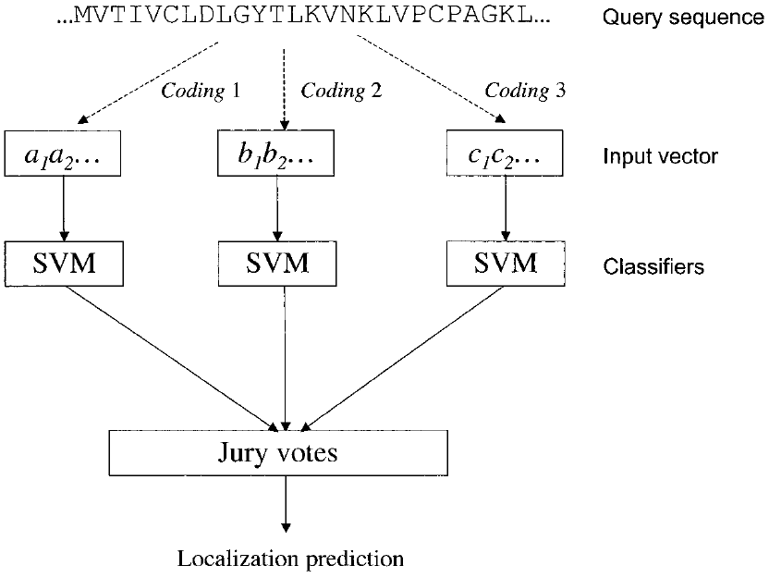
The method of jury votes

Slide 6
Data sets
From SWISS-PROT: 1443 protein sequences.
1302 proteins localized in a single subcellular site:
  248 cytoplasmic.
  268 inner membrane.
  244 periplasmic.
  352 outer membrane.
  190 extracellular.
141 proteins resident at multiple localization sites:
  14 cytoplasmic/inner membrane
  50 inner membrane/periplasmic
  77 outer membrane/extracellular

Slide 7
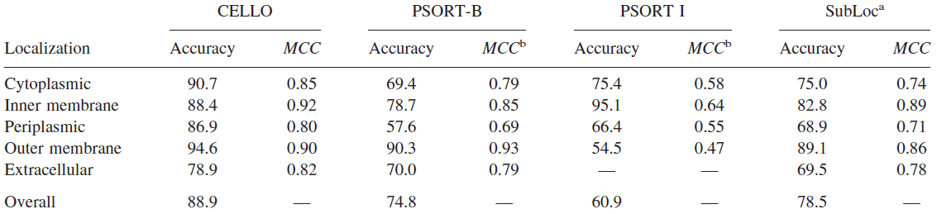
Results
The comparison of predictive performances of different approaches in the prediction of subcellular localization for Gram-negative bacteria.

Slide 8
進度報告
We use the method of jury votes.
  1st jury.
  2nd jury.
  3rd jury.
  4th jury.

