Slide 1
Issues in Stacked Generalization
Kai Ming Ting and Ian H. Witten
Journal of Artificial Intelligence Research Volume 10, pages 271-289, 1999
Presenter : Chih-Ying Lin
Date : May 04, 2010

Slide 2
Abstract
Stacked generalization is a general method of using a high-level model to combine lower-level models to achieve greater predictive accuracy. In this paper we address two crucial issues which have been considered to be a ‘black art’ in classification tasks ever since the introduction of stacked generalization in 1992 by Wolpert: the type of generalizer that is suitable to derive the higher-level model, and the kind of attributes that should be used as its input. We find that best results are obtained when the higher-level model combines the confidence (and not just the predictions) of the lower-level ones.
We demonstrate the effectiveness of stacked generalization for combining three different types of learning algorithms for classification tasks. We also compare the performance of stacked generalization with majority vote and published results of arcing and bagging.

Slide 3


Method
Result
Result
classifier
classifier
class
class
class
prob.
prob.
prob.
classifier
classifier
…
classifier
classifier
classifier
…
classifier
Input data
Input data

Slide 4
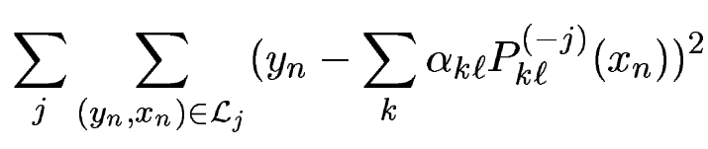
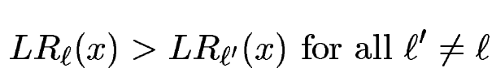
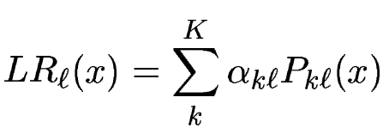
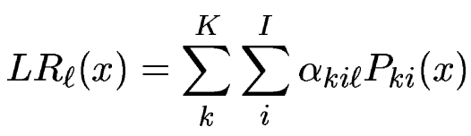
Generalizers
C4.5: decision tree
NB: Naive Bayesian classifier
IB1: lazy learning algorithm
MLR: linear regression
or

Slide 5
Example
X | Class 1 | Class 2 | Class 3
Classifier 1 | 0.9 | 0.1 | 0
Classifier 2 | 0.7 | 0.05 | 0.25
Classifier 3 | 0.4 | 0.3 | 0.3
LR₁(X) | α₁₁*0.9+α₂₁*0.7+α₃₁*0.4 | α₁₁₁*0.9+α₂₁₁*0.7+α₃₁₁*0.4 +α₁₂₂*0.1+α₂₂₂*0.05+α₃₂₂*0.3 +α₁₃₃*0 +α₂₃₃*0.25+α₃₃₃*0.3
LR₂(X) | α₁₂*0.1+α₂₂*0.05+α₃₂*0.3
LR₃(X) | α₁₃*0 +α₂₃*0.25+α₃₃*0.3

Slide 6
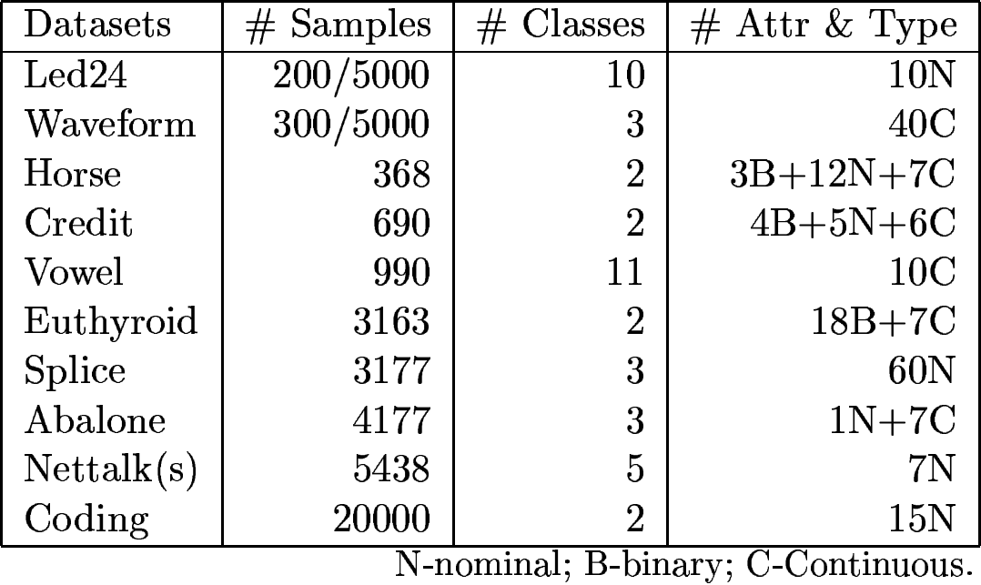
Datastes

Slide 7
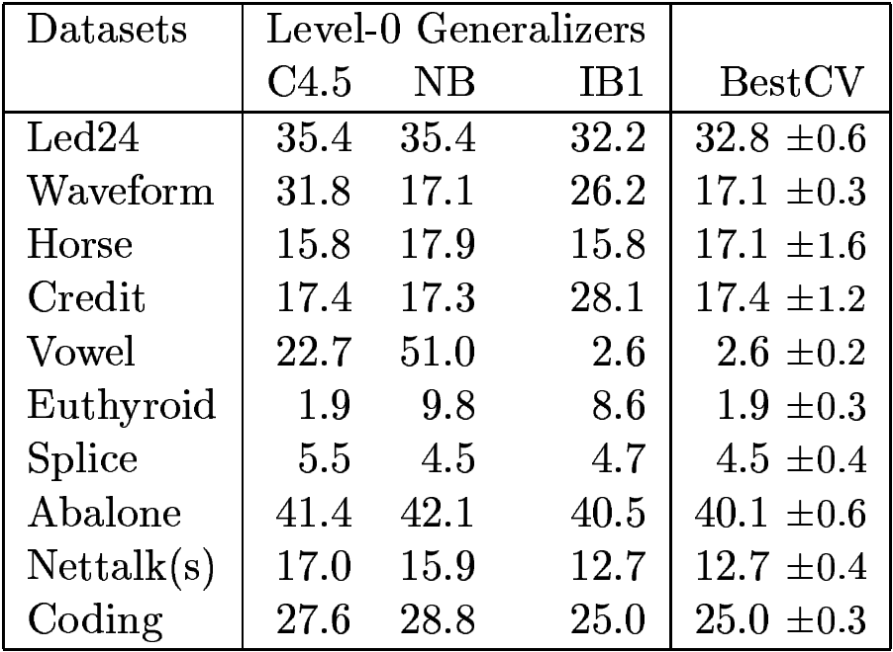
Result

Slide 8
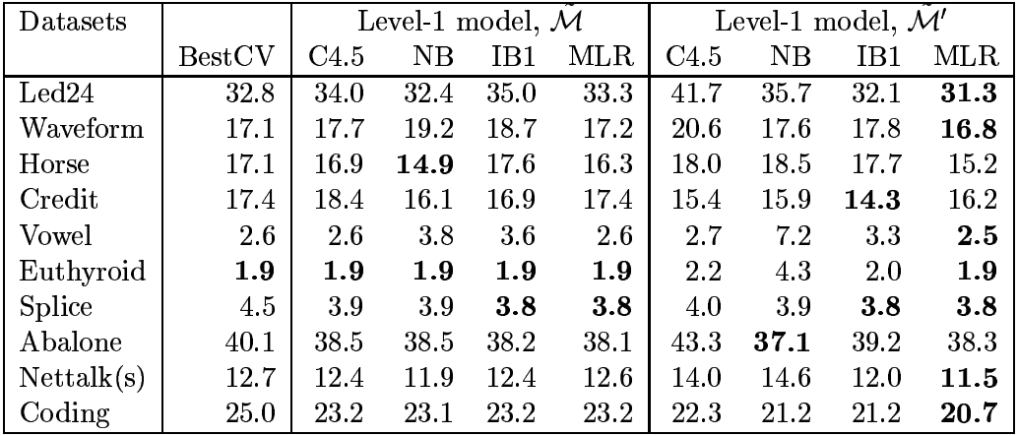
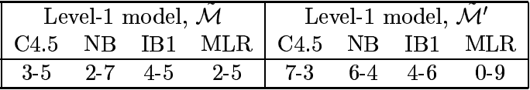
Result

Slide 9
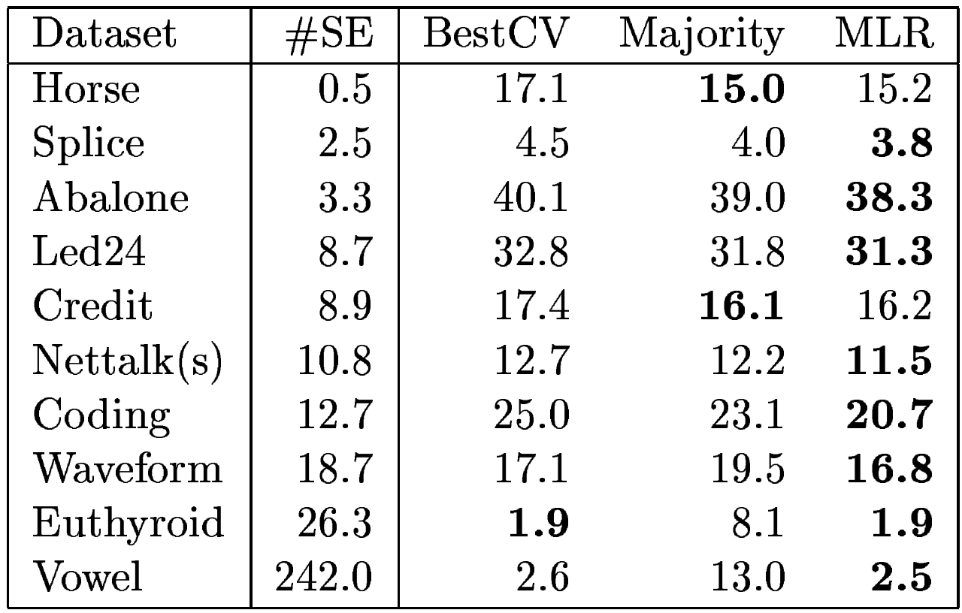
Result

