Slide 1
Review
Protein contacts, inter-residue interactions and side-chain modelling
Guilhem Faure, Aure´lie Bornot, Alexandre G. de Brevern
Biochimie, vol. 90, pp. 626-639, 2008.
Speaker: Chun-Jen Chen
Date: May 10, 2010

Slide 2
Abstract
Three-dimensional structures of proteins are the support of their biological functions. Their folds are stabilized by contacts between residues. Inner protein contacts are generally described through direct atomic contacts, i.e. interactions between side-chain atoms, while contact prediction methods mainly used inter-Ca distances. In this paper, we have analyzed the protein contacts on a recent high quality non-redundant databank using different criteria. First, we have studied the average number of contacts depending on the distance threshold to define a contact.
115/11/07

Slide 3
Abstract
Preferential contacts between types of amino acids have been highlighted. Detailed analyses have been done concerning the proximity of contacts in the sequence, the size of the proteins and fold classes. The strongest differences have been extracted, highlighting important residues. Then, we studied the influence of five different side-chain conformation prediction methods (SCWRL, IRECS, SCAP, SCATD and SCCOMP) on the distribution of contacts. The prediction rates of these different methods are quite similar. However, using a distance criterion between side chains, the results are quite different, e.g. SCAP predicts 50% more contacts than observed, unlike other methods that predict fewer contacts than observed. Contacts deduced are quite distinct from one method to another with at most 75% contacts in common.
115/11/07

Slide 4
Abstract
Moreover, distributions of amino acid preferential contacts present unexpected behaviours distinct from previously observed in the X-ray structures, especially at the surface of proteins. For instance, the interactions involving Tryptophan greatly decrease.
115/11/07

Slide 5
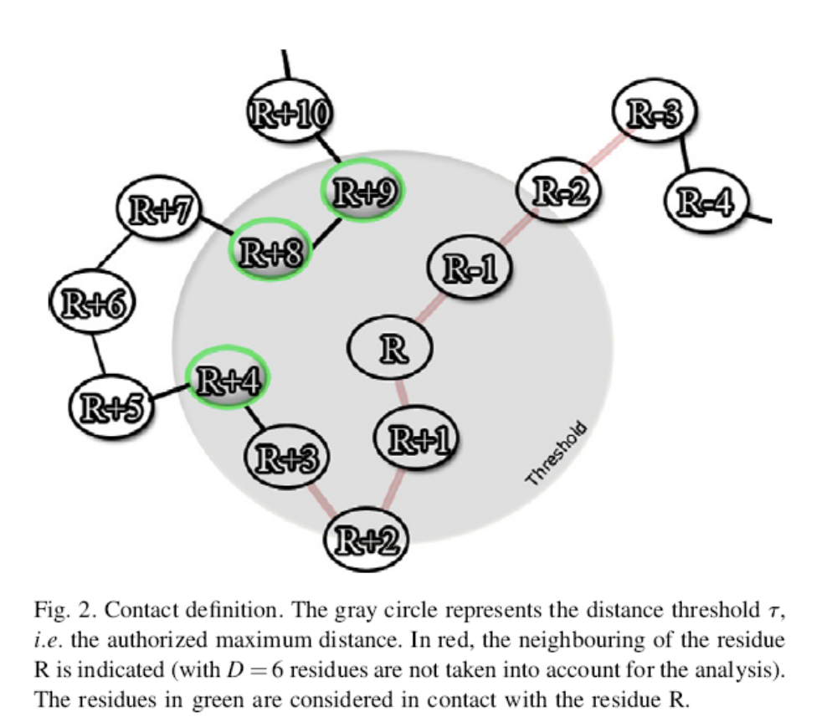
Contact

Slide 6
Data Set
A non-redundant protein databank has been initially built using PDB-REPRDB [97,98]. It was composed of 1736 protein chains taken from the Protein DataBank (PDB) [99]. The set contained proteins with no more than 10% pairwise sequence identity. We selected chains with a resolution better than 2.5 Å. Pairwise root mean square deviation (rmsd) values between all chains were more than 10 Å. Only proteins with more than 99% of complete classical amino acids were conserved.

Slide 7
We analyze various distances:
(1) Ca-Ca, noted Ca
(2) Cb-Cb, noted Cb
(3) Minimal distance between the heavy atoms of the protein backbone of the two residues, noted BB
(4) Minimal distance between the heavy atoms of the side chains of the two residues noted SC
(5) Minimal distances between all the heavy atoms of two residues, noted ALL

Slide 8
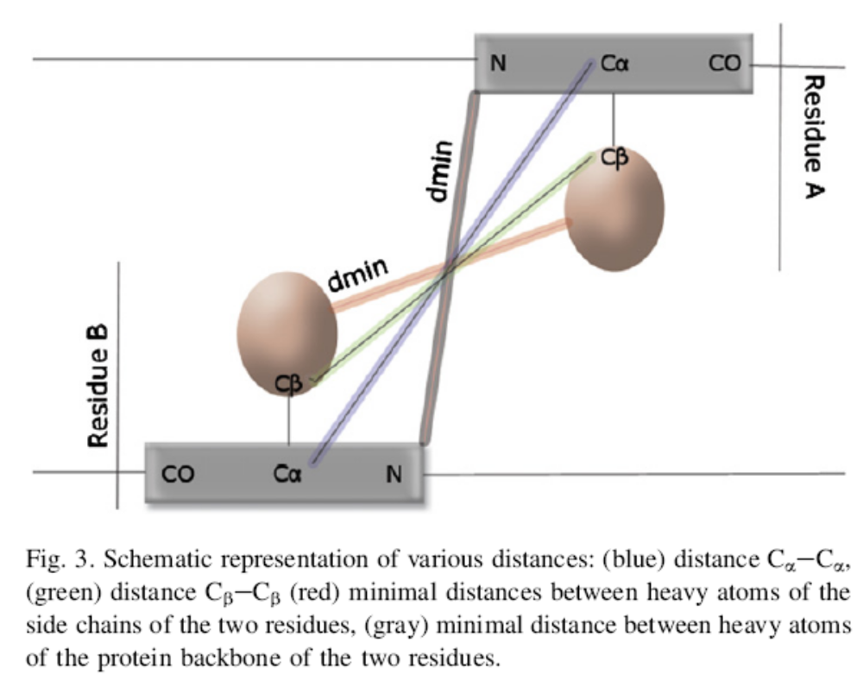

Slide 9
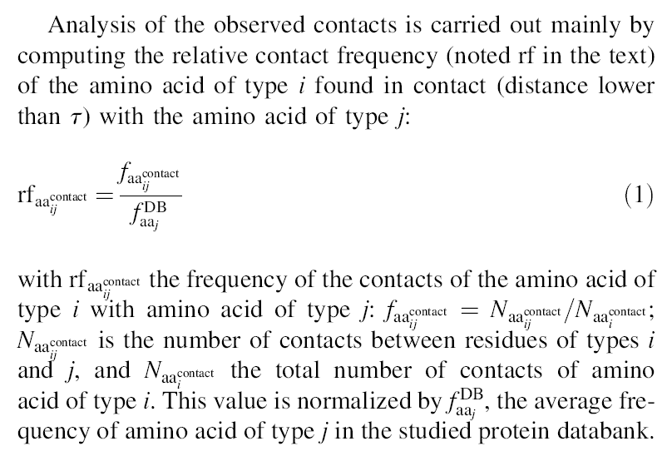

Slide 10
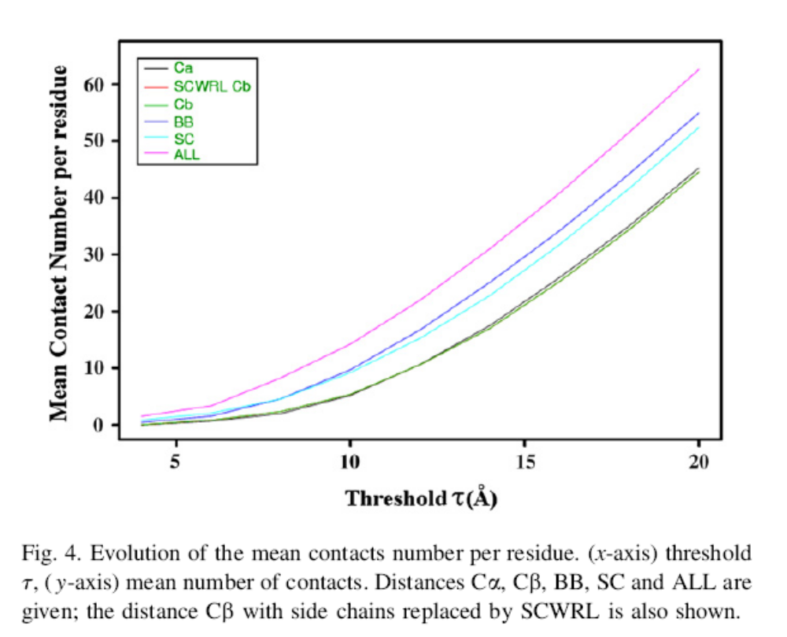

Slide 11
Global analysis
For a τ value of 8 Å, the ratio Cb/Ca is 1.2, SC/Ca is 2.31 and BB/Ca is 2.30 while ALL/Ca equals 4.17.
These results show that the parameters classically used for the prediction take into account a greater number of contacts than the ones considered for the analyses of preferential contacts.

Slide 12
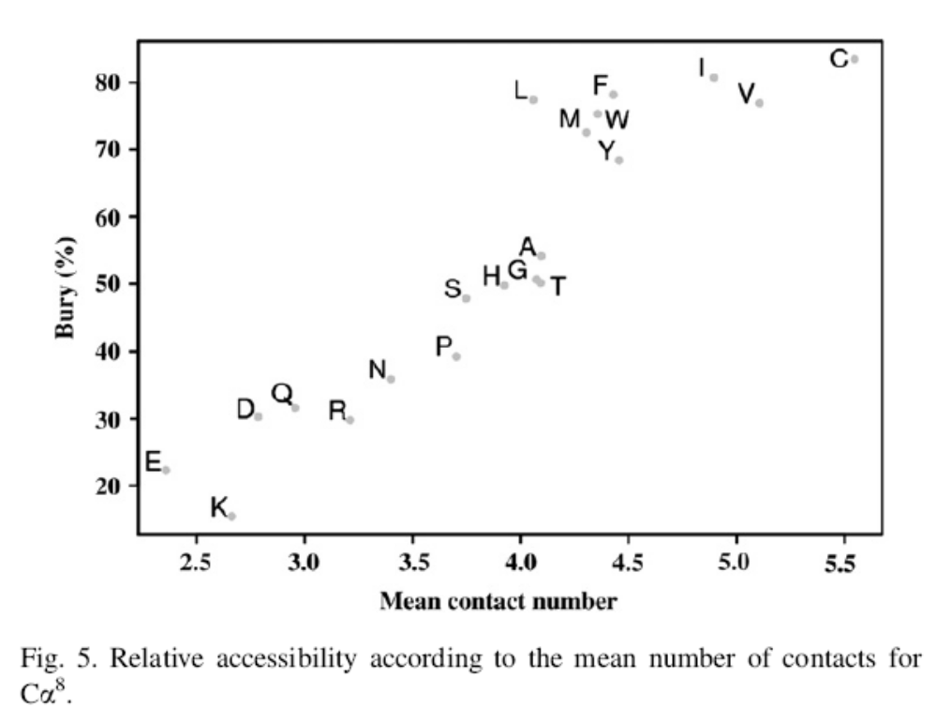
Analysis by amino acid type

Slide 13
Cysteine is the most buried amino acid (only exposed at 20%) and has the greatest mean number of contacts, i.e. 5.5. This is clearly due to their propensity to form disulfide bonds and the constraints they impose in their close neighbourhood.
Charged amino acids are found on the surface of proteins due to their hydrophilic properties. They have a lower mean number of contacts than those of other amino acid.

Slide 14
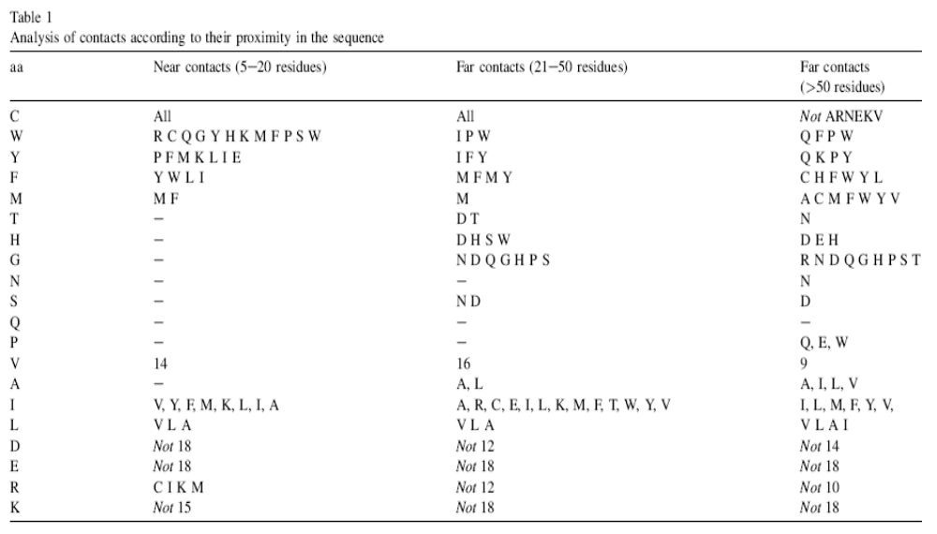

Slide 15
For this analysis and the ones which follow, we selected interactions having a difference of rf higher than 0.2 compared to the values in complete databank.
For the near contacts in the sequence, Cysteines remain always the main amino acid. The aromatic ones (W, Y and F) prevail too; moreover, they have higher rf values. Y, W, M, L and I have preferential contacts with F; P, F, M, K, L, I, E, Q and N with Y; and R, C, Q, G, Y, H, K, M, F, P, W and S with W. The hydrophobic character of Tryptophan thus seems to have more weight in near contacts compared to what is observed in the whole databank

Slide 16
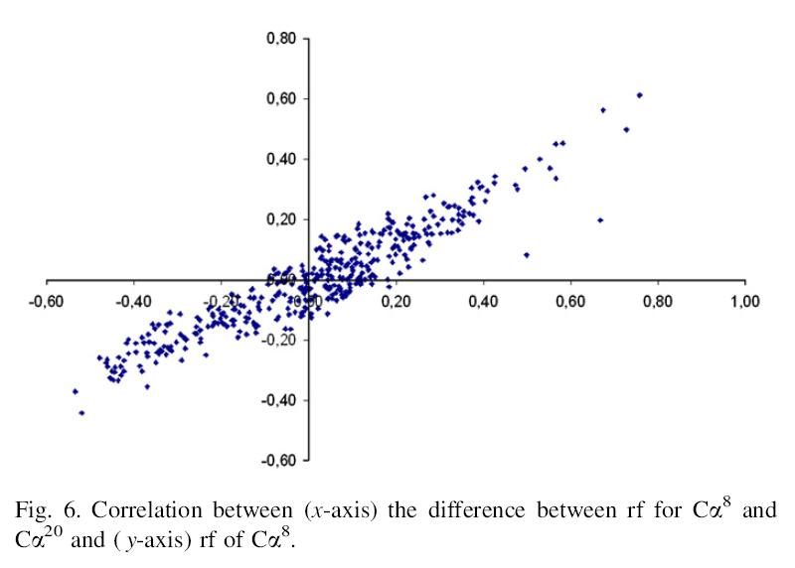

Slide 17
