Slide 1
MAGIIC-PRO: detecting functional signatures by efficient discovery of long patterns in protein sequences
Chen-Ming Hsu, Chien-Yu Chen(陳倩瑜)and Baw-Jhiune Liu(劉寶鈞)
Nucleic Acids Research, 2008, Vol. 36, No. 4 1401
Presenter: Kai-Yu Chen
Date: May 10, 2010

Slide 2
Abstract(1/2)
This paper presents a web service named MAGIIC-PRO, which aims to discover functional signatures of a query protein by sequential pattern mining. Automatic discovery of patterns from unaligned biological sequences is an important problem in molecular biology. MAGIIC-PRO is different from several previously established methods performing similar tasks in two major ways. The first remarkable feature of MAGIIC-PRO is its efficiency in delivering long patterns. With incorporating a new type of gap constraints and some of the state-of-the art data mining techniques, MAGIIC-PRO usually identifies satisfied patterns within an acceptable response time. The efficiency of MAGIIC-PRO enables the users to quickly discover functional signatures of which the residues are not from only one region of the protein sequences or are only conserved in few members of a protein family.

Slide 3
Abstract(2/2)
The second remarkable feature of MAGIIC-PRO is its effort in refining the mining results. Considering large flexible gaps improves the completeness of the derived functional signatures. The users can be directly guided to the patterns with as many blocks as that are conserved simultaneously. In this paper, we show by experiments that MAGIIC-PRO is efficient and effective in identifying ligand-binding sites and hot regions in protein–protein interactions directly from sequences.

Slide 4
INTRODUCTION(1/2)
In proteins, the conserved residues usually appear as clusters (it is called a block in this paper), and multiple clusters together constitute an important substructure.
The residues associated with a functional motif are not necessarily found in one region of the sequence .
In the mining process, a pattern will be reported as long as it matches more than a user-specified percentage of the input sequence set. This is the so-called minimum support constraint.

Slide 5
INTRODUCTION(2/2)
Our approach considers two types of gaps to improve the mining efficiency, where the gaps within a conserved region are called an intra-block gap and the gaps in between two adjacent conserved regions are called inter-block gaps. Using two types of gap constraints for different purposes improves the efficiency of mining process while keeping high accuracy of mining results.
Ex. G-x-G-x(2)-P-x(64,111)-Y-x-C-G
‘x’ and x(2) are called rigid gap
x(64,111) is a flexible gap
The server MAGIIC-PRO further employs rigid intra-block gaps instead of the flexible ones.

Slide 6
Input
MAGIIC-PRO takes a protein sequence as input, and helps the users to prepare the training data for pattern mining.
The task of collecting relative sequences of the query protein can be achieved by using Swiss-Prot annotations or executing the PSI-BLAST program.

Slide 7
Method
MAGIIC-PRO first quickly identifies rigid gapped blocks by bounded-prefix growth technique of MAGIIC.
After that, the candidate blocks are concatenated into patterns with large irregular gaps by exploiting the antimonotone characteristic of this problem (19,20).
Finally, a newly proposed bounded-gap closure checking scheme developed based on (22) is executed to eliminate patterns that can be covered by other super patterns with the same occurrences.

Slide 8
MAGIIC
Bounded-prefix-growth based on the prefix-growth procedure of the PrefixSpan algorithm. In order to identify patterns with large flexible gaps in biological data, the bounded-prefix-growth procedure incorporates intra- and inter-block gap constraints to speed up the mining process.
The proposed procedure is called bounded-prefix-growth because its scanning range in the projected database is restricted by the gap constraints.

Slide 9
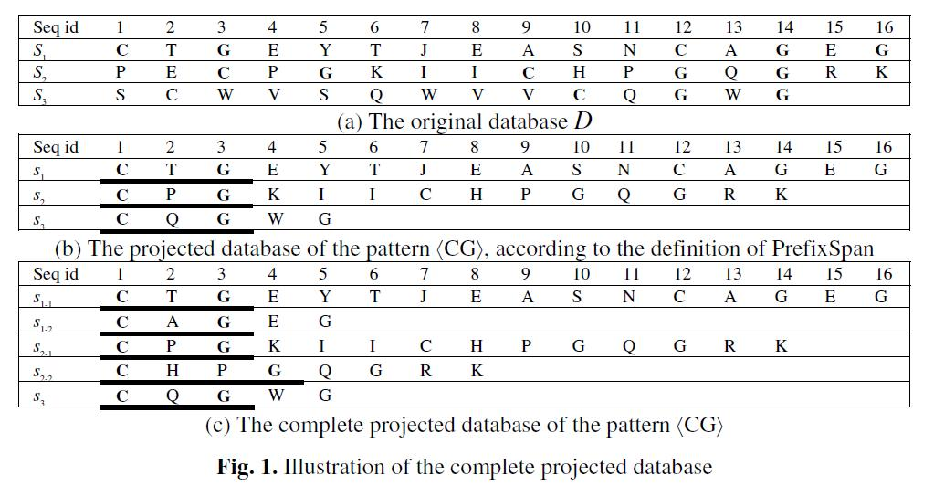
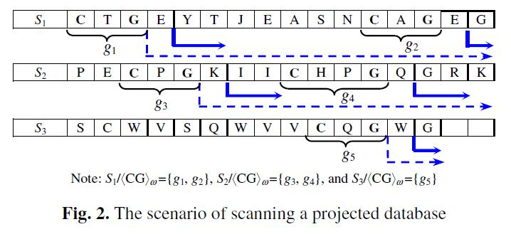
intra-block gap constraints (γ min = 1, γ max = 2).

Slide 10
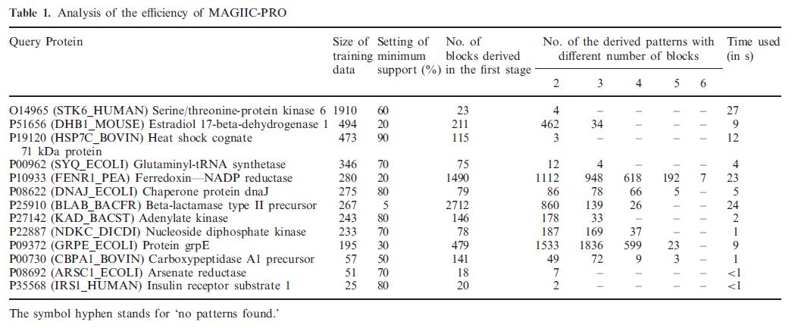
Result

Slide 11
