Slide 1
A comparative study of TF*IDF, LSI and multi-words for text classification
Wen Zhang, Taketoshi Yoshida, Xijin Tang Expert Systems with Applications Volume 38, Issue 3, March 2011, Pages 2758–2765
Presenter: Guo Yi-Pu 2013-01-0815
Notes:
文章抄襲、文章分類的方法之一。

Slide 2
Abstract
One of the main themes in text mining is text representation, which is fundamental and indispensable for text-based intelligent information processing. Generally, text representation includes two tasks: indexing and weighting. This paper has comparatively studied TF*IDF, LSI and multi-word for text representation. We used a Chinese and an English document collection to respectively evaluate the three methods in information retrieval and text categorization. Experimental results have demonstrated that in text categorization, LSI has better performance than other methods in both document collections. Also, LSI has produced the best performance in retrieving English documents. This outcome has shown that LSI has both favorable semantic and statistical quality and is different with the claim that LSI can not produce discriminative power for indexing.

Slide 3
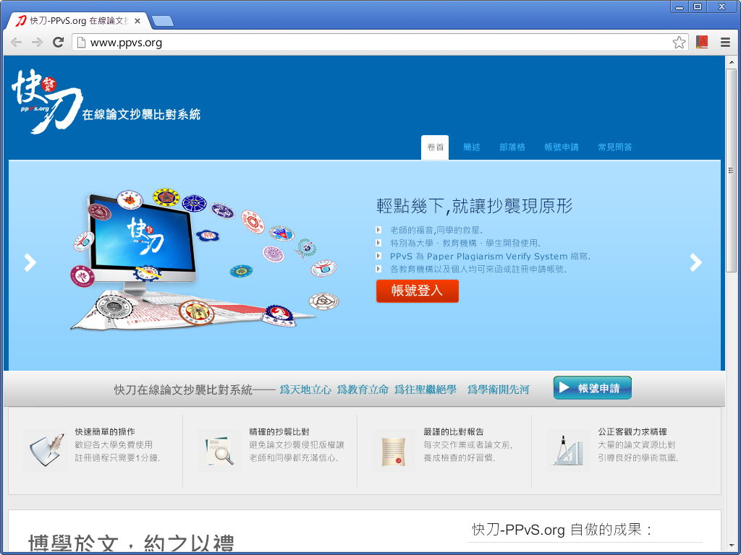

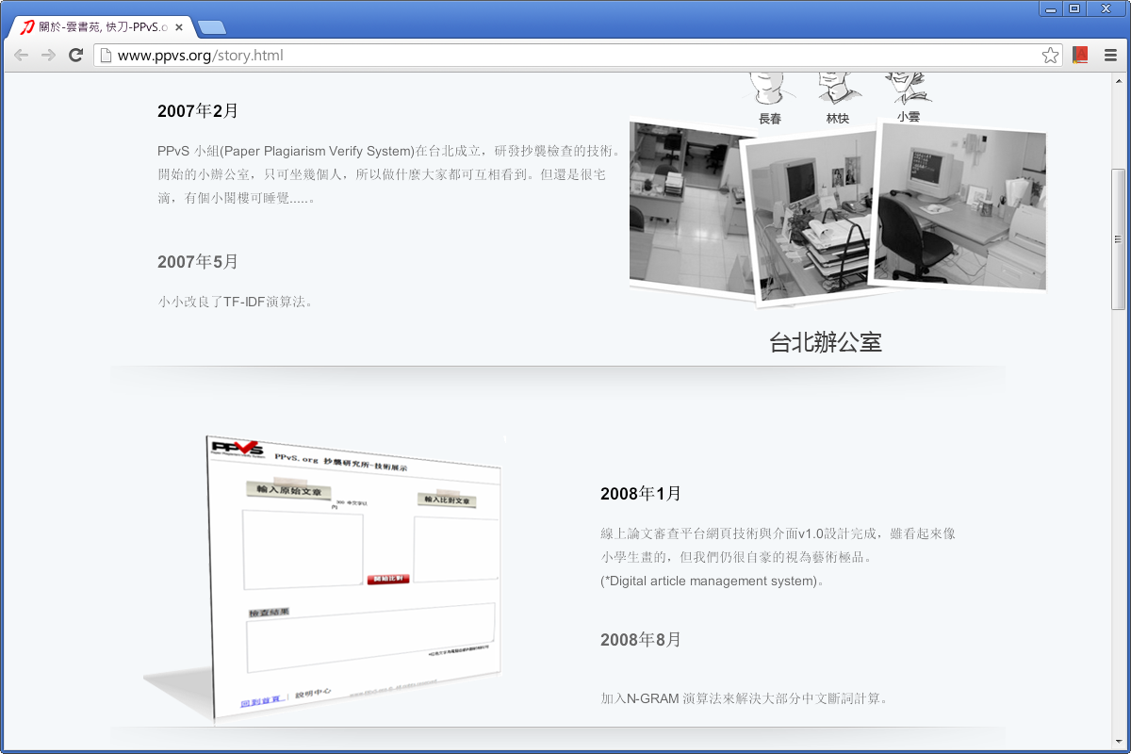

Slide 4
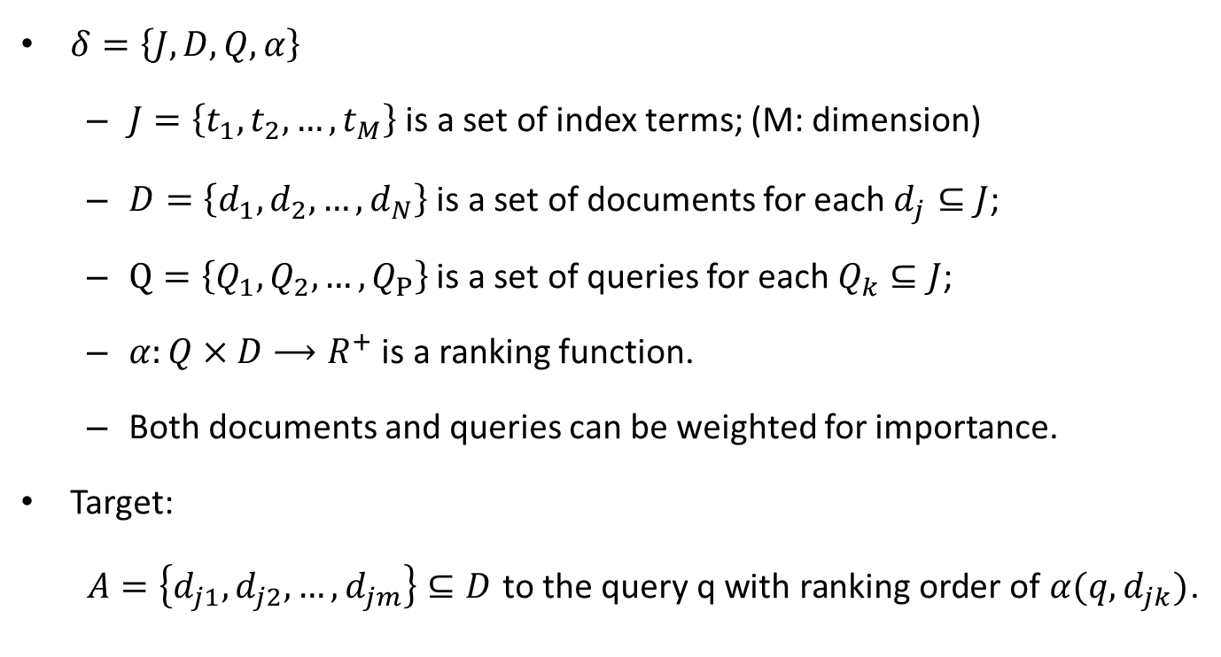
Information retrieval (IR) system
$δ=\left\{J,D,Q,α\right\}$
$J=\left\{t_{1},t_{2},…,t_{M}\right\}$ is a set of index terms; (M: dimension)
$D=\left\{d_{1},d_{2},…,d_{N}\right\}$ is a set of documents for each $d_{j}⊆J$;
$Q=\left\{Q_{1},Q_{2},…,Q_{P}\right\}$ is a set of queries for each $Q_{k}⊆J$;
$α:Q×D⟶R^{+}$ is a ranking function.
Both documents and queries can be weighted for importance.
Target:
$A=\left\{d_{j1},d_{j2},…,d_{jm}\right\}⊆D$ to the query q with ranking order of $α(q,d_{jk})$.
Notes:
D 與 Q 中的每個元素 d_{j} 與 Q_{k} 皆仍為集合。Target：對於每筆查詢，依相關性產生文件的清單。

Slide 5
Preliminaries
Text categorization
L: news, reports, web pages, etc.
Classify the document in test set with trained model using training set.
Text representation
TF*IDF, LSI, Multi-word
Information gain (IG)
Reduce dimensions of the feature space.
SVM
Notes:
Information gain 不太像是 gain？

Slide 6
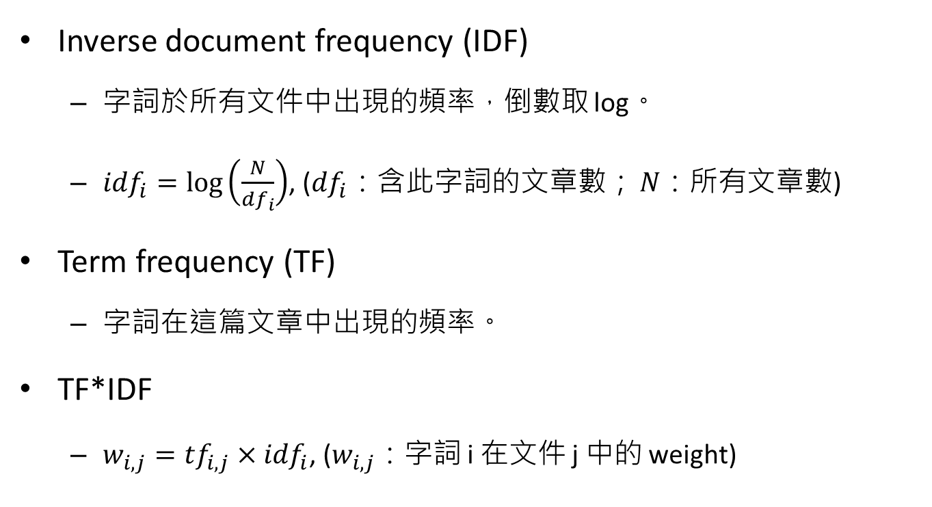
TF*IDF (TF-IDF)
Inverse document frequency (IDF)
字詞於所有文件中出現的頻率，倒數取 log。
${idf}_{i}=\log\left(\frac{N}{{df}_{i}}\right)$, (${df}_{i}$：含此字詞的文章數； $N$：所有文章數)
Term frequency (TF)
字詞在這篇文章中出現的頻率。
TF*IDF
$w_{i,j}={tf}_{i,j}×{idf}_{i}$, ($w_{i,j}$：字詞 i 在文件 j 中的 weight)

Slide 7
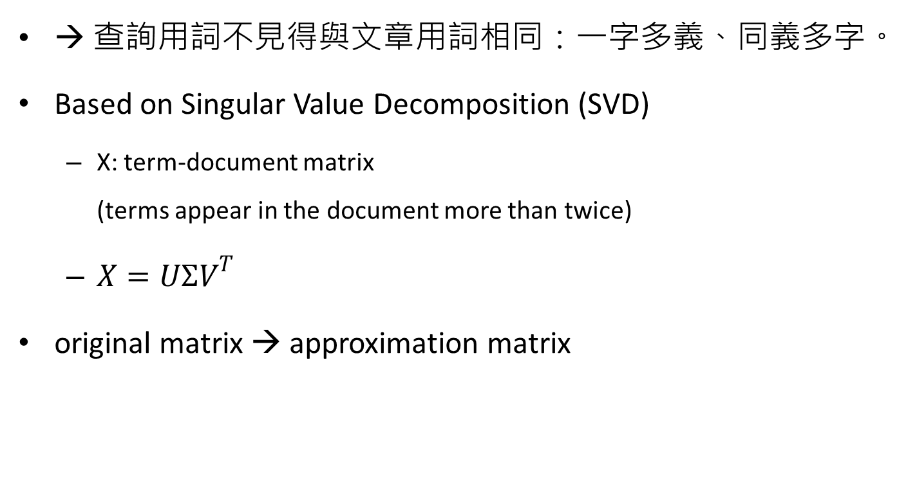
Latent Semantic Indexing (LSI)
→ 查詢用詞不見得與文章用詞相同：一字多義、同義多字。
Based on Singular Value Decomposition (SVD)
X: term-document matrix (terms appear in the document more than twice)
$X=UΣV^{T}$
original matrix → approximation matrix
Notes:
很多時候查詢時的用詞與文章中的用詞不見得相同。Ex：法律用詞

Slide 8
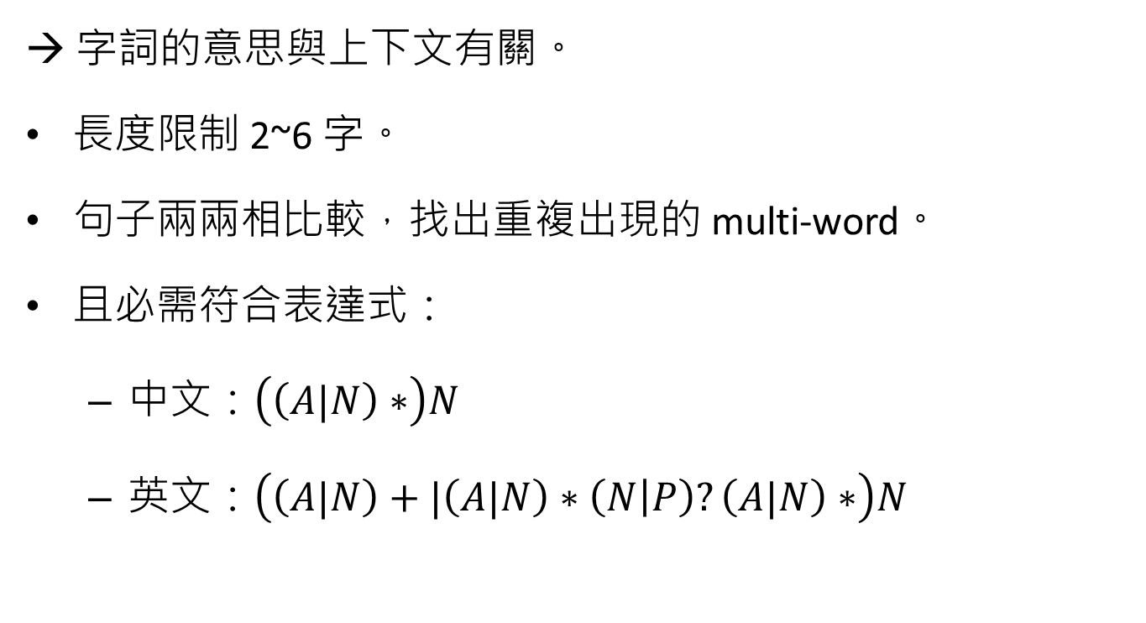
Multi-word
→ 字詞的意思與上下文有關。
長度限制 2~6 字。
句子兩兩相比較，找出重複出現的 multi-word。
且必需符合表達式：
中文：$\left(\left(A|N\right)∗\right)N$
英文：$\left(\left(A|N\right)+|\left(A|N\right)∗\left(N | P\right)?\left(A|N\right)∗\right)N$
Regular expression:
| 或
* 出現多次或沒有
? 出現一次或沒有
+ 出現一次或多次

Slide 9
Datasets
中文：TanCorpV1.0 (谭松波)
14150 篇 / 20 類，論文 from Chinese academic journals。
Choose 4 categories: agriculture, history, politics, economy; randomly select 300 documents for each category.
英文：Reuters-21578 distribution 1.0
21578 篇 / 135 類，新聞 from Reuters newswire in 1987。
4 categories: crude (520), agriculture (574), trade (514), interest (424)

Slide 10
Information gain
Term percentage: [0,1] with increment 0.1.
TF*IDF
TF*IDF score 較高分者，按比例取出。
LSI
Retain a certain percentage of singular values in Σ.
Multi-word
出現次數較高者，按比例取出。

Slide 11
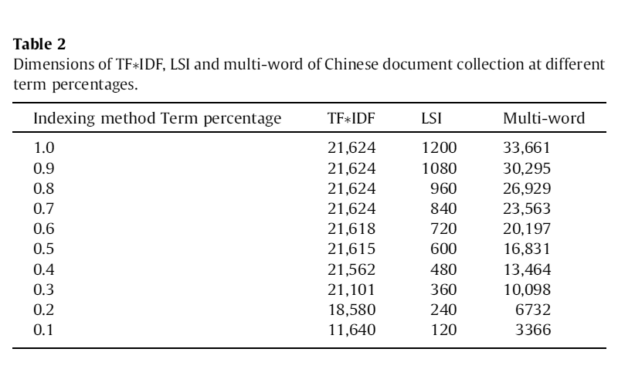
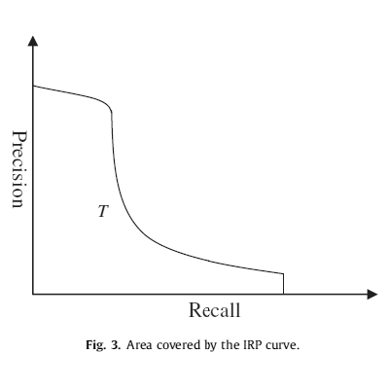
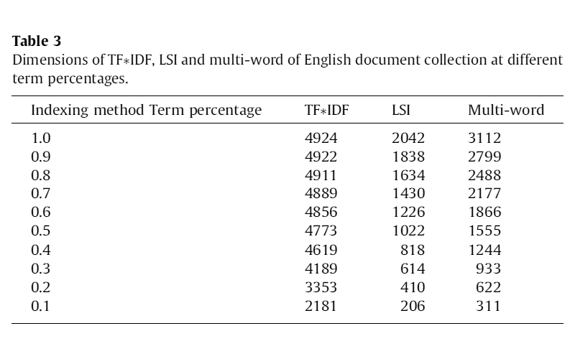
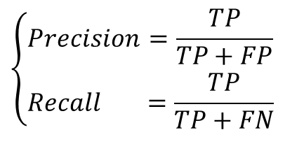
$$\left\{\begin{aligned}&Precision&=\frac{TP}{TP+FP} \\ &Recall&=\frac{TP}{TP+FN} \end{aligned}\right.$$
查準率 (precision)
查全率 (recall)
- via

Slide 12
Experiment
Information retrieval
中文：50 筆查詢，均勻分散於 4 類。
英文：25 筆查詢，均勻分散於 4 類。
Text categorization
SVM: linear kernel (經證明較好) + one-against-the-rest (for multi-class)
3-fold
training: one category randomly 1/3 positive; other categories randomly 1/3 negative;
testing: the rest

Slide 13
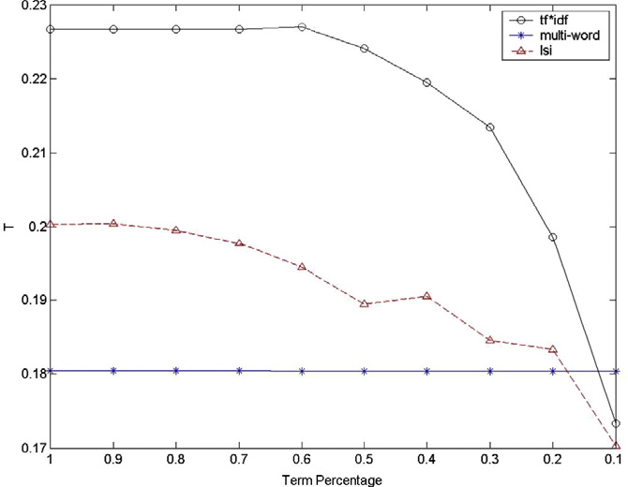
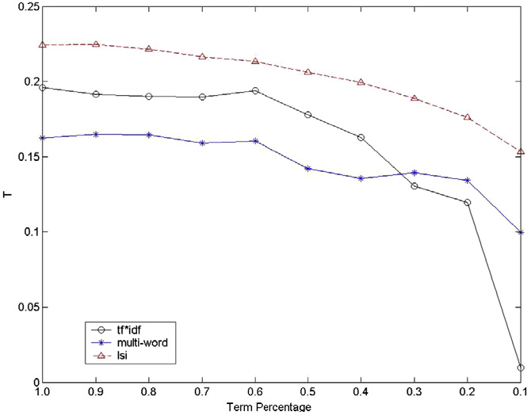
Information retrieval
Chinese information retrieval
English information retrieval

Slide 14
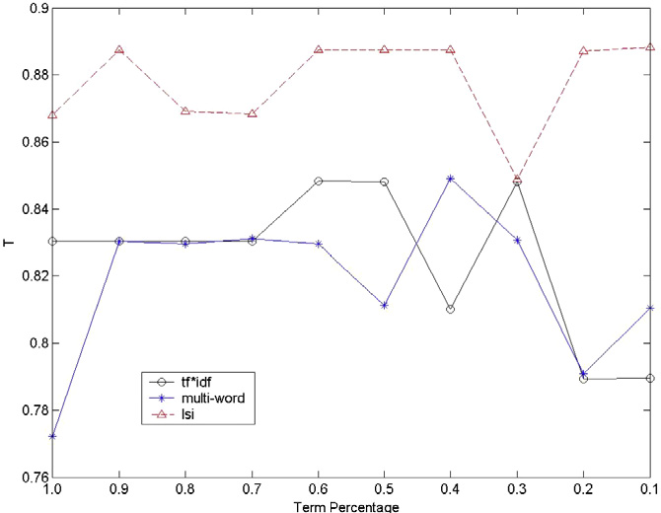
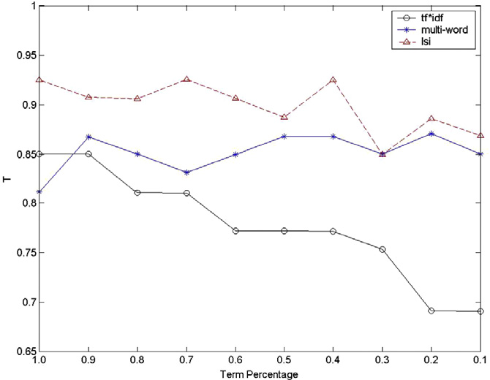
Text categorization
Chinese text categorization
English text categorization

Slide 15

t-test
Chinese information retrieval
$TFIDF≫LSI≫$ multi-word
English information retrieval
$LSI≫TFIDF \sim$ multi-word
Chinese text categorization
$LSI≫TFIDF \sim$ multi-word
English text categorization
$LSI≫TFIDF≫$ multi-word

