Slide 1
Acceleration of sequence clustering using longest common subsequence filtering
Youhei Namiki, Takashi Ishida, Yutaka Akiyama
From The 2012 International Conference on Intelligent Computing
Huangshan, China. 25-29 July 2012
Reporter : Cing-Yao Chen Date : 2013/11/19

Slide 2
Abstract
Background: Huge numbers of genomes can now be sequenced rapidly with recent improvements in sequencing throughput. However, data analysis methods have not kept up, making it difficult to process the vast amounts of available sequence data. This increased processing time is especially critical in DNA sequence clustering because of the intrinsic difficulty in parallelization. Thus, there is a strong demand for a faster clustering algorithm.

Slide 3
Results: We developed a new fast DNA sequence clustering method called LCS-HIT, based on the popular CD-HIT program. The proposed method uses a novel filtering technique based on the longest common subsequence to identify similar sequence pairs. This filtering technique makes the LCS-HIT considerably faster than CD-HIT, without loss of sensitivity. For a dataset of two million DNA sequences, our method was approximately 7.1, 4.4, and 2.2 times faster than CD-HIT for 100, 150, and 400 bases, respectively.

Slide 4
Conclusions: The LCS-HIT clustering program, using a novel filtering technique based on the longest common subsequence, is significantly faster than CD-HIT without compromising clustering accuracy. Moreover, the filtering technique itself is independent from the CD-HIT algorithm. Thus, this technique can be applied to similar clustering algorithms.

Slide 5
Background
基因組定序速度很快，但是分析很慢。
通常定序出來一條序列約150個鹼基，但是會有約1千萬個序列。
CD-HIT
利用序列特性進行分群的軟體
Cd-hit: a fast program for clustering and comparing large sets of protein or nucleotide sequences (Bioinformatics (2006) 被引用1220次)
需要兩天來對1千萬個序列作分群。
原論文跑3百萬個序列約7小時30分
在原論文中並沒有很詳細的討論實作，只有談到利用index table進行實作。

Slide 6
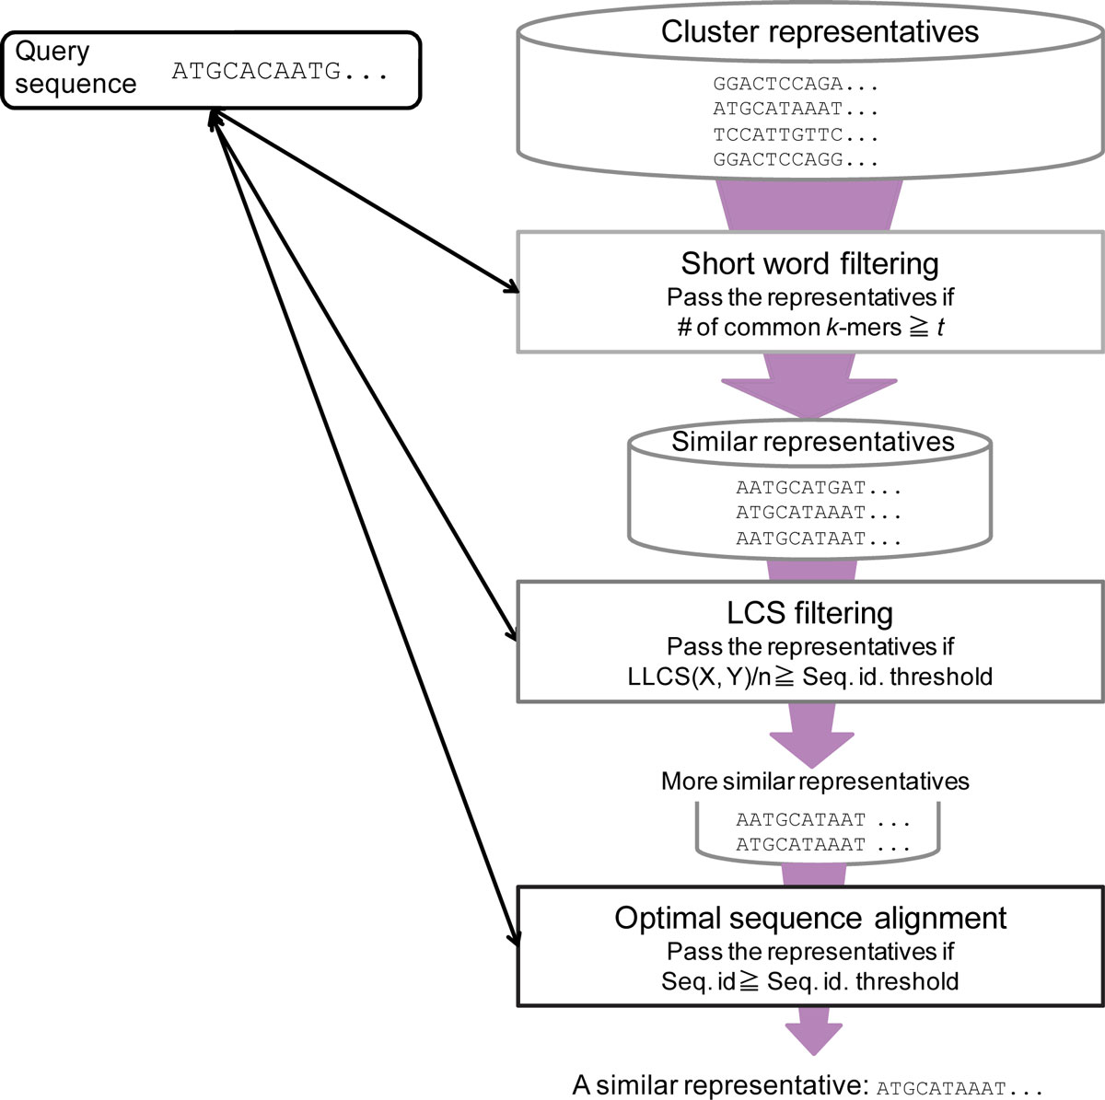
LCS-HIT
bit-parallel LCS-length
computation algorithms
➔ O(n)
LLCS ➔ O(σ⌈m/w⌉n)
pattern of length m in a text of
length n in time
w is the number of bits in the
computer word
Hyyro's bit-parallel
Increased Bit-Parallelism for Approximate String Matching

Slide 7
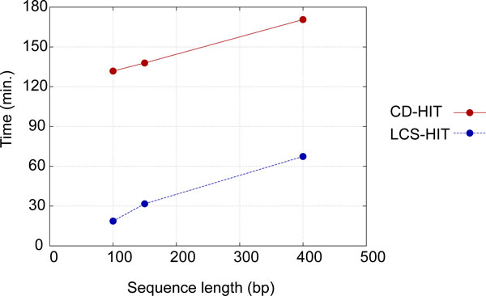
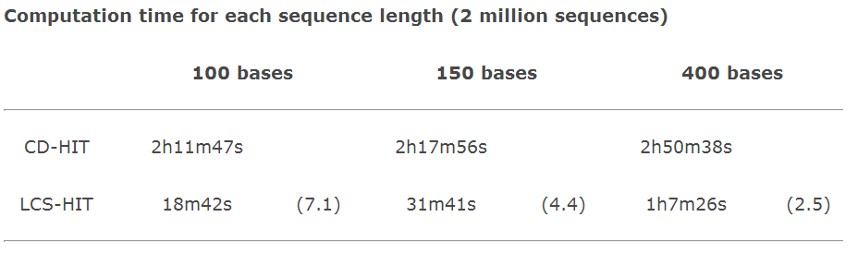
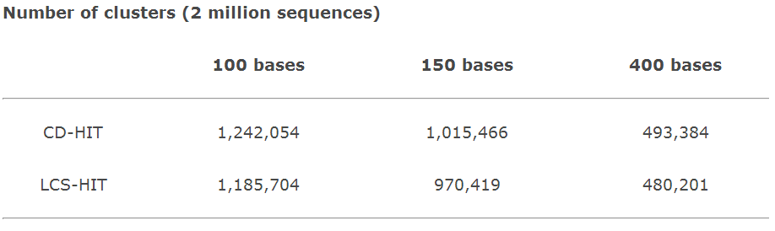
Result

Slide 8
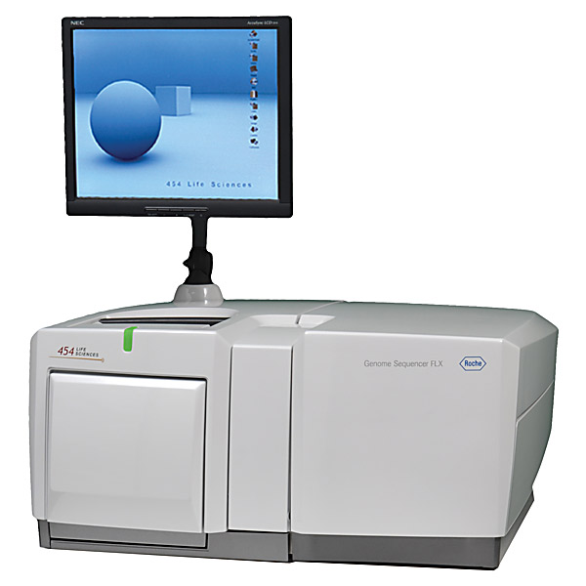
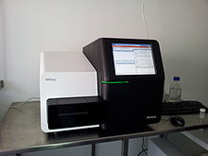
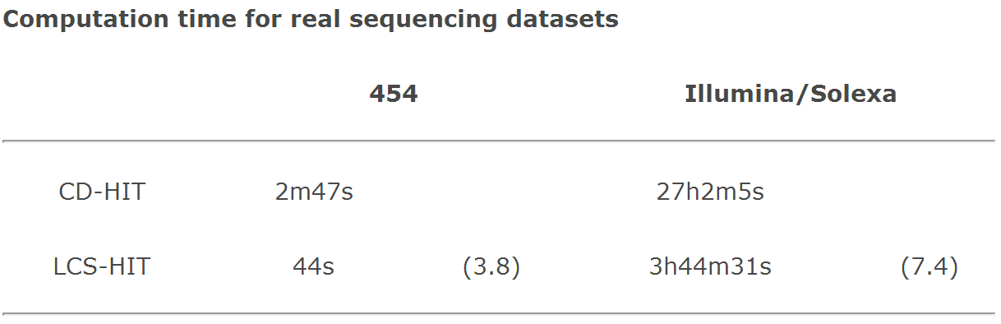
Result
Roche/454

Slide 9
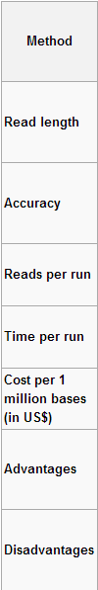
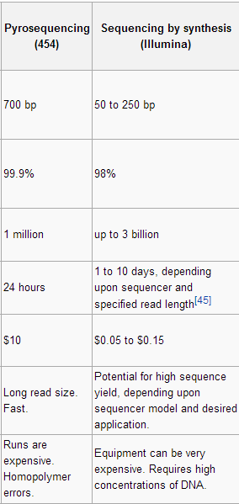
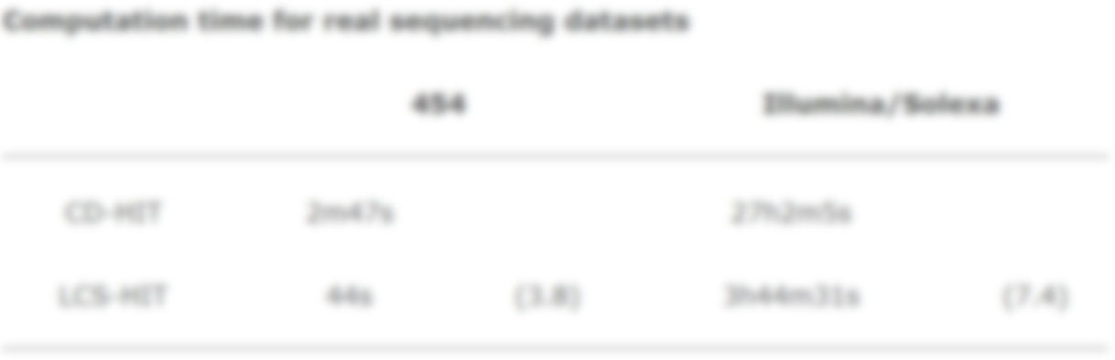
Result
Roche/454

