Slide 1
Disulﬁde connectivity prediction based on structural information without a prior knowledge of the bonding state of cysteines
Hsuan-Hung Lin,Jiin-Chyr Hsu, Yuan-Nian Hsu, Ren-Hao Pan,Yung-Fu Chen, Lin-Yu Tseng
Computers in Biology and Medicine 43 (2013) 1941–1948
Presenter: Fang Jun Yi
Date: 2013.11.19

Slide 2
Abstract
Previous studies predicted the disulﬁde bonding patterns of cysteines using a prior knowledge of their bonding states. In this study, we propose a method that is based on the ensemble support vector machine (SVM), with the structural features of cysteines extracted without any prior knowledge of their bonding states.
This method is useful for improving the predictive performance of disulﬁde bonding patterns. For comparison, the proposed method was tested with the same dataset SPX that was adopted in previous studies.

Slide 3
Abstract
The experimental results demonstrate that bridge classiﬁcation and disulﬁde connectivity predictions achieve 96.5% and 89.2% accuracy, respectively, using the ensemble SVM model, which outperforms the traditional method (51.5% and 51.0%, respectively) and the model that is based on a single-kernel SVM classiﬁer (94.6% and 84.4%, respectively).
For protein chain and residue classiﬁcations, the sensitivity, speciﬁcity, and accuracy of ensemble and single-kernel SVM approaches are better than those of the traditional methods. The predictive performances of the ensemble SVM and single-kernel models are identical, indicating that the ensemble model can converge to the single-kernel model for some applications.

Slide 4
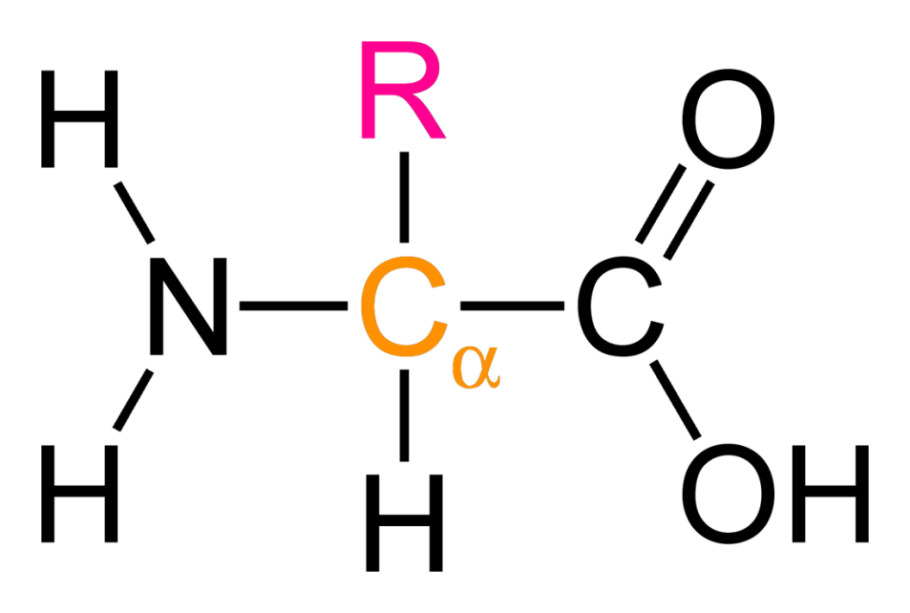
Amino acid(氨基酸)
構成蛋白質的基本單位，圖中的R即為residue(殘基)，不同的Amino acid的差異即為具有不同的residue
>1A0M:A|PDBID|CHAIN|SEQUENCE (from PDB) GCCSDPRCNMNNPDYCX

Slide 5
Fours problems of disulfide bond prediction
protein chain classiﬁcation to determine whether a protein contains disulﬁde bridges.
residue classiﬁcation to categorize the bonding state of cysteines.
bridge classiﬁcation to predict whether a pair of cysteines is linked by a disulﬁde bond.
disulﬁde bonding pattern prediction to predict the cysteine pairs that are bonded to each other.

Slide 6
Three categories of recent approaches
methods for predicting the cysteine bonding states.
approaches for predicting the disulﬁde bonding patterns with a prior knowledge of the cysteine bonding states.
methods for predicting both cysteine bonding states and disulﬁde bonding patterns.

Slide 7
Methodology
In this study, for each cysteine pairs we use normalized pair distance(NPD) as the feature, and ensemble SVM model to compute the connectivity probabilities of cysteine pairs.
The multiple trajectory search (MTS) was used to evolve the SVM parameters, i.e., C and γ, theNPD window sizes, and the weights of individual models in the ensemble SVM classiﬁer.
Finally, the modiﬁed maximum weight perfect matching algorithm was then used to ﬁnd the disulﬁde connectivity pattern without a prior knowledge of the bonding state of cysteines.

Slide 8
Normalized pair distance(NPD)
NPD is structure-related feature.
Here use The MODELLER software to predict the coordinates (X, Y,and Z) of the Cα of each amino acid in the protein sequence.
GCCSDPRCNMNNPDYCX
Than the NPD (window size = 3)for the above protein is
(D_{DP}, D_{PD}, D_{RY}, D_{CC}, D_{NX}, D ,D)
Here, D is Euclidean distance

Slide 9
Normalized pair distance(NPD)
Here we set a threshold of 15, if any above mentained Euclidean distance is not greater than 15, then this cysteine pair will not be considered as a disulﬁde bond candidate.
Adjust the feature values to lie within the range from --1 to 1 by (D_{i,j} - 7.5) / 7.5

Slide 10

Ensemble SVM
Why Ensemble SVM not single-kernel SVM
if several different optimal assumptions exist, then the ensemble classiﬁers can reduce the risk of choosing a wrong assumption.
a single machine learning algorithm may result in obtaining local optima, whereas, the ensemble method may obtain a better solution.
in general, a single model cannot achieve the desired function.

Slide 11
The multiple trajectory search (MTS)
In MTS, multiple agents were used to concurrently search the solution space, in which each agent performed an iterated local search using one of three candidate methods for local searching.
By choosing one of the local search methods that best ﬁts the landscape of a solution's neighborhood, an agent may ﬁnd its way to a local optimum or to the global optimum.
Multiple trajectory search for selecting SVM parameters, window sizes, and probability weights

Slide 12
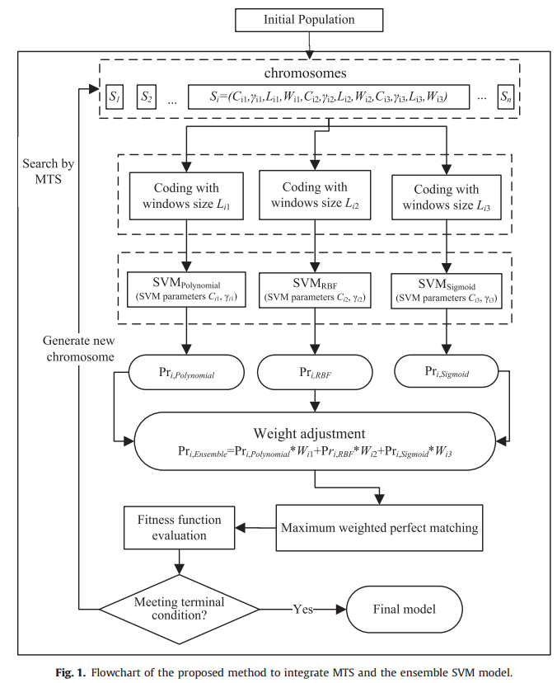

Slide 13
The modiﬁed maximum weight perfect matching algorithm
For a protein, verteices indicate all cycteines in the protein, noticed that we donnot know the bonding state(oxidized or not) of cycteine here.
Edge weights that are labeled as the contact potentials between the corresponding pairs of cysteines.

Slide 14
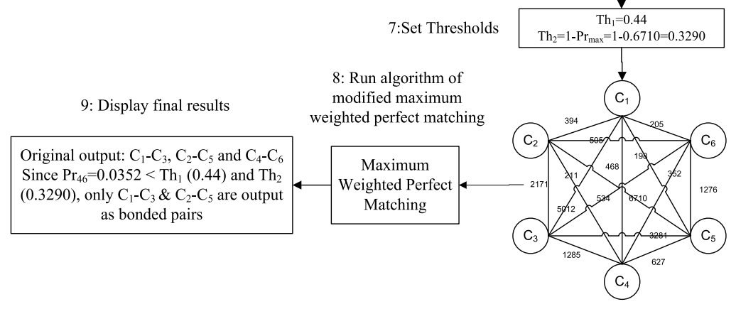
The modiﬁed maximum weight perfect matching algorithm
Here is a graph to show a example:

Slide 15
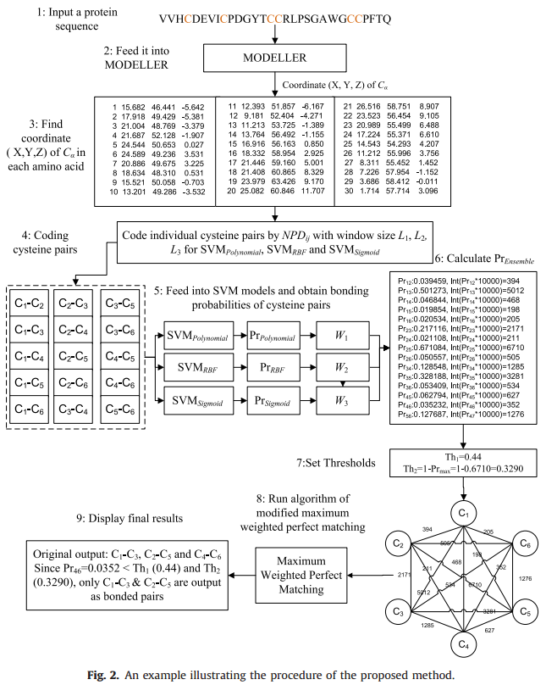

Slide 16
Experimental results; Datasets:
MART : 969 protein sequences, extracted from PDB with sequence identities less than 25%; Among the 4136 segments with cysteines, 2690 were in the free state, and the other 1446 were in the disulﬁde bonded state(20-fold cross-validation)
SPXC: has 897 positive sequences and 1650 negative sequences that contained no disulﬁde bridges
SPX is a collection of 1018 proteins which contain at least one intra-chain disulﬁde bond and at least 12 amino acids.
Both SPXC and SPX datasets that were extracted from the PDB on May 17, 2004. Used UniqueProt tool to remove overrepresentation of particular protein families.(10-fold cross-validation)

Slide 17
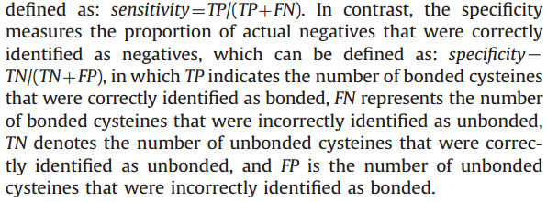
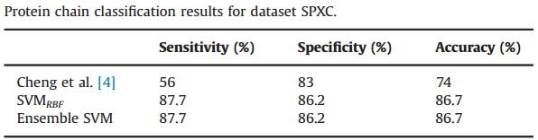
Experimental results; Protein chain classiﬁcation
Sensitivity: positive sequences 被預測為positive(此序列存在雙硫鍵) 的比率。
Specificity: negative sequences 被預測為negative 的比率。

Slide 18
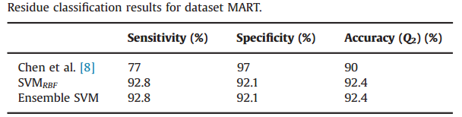
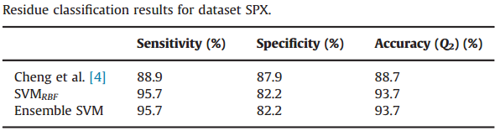
Experimental results; Residue classiﬁcation
The overall predictive accuracy Q₂ is evaluated as Q ₂ =Nc/Na with Nc and Na indicating the total number of correctly predicted bonding state of cysteines and the total number of cysteines, respectively.

Slide 19
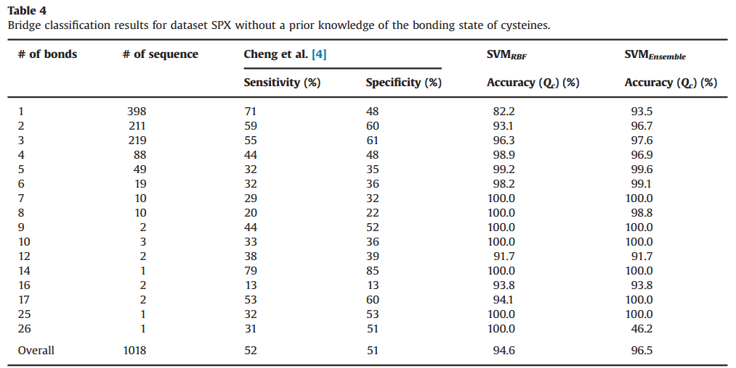
Experimental results; Bridge classiﬁcation

Slide 20
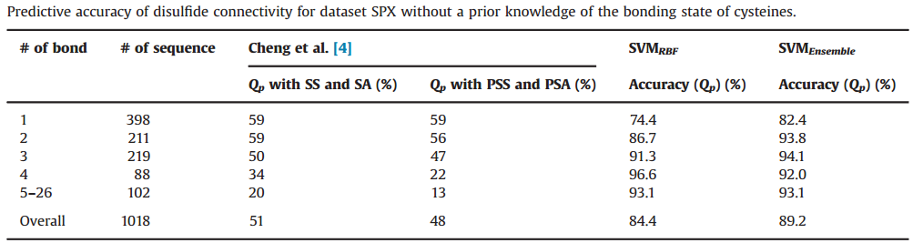
Experimental results; Bridge classiﬁcation

