Slide 1
A Linear Space Algorithm for Computing Maximal Common Subsequences
D.S. Hirschberg
Communications of the ACM, Vol. 18, No. 6, pp. 341–343, 1975
Presenter: Che-Jui Hsu (許哲睿)
Date: 2013/11/26
Notes:
http://dl.acm.org/citation.cfm?id=360861

Slide 2
Abstract
The problem of finding a longest common subsequence of two strings has been solved in quadratic time and space. An algorithm is presented which will solve this problem in quadratic time and in linear space.

Slide 3
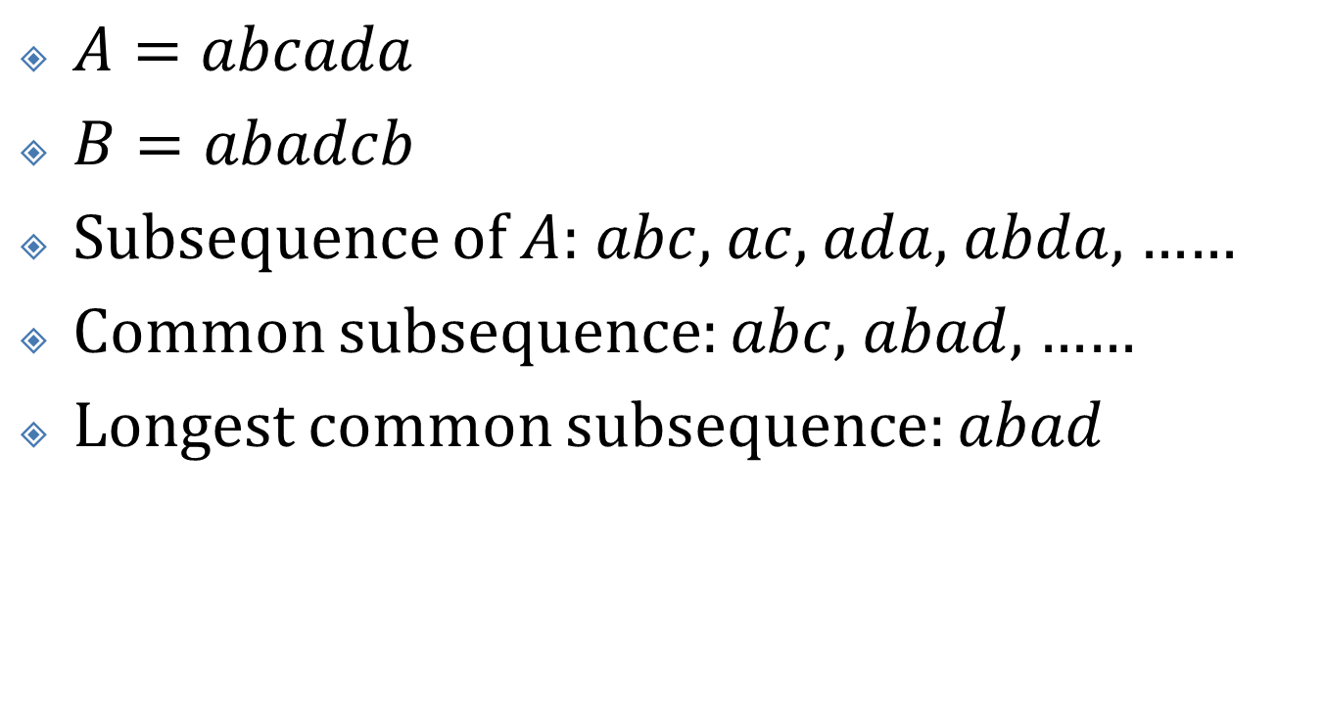
LCS
$A=abcada$
$B=abadcb$
Subsequence of $A$: $abc$, $ac$, $ada$, $abda$, ……
Common subsequence: $abc$, $abad$, ……
Longest common subsequence: $abad$

Slide 4

Algorithm A (1/4)
Input: $A_{1m}$, $B_{1n}$
Output: matrix $L$ ($L\left(i, j\right)=\text{length} \text{of} LCS\left(A_{1i},B_{1j}\right)$)

Slide 5

Algorithm A (2/4)
$A=abcada$, $B=abadcb$
 |  |  | a | b | a | d | c | b
 |  | 0 | 1 | 2 | 3 | 4 | 5 | 6
 | 0 | 0 | 0 | 0 | 0 | 0 | 0 | 0
a | 1 | 0
b | 2 | 0
c | 3 | 0
a | 4 | 0
d | 5 | 0
a | 6 | 0

Slide 6
Algorithm A (3/4)
$A=abcada$, $B=abadcb$
 |  |  | a | b | a | d | c | b
 |  | 0 | 1 | 2 | 3 | 4 | 5 | 6
 | 0 | 0 | 0 | 0 | 0 | 0 | 0 | 0
a | 1 | 0 | 1 | 1 | 1 | 1 | 1 | 1
b | 2 | 0 | 1 | 2 | 2 | 2 | 2 | 2
c | 3 | 0 | 1 | 2 | 2 | 2 | 3 | 3
a | 4 | 0 | 1 | 2 | 3 | 3 | 3 | 3
d | 5 | 0 | 1 | 2 | 3 | 4 | 4 | 4
a | 6 | 0 | 1 | 2 | 3 | 4 | 4 | 4

Slide 7

Algorithm A (4/4)
Time: $O\left(mn\right)$
Space: $m+n+\left(m+1\right)\left(n+1\right)=O\left(mn\right)$

Slide 8

Algorithm B (1/9)
Input: $A_{1m}$, $B_{1n}$
Output: array $LL$ ($LL\left(j\right)=L\left(m, j\right)$)

Slide 9
Algorithm B (2/9)
$A=abcada$, $B=abadcb$
 |  |  | a | b | a | d | c | b
 |  | 0 | 1 | 2 | 3 | 4 | 5 | 6
 | 0
a | 1 | 0 | 0 | 0 | 0 | 0 | 0 | 0
b
c
a
d
a

Slide 10
Algorithm B (3/9)
$A=abcada$, $B=abadcb$
 |  |  | a | b | a | d | c | b
 |  | 0 | 1 | 2 | 3 | 4 | 5 | 6
 | 0 | 0 | 0 | 0 | 0 | 0 | 0 | 0
a | 1 | 0 | 1 | 1 | 1 | 1 | 1 | 1
b
c
a
d
a

Slide 11
Algorithm B (4/9)
$A=abcada$, $B=abadcb$
 |  |  | a | b | a | d | c | b
 |  | 0 | 1 | 2 | 3 | 4 | 5 | 6
a | 0 | 0 | 1 | 1 | 1 | 1 | 1 | 1
b | 1 | 0 | 1 | 2 | 2 | 2 | 2 | 2
c
a
d
a

Slide 12
Algorithm B (5/9)
$A=abcada$, $B=abadcb$
 |  |  | a | b | a | d | c | b
 |  | 0 | 1 | 2 | 3 | 4 | 5 | 6
a
b | 0 | 0 | 1 | 2 | 2 | 2 | 2 | 2
c | 1 | 0 | 1 | 2 | 2 | 2 | 3 | 3
a
d
a

Slide 13
Algorithm B (6/9)
$A=abcada$, $B=abadcb$
 |  |  | a | b | a | d | c | b
 |  | 0 | 1 | 2 | 3 | 4 | 5 | 6
a
b
c | 0 | 0 | 1 | 2 | 2 | 2 | 3 | 3
a | 1 | 0 | 1 | 2 | 3 | 3 | 3 | 3
d
a

Slide 14
Algorithm B (7/9)
$A=abcada$, $B=abadcb$
 |  |  | a | b | a | d | c | b
 |  | 0 | 1 | 2 | 3 | 4 | 5 | 6
a
b
c
a | 0 | 0 | 1 | 2 | 3 | 3 | 3 | 3
d | 1 | 0 | 1 | 2 | 3 | 4 | 4 | 4
a

Slide 15
Algorithm B (8/9)
$A=abcada$, $B=abadcb$
 |  |  | a | b | a | d | c | b
 |  | 0 | 1 | 2 | 3 | 4 | 5 | 6
a
b
c
a
d | 0 | 0 | 1 | 2 | 3 | 4 | 4 | 4
a | 1 | 0 | 1 | 2 | 3 | 4 | 4 | 4

Slide 16

Algorithm B (9/9)
Time: $O\left(mn\right)$
Space: $m+n+\left(n+1\right)+2\left(n+1\right)=O\left(m+n\right)$

Slide 17
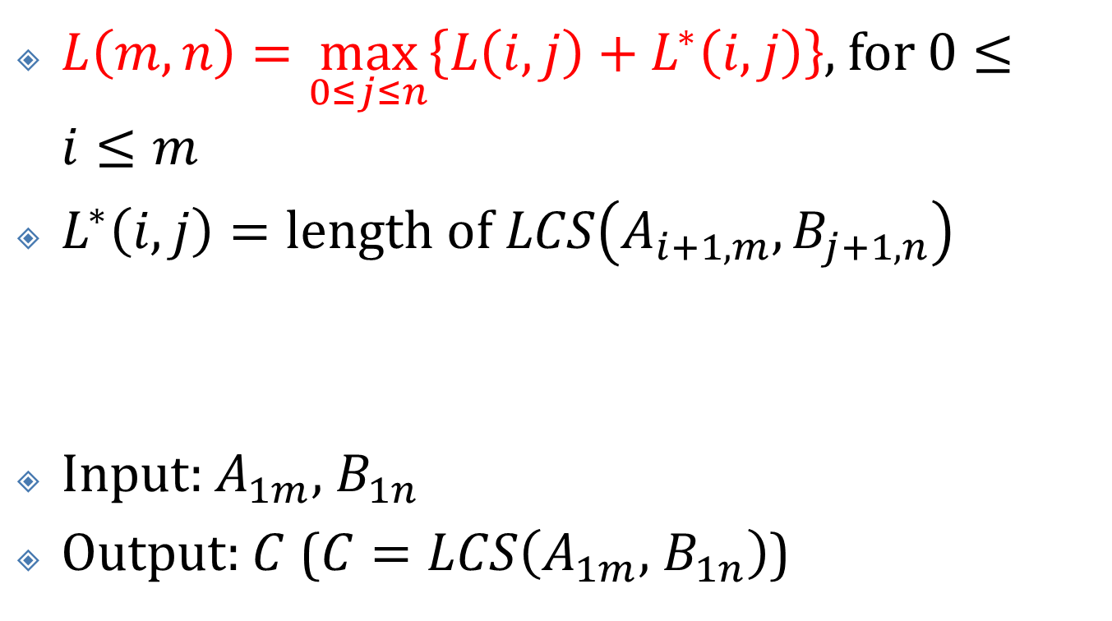
Algorithm C (1/10)
$L\left(m, n\right)=\max_{0≤j≤n}\left\{L\left(i, j\right)+L^{∗}\left(i, j\right)\right\}$, for $0≤i≤m$
$L^{∗}\left(i, j\right)=\text{length} \text{of} LCS\left(A_{i+1, m}, B_{j+1, n}\right)$
Input: $A_{1m}$, $B_{1n}$
Output: $C$ ($C=LCS\left(A_{1m}\text{, }B_{1n}\right)$)

Slide 18
Algorithm C (2/10)

Slide 19

Algorithm C (3/10)
$A=abcada$, $B=abadcb$
Divide to
$A_{1, 3}=abc$, $B=abadcb$
${\hat{A}}_{6, 4}=ada$, $\hat{B}=bcdaba$

Slide 20

Algorithm C (4/10)
$A_{1, 3}=abc$, $B=abadcb$
 |  |  | a | b | a | d | c | b
 |  | 0 | 1 | 2 | 3 | 4 | 5 | 6
 |  | 0 | 0 | 0 | 0 | 0 | 0 | 0
a |  | 0 | 1 | 1 | 1 | 1 | 1 | 1
b | 0 | 0 | 1 | 2 | 2 | 2 | 2 | 2
c | 1 | 0 | 1 | 2 | 2 | 2 | 3 | 3

Slide 21

Algorithm C (5/10)
${\hat{A}}_{6, 4}=ada$, $\hat{B}=bcdaba$
 |  |  | b | c | d | a | b | a
 |  | 0 | 1 | 2 | 3 | 4 | 5 | 6
 |  | 0 | 0 | 0 | 0 | 0 | 0 | 0
a |  | 0 | 0 | 0 | 0 | 1 | 1 | 1
d | 0 | 0 | 0 | 0 | 1 | 1 | 1 | 1
a | 1 | 0 | 0 | 0 | 1 | 2 | 2 | 2

Slide 22
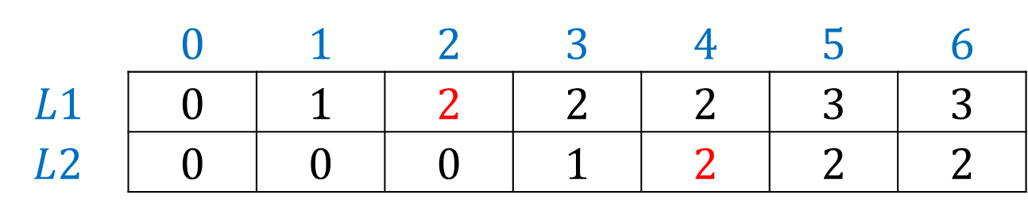
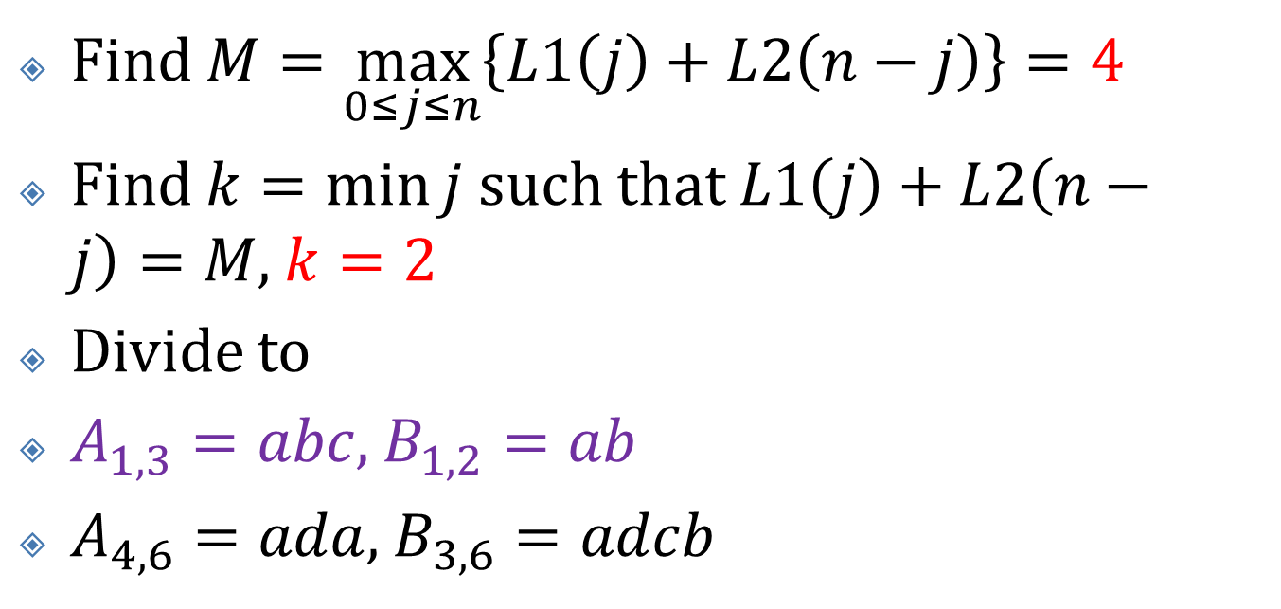
Algorithm C (6/10)
 | 0 | 1 | 2 | 3 | 4 | 5 | 6
$$L1$$ | 0 | 1 | 2 | 2 | 2 | 3 | 3
$$L2$$ | 0 | 0 | 0 | 1 | 2 | 2 | 2
Find $M=\max_{0≤j≤n}\left\{L1\left(j\right)+L2\left(n−j\right)\right\}=4$
Find $k=\min{j}$ such that $L1\left(j\right)+L2\left(n−j\right)=M$, $k=2$
Divide to
$A_{1, 3}=abc$, $B_{1, 2}=ab$
$A_{4, 6}=ada$, $B_{3, 6}=adcb$

Slide 23

Algorithm C (7/10)
$A_{1, 3}=abc$, $B_{1, 2}=ab$
Divide to
$A_{1}=a$, $B_{1, 2}=ab$
${\hat{A}}_{3, 2}=cb$, ${\hat{B}}_{2, 1}=ba$

Slide 24

Algorithm C (8/10)
$A_{1}=a$, $B_{1, 2}=ab$
${\hat{A}}_{3, 2}=cb$, ${\hat{B}}_{2, 1}=ba$
 |  |  | a | b
 |  | 0 | 1 | 2
 | 0 | 0 | 0 | 0
a | 1 | 0 | 1 | 1
 |  |  | b | a
 |  | 0 | 1 | 2
 |  | 0 | 0 | 0
c | 0 | 0 | 0 | 0
b | 1 | 0 | 1 | 1

Slide 25
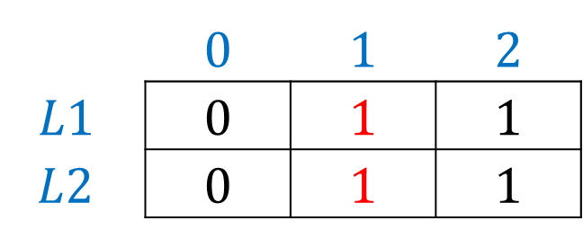
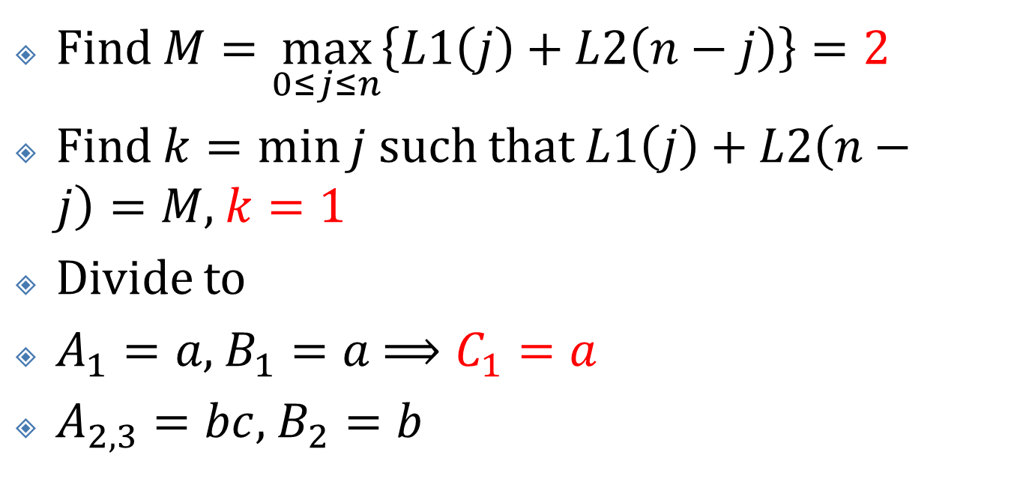
Algorithm C (9/10)
 | 0 | 1 | 2
$$L1$$ | 0 | 1 | 1
$$L2$$ | 0 | 1 | 1
Find $M=\max_{0≤j≤n}\left\{L1\left(j\right)+L2\left(n−j\right)\right\}=2$
Find $k=\min{j}$ such that $L1\left(j\right)+L2\left(n−j\right)=M$, $k=1$
Divide to
$A_{1}=a$, $B_{1}=a$ $⟹C_{1}=a$
$A_{2, 3}=bc$, $B_{2}=b$

Slide 26
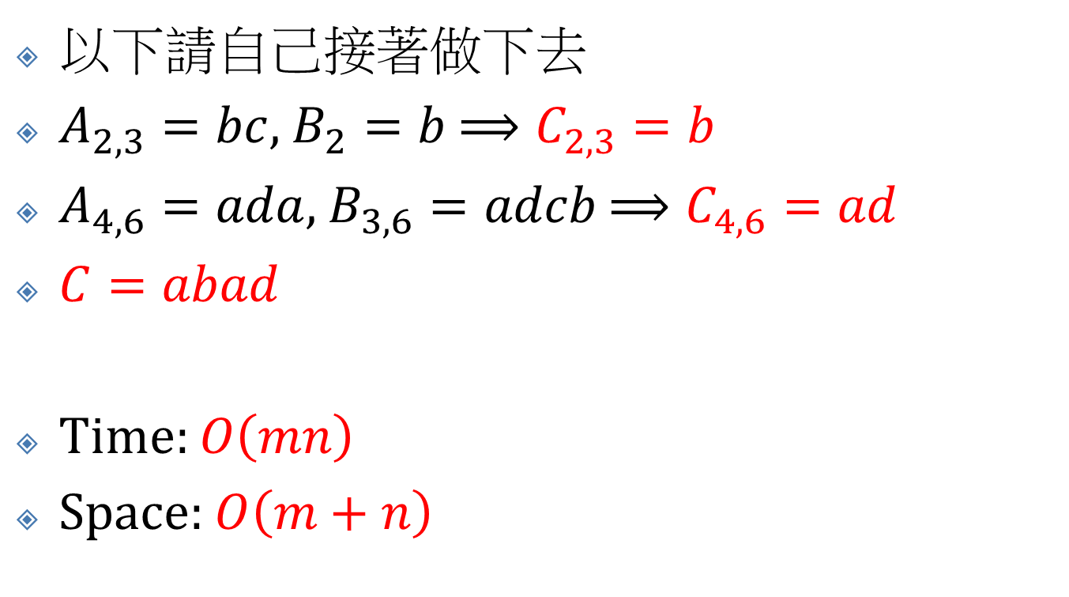
Algorithm C (10/10)
以下請自己接著做下去
$A_{2, 3}=bc$, $B_{2}=b$ $⟹C_{2, 3}=b$
$A_{4, 6}=ada$, $B_{3, 6}=adcb$ $⟹C_{4, 6}=ad$
$C=abad$
Time: $O\left(mn\right)$
Space: $O\left(m+n\right)$

