Slide 1
Algorithms for the Longest Common Subsequence Problem
DANIEL S. HEIRSCHBERG
Journal of the Association for Computing Machinery, Vol 24, No 4, October 1977, pp 664-675
Presenter: 許竣傑
2013/11/26

Slide 2
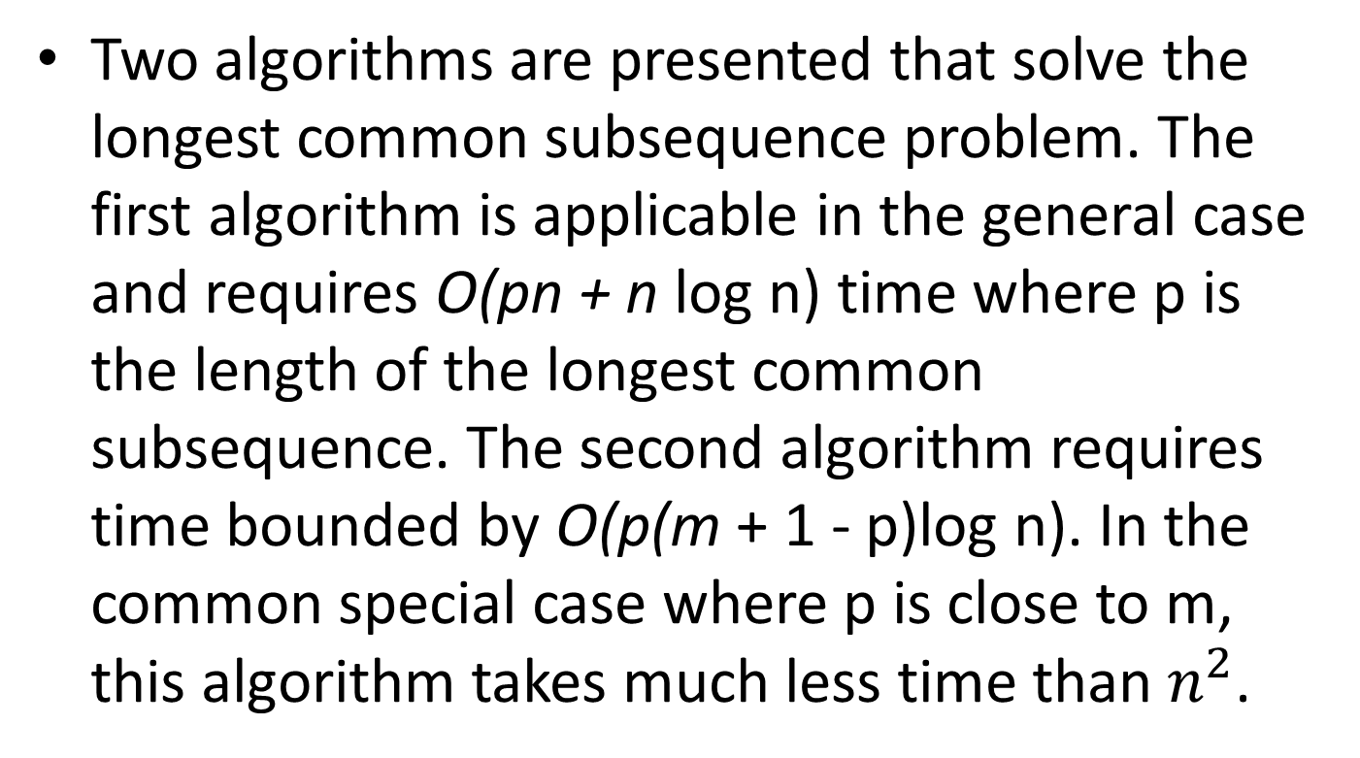
Abstract
Two algorithms are presented that solve the longest common subsequence problem. The first algorithm is applicable in the general case and requires O(pn + n log n) time where p is the length of the longest common subsequence. The second algorithm requires time bounded by O(p(m + 1 - p)log n). In the common special case where p is close to m, this algorithm takes much less time than$n^{2}$.

Slide 3
LCS
A: a g c t g a c g
B: c a c a g t a g
LCS: a c g a g

Slide 4
K-candidate
 |  | C | A | C | G
 | 0 | 0 | 0 | 0 | 0
A | 0 | 0 | 1 | 1 | 1
G | 0 | 0 | 1 | 1 | 2
C | 0 | 1 | 1 | 2 | 2

Slide 5
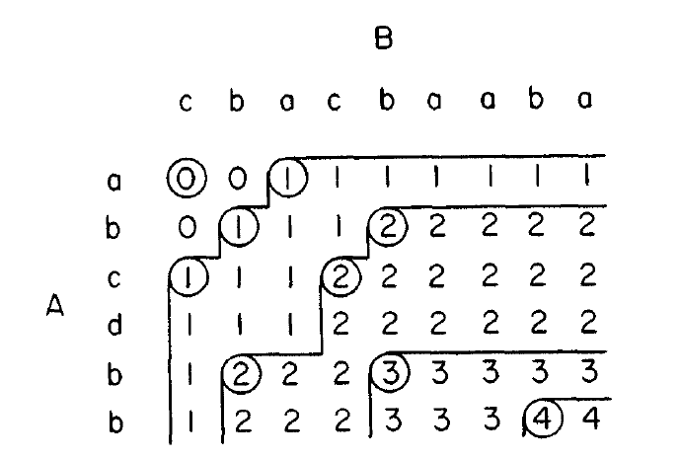
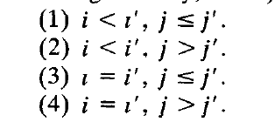

Minimal K-candidate
< <i, j> <$i^{′},j^{′}$>

Slide 6
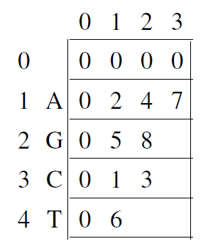

ALGD
$$PB[θ,N[θ]]$$
B 0 1 2 3 4 5 6 7 8
A
 | - | C | A | C | A | G | T | A | G
- | 0 | 0 | 0 | 0 | 0 | 0 | 0 | 0 | 0
A | 0 | 0 | 1 | 1 | 1 | 1 | 1 | 1 | 1
G | 0 | 0 | 1 | 1 | 1 | 2 | 2 | 2 | 2
C | 0 | 1 | 1 | 2 | 2 | 2 | 2 | 2 | 2
T | 0 | 1 | 1 | 2 | 2 | 2 | 3 | 3 | 3
G | 0 | 1 | 1 | 2 | 2 | 3 | 3 | 3 | 4
A | 0 | 1 | 2 | 2 | 3 | 3 | 3 | 4 | 4
C | 0 | 1 | 2 | 3 | 3 | 3 | 3 | 4 | 4
G | 0 | 1 | 2 | 3 | 3 | 3 | 4 | 4 | 5
K=1
0
1
Low < j < high
2
0 < j < 9
3
0 < j < 2
4
- A G C T G A C G
5
0 | 1 | 2 | 3 | 4 | 5 | 6 | 7 | 8
- | 2 | 0 | 1 | 0 | 0 | 0 | 0 | 0
6
7
0 < j < 1
8

Slide 7
ALGD
B 0 1 2 3 4 5 6 7 8
A
 | - | C | A | C | A | G | T | A | G
- | 0 | 0 | 0 | 0 | 0 | 0 | 0 | 0 | 0
A | 0 | 0 | 1 | 1 | 1 | 1 | 1 | 1 | 1
G | 0 | 0 | 1 | 1 | 1 | 2 | 2 | 2 | 2
C | 0 | 1 | 1 | 2 | 2 | 2 | 2 | 2 | 2
T | 0 | 1 | 1 | 2 | 2 | 2 | 3 | 3 | 3
G | 0 | 1 | 1 | 2 | 2 | 3 | 3 | 3 | 4
A | 0 | 1 | 2 | 2 | 3 | 3 | 3 | 4 | 4
C | 0 | 1 | 2 | 3 | 3 | 3 | 3 | 4 | 4
G | 0 | 1 | 2 | 3 | 3 | 3 | 4 | 4 | 5
K=2
0
Low < j < high
1
2 < j < 9
2
2 < j < 5
3
2 < j < 3
1 < j < 3
4
1 < j < 2
5
6
0 | 1 | 2 | 3 | 4 | 5 | 6 | 7 | 8
- | 2 | 0 | 1 | 0 | 0 | 0 | 0 | 0
- | - | 5 | 3 | 0 | 0 | 2 | 0 | 0
7
8

Slide 8
ALGD
B 0 1 2 3 4 5 6 7 8
A
 | - | C | A | C | A | G | T | A | G
- | 0 | 0 | 0 | 0 | 0 | 0 | 0 | 0 | 0
A | 0 | 0 | 1 | 1 | 1 | 1 | 1 | 1 | 1
G | 0 | 0 | 1 | 1 | 1 | 2 | 2 | 2 | 2
C | 0 | 1 | 1 | 2 | 2 | 2 | 2 | 2 | 2
T | 0 | 1 | 1 | 2 | 2 | 2 | 3 | 3 | 3
G | 0 | 1 | 1 | 2 | 2 | 3 | 3 | 3 | 4
A | 0 | 1 | 2 | 2 | 3 | 3 | 3 | 4 | 4
C | 0 | 1 | 2 | 3 | 3 | 3 | 3 | 4 | 4
G | 0 | 1 | 2 | 3 | 3 | 3 | 4 | 4 | 5
K=3
0
Low < j < high
1
5 < j < 9
3 < j < 9
2
3
3 < j < 6
4
3 < j < 5
3 < j < 4
2 < j < 4
5
0 | 1 | 2 | 3 | 4 | 5 | 6 | 7 | 8
- | 2 | 0 | 1 | 0 | 0 | 0 | 0 | 0
- | - | 5 | 3 | 0 | 0 | 2 | 0 | 0
- | - | - | 0 | 6 | 5 | 4 | 3 | 0
6
7
8

Slide 9
ALGD
B 0 1 2 3 4 5 6 7 8
A
 | - | C | A | C | A | G | T | A | G
- | 0 | 0 | 0 | 0 | 0 | 0 | 0 | 0 | 0
A | 0 | 0 | 1 | 1 | 1 | 1 | 1 | 1 | 1
G | 0 | 0 | 1 | 1 | 1 | 2 | 2 | 2 | 2
C | 0 | 1 | 1 | 2 | 2 | 2 | 2 | 2 | 2
T | 0 | 1 | 1 | 2 | 2 | 2 | 3 | 3 | 3
G | 0 | 1 | 1 | 2 | 2 | 3 | 3 | 3 | 4
A | 0 | 1 | 2 | 2 | 3 | 3 | 3 | 4 | 4
C | 0 | 1 | 2 | 3 | 3 | 3 | 3 | 4 | 4
G | 0 | 1 | 2 | 3 | 3 | 3 | 4 | 4 | 5
0
1
A: A G C T G A C G
0 | 1 | 2 | 3 | 4 | 5 | 6 | 7 | 8
- | 2 | 0 | 1 | 0 | 0 | 0 | 0 | 0
- | - | 5 | 3 | 0 | 0 | 2 | 0 | 0
- | - | - | 0 | 6 | 5 | 4 | 3 | 0
- | - | - | - | - | 8 | 7 | 0 | 5
- | - | - | - | - | - | - | - | 8
2
K=1
3
K=2
4
K=3
5
K=4
6
K=5
7
8

Slide 10
ALGE
 | B: | A | A | C | T | A | T | G | A | T
A: |  | 0 | 0 | 0 | 0 | 0 | 0 | 0 | 0 | 0
C | 0 | 0 | 0 | 1 | 1 | 1 | 1 | 1 | 1 | 1
G | 0 | 0 | 0 | 1 | 1 | 1 | 1 | 2 | 2 | 2
C | 0 | 0 | 0 | 1 | 1 | 1 | 1 | 2 | 2 | 2
A | 0 | 1 | 1 | 1 | 1 | 2 | 2 | 2 | 3 | 3
T | 0 | 1 | 1 | 1 | 2 | 2 | 3 | 3 | 3 | 4
T | 0 | 1 | 1 | 1 | 2 | 2 | 3 | 3 | 3 | 4
A | 0 | 1 | 2 | 2 | 2 | 3 | 3 | 3 | 4 | 4
T | 0 | 1 | 2 | 2 | 3 | 3 | 4 | 4 | 4 | 5
T | 0 | 1 | 2 | 2 | 3 | 3 | 4 | 4 | 4 | 5
G | 0 | 1 | 2 | 2 | 3 | 3 | 4 | 5 | 5 | 5

Slide 11
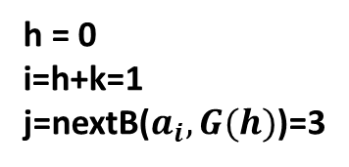
nextb |  | A | A | C | T | A | T | G | A | T
 | 0 | 1 | 2 | 3 | 4 | 5 | 6 | 7 | 8 | 9 | 10
A | 1 | 2 | 5 | 5 | 5 | 8 | 8 | 8 | 10 | 10 | 10
G | 7 | 7 | 7 | 7 | 7 | 7 | 7 | 10 | 10 | 10 | 10
C | 3 | 3 | 3 | 10 | 10 | 10 | 10 | 10 | 10 | 10 | 10
T | 4 | 4 | 4 | 4 | 6 | 6 | 9 | 9 | 9 | 10 | 10
假設 h = 6
B 0 1 2 3 4 5 6 7 8 9
A
0 1 2 3 4 5 6
 |  | A | A | C | T | A | T | G | A | T
 | - | 0 | 0 | 0 | 0 | 0 | 0 | 0 | 0 | 0
C | 0 | 0 | 0 | 1 | 1 | 1 | 1 | 1 | 1 | 1
G | 0 | 0 | 0 | 1 | 1 | 1 | 1 | 2 | 2 | 2
C | 0 | 0 | 0 | 1 | 1 | 1 | 1 | 2 | 2 | 2
A | 0 | 1 | 1 | 1 | 1 | 2 | 2 | 2 | 3 | 3
T | 0 | 1 | 1 | 1 | 2 | 2 | 3 | 3 | 3 | 4
T | 0 | 1 | 1 | 1 | 2 | 2 | 3 | 3 | 3 | 4
A | 0 | 1 | 2 | 2 | 2 | 3 | 3 | 3 | 4 | 4
T | 0 | 1 | 2 | 2 | 3 | 3 | 4 | 4 | 4 | 5
T | 0 | 1 | 2 | 2 | 3 | 3 | 4 | 4 | 4 | 5
G | 0 | 1 | 2 | 2 | 3 | 3 | 4 | 4 | 5 | 5
F(h) 0 0 0 0 0 0 0
0
G(h) 0 0 0 0 0 0 0
1
2
imax=0
jmin=10
3
4
h = 0
i=h+k=1
j=nextB($a_{i},G(h)$)=3
5
6
F(h) 1 0 0 0 0 0 0
7
G(h) 3 0 0 0 0 0 0
8
imax=1
jmin=3
9
10

Slide 12
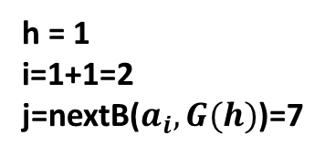
nextb |  | A | A | C | T | A | T | G | A | T
 | 0 | 1 | 2 | 3 | 4 | 5 | 6 | 7 | 8 | 9 | 10
A | 1 | 2 | 5 | 5 | 5 | 8 | 8 | 8 | 10 | 10 | 10
G | 7 | 7 | 7 | 7 | 7 | 7 | 7 | 10 | 10 | 10 | 10
C | 3 | 3 | 3 | 10 | 10 | 10 | 10 | 10 | 10 | 10 | 10
T | 4 | 4 | 4 | 4 | 6 | 6 | 9 | 9 | 9 | 10 | 10
B 0 1 2 3 4 5 6 7 8 9
A
F(h) 1 0 0 0 0 0 0
 |  | A | A | C | T | A | T | G | A | T
 | - | 0 | 0 | 0 | 0 | 0 | 0 | 0 | 0 | 0
C | 0 | 0 | 0 | 1 | 1 | 1 | 1 | 1 | 1 | 1
G | 0 | 0 | 0 | 1 | 1 | 1 | 1 | 2 | 2 | 2
C | 0 | 0 | 0 | 1 | 1 | 1 | 1 | 2 | 2 | 2
A | 0 | 1 | 1 | 1 | 1 | 2 | 2 | 2 | 3 | 3
T | 0 | 1 | 1 | 1 | 2 | 2 | 3 | 3 | 3 | 4
T | 0 | 1 | 1 | 1 | 2 | 2 | 3 | 3 | 3 | 4
A | 0 | 1 | 2 | 2 | 2 | 3 | 3 | 3 | 4 | 4
T | 0 | 1 | 2 | 2 | 3 | 3 | 4 | 4 | 4 | 5
T | 0 | 1 | 2 | 2 | 3 | 3 | 4 | 4 | 4 | 5
G | 0 | 1 | 2 | 2 | 3 | 3 | 4 | 4 | 5 | 5
0
G(h) 3 0 0 0 0 0 0
1
imax=1
jmin=3
2
3
h = 1
i=1+1=2
j=nextB($a_{i},G(h)$)=7
4
5
F(h) 1 1 0 0 0 0 0
6
G(h) 3 3 0 0 0 0 0
7
8
9
10

Slide 13
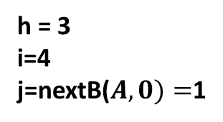
nextb |  | A | A | C | T | A | T | G | A | T
 | 0 | 1 | 2 | 3 | 4 | 5 | 6 | 7 | 8 | 9 | 10
A | 1 | 2 | 5 | 5 | 5 | 8 | 8 | 8 | 10 | 10 | 10
G | 7 | 7 | 7 | 7 | 7 | 7 | 7 | 10 | 10 | 10 | 10
C | 3 | 3 | 3 | 10 | 10 | 10 | 10 | 10 | 10 | 10 | 10
T | 4 | 4 | 4 | 4 | 6 | 6 | 9 | 9 | 9 | 10 | 10
B 0 1 2 3 4 5 6 7 8 9
A
 |  | A | A | C | T | A | T | G | A | T
 | - | 0 | 0 | 0 | 0 | 0 | 0 | 0 | 0 | 0
C | 0 | 0 | 0 | 1 | 1 | 1 | 1 | 1 | 1 | 1
G | 0 | 0 | 0 | 1 | 1 | 1 | 1 | 2 | 2 | 2
C | 0 | 0 | 0 | 1 | 1 | 1 | 1 | 2 | 2 | 2
A | 0 | 1 | 1 | 1 | 1 | 2 | 2 | 2 | 3 | 3
T | 0 | 1 | 1 | 1 | 2 | 2 | 3 | 3 | 3 | 4
T | 0 | 1 | 1 | 1 | 2 | 2 | 3 | 3 | 3 | 4
A | 0 | 1 | 2 | 2 | 2 | 3 | 3 | 3 | 4 | 4
T | 0 | 1 | 2 | 2 | 3 | 3 | 4 | 4 | 4 | 5
T | 0 | 1 | 2 | 2 | 3 | 3 | 4 | 4 | 4 | 5
G | 0 | 1 | 2 | 2 | 3 | 3 | 4 | 4 | 5 | 5
0
1
imax=1
jmin=3
2
3
h = 3
i=4
j=nextB($A,0)=$1
4
5
F(h) 1 1 1 4 0 0 0
6
G(h) 3 3 3 1 0 0 0
7
imax=4
jmin=1
8
9
10

Slide 14
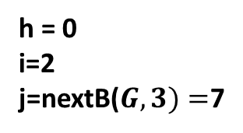
nextb |  | A | A | C | T | A | T | G | A | T
 | 0 | 1 | 2 | 3 | 4 | 5 | 6 | 7 | 8 | 9 | 10
A | 1 | 2 | 5 | 5 | 5 | 8 | 8 | 8 | 10 | 10 | 10
G | 7 | 7 | 7 | 7 | 7 | 7 | 7 | 10 | 10 | 10 | 10
C | 3 | 3 | 3 | 10 | 10 | 10 | 10 | 10 | 10 | 10 | 10
T | 4 | 4 | 4 | 4 | 6 | 6 | 9 | 9 | 9 | 10 | 10
B 0 1 2 3 4 5 6 7 8 9
K=2
A
F(h) 1 1 1 4 4 4 4
 |  | A | A | C | T | A | T | G | A | T
 | - | 0 | 0 | 0 | 0 | 0 | 0 | 0 | 0 | 0
C | 0 | 0 | 0 | 1 | 1 | 1 | 1 | 1 | 1 | 1
G | 0 | 0 | 0 | 1 | 1 | 1 | 1 | 2 | 2 | 2
C | 0 | 0 | 0 | 1 | 1 | 1 | 1 | 2 | 2 | 2
A | 0 | 1 | 1 | 1 | 1 | 2 | 2 | 2 | 3 | 3
T | 0 | 1 | 1 | 1 | 2 | 2 | 3 | 3 | 3 | 4
T | 0 | 1 | 1 | 1 | 2 | 2 | 3 | 3 | 3 | 4
A | 0 | 1 | 2 | 2 | 2 | 3 | 3 | 3 | 4 | 4
T | 0 | 1 | 2 | 2 | 3 | 3 | 4 | 4 | 4 | 5
T | 0 | 1 | 2 | 2 | 3 | 3 | 4 | 4 | 4 | 5
G | 0 | 1 | 2 | 2 | 3 | 3 | 4 | 4 | 5 | 5
0
G(h) 3 3 3 1 1 1 1
1
imax=0
jmin=10
2
3
h = 0
i=2
j=nextB($G,3)=$7
4
5
F(h) 2 1 1 4 4 4 4
6
G(h) 7 3 3 1 1 1 1
7
imax=2
jmin=7
8
9
10

Slide 15
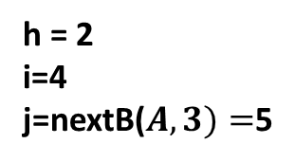
nextb |  | A | A | C | T | A | T | G | A | T
 | 0 | 1 | 2 | 3 | 4 | 5 | 6 | 7 | 8 | 9 | 10
A | 1 | 2 | 5 | 5 | 5 | 8 | 8 | 8 | 10 | 10 | 10
G | 7 | 7 | 7 | 7 | 7 | 7 | 7 | 10 | 10 | 10 | 10
C | 3 | 3 | 3 | 10 | 10 | 10 | 10 | 10 | 10 | 10 | 10
T | 4 | 4 | 4 | 4 | 6 | 6 | 9 | 9 | 9 | 10 | 10
B 0 1 2 3 4 5 6 7 8 9
A
K=2
 |  | A | A | C | T | A | T | G | A | T
 | - | 0 | 0 | 0 | 0 | 0 | 0 | 0 | 0 | 0
C | 0 | 0 | 0 | 1 | 1 | 1 | 1 | 1 | 1 | 1
G | 0 | 0 | 0 | 1 | 1 | 1 | 1 | 2 | 2 | 2
C | 0 | 0 | 0 | 1 | 1 | 1 | 1 | 2 | 2 | 2
A | 0 | 1 | 1 | 1 | 1 | 2 | 2 | 2 | 3 | 3
T | 0 | 1 | 1 | 1 | 2 | 2 | 3 | 3 | 3 | 4
T | 0 | 1 | 1 | 1 | 2 | 2 | 3 | 3 | 3 | 4
A | 0 | 1 | 2 | 2 | 2 | 3 | 3 | 3 | 4 | 4
T | 0 | 1 | 2 | 2 | 3 | 3 | 4 | 4 | 4 | 5
T | 0 | 1 | 2 | 2 | 3 | 3 | 4 | 4 | 4 | 5
G | 0 | 1 | 2 | 2 | 3 | 3 | 4 | 4 | 5 | 5
0
1
imax=2
jmin=7
2
3
h = 2
i=4
j=nextB($A,3)=$5
4
5
F(h) 2 2 4 4 4 4 4
6
G(h) 7 7 5 1 1 1 1
7
imax=4
jmin=5
8
9
10

Slide 16
 | B: | A | A | C | T | A | T | G | A | T
A: |  | 0 | 0 | 0 | 0 | 0 | 0 | 0 | 0 | 0
C | 0 | 0 | 0 | 1 | 1 | 1 | 1 | 1 | 1 | 1
G | 0 | 0 | 0 | 1 | 1 | 1 | 1 | 2 | 2 | 2
C | 0 | 0 | 0 | 1 | 1 | 1 | 1 | 2 | 2 | 2
A | 0 | 1 | 1 | 1 | 1 | 2 | 2 | 2 | 3 | 3
T | 0 | 1 | 1 | 1 | 2 | 2 | 3 | 3 | 3 | 4
T | 0 | 1 | 1 | 1 | 2 | 2 | 3 | 3 | 3 | 4
A | 0 | 1 | 2 | 2 | 2 | 3 | 3 | 3 | 4 | 4
T | 0 | 1 | 2 | 2 | 3 | 3 | 4 | 4 | 4 | 5
T | 0 | 1 | 2 | 2 | 3 | 3 | 4 | 4 | 4 | 5
G | 0 | 1 | 2 | 2 | 3 | 3 | 4 | 5 | 5 | 5

Slide 17
Thank You!

