Slide 1
A Fast Algorithm for Computing Longest Common Subsequences Communications of the ACM vol. 20 pp.350–353 (1977)
James W. Hunt
Stanford Univ., Stanford, CA
Thomas G. Szymanski
Princeton Univ., Princeton, NJ
Presentor：Hsin-Chuan Yuan

Slide 2
Abstract
Previously published algorithms for finding the longest common subsequence of two sequences of length n have had a best-case running time of O(n²). An algorithm for this problem is presented which has a running time of O((r + n) log n), where r is the total number of ordered pairs of positions at which the two sequences match. Thus in the worst case the algorithm has a running time of O(n² log n). However, for those applications where most positions of one sequence match relatively few positions in the other sequence, a running time of O(n log n) can be expected.

Slide 3
The Longest Increasing Subsequence (LIS) Problem
Definition:
Input: One numeric sequence S
Output: The longest increasing subsequence in S
Example: Given S = 35274816, the LIS in S is 3578.
By applying the LCS algorithm, this problem can be solved in O(n²) time.
Robinson-Schensted-Knuth Algorithm can solve the LIS problem in O(nlogn) time.

Slide 4
Robinson-Schensted-Knuth Algorithm for LIS
Input
3
5
2
7
4
8
1
6
1
3
3
2
2
2
2
1
1
L
2
5
5
5
4
4
4
4
3
7
7
7
7
6
4
8
8
8
LIS: 3578
time complexity: O(nlogn)
n numbers are inserted and each insertion takes O(logn) time for binary search.

Slide 5
Hunt-Szymanski LCS Algorithm
By extending the idea in RSK algorithm, the LCS problem can be solved in O((r + n) log n) time, where r denotes the number of matches.
This algorithm is faster than traditional dynamic programming if r is small (in the worst case r = n²).

Slide 6
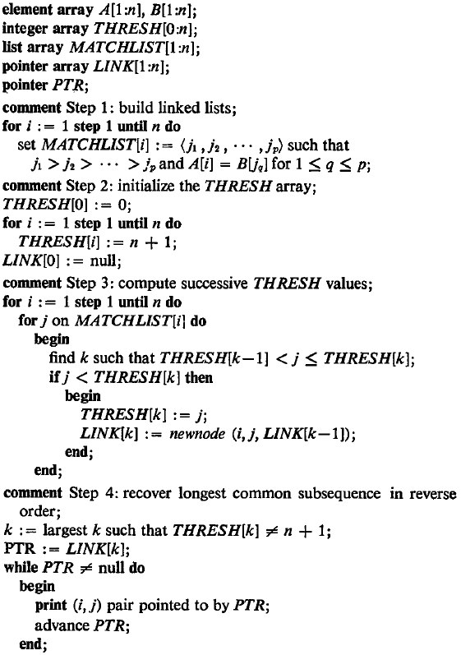

Slide 7
The Pairs of Matching
Input sequences: ABCBDDA and BADBABD Pairs of matching:
 | B | A | D | B | A | B | D
A |  | X
B |  |  |  | X
C
B |  |  |  |  |  | X
D |  |  |  |  |  |  | X
D
A
MATCHLIST[1] = (5, 2)
MATCHLIST[2] = (6, 4, 1)
MATCHLIST[3] = ( )
MATCHLIST[4] = MATCHLIST[2]
MATCHLIST[5] = (7, 3)
MATCHLIST[6] = MATCHLIST[5]
MATCHLIST[7] = MATCHLIST[I]

Slide 8
Example for Hunt-Szymanski Algorithm
The insertion order is row major and column backward.
r
 | (1,5) | (1,2) | (2,6) | (2,4) | (2,1) | (4,6) | (4,4) | (4,1) | (5,7) | (5,3) | (6,7) | (6,3) | (7,5) | (7,2)
1 | (1,5) | (1,2) | (1,2) | (1,2) | (2,1) | (2,1) | (2,1) | (2,1) | (2,1) | (2,1) | (2,1) | (2,1) | (2,1) | (2,1)
2 |  |  | (2,6) | (2,4) | (2,4) | (2,4) | (2,4) | (2,4) | (2,4) | (5,3) | (5,3) | (5,3) | (5,3) | (7,2)
3 |  |  |  |  |  | (4,6) | (4,6) | (4,6) | (4,6) | (4,6) | (4,6) | (4,6) | (7,6) | (7,6)
4 |  |  |  |  |  |  |  |  | (5,7) | (5,7) | (5,7) | (5,7) | (5,7) | (5,7)
L
Time Complexity: O(r log n), r: # of matches
Each match needs O(log n) time for binary search.

Slide 9
Example for Hunt-Szymanski Algorithm
The insertion order is row major and column backward.
r
 | (1,5) | (1,2) | (2,6) | (2,4) | (2,1) | (4,6) | (4,4) | (4,1) | (5,7) | (5,3) | (6,7) | (6,3) | (7,5) | (7,2)
1 | (1,5) | (1,2) | (1,2) | (1,2) | (2,1) | (2,1) | (2,1) | (2,1) | (2,1) | (2,1) | (2,1) | (2,1) | (2,1) | (2,1)
2 |  |  | (2,6) | (2,4) | (2,4) | (2,4) | (2,4) | (2,4) | (2,4) | (5,3) | (5,3) | (5,3) | (5,3) | (7,2)
3 |  |  |  |  |  | (4,6) | (4,6) | (4,6) | (4,6) | (4,6) | (4,6) | (4,6) | (7,6) | (7,6)
4 |  |  |  |  |  |  |  |  | (5,7) | (5,7) | (5,7) | (5,7) | (5,7) | (5,7)
L
Time Complexity: O(r log n), r: # of matches
Each match needs O(log n) time for binary search.

Slide 10
Conclusions

