Slide 1
A Faster Algorithm Computing String Edit Distances*
JOURNAL OF COMPUTER AND SYSTEM SCIENCES 20, 18+3,1 (1980)
WILLIAM J. MASEK
MITLaboratory for Computer Science, Cambridge, Massachusetts 02139
AND
MICHAEL S. PATESON
School of Computer Science, University of Warwick, Coventry, Warwicks, United Kingdom
Received September 25, 1978; revised August 6, 1979
Presenter:De-Sheng Jhan
2013/12/11

Slide 2
Abstract
The edit distance between two character strings can be defined as the minimum cost of a sequence of editing operations which transforms one string into the other. The operations we admit are deleting, inserting and replacing one symbol at a time, with possibly different costs for each of these operations. The problem of finding the longest common subsequence of two strings is a special case of the problem of computing edit distances. We describe an algorithm for computing the edit distance between two strings of length n and m, n > m, which requires O(n * max( 1, m/log n)) steps whenever the costs of edit operations are integral multiples of a single positive real number and the alphabet for the strings is finite. These conditions are necessary for the algorithm to achieve the time bound.

Slide 3
Edit Distance(1/3)
將string A 經由 Insertion、Deletion、Substitution 變成string B 花費的cost 。
Insertion cost = 1
Deletion cost = 1
Substitution cost = 2

Slide 4
Edit Distance(2/3)
Ex: A = “bced” -> B = “acd”
Case1: step1: Deletion b ->“ced” (1)
step2: Insertion a ->”aced” (1)
step3: Substitution (e->d) ->“acdd” (2)
step4: Deletion d ->”acd” (1)
cost = 1 + 1 + 2 + 1 = 5

Slide 5
Edit Distance(3/3)
Ex: A = “bced” -> B = “acd”
Case2: step1: Substitution (b->a) ->“aced” (2)
step2: Deletion e ->”acd” (1)
cost = 2 + 1 = 3

Slide 6
Minimum Edit Distance(1/3)
將string A 經由 Insertion、Deletion、Substitution 變成string B 花費的最小cost 。
D( i , j ) = min( D( i–1 ,j-1) + (A[i]==B[j]?0:2),
D(i-1,j) + (Deletion cost),
D(i,j-1) + (Insertion cost ))

Slide 7
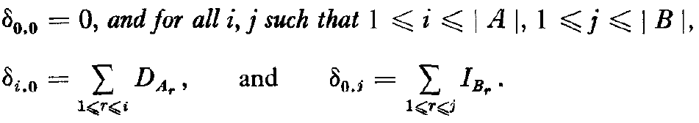
Minimum Edit Distance(2/3)
0 | 1 | …… |  | |B|
1
. . . .
|A|

Slide 8
Minimum Edit Distance(3/3)
Ex: A = “bced” -> B = “acd”
 |  | a | c | d
 | 0 | 1 | 2 | 3
b | 1 | 2 | 3 | 4
c | 2 | 3 | 2 | 3
e | 3 | 4 | 3 | 4
d | 4 | 5 | 4 | 3
D(i,j) = min(D(i-1,j-1) + (A[i]==B[i]?0:2),
D(i-1, j) + 1 ,
D(I,j -1) + 1 )
O(|A||B|)

Slide 9
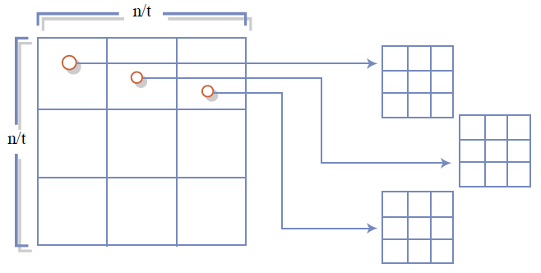
Four-Russians Speedup
The four Russians’ algorithm works faster by splitting the computation into many smaller computations 。

Slide 10
Faster Algorithm
Algorithm Y
Algorithm Z
Done

Slide 11
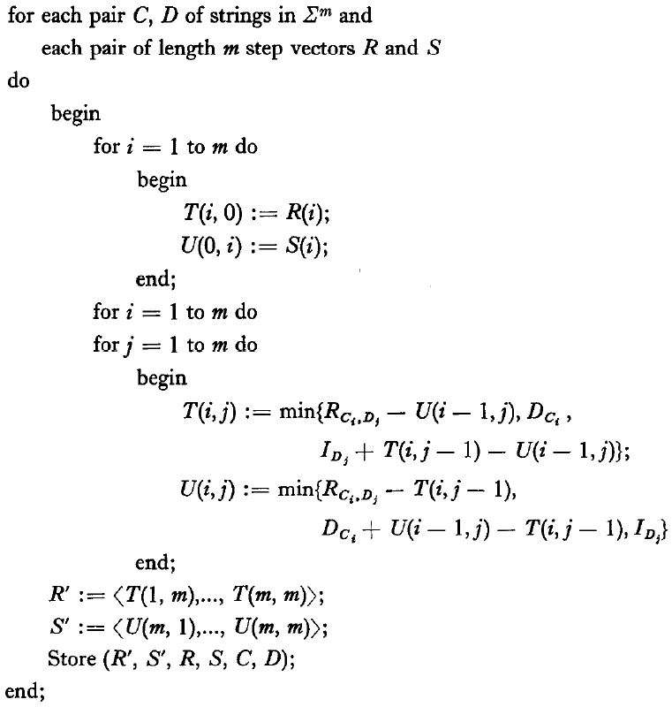
Algorithm Y(1/6)

Slide 12
Algorithm Y(2/6)
Ex: A = “ababbb” ->B =“babaaa”
 |  | b | a | b | a | a | a
 | 0 | 1 | 2 | 3 | 4 | 5 | 6
a | 1
b | 2
a | 3
b | 4
b | 5
b | 6

Slide 13
Algorithm Y(3/6)
m = 3 submatrices size (m+1)*(m+1)
 |  | b | a | b | a | a | a
 | 0 | 1 | 2 | 3 | 4 | 5 | 6
a | 1
b | 2
a | 3
b | 4
b | 5
b | 6

Slide 14
Preprocess Lookup Table(4/6)
計算所有長度m之字串的 Minimum Edit Distance。
Ex: m = 3 假設 X != Y
 |  | X | X | X
 | 3 | 4 | 5 | 6
X | 2 | 3 | 4 | 5
Y | 1 | 2 | 3 | 4
X | 2 | 1 | 2 | 3
 |  | C | C | C
 | 2 | 3 | 4 | 5
C | 1 | 2 | 3 | 4
G | 0 | 1 | 2 | 3
C | 1 | 0 | 1 | 2
Store:((5,4,3),(1,2,3),(3,2,1,2),(3,4,5,6)(X,Y,X)(X,X,X))
Store:((4,3,2),(0,1,2),(2,1,0,1),(2,3,4,5)(C,G,C)(C,C,C))

Slide 15
Reduce Lookup Table(5/6)
 |  | X | X | X
 | 3 | 4 | 5 | 6
X | 2 | 3 | 4 | 5
Y | 1 | 2 | 3 | 4
X | 2 | 1 | 2 | 3
 |  | C | C | C
 | 2 | 3 | 4 | 5
C | 1 | 2 | 3 | 4
G | 0 | 1 | 2 | 3
C | 1 | 0 | 1 | 2
1
1
1
1
1
1
3 | 4 | 5 | 6
2 | 3 | 4 | 5
1 | 2 | 3 | 4
2 | 1 | 2 | 3
2 | 3 | 4 | 5
1 | 2 | 3 | 4
0 | 1 | 2 | 3
1 | 0 | 1 | 2
-1
-1
-1
-1
-1
-1
1
-1
1
-1 1 1
Store:((-1,-1,-1),(-1,1,1),(-1,-1,1),(1,1,1),(R,T,R)(R,R,R))

Slide 16
Algorithm Y(6/6)
 |  | a | a | a
 | 3 | 4 | 5 | 6
a | 2 | 3 | 4 | 5
b | 1 | 2 | 3 | 4
a | 2 | 1 | 2 | 3
 |  | a | a | a
 | 3 | 4 | 5 | 6
a | 2
b | 1
a | 2
1 1 1
 |  | a | a | a
 | 3 | 4 | 5 | 6
a | 2 |  |  | 5
b | 1 |  |  | 4
a | 2 | 1 | 2 | 3
3 | 4 | 5 | 6
2
1
2
-1
-1
1
F((-1,-1,1),(1,1,1),(a,b,a)(a,a,a))
Store:((-1,-1,-1),(-1,1,1),(-1,-1,1),(1,1,1),(R,T,R)(R,R,R))

Slide 17
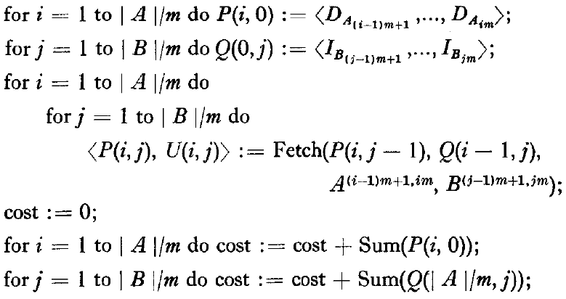
Algorithm Z(1/8)

Slide 18
Algorithm Z(2/8)
Ex: A = “ababbb” B =“babaaa” m=3
 |  | b | a | b | a | a | a
 | 0 | 1 | 2 | 3 | 4 | 5 | 6
a | 1
b | 2
a | 3
b | 4
b | 5
b | 6

Slide 19
Algorithm Z(3/8)
Ex: A = “ababbb” B =“babaaa”
 |  | b | a | b | a | a | a
 | 0 | 1 | 2 | 3 | 4 | 5 | 6
a | 1
b | 2
a | 3
b | 4
b | 5
b | 6

Slide 20
Algorithm Z(4/8)
Ex: A = “ababbb” B =“babaaa” M=3
 |  | b | a | b | a | a | a
 | 0 | 1 | 2 | 3 | 4 | 5 | 6
a | 1 |  |  | 2
b | 2 |  |  | 1
a | 3 | 2 | 1 | 2
b | 4
b | 5
b | 6
F((1,1,1),(1,1,1)(a,b,a)(b,a,b))
Return ((-1,-1,1),(-1,-1,1))

Slide 21
Algorithm Z(5/8)
 |  | b | a | b | a | a | a
 | 0 | 1 | 2 | 3 | 4 | 5 | 6
a | 1 |  |  | 2 |  |  | 5
b | 2 |  |  | 1 |  |  | 4
a | 3 | 2 | 1 | 2 | 1 | 2 | 3
b | 4
b | 5
b | 6
F((-1,-1,1),(1,1,1)(a,b,a)(a,a,a))
Return ((-1,-1,-1),(-1,1,1))

Slide 22
Algorithm Z(6/8)
 |  | b | a | b | a | a | a
 | 0 | 1 | 2 | 3 | 4 | 5 | 6
a | 1 |  |  | 2 |  |  | 5
b | 2 |  |  | 1 |  |  | 4
a | 3 | 2 | 1 | 2 | 1 | 2 | 3
b | 4 |  |  | 1
b | 5 |  |  | 2
b | 6 | 5 | 4 | 3
F((1,1,1),(-1,-1,1)(b,b,b)(b,a,b))
Return ((-1,1,1),(-1,-1,-1))

Slide 23
Algorithm Z(7/8)
 |  | b | a | b | a | a | a
 | 0 | 1 | 2 | 3 | 4 | 5 | 6
a | 1 |  |  | 2 |  |  | 5
b | 2 |  |  | 1 |  |  | 4
a | 3 | 2 | 1 | 2 | 1 | 2 | 3
b | 4 |  |  | 1 |  |  | 4
b | 5 |  |  | 2 |  |  | 5
b | 6 | 5 | 4 | 3 | 4 | 5 | 6
F((-1,1,1),(-1,1,1)(b,b,b)(a,a,a))
Return ((1,1,1),(1,1,1))

Slide 24
Algorithm Z(8/8)
 |  | b | a | b | a | a | a
 | 0 | 1 | 2 | 3 | 4 | 5 | 6
a | 1 |  |  | 2 |  |  | 5
b | 2 |  |  | 1 |  |  | 4
a | 3 | 2 | 1 | 2 | 1 | 2 | 3
b | 4 |  |  | 1 |  |  | 4
b | 5 |  |  | 2 |  |  | 5
b | 6 | 5 | 4 | 3 | 4 | 5 | 6

Slide 25
 |  | b | a | b | a | a | a
 | 0 | 1 | 2 | 3 | 4 | 5 | 6
a | 1 |  |  | 2 |  |  | 5
b | 2 |  |  | 1 |  |  | 4
a | 3 | 2 | 1 | 2 | 1 | 2 | 3
b | 4 |  |  | 1 |  |  | 4
b | 5 |  |  | 2 |  |  | 5
b | 6 | 5 | 4 | 3 | 4 | 5 | 6
用faster algorithm
 |  | b | a | b | a | a | a
 | 0 | 1 | 2 | 3 | 4 | 5 | 6
a | 1 | 2 | 1 | 2 | 3 | 4 | 5
b | 2 | 1 | 2 | 1 | 2 | 3 | 4
a | 3 | 2 | 1 | 2 | 1 | 2 | 3
b | 4 | 3 | 2 | 1 | 2 | 3 | 4
b | 5 | 4 | 3 | 2 | 3 | 4 | 5
b | 6 | 5 | 4 | 3 | 4 | 5 | 6
沒用faster algorithm

Slide 26


Analysis Faster Algorithm
Algorithm Y takes time O(m²log m) to calculate and store each submatrix,calculating all of the final step vectors takes total time
= , for some k depending only on the number of steps and Σ , but not m.

Slide 27


Assume|A| ≥ |B|
Blocks number (|A|/M)*(|B|/M) = O(|A||B|/M²)
Each block need
if m >|B|,algorithm runs in time O(|A|)

Slide 28
Thank you for listening

