Slide 1
The String-to-String Correction Problem
Robert A. Wagner & Michael J. Fischer Journal of the Association for Computing Machinery, vol. 21, No. 1, p.p. 168-173, January 1974
Presenter: Chun-Chieh Tai
Date: December 11, 2013

Slide 2
Abstract
The string-to-string correction problem is to determine the distance between two strings as measured by the minimum cost sequence of "edit operations" needed to change the one string into the other. The edit operations investigated allow changing one symbol of a string into another single symbol, deleting one symbol from a string, or inserting a single symbol into a string. An algorithm is presented which solves this problem in time proportional to the product of the lengths of the two strings. Possible applications are to the problems of automatic spelling correction and determining the longest subsequence of characters common to two strings.

Slide 3
Introduction
three editing operations are:
changing one character to another single character
deleting one character from the given string
inserting a single character into the given string
kitten轉成sitting：
sitten （k→s） // change
sittin （e→i） // change
sitting （→g） // insert

Slide 4
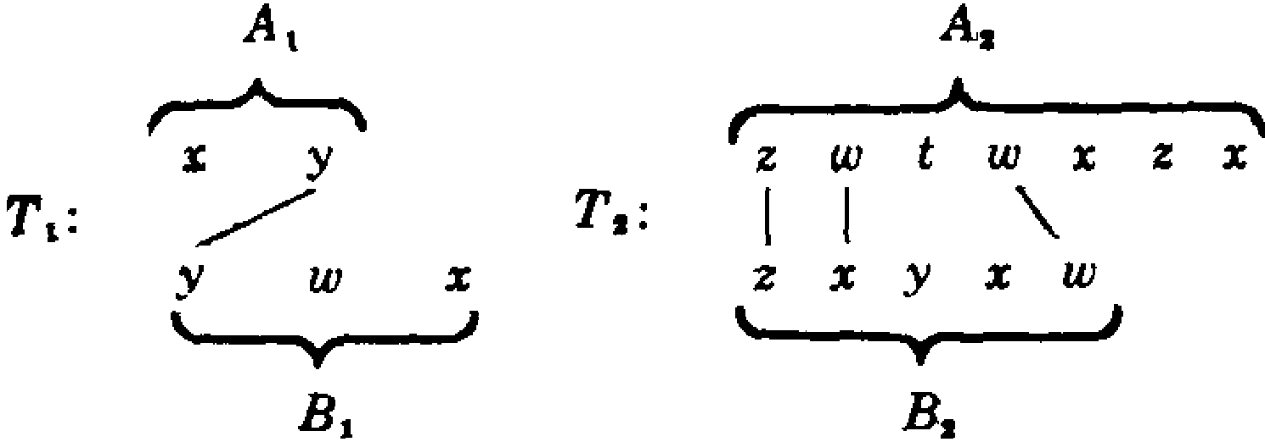
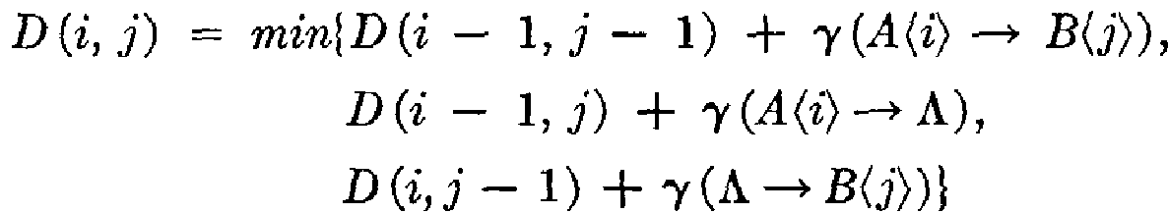
Edit Distance
We let the edit distance δ(A,B) from string A to string B be the minimum cost trace of all sequences of edit operations which transform A into B.
δ(A,B)=min {γ(T) | T is a trace from A to B}, where A and B are two strings, and γ id a cost function.
←change
←delete
←insert

Slide 5
Example
kitten -> sitting
D(i,j)=min{D(i-1,j-1)+0, // if A_{i}=B_{j} D(i-1,j-1)+1, // change
D(i-1,j)+1, // delete D(i,j-1)+1} // insert
 |  | k | i | t | t | e | n
 | 0 | 1 | 2 | 3 | 4 | 5 | 6
s | 1 | 1 | 2 | 3 | 4 | 5 | 6
i | 2 | 2 | 1 | 2 | 3 | 4 | 5
t | 3 | 3 | 2 | 1 | 2 | 3 | 4
t | 4 | 4 | 3 | 2 | 1 | 2 | 3
i | 5 | 5 | 4 | 3 | 2 | 2 | 3
n | 6 | 6 | 5 | 4 | 3 | 3 | 2
g | 7 | 7 | 6 | 5 | 4 | 4 | 3

Slide 6
Example
kitten -> sitting
D(i,j)=min{D(i-1,j-1)+0, // if A_{i}=B_{j} D(i-1,j-1)+1, // change
D(i-1,j)+1, // delete D(i,j-1)+1} // insert
 |  | k | i | t | t | e | n
 | 0 | 1 | 2 | 3 | 4 | 5 | 6
s | 1 | 1 | 2 | 3 | 4 | 5 | 6
i | 2 | 2 | 1 | 2 | 3 | 4 | 5
t | 3 | 3 | 2 | 1 | 2 | 3 | 4
t | 4 | 4 | 3 | 2 | 1 | 2 | 3
i | 5 | 5 | 4 | 3 | 2 | 2 | 3
n | 6 | 6 | 5 | 4 | 3 | 3 | 2
g | 7 | 7 | 6 | 5 | 4 | 4 | 3

Slide 7
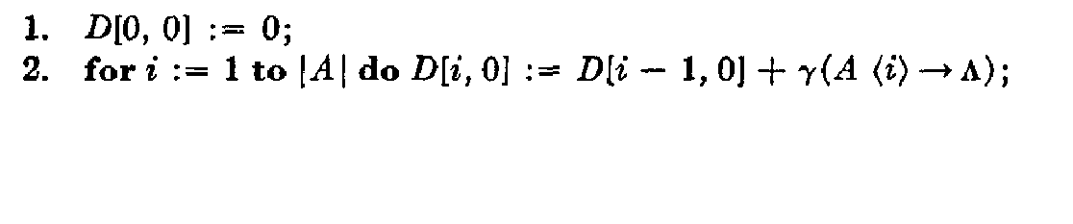
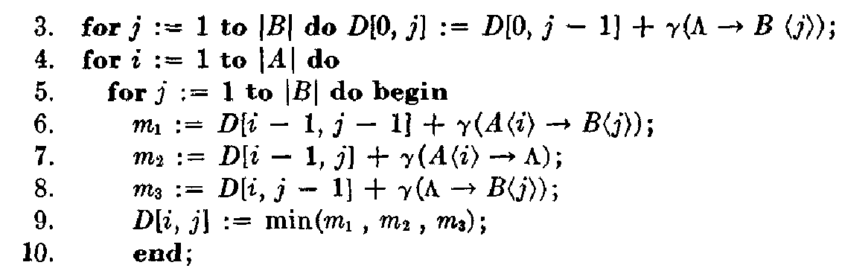
Algorithm X
the total time is O(|A|x|B|)

Slide 8
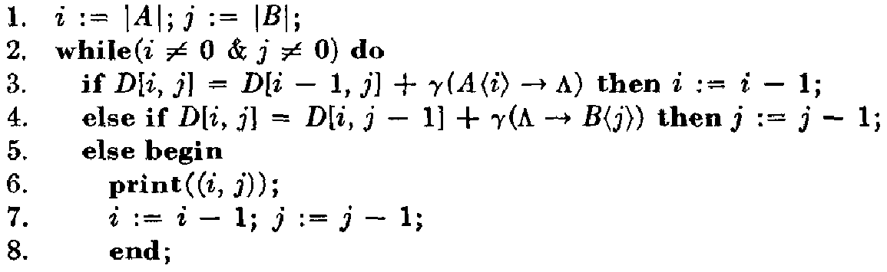
Algorithm Y
If an actual trace T from A to B of least cost is desired, algorithm Y will print the pairs in T.
the total time is O(|A|+|B|)

Slide 9
Longest Common Subsequences
Let ρ(A,B) be the length of the longest common subsequence of A and B.
δ(A,B)= |A|+|B|-2ρ(A,B)
＝＞ρ(A,B) =（ |A|＋|B| －δ(A,B)）/ 2

Slide 10
Thanks for your listening.

