Slide 1
Sequence Matching and Genealogy Tree Drawing Based on Edit Distance Algorithm
Yuxuan Guo, Wenjian Zhang, Haochen Cui and Ning Li
2023 3rd International Conference on Frontiers of Electronics, Information and Computation Technologies (ICFEICT), Yangzhou, China
Presenter: Wen-Yu Chang
Date: Jan. 2, 2024

Slide 2
Abstract(1/2)
Sequence homology is widespread in the genetics and evolution of organisms, and is especially evident in families. Sequence homology is often a biological homology between DNA, RNA or protein sequences, and through homology studies, the relationship between two sequences and the evolution and variation of a common ancestral sequence can be demonstrated by their similarity. The edit distance algorithm has a simple structure, high accuracy, and low time complexity. In this paper, the distance between two sequences is determined by a sequence comparison method based on the edit distance algorithm.

Slide 3
Abstract(2/2)
Subsequently, the complexity and accuracy of the sequence distance algorithm are analyzed, and based on the sequence distance model, a sequence lineage model is designed to determine the ancestral sequences and draw the lineage tree. The algorithm structure of this method is simple, with high accuracy and low time complexity, which has a positive effect on solving the sequence comparison problem.

Slide 4
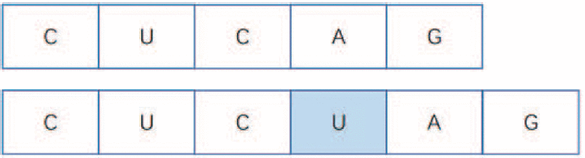
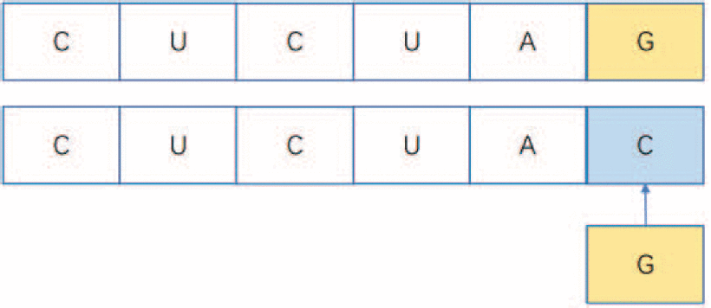
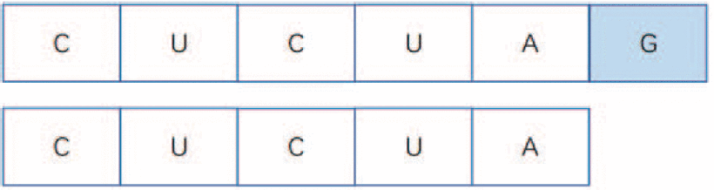
RNA Base Change Mode
Insert
Modify
Delete

Slide 5
Edit Distance Algorithm
 |  | A | U | C | G | C | U
 | 0 | 1 | 2 | 3 | 4 | 5 | 6
U | 1
C | 2
G | 3
A | 4
A | 5
U | 6

Slide 6
Edit Distance Algorithm
 |  | A | U | C | G | C | U
 | 0 | 1 | 2 | 3 | 4 | 5 | 6
U | 1 | 0+1
C | 2
G | 3
A | 4
A | 5
U | 6

Slide 7
Edit Distance Algorithm
 |  | A | U | C | G | C | U
 | 0 | 1 | 2 | 3 | 4 | 5 | 6
U | 1 | 1 | 1
C | 2
G | 3
A | 4
A | 5
U | 6

Slide 8
Edit Distance Algorithm
 |  | A | U | C | G | C | U
 | 0 | 1 | 2 | 3 | 4 | 5 | 6
U | 1 | 1 | 1 | 1+1
C | 2
G | 3
A | 4
A | 5
U | 6

Slide 9
Edit Distance Algorithm
 |  | A | U | C | G | C | U
 | 0 | 1 | 2 | 3 | 4 | 5 | 6
U | 1 | 1 | 1 | 2 | 2+1
C | 2
G | 3
A | 4
A | 5
U | 6

Slide 10
Edit Distance Algorithm
 |  | A | U | C | G | C | U
 | 0 | 1 | 2 | 3 | 4 | 5 | 6
U | 1 | 1 | 1 | 2 | 3 | 3+1
C | 2
G | 3
A | 4
A | 5
U | 6

Slide 11
Edit Distance Algorithm
 |  | A | U | C | G | C | U
 | 0 | 1 | 2 | 3 | 4 | 5 | 6
U | 1 | 1 | 1 | 2 | 3 | 4 | 5
C | 2
G | 3
A | 4
A | 5
U | 6

Slide 12
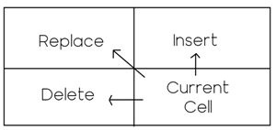
Backtracking
 |  | A | U | C | G | C | U
 | 0 | 1 | 2 | 3 | 4 | 5 | 6
U | 1 | 1 | 1 | 2 | 3 | 4 | 5
C | 2 | 2 | 2 | 1 | 2 | 3 | 4
G | 3 | 3 | 3 | 2 | 1 | 2 | 3
A | 4 | 3 | 4 | 3 | 2 | 2 | 3
A | 5 | 4 | 4 | 4 | 3 | 3 | 3
U | 6 | 5 | 4 | 5 | 4 | 4 | 3

Slide 13
Backtracking
 |  | A | U | C | G | C | U
 | 0 | 1 | 2 | 3 | 4 | 5 | 6
U | 1 | 1 | 1 | 2 | 3 | 4 | 5
C | 2 | 2 | 2 | 1 | 2 | 3 | 4
G | 3 | 3 | 3 | 2 | 1 | 2 | 3
A | 4 | 3 | 4 | 3 | 2 | 2 | 3
A | 5 | 4 | 4 | 4 | 3 | 3 | 3
U | 6 | 5 | 4 | 5 | 4 | 4 | 3

Slide 14
Backtracking
 |  | A | U | C | G | C | U
 | 0 | 1 | 2 | 3 | 4 | 5 | 6
U | 1 | 1 | 1 | 2 | 3 | 4 | 5
C | 2 | 2 | 2 | 1 | 2 | 3 | 4
G | 3 | 3 | 3 | 2 | 1 | 2 | 3
A | 4 | 3 | 4 | 3 | 2 | 2 | 3
A | 5 | 4 | 4 | 4 | 3 | 3 | 3
U | 6 | 5 | 4 | 5 | 4 | 4 | 3
Replace C to A

Slide 15
Backtracking
 |  | A | U | C | G | C | U
 | 0 | 1 | 2 | 3 | 4 | 5 | 6
U | 1 | 1 | 1 | 2 | 3 | 4 | 5
C | 2 | 2 | 2 | 1 | 2 | 3 | 4
G | 3 | 3 | 3 | 2 | 1 | 2 | 3
A | 4 | 3 | 4 | 3 | 2 | 2 | 3
A | 5 | 4 | 4 | 4 | 3 | 3 | 3
U | 6 | 5 | 4 | 5 | 4 | 4 | 3
Insert A between G and A

Slide 16
Backtracking
 |  | A | U | C | G | C | U
 | 0 | 1 | 2 | 3 | 4 | 5 | 6
U | 1 | 1 | 1 | 2 | 3 | 4 | 5
C | 2 | 2 | 2 | 1 | 2 | 3 | 4
G | 3 | 3 | 3 | 2 | 1 | 2 | 3
A | 4 | 3 | 4 | 3 | 2 | 2 | 3
A | 5 | 4 | 4 | 4 | 3 | 3 | 3
U | 6 | 5 | 4 | 5 | 4 | 4 | 3

Slide 17
Backtracking
 |  | A | U | C | G | C | U
 | 0 | 1 | 2 | 3 | 4 | 5 | 6
U | 1 | 1 | 1 | 2 | 3 | 4 | 5
C | 2 | 2 | 2 | 1 | 2 | 3 | 4
G | 3 | 3 | 3 | 2 | 1 | 2 | 3
A | 4 | 3 | 4 | 3 | 2 | 2 | 3
A | 5 | 4 | 4 | 4 | 3 | 3 | 3
U | 6 | 5 | 4 | 5 | 4 | 4 | 3

Slide 18
Backtracking
 |  | A | U | C | G | C | U
 | 0 | 1 | 2 | 3 | 4 | 5 | 6
U | 1 | 1 | 1 | 2 | 3 | 4 | 5
C | 2 | 2 | 2 | 1 | 2 | 3 | 4
G | 3 | 3 | 3 | 2 | 1 | 2 | 3
A | 4 | 3 | 4 | 3 | 2 | 2 | 3
A | 5 | 4 | 4 | 4 | 3 | 3 | 3
U | 6 | 5 | 4 | 5 | 4 | 4 | 3

Slide 19
Backtracking
 |  | A | U | C | G | C | U
 | 0 | 1 | 2 | 3 | 4 | 5 | 6
U | 1 | 1 | 1 | 2 | 3 | 4 | 5
C | 2 | 2 | 2 | 1 | 2 | 3 | 4
G | 3 | 3 | 3 | 2 | 1 | 2 | 3
A | 4 | 3 | 4 | 3 | 2 | 2 | 3
A | 5 | 4 | 4 | 4 | 3 | 3 | 3
U | 6 | 5 | 4 | 5 | 4 | 4 | 3
Delete A

Slide 20
Backtracking
 |  | A | U | C | G | C | U
 | 0 | 1 | 2 | 3 | 4 | 5 | 6
U | 1 | 1 | 1 | 2 | 3 | 4 | 5
C | 2 | 2 | 2 | 1 | 2 | 3 | 4
G | 3 | 3 | 3 | 2 | 1 | 2 | 3
A | 4 | 3 | 4 | 3 | 2 | 2 | 3
A | 5 | 4 | 4 | 4 | 3 | 3 | 3
U | 6 | 5 | 4 | 5 | 4 | 4 | 3
AUCG - CU
- UCGAAU
The distance is 3.

Slide 21
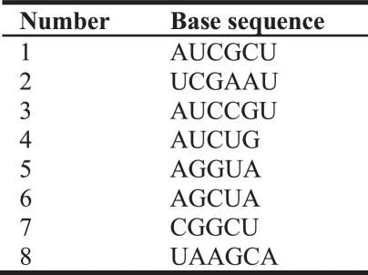



$${dist}_{edit}\left(i, j\right)$$
$$j$$
 | 1 | 2 | 3 | 4 | 5 | 6 | 7 | 8
1 | - | 3 | 2 | 3 | 4 | 3 | 3 | 4
2 | 3 | - | 4 | 5 | 4 | 5 | 3 | 4
3 | 2 | 4 | - | 2 | 4 | 4 | 4 | 5
4 | 3 | 5 | 2 | - | 3 | 2 | 4 | 5
5 | 4 | 4 | 4 | 3 | - | 1 | 3 | 3
6 | 3 | 2 | 4 | 2 | 1 | - | 3 | 3
7 | 3 | 3 | 4 | 4 | 3 | 3 | - | 4
8 | 4 | 4 | 5 | 5 | 3 | 3 | 4 | -
$$i$$

Slide 22
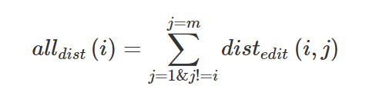
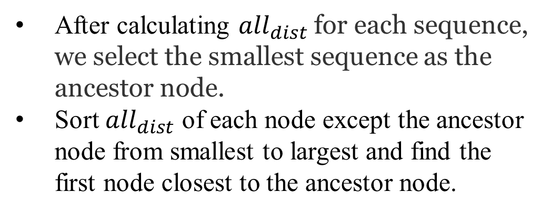
Genealogy Tree
After calculating ${all}_{dist}$for each sequence, we select the smallest sequence as the ancestor node.
Sort ${all}_{dist}$ of each node except the ancestor node from smallest to largest and find the first node closest to the ancestor node.

Slide 23








Genealogy Tree
${dist}_{edit}\left(1, 2\right)=3$
${dist}_{edit}\left(1, 6\right)=3$
AUCG - CU
- UCGAAU
AUCGCU -
A - - GCUA
${dist}_{edit}\left(1, 3\right)=2$
${dist}_{edit}\left(1, 7\right)=3$
AUCGCU
AUCCGU
AUCGCU
- CGGCU
${dist}_{edit}\left(1, 4\right)=3$
${dist}_{edit}\left(1, 8\right)=4$
AUCGCU
AUC - UG
AUCGCU
UAAGCA
$${all}_{dist}\left(1\right)=22$$
${dist}_{edit}\left(1, 5\right)=4$
AUCGCU
A - GGUA

Slide 24
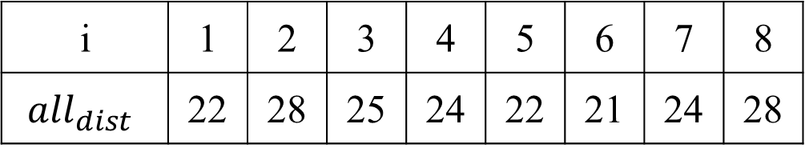

Genealogy Tree
i | 1 | 2 | 3 | 4 | 5 | 6 | 7 | 8
$${all}_{dist}$$ | 22 | 28 | 25 | 24 | 22 | 21 | 24 | 28
$${class}_{root}$$
6

Slide 25
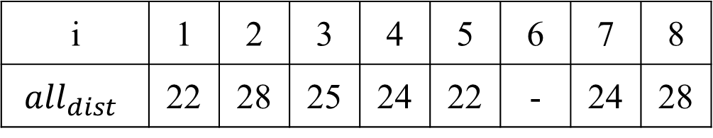

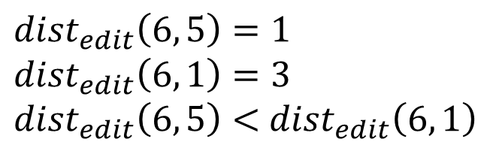
Genealogy Tree
i | 1 | 2 | 3 | 4 | 5 | 6 | 7 | 8
$${all}_{dist}$$ | 22 | 28 | 25 | 24 | 22 | - | 24 | 28
$${class}_{root}$$
6
5
$${dist}_{edit}\left(6, 5\right)=1$$
$${dist}_{edit}\left(6, 1\right)=3$$
${dist}_{edit}\left(6, 5\right)<$ ${dist}_{edit}\left(6, 1\right)$

Slide 26
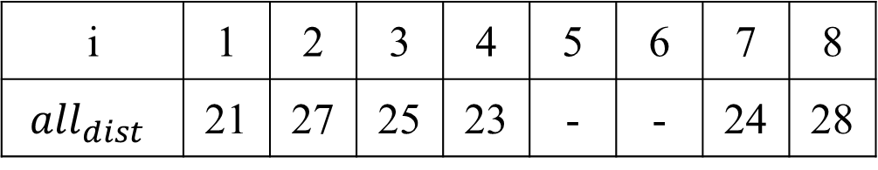
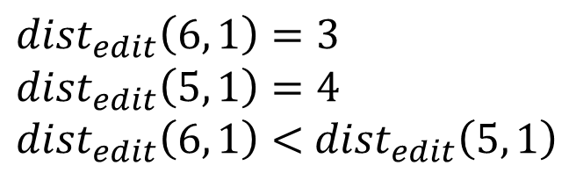
Genealogy Tree
i | 1 | 2 | 3 | 4 | 5 | 6 | 7 | 8
$${all}_{dist}$$ | 21 | 27 | 25 | 23 | - | - | 24 | 28
$${class}_{root}$$
6
5
1
$${dist}_{edit}\left(6, 1\right)=3$$
$${dist}_{edit}\left(5, 1\right)=4$$
${dist}_{edit}\left(6, 1\right)<$ ${dist}_{edit}\left(5, 1\right)$

Slide 27
Genealogy Tree
6
5
1
8
3
2
7
4

Slide 28
Time Complexity
The edit distance algorithm: O$\left(mn\right)$
Mapping Genealogical Trees: O$\left(n\log{n}\right)$

