Slide 1
Finding a maximum independent set in time O(2^{n/4})
J. M. Robson
January 2001
Presenter: Yu-Yen Chu
Date: Jan. 2, 2024

Slide 2
Abstract
We improve previous algorithms for finding the size of the largest independent set of a graph in three ways: firstly a more detailed analysis of the possible local structures around a vertex where the algorithm will branch recursively, much of the most detailed analysis being done by computer, secondly more use of auxiliary functions which consider independent sets subject to certain extra conditions and thirdly a better analysis of the improvements achieved by a dynamic programming variant. These improvements reduce the constant c in the O(2^{cn}) time bound to less than 0.25.

Slide 3
Problem Setup
Notations
N(v): the set of neighbors of vertex v.
[N](v): N(v) + v.
N²(v): N(N(v)) – [N](v).
[N]²(v): [N]([N](v)).
d(v): the degree of vertex v.
Functions
stab(G): returns the number of vertices of m.i.s. of G (run time is k2^{cn}, with |G| = n).
stab’(G, (S_{i}, n_{i})): returns the number of vertices of m.i.s. of G, where S_{i} is a subset of G and n_{i} is the minimum number of vertices of S_{i} that m.i.s. contains.
stab’’(G, x, y): returns the number of vertices of m.i.s. of G, where x and y are vertices of G and they are not connected by an edge.

Slide 4
Problem Setup
For a graph G=(V, E) with |V| = n(or |G| = n), the upper bound of the time complexity of finding a maximum independent set(m.i.s.) is O(2^{cn}) with c <= 1 (or O(a^{n}) with a <= 2).
With the induction of n, find k and c such that the time complexity of finding a m.i.s. is less than k2^{cn}, k = polynomial(n).
Recursive call
Assume A is a vertex of G and d(A)=2.
|m.i.s. of G| = max( stab(G-[N](A)), stab(G-A) ),
run time <= k2^{c(n-|[N](A)|)} + k2^{c(n-|A|)} = x * k2^{cn}
k2^{c(n-3)} + k2^{c(n-1)} = x * k2^{cn}
2^{-3c} + 2^{-c} = x
a⁻³ + a⁻¹ = x (x means the relationship between k2^{c(n-|[N](A)|)} + k2^{c(n-|A|)} and k2^{cn})

Slide 5
N(v): the set of neighbors of vertex v.
[N](v): N(v) + v.
N²(v): N(N(v)) – [N](v).
[N]²(v): [N]([N](v)).
stab(G): returns the number of vertices of m.i.s. of G.
stab’(G, (S_{i}, n_{i})): returns the number of vertices of m.i.s. of G, where S_{i} is a subset of G and n_{i} is the minimum number of vertices of S_{i} that m.i.s. contains.
B
A
C
Assume vertex has d(A) = 2, and its neighbors are B and C.
B and B’ are connected: stab(G – [N](A)), run time <= k2^{c(n-3)} = x * k2^{cn}, x = 2^{-3c} = a⁻³.
Otherwise: max( 1 + stab’(G – [N](A), ([N]²(A) – [N](A), 2)), 2 + stab(G – [N]²(A)) )
Let y = | [N]²(A) – [N](A) |.
y <= 1: stab’() doesn’t need to calculate, and the run time of stab(G – [N]²(A)) <= k2^{c(n-3)}, x = a⁻³.
y = 2: stab’() can be replaced by 2 + stab(G – [N]³(A)).
If | [N]³(A) – [N]²(A) | = 1, x = a⁻⁶. Otherwise, x = a⁻⁷ + a⁻⁵.
Therefore, x = max(a⁻⁶, a⁻⁷ + a⁻⁵) = a⁻⁷ + a⁻⁵.
y = 3: x = a3 * a⁻³ + a⁻⁶. (a3 is the value of the situation that there are 3 vertices with some constraints.)
y = 4: x = a4 * a⁻³ + a⁻⁷.
y = 5: x = a5 * a⁻³ + a⁻⁸.
y = 6: x = a⁻³ + a⁻⁹.
y > 6: x = a⁻³ + a⁻¹⁰.
Therefore, x = max(a⁻³, a⁻⁷ + a⁻⁵, a3 * a⁻³ + a⁻⁶, a4 * a⁻³ + a⁻⁷, a5 * a⁻³ + a⁻⁸, a⁻³ + a⁻⁹, a⁻³ + a⁻¹⁰) = a⁻³ + a⁻⁹.
a = 1.202431 (or c = 0.265955) is found for the algorithm.

Slide 6
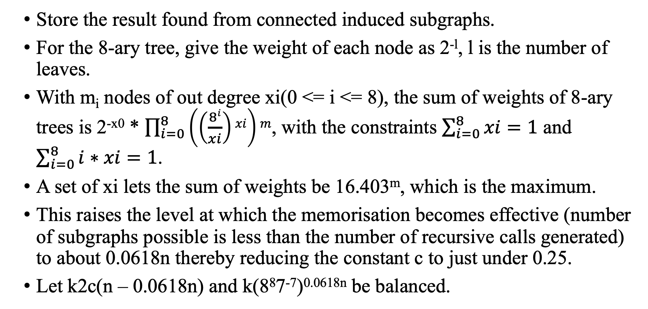
Memorization
Store the result found from connected induced subgraphs.
For the 8-ary tree, give the weight of each node as 2^{-l}, l is the number of leaves.
With m_{i} nodes of out degree xi(0 <= i <= 8), the sum of weights of 8-ary trees is 2^{-x0} * $\prod_{i=0}^{8}{\left(\left(\frac{8i}{xi}\right)xi\right)m}$, with the constraints $\sum_{i=0}^{8}{xi}=1$ and $\sum_{i=0}^{8}{i∗xi}=1$.
A set of xi lets the sum of weights be 16.403^{m}, which is the maximum.
This raises the level at which the memorisation becomes effective (number of subgraphs possible is less than the number of recursive calls generated) to about 0.0618n thereby reducing the constant c to just under 0.25.
Let k2c(n – 0.0618n) and k(8⁸7⁻⁷)^{0.0618n} be balanced.

