Slide 1
Algorithms for Maximum independent Sets
ROBSON, John Michael. Algorithms for maximum independent sets. Journal of Algorithms, 1986, 7.3: 425-440.
Presenter : Jing-Xiang.Yang
Date : Jan. 2, 2024

Slide 2
ABSTRACT
An algorithm is presented which finds (the size of) a maximum independent set of an n vertex graph in time O(2^{0.276n}) lmproving on a previous bound of O(2^{n/3}). The improvement comes principally from three sources: first, a modified recursive algorithm based on a more detailed study of the possible subgraphs around a chosen vertex; second, an improvement, not in the algorithm but in the time bound proved, by an argument about connected regular graphs; third, a time-space trade-off which can speed up recursive algorithms from a fairly wide class.

Slide 3
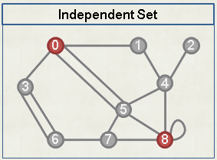
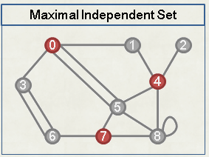
Independent Set
Independent Set
(A subset of vertices in whch no two vertices are adjacent).

Slide 4
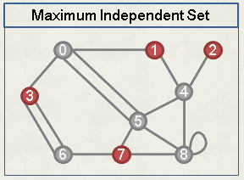
Maximum Independent Set

Slide 5
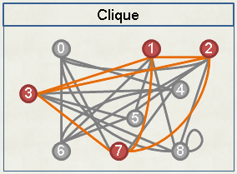
Independent Set & Clique

Slide 6
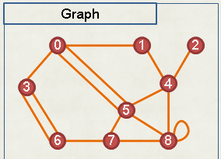
Notation
d(v) : degree of v in G
N(v) : the set of neighbours of v in G
N²(v) : the set of neighbours in G of vertices in N(v) excluding v
N(v) : v + N(v)

Slide 7
Basic Recursive Structure

Slide 8

Containing B

Slide 9

Not Containing B

Slide 10
Auxiliary Function ms²

Slide 11
Auxiliary Function ms²
ms²(G,S) : maximum size of an independent set of G containing at least two elements of S
If d(A) is small, then ms²(G - A, N(A)) may be much faster to compute than ms(G - A).

Slide 12


Slide 13
Overall Approach
Pick 2 Adjacent vertices A, B -> d(A) is small, d(B) is larger
If d(A) is small enough
otherwise

Slide 14
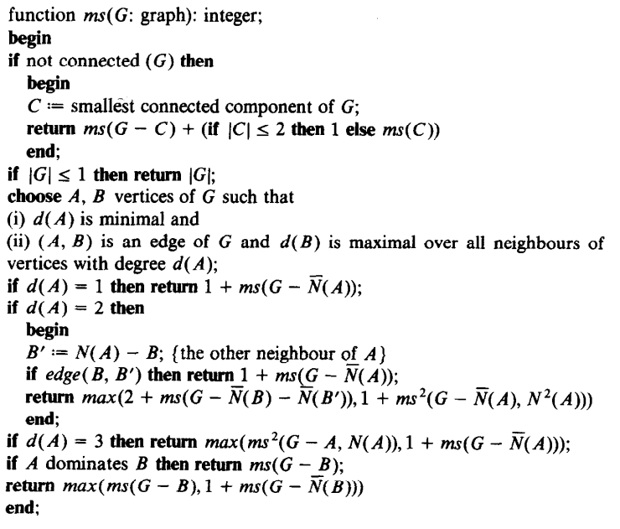

Slide 15
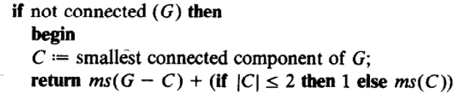

Slide 16
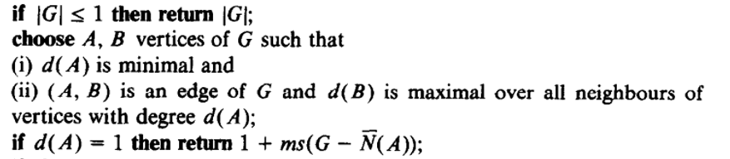
B
A

Slide 17
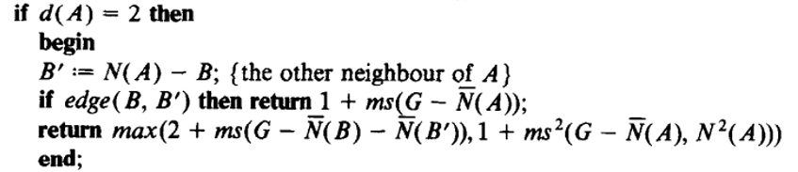
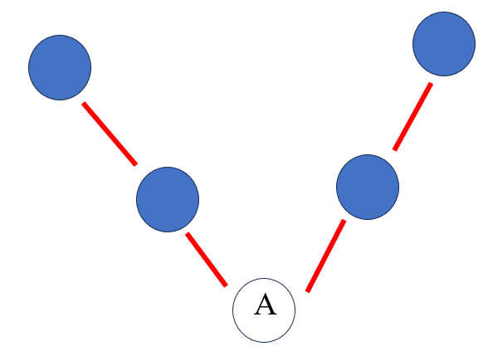
A

Slide 18
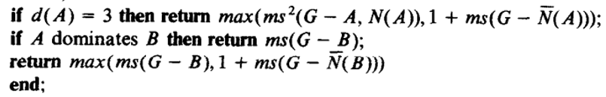
A

Slide 19
Time Complexity Improvement
O(2^{cn}) for c < 1/3
O(2^{cn}) for c < 0.296 (Polynomial space )
O(2^{cn}) for c < 0.276 (Exponential space )
Notes:
一個圖有n個點，則會有2^n個子圖，因此要記憶的話，空間會是指數成長

Slide 20
Time Complexity Improvement
O(2^{cn}) for c < 1/3
O(2^{cn}) for c < 0.296 (Polynomial space )
O(2^{cn}) for c < 0.276 (Exponential space )
Notes:
一個圖有n個點，則會有2^n個子圖，因此要記憶的話，空間會是指數成長

Slide 21
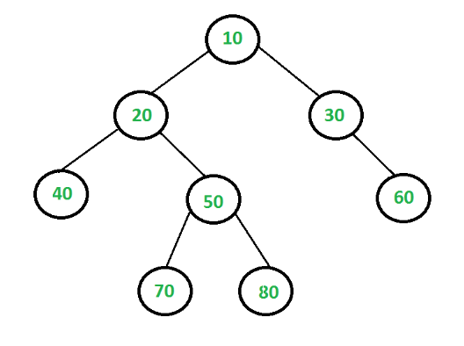
Time Complexity Improvement
Memorization
O(2^{cn}) for c < 0.276 (Exponential space )
Notes:
一個圖有n個點，則會有2^n個子圖，因此要記憶的話，空間會是指數成長

Slide 22
Thanks

