Slide 1
String pattern searching algorithm based on characters indices
Ivan Markić, Maja Stula and Marija Zorić
2019 4th International Conference on Smart and Sustainable Technologies (SpliTech), Bol/Split, Croatia, June 18-21, 2019
Presenter: Wen-Yu Chang
Date: Jan. 30, 2024
Notes:
克羅埃西亞,波爾,斯普利特

Slide 2
Abstract
In this article we shortly present new string pattern matching algorithm. The algorithm uses novel technique for skipping unnecessary comparisons in pattern searching phase. The pattern searching is applied in almost all branches of science such as bioinformatics, information security, text mining, etc. In the context of continuous increase of data, efficient algorithms are necessary to ensure that one can find a pattern in a sequence in a fast and accurate manner. Pattern searching solves the problem of finding a pattern exhibiting certain properties within a given sequence of symbols. Concept of the new algorithm presented in this article is based on a character index in a pattern, aiming at, but not limited to patterns in DNA sequences.

Slide 3
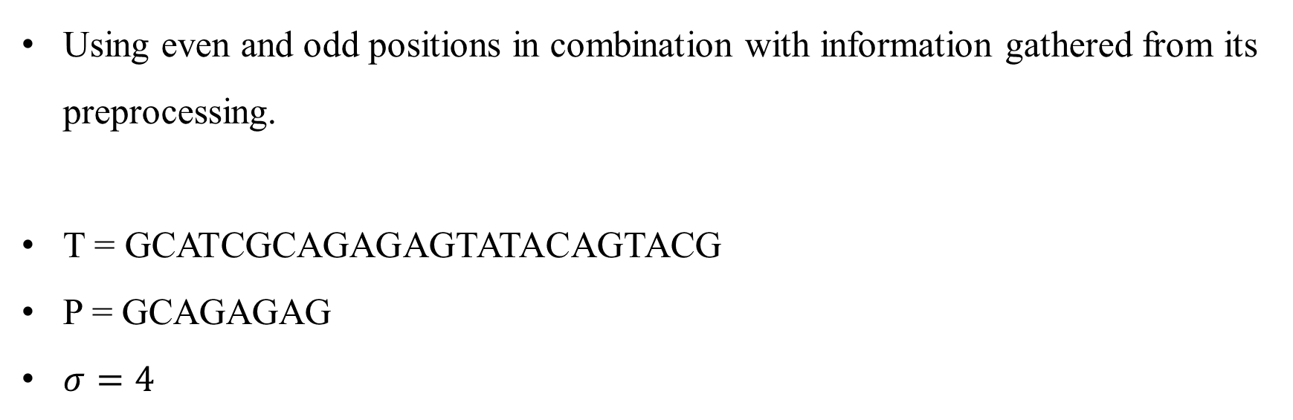
Algorithm Based on Characters Indices
Using even and odd positions in combination with information gathered from its preprocessing.
T = GCATCGCAGAGAGTATACAGTACG
P = GCAGAGAG
$σ=4$

Slide 4
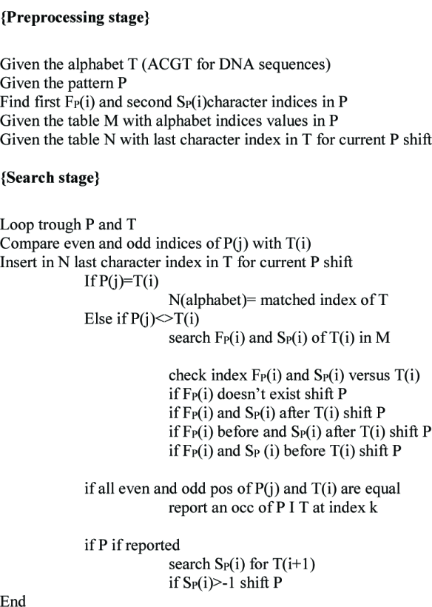
The Pseudocode

Slide 5
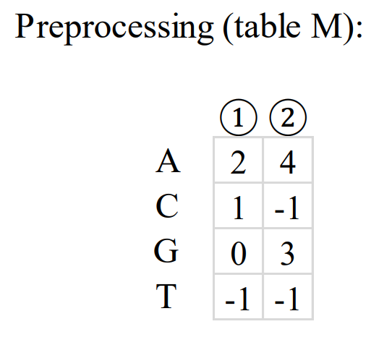


Last current index:
A
-1
-1
-1
-1
C
G
T
0 | 1 | 2 | 3 | 4 | 5 | 6 | 7 | 8 | 9 | 10 | 11 | 12 | 13 | 14 | 15 | 16 | 17 | 18 | 19 | 20 | 21 | 22 | 23
$$T$$
G | C | A | T | C | G | C | A | G | A | G | A | G | T | A | T | A | C | A | G | T | A | C | G
$$P$$
G | C | A | G | A | G | A | G
0 | 1 | 2 | 3 | 4 | 5 | 6 | 7

Slide 6
Last current index:
A
-1
1
-1
3
C
G
T
0 | 1 | 2 | 3 | 4 | 5 | 6 | 7 | 8 | 9 | 10 | 11 | 12 | 13 | 14 | 15 | 16 | 17 | 18 | 19 | 20 | 21 | 22 | 23
$$T$$
G | C | A | T | C | G | C | A | G | A | G | A | G | T | A | T | A | C | A | G | T | A | C | G
$$P$$
G | C | A | G | A | G | A | G
0 | 1 | 2 | 3 | 4 | 5 | 6 | 7

Slide 7
Last current index:
A
-1
-1
1
-1
C
G
T
0 | 1 | 2 | 3 | 4 | 5 | 6 | 7 | 8 | 9 | 10 | 11 | 12 | 13 | 14 | 15 | 16 | 17 | 18 | 19 | 20 | 21 | 22 | 23
$$T$$
G | C | A | T | C | G | C | A | G | A | G | A | G | T | A | T | A | C | A | G | T | A | C | G
$$P$$
G | C | A | G | A | G | A | G
0 | 1 | 2 | 3 | 4 | 5 | 6 | 7

Slide 8
Last current index:
A
6, 4, 2
1
3, 5, 7
-1
C
G
T
0 | 1 | 2 | 3 | 4 | 5 | 6 | 7 | 8 | 9 | 10 | 11 | 12 | 13 | 14 | 15 | 16 | 17 | 18 | 19 | 20 | 21 | 22 | 23
$$T$$
G | C | A | T | C | G | C | A | G | A | G | A | G | T | A | T | A | C | A | G | T | A | C | G
$$P$$
G | C | A | G | A | G | A | G
0 | 1 | 2 | 3 | 4 | 5 | 6 | 7

Slide 9
Last current index:
A
-1
-1
-1
1
C
G
T
0 | 1 | 2 | 3 | 4 | 5 | 6 | 7 | 8 | 9 | 10 | 11 | 12 | 13 | 14 | 15 | 16 | 17 | 18 | 19 | 20 | 21 | 22 | 23
$$T$$
G | C | A | T | C | G | C | A | G | A | G | A | G | T | A | T | A | C | A | G | T | A | C | G
$$P$$
G | C | A | G | A | G | A | G
0 | 1 | 2 | 3 | 4 | 5 | 6 | 7

Slide 10
Last current index:
A
5
1
3
-1
C
G
T
0 | 1 | 2 | 3 | 4 | 5 | 6 | 7 | 8 | 9 | 10 | 11 | 12 | 13 | 14 | 15 | 16 | 17 | 18 | 19 | 20 | 21 | 22 | 23
$$T$$
G | C | A | T | C | G | C | A | G | A | G | A | G | T | A | T | A | C | A | G | T | A | C | G
$$P$$
G | C | A | G | A | G | A | G
0 | 1 | 2 | 3 | 4 | 5 | 6 | 7

Slide 11
Last current index:
A
6, 4, 2
1
3, 5, 7
-1
C
G
T
0 | 1 | 2 | 3 | 4 | 5 | 6 | 7 | 8 | 9 | 10 | 11 | 12 | 13 | 14 | 15 | 16 | 17 | 18 | 19 | 20 | 21 | 22 | 23
$$T$$
G | C | A | T | C | G | C | A | G | A | G | A | G | A | G | C | A | G | A | G | A | G | C | G
$$P$$
G | C | A | G | A | G | A | G
0 | 1 | 2 | 3 | 4 | 5 | 6 | 7

Slide 12
Last current index:
A
-1
-1
1
-1
C
G
T
0 | 1 | 2 | 3 | 4 | 5 | 6 | 7 | 8 | 9 | 10 | 11 | 12 | 13 | 14 | 15 | 16 | 17 | 18 | 19 | 20 | 21 | 22 | 23
$$T$$
G | C | A | T | C | G | C | A | G | A | G | A | G | A | G | C | A | G | A | G | A | G | C | G
$$P$$
G | C | A | G | A | G | A | G
0 | 1 | 2 | 3 | 4 | 5 | 6 | 7

Slide 13
Last current index:
A
1
-1
-1
-1
C
G
T
0 | 1 | 2 | 3 | 4 | 5 | 6 | 7 | 8 | 9 | 10 | 11 | 12 | 13 | 14 | 15 | 16 | 17 | 18 | 19 | 20 | 21 | 22 | 23
$$T$$
G | C | A | T | C | G | C | A | G | A | G | A | G | A | G | C | A | G | A | G | A | G | C | G
$$P$$
G | C | A | G | A | G | A | G
0 | 1 | 2 | 3 | 4 | 5 | 6 | 7

Slide 14
Last current index:
A
1
-1
-1
-1
C
G
T
0 | 1 | 2 | 3 | 4 | 5 | 6 | 7 | 8 | 9 | 10 | 11 | 12 | 13 | 14 | 15 | 16 | 17 | 18 | 19 | 20 | 21 | 22 | 23
$$T$$
G | C | A | T | C | G | C | A | G | A | G | A | G | A | G | C | A | G | A | G | A | G | C | G
$$P$$
G | C | A | G | A | G | A | G
0 | 1 | 2 | 3 | 4 | 5 | 6 | 7

Slide 15
Last current index:
A
6, 4, 2
1
3, 5, 7, 0
-1
C
G
T
0 | 1 | 2 | 3 | 4 | 5 | 6 | 7 | 8 | 9 | 10 | 11 | 12 | 13 | 14 | 15 | 16 | 17 | 18 | 19 | 20 | 21 | 22 | 23
$$T$$
G | C | A | T | C | G | C | A | G | A | G | A | G | A | G | C | A | G | A | G | A | G | C | G
$$P$$
G | C | A | G | A | G | A | G
0 | 1 | 2 | 3 | 4 | 5 | 6 | 7

Slide 16
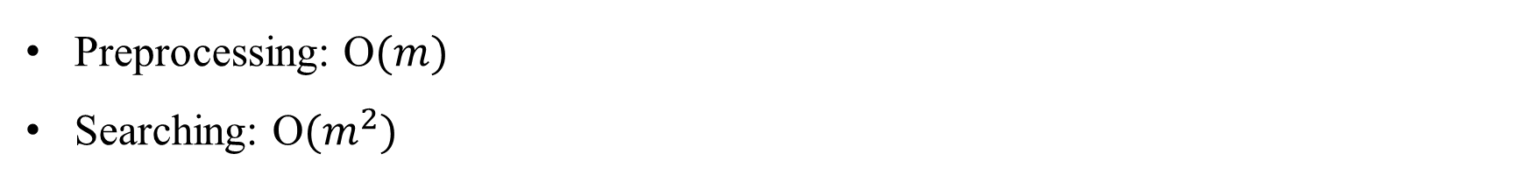
Time Complexity
Preprocessing: O$(m)$
Searching: O$(m^{2})$

