Slide 1
Fusion of weighted Voronoi diagram and A* algorithm for mobile robot path planning
Zhihai Liu, Long Gao, Feiyi Liu, Dongyang Liu, Wenyu Han
2022 2nd International Conference on Electrical Engineering and Mechatronics Technology (ICEEMT), Hangzhou, China, 01-03 July 2022
Presenter: Hsin-Chang Yu
Date: Jan. 30, 2024

Slide 2
Abstract
A* algorithm is one of the most common algorithms in path planning for mobile robots, which can complete global search and seek the lowest cost path. A* algorithm has more search ability compared with other algorithms, but its algorithm has long computation time, more search nodes and other drawbacks have always existed.

Slide 3
Abstract
To address these problems, this paper proposes a way to plan paths by fusing weighted Voronoi map and improved A* algorithm, which will adopt the concept of A* algorithm and combine with the idea of map construction, taking the lead to take the weighted Voronoi point as the priority expansion node, and if there is no directly searchable generation value minimum weighted Voronoi node, the weighted Voronoi edge will be the priority path, and so on.

Slide 4
Abstract
Simulation experimental results show that the algorithm can search for shorter paths in complex environments with relatively faster speed, which not only improves the search efficiency, but also improves the safety and accuracy of the paths.

Slide 5

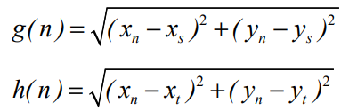
A* Algorithm

Slide 6
A* Algorithm

Slide 7

Voronoi Diagram

Slide 8
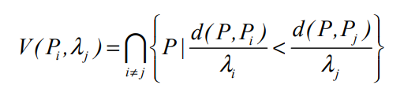
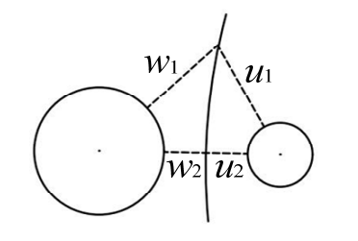
Weighted Voronoi Diagram

Slide 9
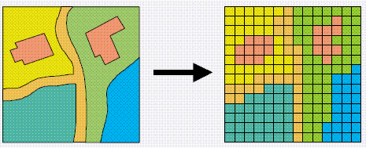
Raster Map

Slide 10
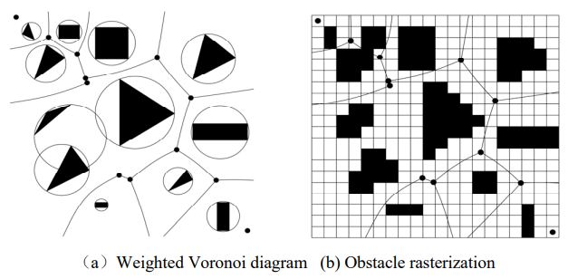

Step 1

Slide 11
Step 2
If node can be reached → Step3
If not → traditional A* algorithm

Slide 12
Step 3
Obstacle boundary set
CloseList

Slide 13
Step 4
Intersect → Step two
Not Intersect → update the CloseList, delete redundant nodes, repeat the operation.

Slide 14
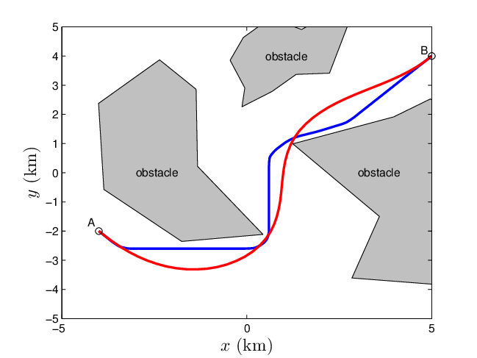
Step 5
Path Smoothing
Bézier curve

Slide 15
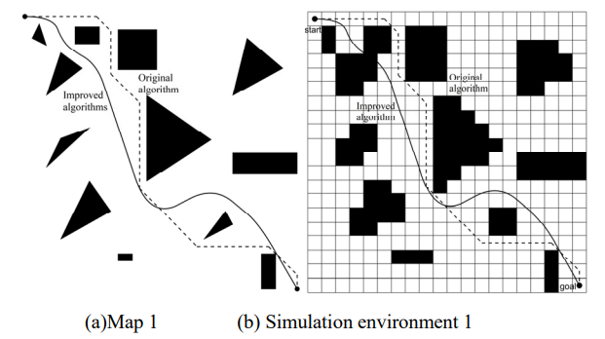
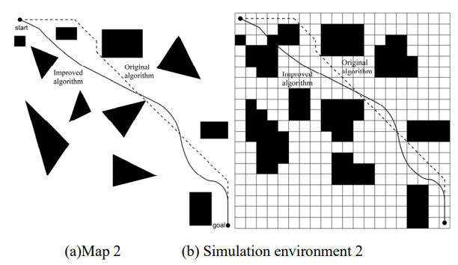
Result

Slide 16
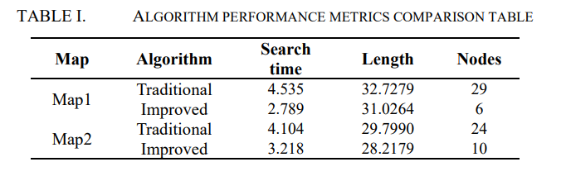
Result

Slide 17
Thanks
Notes:
Given a string S of length n, an integer p ∈ [1..n] is a period of S if S[i] = S[i + p] for all i ∈ [1..n − p].
S[|S| − p + 1] = c

