Slide 1
Longest increasing subsequences in sliding windows
Michael H. Albert, Alexander Golynski, Angele M. Hamel,
Alejandro Lopez-Ortiz, S. Srinivasa Rao, Mohammad Ali Safari
Theoretical Computer Science 321 (2004) 405–414
Presenter: Wen-Yu Chang
Date: Nov. 12, 2024

Slide 2
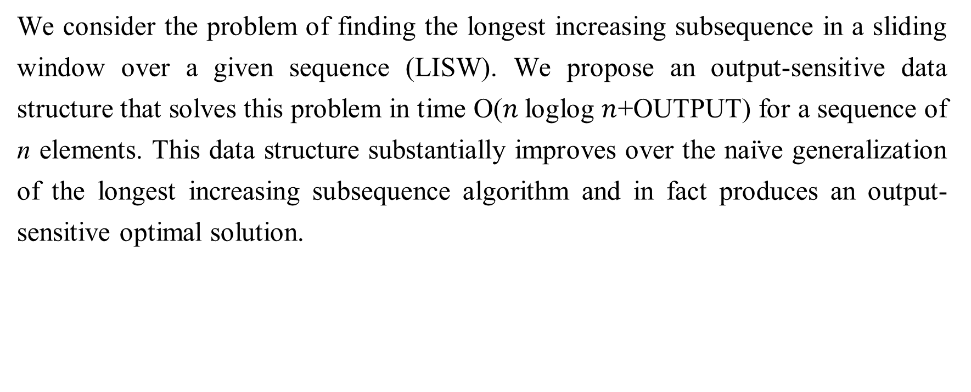
Abstract
We consider the problem of finding the longest increasing subsequence in a sliding window over a given sequence (LISW). We propose an output-sensitive data structure that solves this problem in time O($n$loglog $n$+OUTPUT) for a sequence of n elements. This data structure substantially improves over the naı̈ve generalization of the longest increasing subsequence algorithm and in fact produces an output-sensitive optimal solution.

Slide 3
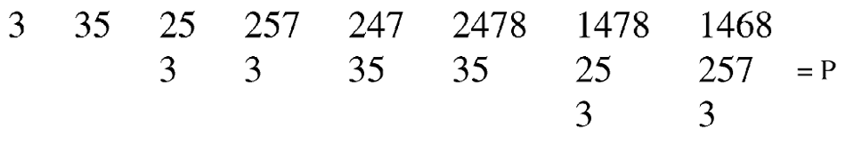
Robinson–Schensted–Knuth Algorithm
$α=3, 5, 2, 7, 4, 8, 1, 6$

Slide 4
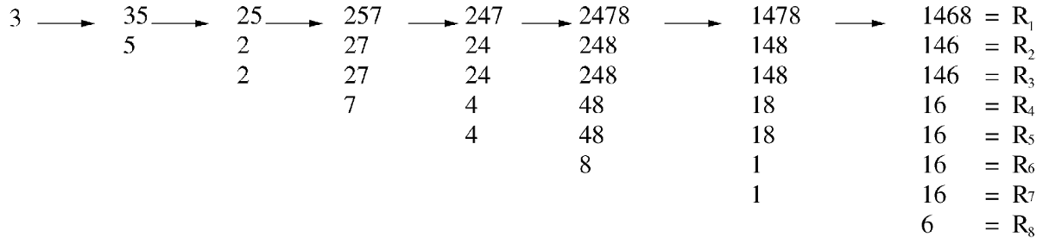
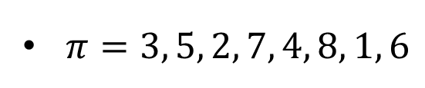
Row towers
$π=3, 5, 2, 7, 4, 8, 1, 6$

Slide 5
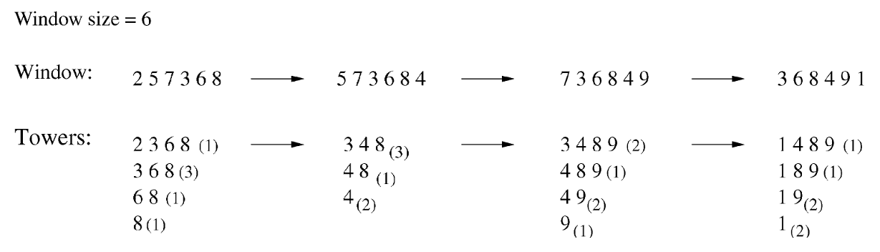
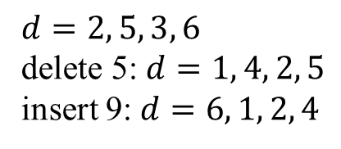
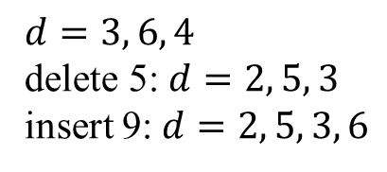
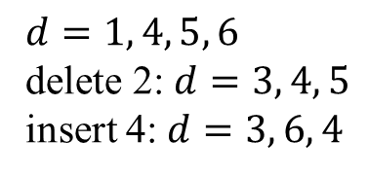
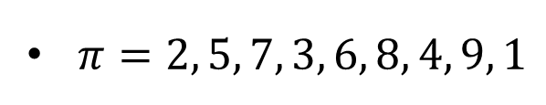
Algorithm
$π=2, 5, 7, 3, 6, 8, 4, 9, 1$
$$d=1, 4, 5, 6$$
delete 2: $d=3, 4, 5$
insert 4: $d=3, 6, 4$
$$d=3, 6, 4$$
delete 5: $d=2, 5, 3$
insert 9: $d=2, 5, 3, 6$
$$d=2, 5, 3, 6$$
delete 5: $d=1, 4, 2, 5$
insert 9: $d=6, 1, 2, 4$

Slide 6
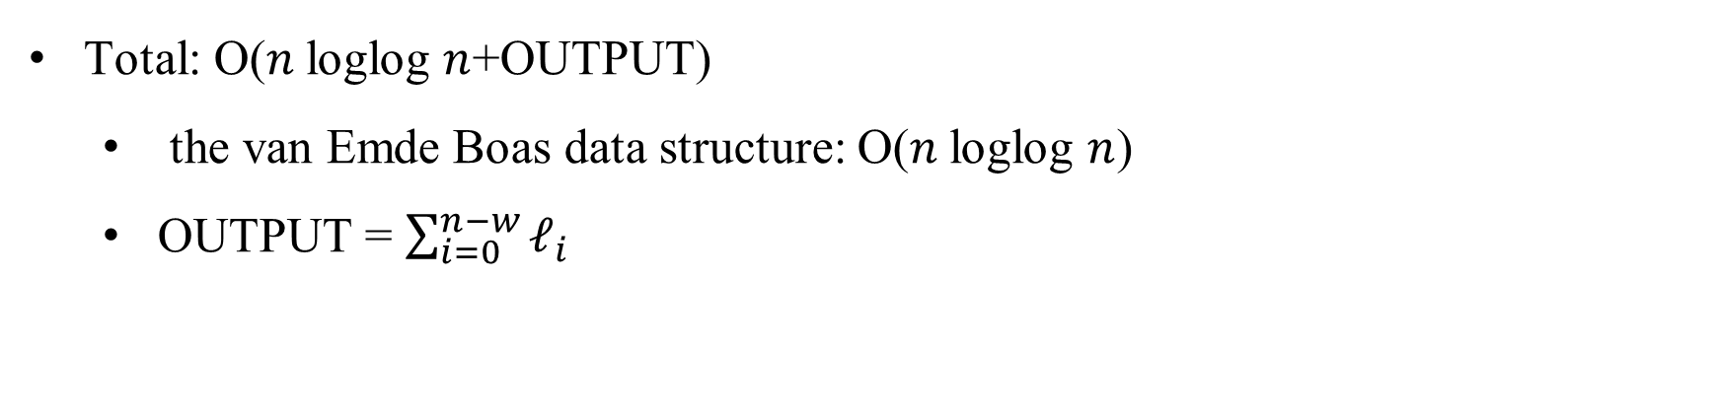
Time Complexity
Total: O($n$loglog $n$+OUTPUT)
the van Emde Boas data structure: O($n$loglog $n$)
OUTPUT = $\sum_{i=0}^{n−w}{ℓ_{i}}$
Notes:
li is the length of the longest increasing sequence in window i

