Slide 1
Improvised divide and conquer approach for the LIS problem
Seema Rani, Dharmveer Singh Rajpoot
Journal of Discrete Algorithms, Volume 48, January 2018, 17-26
Presenter: I-Sheng Chen
Date: Nov. 12, 2024

Slide 2
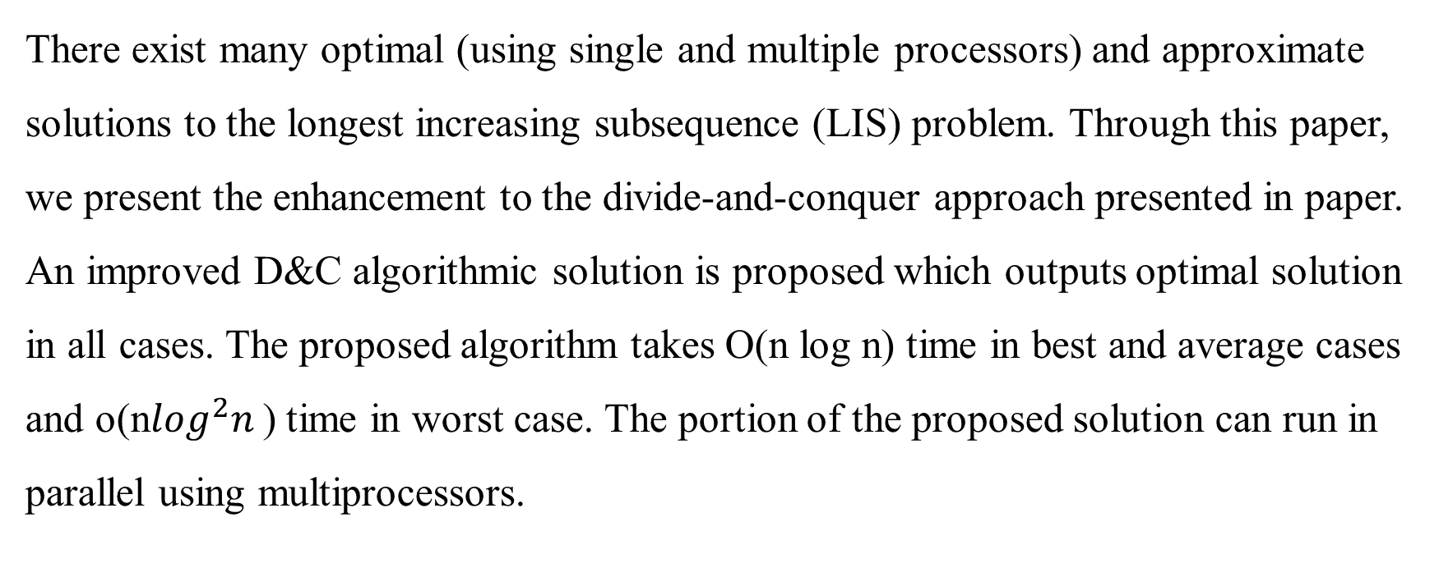
Abstract
There exist many optimal (using single and multiple processors) and approximate solutions to the longest increasing subsequence (LIS) problem. Through this paper, we present the enhancement to the divide-and-conquer approach presented in paper. An improved D&C algorithmic solution is proposed which outputs optimal solution in all cases. The proposed algorithm takes O(n log n) time in best and average cases and o(n$\log^{2}n$) time in worst case. The portion of the proposed solution can run in parallel using multiprocessors.

Slide 3
Principal Row of Young Tableau（PRYT）
X = <2, 9, 6, 8, 3, 4, 7, 10>
Y = <2, 3, 4, 7, 10>
initial: Y = <2>
插入9 : Y = <2 , 9>
插入6 : Y = <2 , 6>
插入8 : Y = <2 , 6 , 8>
插入3 : Y = <2 , 3 , 8>
插入4 : Y = <2 , 3 , 4 >
插入7 : Y = <2 , 3 , 4 , 7>
插入10 : Y = <2 , 3 , 4 , 7 , 10>
以 4 結尾的 LIS 是 ⟨2,3,4⟩，長度為 3。
以 7 結尾的 LIS 是 ⟨2,3,4,7⟩，長度為 4。

Slide 4
Divide
X =< 8, 9, 5, 2, 3, 7, 10, 4, 1, 6 >
X1 = <(5, 3), (2, 4), (3, 5), (4, 8), (1, 9)>、X2 = <(8, 1), (9, 2), (7, 6), (10, 7), (6, 10)>
X11 = < (2, 4), (1, 9) >、X12 = < (5, 3), (3, 5), (4, 8) >
X111 = < (1, 9) >、X112 = < (2, 4) >、 X121 = < (3, 5) >、
X1221 = < (4, 8) >、X1222 = < (5, 3) >、 X211 = < (6, 10) >、
X212 = < (7, 6) >、 X221 = < (8, 1) >、X2221 = < (9, 2) >、 X2222 = < (10, 7) >
Pred[1, 2 ... , index] = Pred[1, 2 ... , 10] = [0,..., 0]

Slide 5
Combine(X11&X122)
X11 = < (2, 4), (1, 9) >
X111 = < (1, 9) >、X112 = < (2, 4) >
2 ∈ X112， Pred[4] = 0 且 longest_LIS_len = 0 => PRYT = < (2, 4) >
1 ∈ X111 , Pred[9] = 0 且 longest_LIS_len = 0 => PRYT = < (1, 9) >
=> PRYT = < (1, 9) >、Pred[1 ... 10] = [0,..., 0]
X122 = < (5, 3), (4, 8) >
=> PRYT = < (4, 8) >、Pred[1 ... 10] = [0,..., 0]

Slide 6
Combine(X12)
X12 = < (5, 3), (3, 5), (4, 8) > =>
step 1: 5 ∈ X122，Pred[3]=0，longest_LIS_len = 0
=> PRYT=<(5,3)>
step 2: 3 ∈ X121，Pred[5]=0
=> PRYT=<(3,5)> 、longest_LIS_len=1
step 3: 4 ∈ X122，Pred[8]=0，longest_LIS_len = 1
=> PRYT=<(3,5),(4,8)> 、Pred[8] = 5
Pred[1 ... 10] = [0, 0, 0, 0, 0, 0, 0, 5, 0, 0]

Slide 7
Combine(X1)
X1 = <(5, 3), (2, 4), (3, 5), (4, 8), (1, 9)>、Pred[1 ... 10] = [0, 0, 0, 0, 0, 0, 0, 5, 0, 0]
X11 = < (2, 4), (1, 9) >、X12 = < (5, 3), (3, 5), (4, 8) >
Step 1 :PRYT =< (5, 3) >
Step 2: PRYT =< (2, 4) >, longest_LIS_len = 1
Step 3: PRYT =< (2, 4),(3, 5) >, Pred[5] = 4
Step 4: PRYT =< (2, 4),(3, 5),(4, 8) >
Step 5: PRYT =< (1, 9),(3, 5),(4, 8) >
Pred[1 ... 10] = [0, 0, 0, 0, 4, 0, 0, 5, 0, 0]

Slide 8
Combine(X222&X22)
X222 = < (9, 2), (10, 7) >
X2221 = < (9, 2) >、 X2222 = < (10, 7) >
=> PRYT = < (9, 2), (10, 7) >、Pred[1 ... 10] = [0, 0, 0, 0, 4, 0, 2, 5, 0, 0]
X22 = < (8, 1), (9, 2), (10, 7) >
=> PRYT = < (8, 1), (9, 2), (10, 7) >、 Pred[1 ... 10] = [0, 1, 0, 0, 4, 0, 2, 5, 0, 0]

Slide 9
Combine(X2)
X2 = < (8, 1), (9, 2), (7, 6), (10, 7), (6, 10) >
Pred[1 ... 10] = [0, 1, 0, 0, 4, 0, 2, 5, 0, 0]
Step 1: PRYT =< (8, 1) >
Step 2: PRYT =< (8, 1),(9, 2) >
Step 3: PRYT =< (7, 6),(9, 2) >, longest_LIS_len = 1
Step 4: PRYT =< (7, 6),(9, 2),(10, 7) >
Step 5: PRYT =< (6, 10),(9, 2),(10, 7) >
Pred[1 ... 10] = [0, 1, 0, 0, 4, 0, 2, 5, 0, 0]

Slide 10
Combine(X)(1/2)
X =< 8, 9, 5, 2, 3, 7, 10, 4, 1, 6 > Pred[1 ... 10] = [0, 1, 0, 0, 4, 0, 2, 5, 0, 0]
X1 = <(5, 3), (2, 4), (3, 5), (4, 8), (1, 9)>、X2 = <(8, 1), (9, 2), (7, 6), (10, 7), (6, 10)>
Step 1: PRYT =< (8, 1) >
Step 2: PRYT =< (8, 1),(9, 2) >
Step 3: PRYT =< (5, 3),(9, 2) >, longest_LIS_len = 1
Step 4: PRYT =< (2, 4),(9, 2) >
Step 5: PRYT =< (2, 4),(3, 5) >, longest_LIS_len = 2
Step 6: PRYT = < (2, 4), (3, 5), (7, 6) >，且 Pred[6] = 5

Slide 11
Combine(X)(2/2)
Step 7: (10, 7) ∈ X2, Pred[7] = 2
PRYT = < (2, 4), (3, 5), (7, 6) >
PRYT =< (2, 4),(3, 5),(7, 6),(10, 7) >, Pred[7] = 6
Step 8: PRYT =< (2, 4),(3, 5),(4, 8),(10, 7) >, longest_LIS_len = 3
Step 9: PRYT =< (1, 9),(3, 5),(4, 8),(10, 7) >
Step 10 : PRYT = < (1, 9), (3, 5), (4, 8), (6, 10) >,且 Pred[10] = 8
PRYT = < (1, 9), (3, 5), (4, 8), (6, 10) >，且 Pred[1 ... 10] = [0, 1, 0, 0, 4, 5, 6, 5, 0, 8]。
LIS: 10→8→5→4 => 4→5→8→10 =(2, 3, 4, 6)

Slide 12
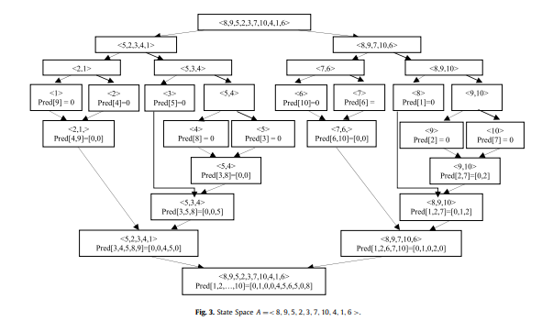

Slide 13
Example
X=<10,12,1,2,3,8,14> , Pred[1,2,...,7]=[0,1,0,3,4,0,2]
X1=<(1,3),(2,4),(3,5)>, X2=<(10,1),(12,2),(8,6),(14,7)>
Step 1: PRYT = <(10, 1) >, Pred[1] = 0
Step 2: PRYT = <(10, 1), (12, 2) >, Pred[2] = 1
Step 3: PRYT = <(1, 3), (12, 2) >, Pred[3] = 0
Step 4: PRYT = <(1, 3), (2, 4) >, Pred[4] = 3
Step 5: PRYT = <(1, 3), (2, 4), (3, 5) >, Pred[5] = 4
Step 6: PRYT = < (1, 3), (2, 4), (3, 5), (8, 6) >, Pred[6] = 5
✔Step 7:
14∈X2 且 Pred[7] = 2 不在 PRYT 中
PRYT = <(1, 3), (2, 4), (3, 5), (8, 6), (14, 7)>, Pred[7] = 6
Pred[1,2,...,7]=[0,1,0,3,4,5,6]
LIS: 7→6→5→4 → 3=> 3→4→5→6 →7 =(1, 2, 3, 8, 14)
❌Step 7:
14∈X2 且 Pred[7] = 2 不在 PRYT 中
PRYT = <(1, 3), (2, 4), (3, 5), (14, 7)>, Pred[7] = 5
Pred[1,2,...,7]=[0,1,0,3,4,5,5]
LIS: 7→5→4→3 => 3→4→5→7 =(1, 2, 3, 14)

Slide 14
Conclusion
Averge case(不需要使用binary search時)
Time Complexity: O(n logn)
Worst case(需要使用binary search時)
Time Complexity: o(n log² n)

Slide 15
Thanks

