Slide 1
Domino Antimagic Squares and Rectangles
Alison M. Marr, Christina Napier, Lauren M. Nelsen, Luke L. Nelsen and Violeta Vasilevska
Recreational Mathematics Magazine(2024), 11(19), 27-40.
Presenter: Hsin-Chang Yu
Date: Nov. 12, 2024

Slide 2
Abstract
A domino antimagic square of order n is an n×n array formed from a subset of the standard set of 28 dominoes such that the sums of the rows, columns, and two main diagonals form a set of 2n + 2 distinct, consecutive integers while an m × n domino antimagic rectangle is an m × n rectangular array formed from a subset of the standard set of 28 dominoes such that the sums of the rows and columns form a set of m + n distinct, consecutive integers.

Slide 3
Abstract
This paper outlines what the possible dimensions are for m×n domino antimagic rectangles and provides many examples of both domino antimagic rectangles and squares. Many open questions are given at the end of the paper for future exploration.

Slide 4
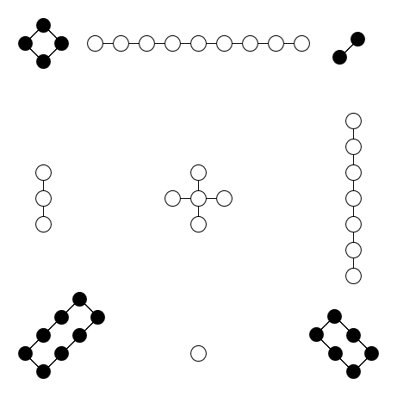
Magic Square
4 | 9 | 2
3 | 5 | 7
8 | 1 | 6

Slide 5
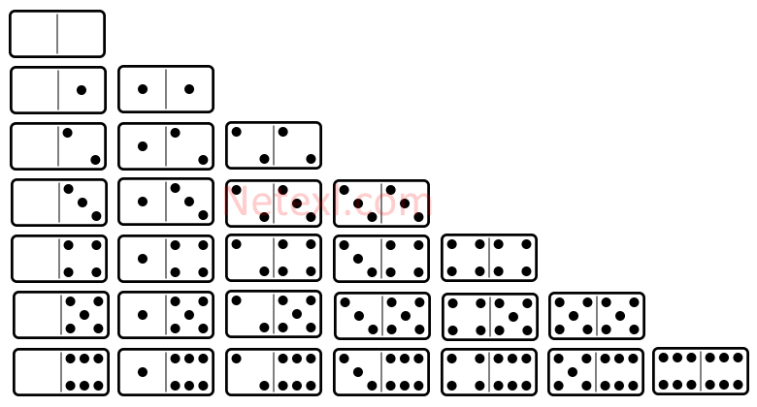
Domino

Slide 6
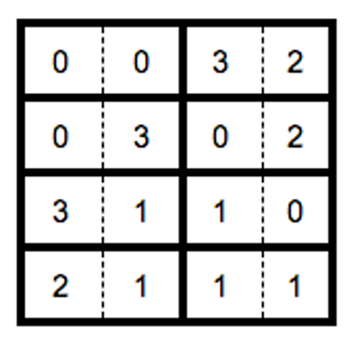
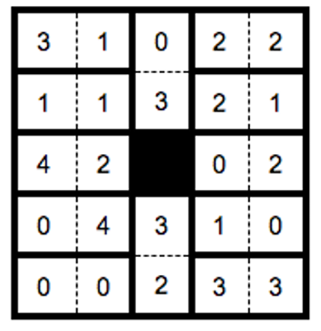
Domino Magic Square

Slide 7
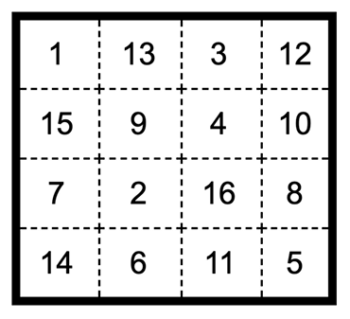
Antimagic Squares
numbers 1 to n²
no the same sum
sums is a set of
consecutive integers

Slide 8
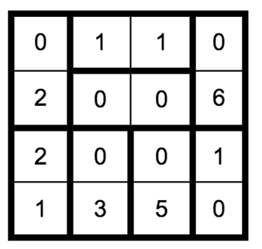
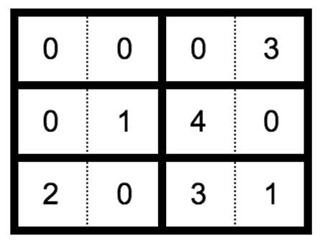
Domino Antimagic Squares/Rectangles

Slide 9
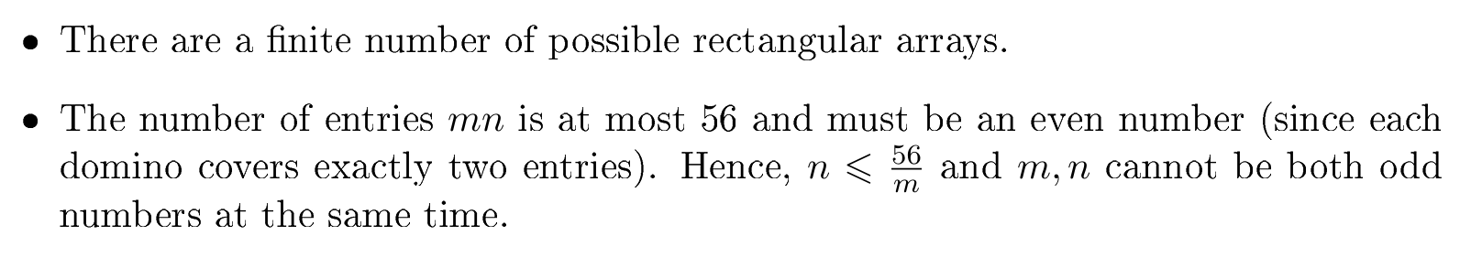
Derivation

Slide 10

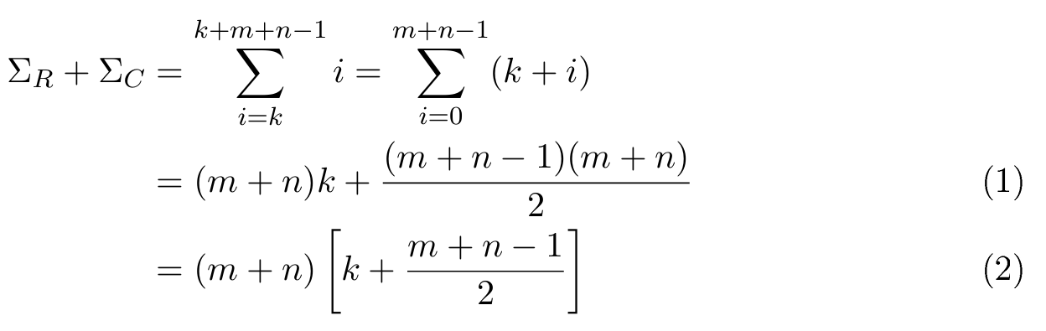
Derivation

Slide 11

Derivation
m + n $≡$2 mod 4 is impossible
k and $\frac{m+n−1}{2}$must have the same parity

Slide 12
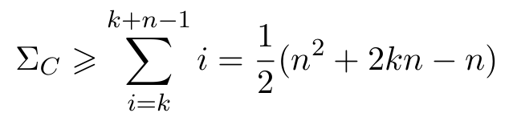
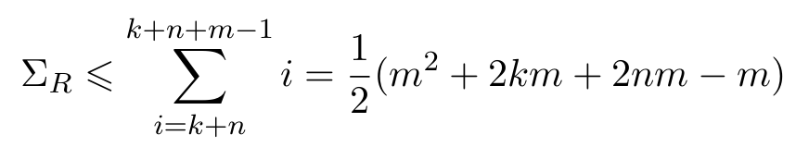
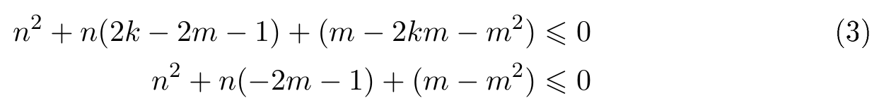
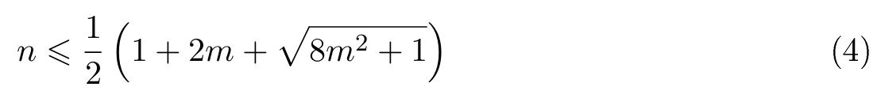
Derivation

Slide 13
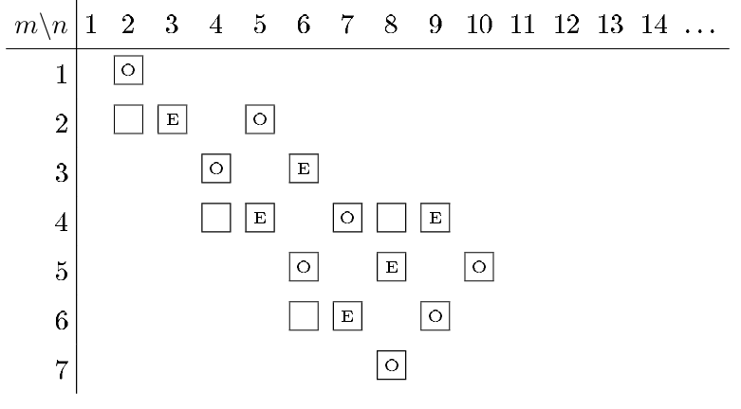
Result

Slide 14
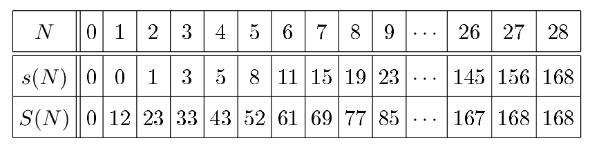
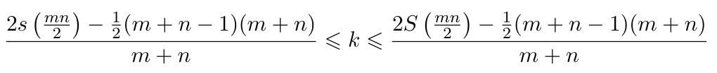
Result

Slide 15
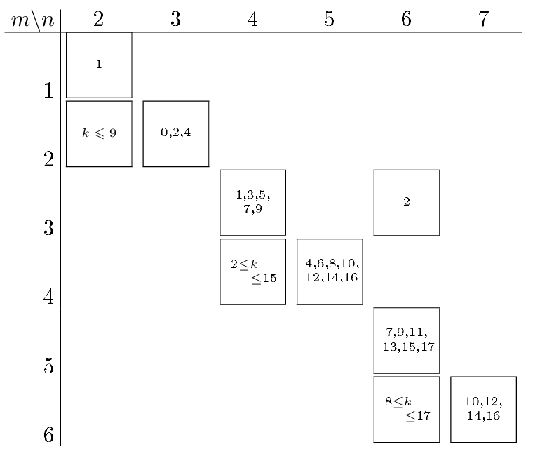
Result

Slide 16
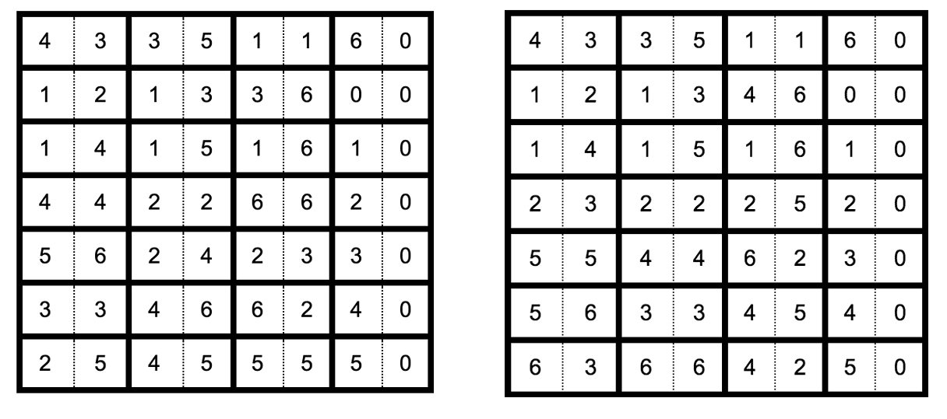
Result

Slide 17
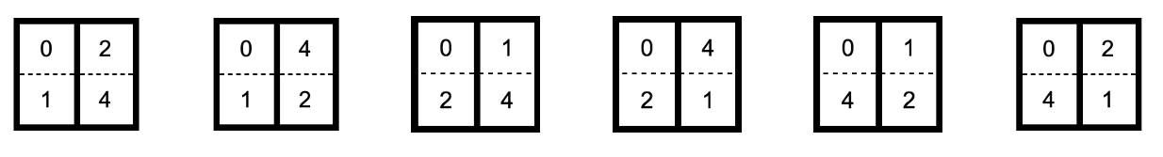
Result

Slide 18
Thanks
Notes:
Given a string S of length n, an integer p ∈ [1..n] is a period of S if S[i] = S[i + p] for all i ∈ [1..n − p].
S[|S| − p + 1] = c

