Slide 1
Duel and Sweep Algorithm for Order-Preserving Pattern Matching
Davaajav Jargalsaikhan, Diptarama, Yohei Ueki, Ryo Yoshinaka, and Ayumi Shinohara
SOFSEM 2018: Theory and Practice of Computer Science: 44th International Conference on Current Trends in Theory and Practice of Computer Science, Krems, Austria, January 29-February 2, 2018, Proceedings 44 pp. 624-635
Presenter: Wen-Yu Chang
Date: Dec. 11, 2024
Notes:
奧地利 多瑙河畔克雷姆斯

Slide 2
Abstract
Given a text and a pattern over an alphabet, the classic exact matching problem searches for all occurrences of the pattern in the text. Unlike exact matching, order-preserving pattern matching (OPPM) considers the relative order of elements, rather than their real values. In this paper, we propose an efficient algorithm for the OPPM problem using the “duel-and-sweep” paradigm. For a pattern of length m and a text of length n, our algorithm runs in O(n+mlogm) time in general, and in O(n+m) time under an assumption that the characters in a string can be sorted in linear time with respect to the string size. We also perform experiments and show that our algorithm is faster than the KMP-based algorithm.

Slide 3
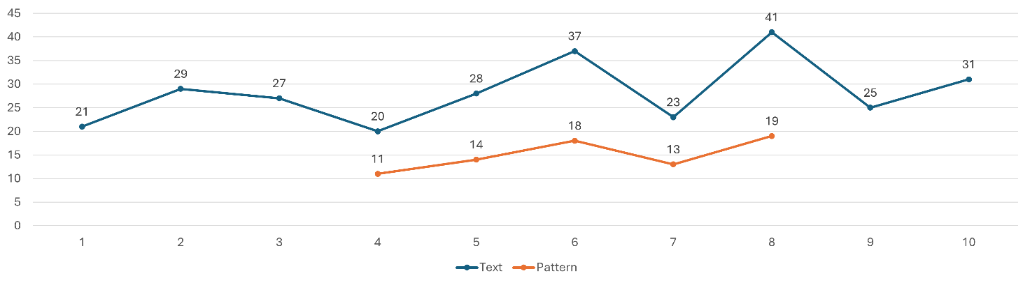
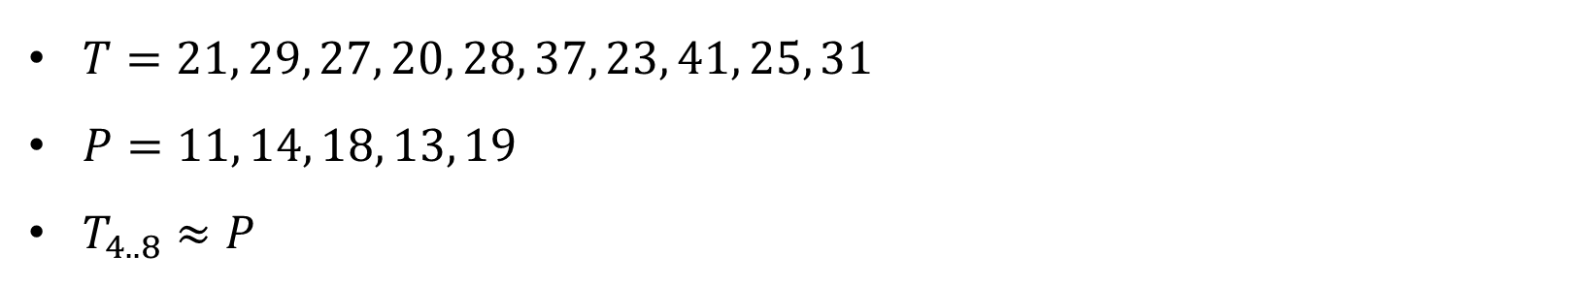
Order-preserving pattern matching (OPPM)
$T=21, 29, 27, 20, 28, 37, 23, 41, 25, 31$
$P=11, 14, 18, 13, 19$
$T_{4..8}≈P$

Slide 4
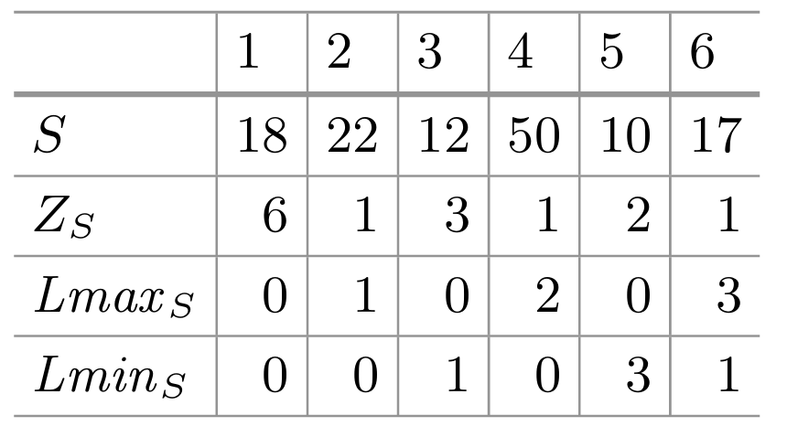
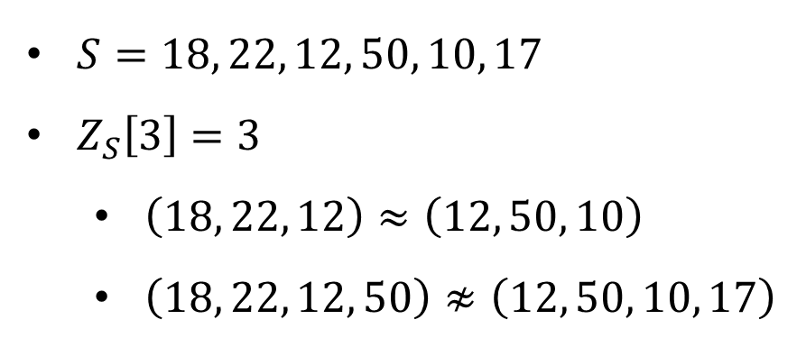
Z-array
$S=18, 22, 12, 50, 10, 17$
$Z_{S}\left[3\right]=3$
$\left(18, 22, 12\right)≈\left(12, 50, 10\right)$
$\left(18, 22, 12, 50\right)≉\left(12, 50, 10, 17\right)$

Slide 5
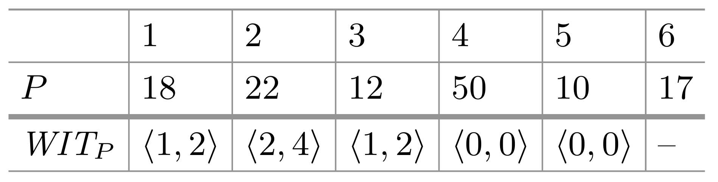
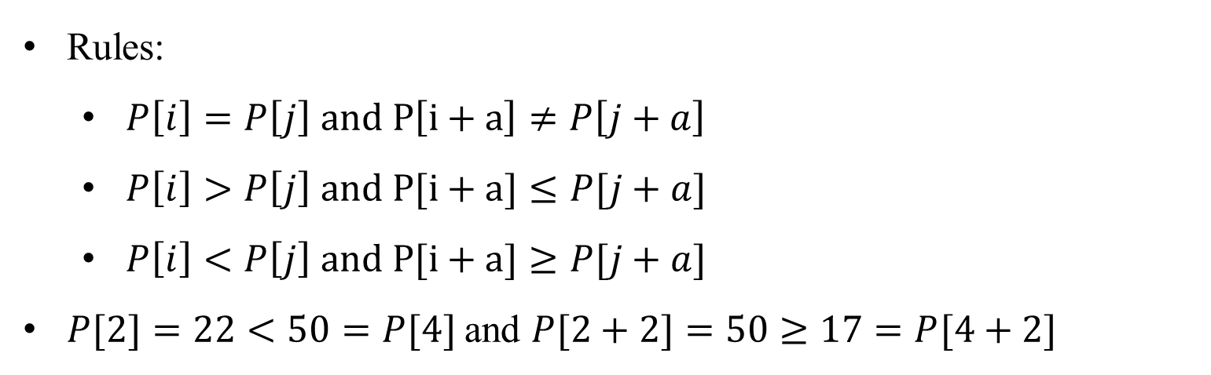
Witness table
18 | 22 | 12 | 50 | 10 | 17
18 | 22 | 12 | 50 | 10 | 17
Rules:
$P\left[i\right]=P\left[j\right] and P\left[i+a\right]≠P\left[j+a\right]$
$P\left[i\right]>P\left[j\right] and P[i+a]≤P[j+a]$
$P\left[i\right]<P\left[j\right] and P[i+a]≥P[j+a]$
$P[2]=22<50=P[4]$and $P[2+2]=50≥17=P[4+2]$
18 | 22 | 12 | 50 | 10 | 17
18 | 22 | 12 | 50 | 10 | 17
Notes:
比對過程中快速篩選出不匹配的候選子字串

Slide 6
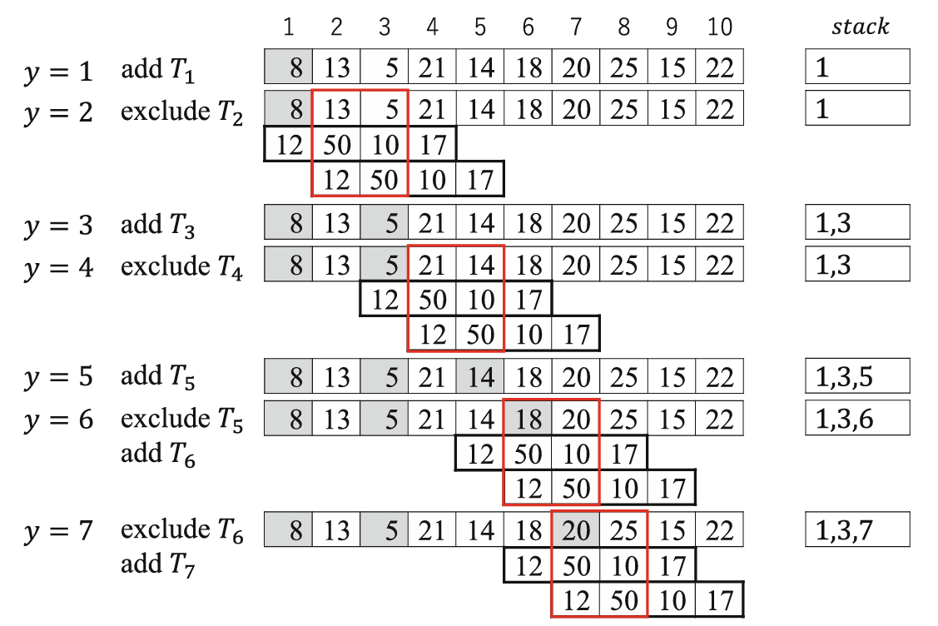
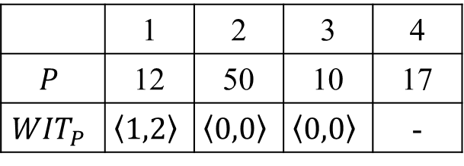
Duel-and-sweep Algorithm (1/4)
 | 1 | 2 | 3 | 4
$$P$$ | 12 | 50 | 10 | 17
$${WIT}_{P}$$ | $$\left\langle 1,2\right\rangle$$ | $$\left\langle 0,0\right\rangle$$ | $$\left\langle 0,0\right\rangle$$ | -
Dueling Stage

Slide 7
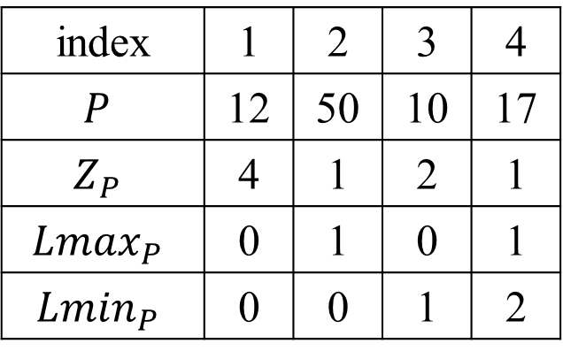


Duel-and-sweep Algorithm (2/4)
Sweeping Stage
index | 1 | 2 | 3 | 4
$$P$$ | 12 | 50 | 10 | 17
$$Z_{P}$$ | 4 | 1 | 2 | 1
$${Lmax}_{P}$$ | 0 | 1 | 0 | 1
$${Lmin}_{P}$$ | 0 | 0 | 1 | 2
8 | 13 | 5 | 21 | 14 | 18 | 20 | 25 | 15 | 22
$${Lmax}_{T′}$$
0 | 1 | 0 | 2
0 | 0 | 1 | 0
$${Lmin}_{T′}$$

Slide 8
Duel-and-sweep Algorithm (3/4)
Sweeping Stage
index | 1 | 2 | 3 | 4
$$P$$ | 12 | 50 | 10 | 17
$$Z_{P}$$ | 4 | 1 | 2 | 1
$${Lmax}_{P}$$ | 0 | 1 | 0 | 1
$${Lmin}_{P}$$ | 0 | 0 | 1 | 2
8 | 13 | 5 | 21 | 14 | 18 | 20 | 25 | 15 | 22
$${Lmax}_{T′}$$
0 | 1 | 1 | 3
0 | 0 | 2 | 2
$${Lmin}_{T′}$$

Slide 9
Duel-and-sweep Algorithm (4/4)
Sweeping Stage
index | 1 | 2 | 3 | 4
$$P$$ | 12 | 50 | 10 | 17
$$Z_{P}$$ | 4 | 1 | 2 | 1
$${Lmax}_{P}$$ | 0 | 1 | 0 | 1
$${Lmin}_{P}$$ | 0 | 0 | 1 | 2
8 | 13 | 5 | 21 | 14 | 18 | 20 | 25 | 15 | 22
$${Lmax}_{T′}$$
0 | 1 | 0 | 1
0 | 0 | 1 | 2
$${Lmin}_{T′}$$

Slide 10
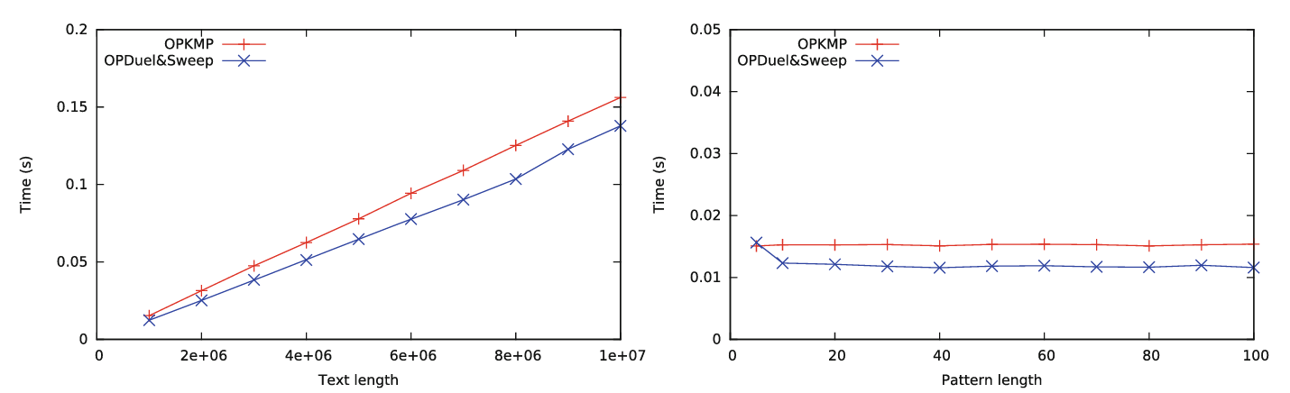
Experiments (1/2)

Slide 11
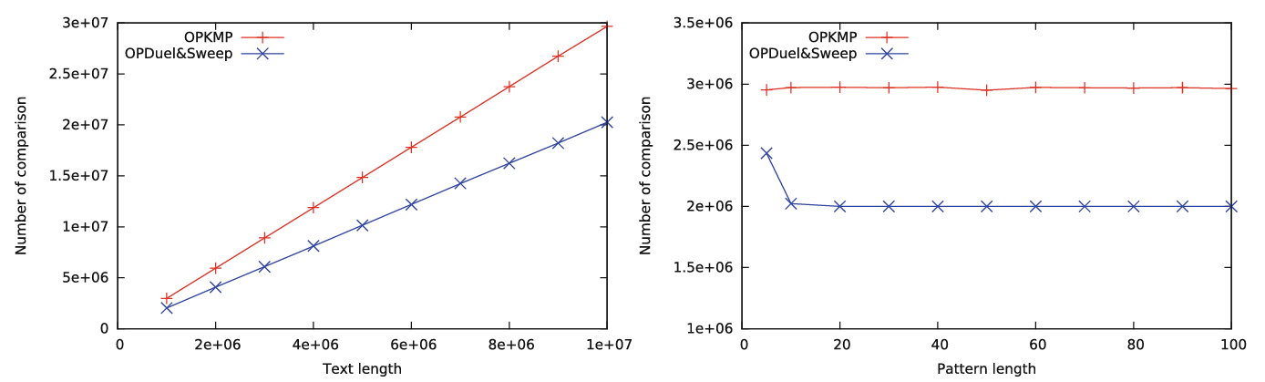
Experiments (2/2)

Slide 12
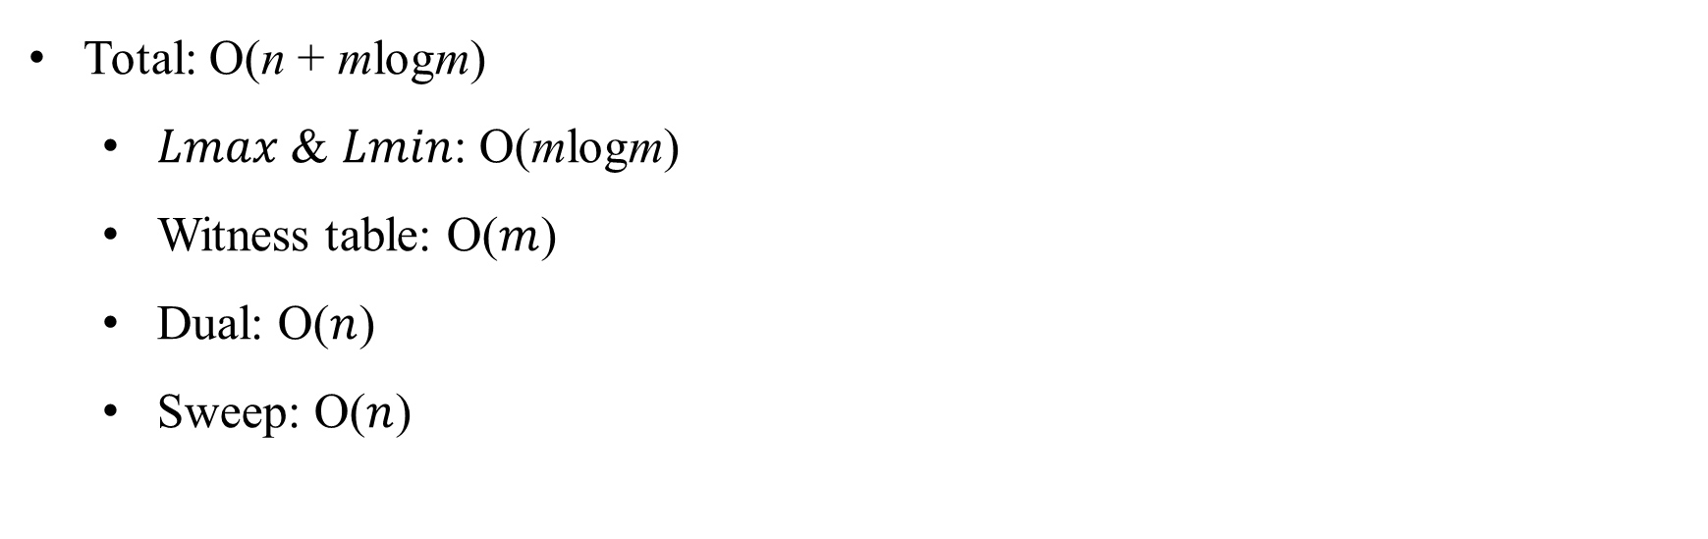
Time Complexity
Total: O(n + mlogm)
$Lmax$ & $Lmin$: O(mlogm)
Witness table: O($m$)
Dual: O($n$)
Sweep: O($n$)

