Slide 1
Motivated numeracy and enlightened self-government
Dan M. Kahan, Ellen Peters, Erica Cantrell Dawson and Paul Slovic
Behavioural Public Policy(2017), 1(1), 54-86.
Presenter: Hsin-Chang Yu
Date: Dec. 11, 2024

Slide 2
Abstract
Why does public conflict over societal risks persist in the face of compelling and widely accessible scientific evidence? We conducted an experiment to probe two alternative answers: the ‘science comprehension thesis’ (SCT), which identifies defects in the public's knowledge and reasoning capacities as the source of such controversies; and the ‘identity-protective cognition thesis’ (ICT), which treats cultural conflict as disabling the faculties that members of the public use to make sense of decision-relevant science.

Slide 3
Abstract
In our experiment, we presented subjects with a difficult problem that turned on their ability to draw valid causal inferences from empirical data. As expected, subjects highest in numeracy – a measure of the ability and disposition to make use of quantitative information – did substantially better than less numerate ones when the data were presented as results from a study of a new skin rash treatment. Also as expected, subjects’ responses became politically polarized – and even less accurate – when the same data were presented as results from the study of a gun control ban.

Slide 4
Abstract
But contrary to the prediction of SCT, such polarization did not abate among subjects highest in numeracy; instead, it increased. This outcome supported ICT, which predicted that more numerate subjects would use their quantitative-reasoning capacity selectively to conform their interpretation of the data to the result most consistent with their political outlooks. We discuss the theoretical and practical significance of these findings.

Slide 5



The Question

Slide 6
The Question
 | Rash Got Better | Rash Got Worse
 | 223 | 75
 | 107 | 21

Slide 7
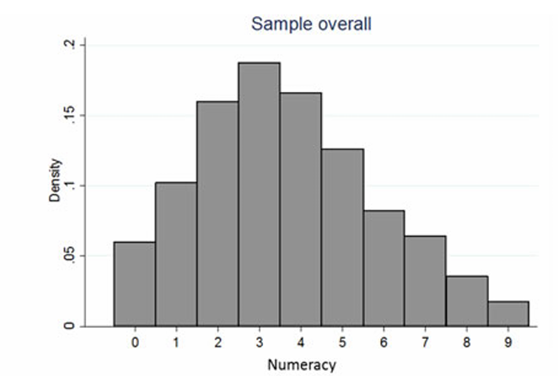
Data

Slide 8
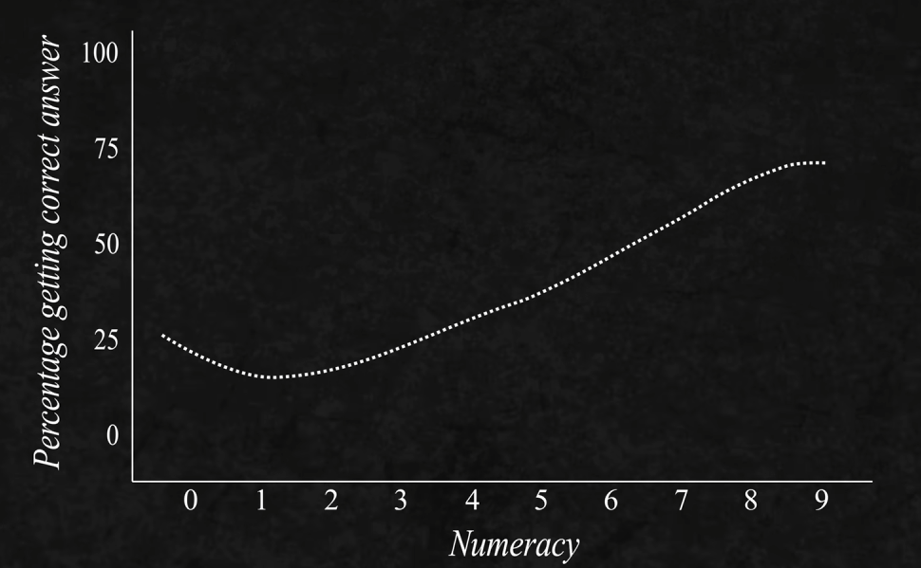
Result

Slide 9
Another Question
 | Rash Got Worse | Rash Got Better
 | 223 | 75
 | 107 | 21

Slide 10
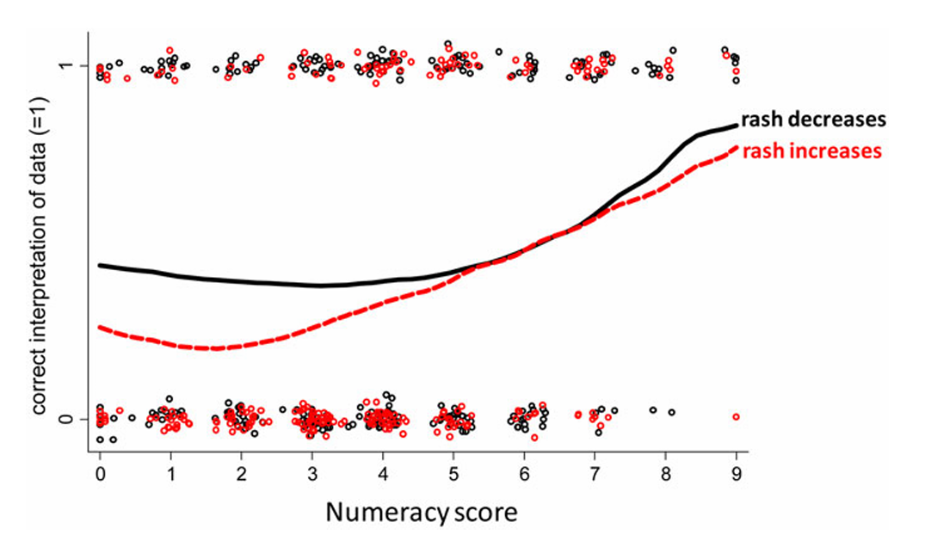
Result

Slide 11
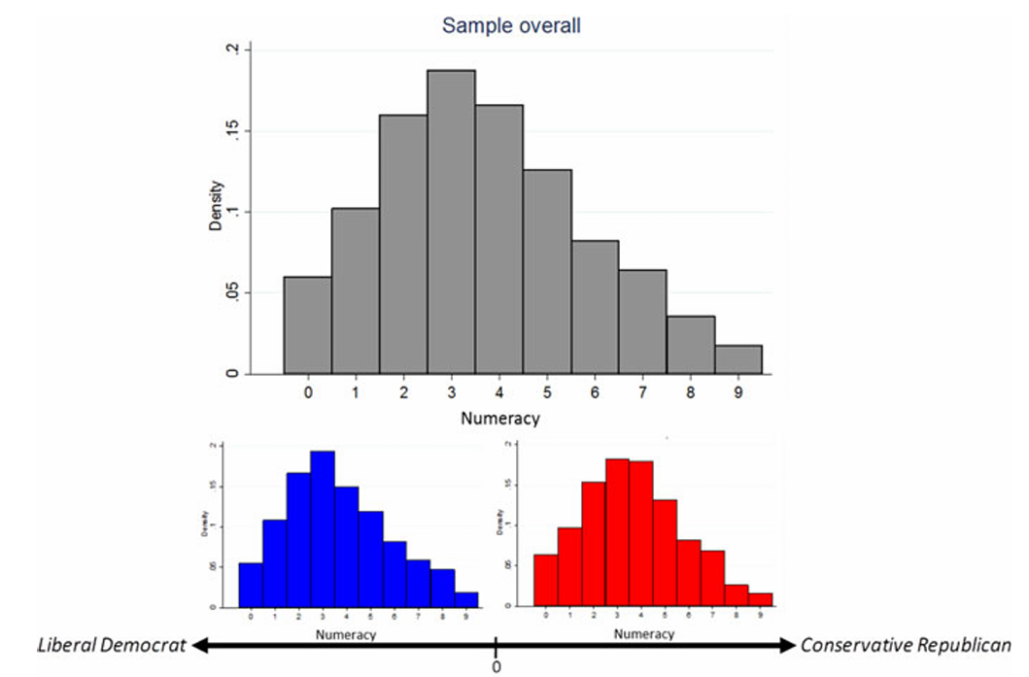


Data

Slide 12
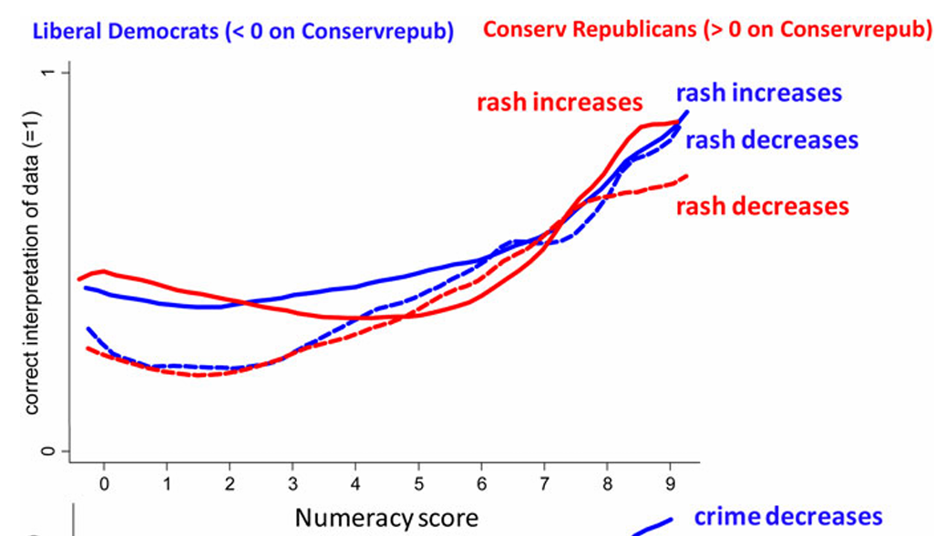

Result

Slide 13

The Other Question
 | Increase in crime | Decrease in crime
 | 223 | 75
 | 107 | 21

Slide 14
The Other Question
 | Decrease in crime | Increase in crime
 | 223 | 75
 | 107 | 21

Slide 15
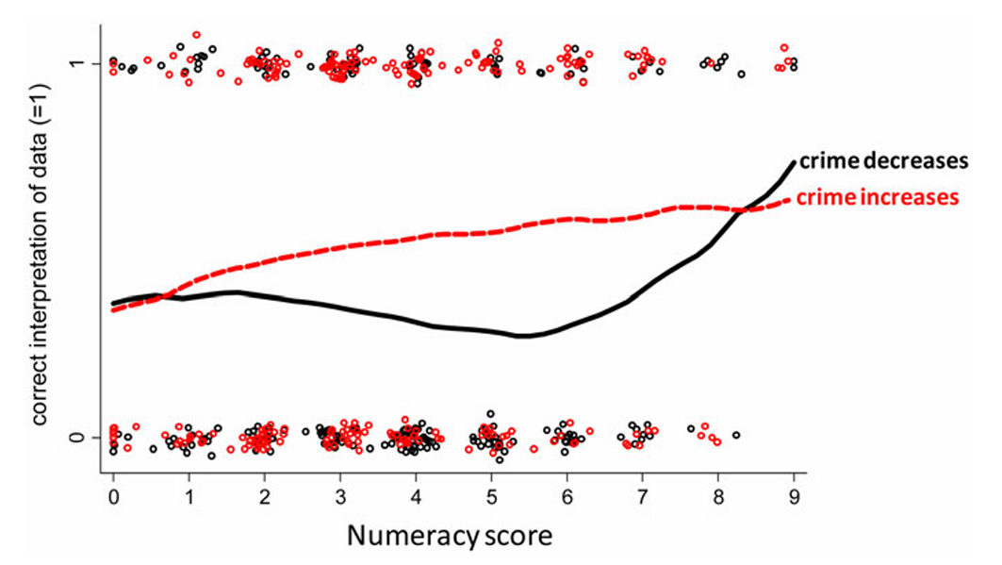
Result

Slide 16
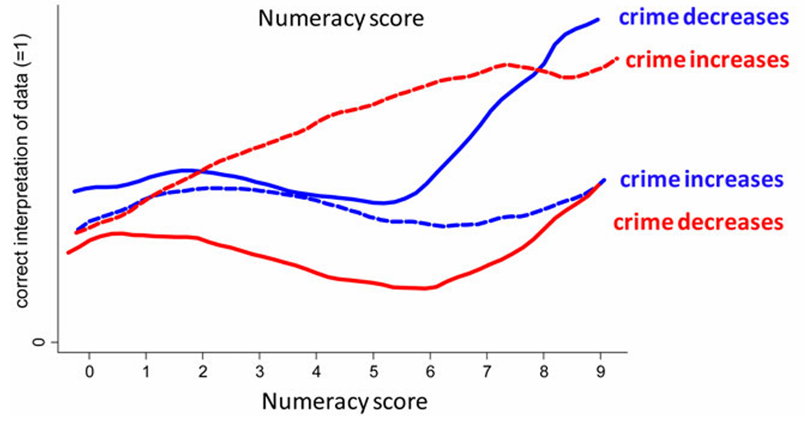
Result

Slide 17
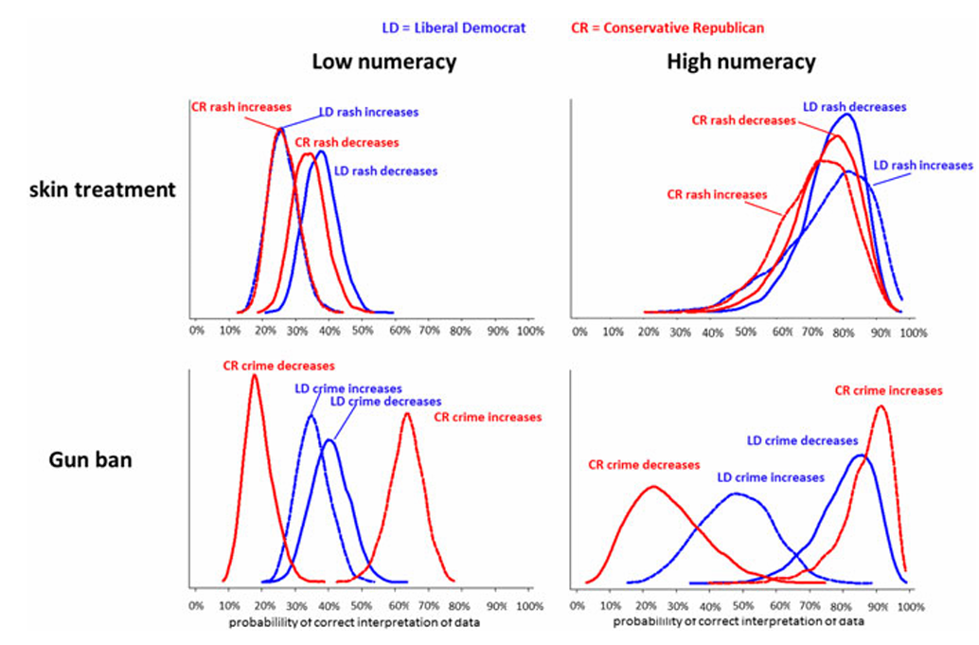
Result

Slide 18
Conclusion

Slide 19
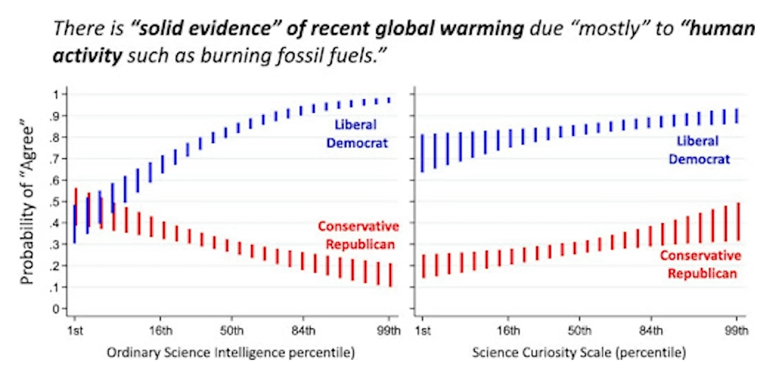
Conclusion

Slide 20


Reference

Slide 21
Thanks
Notes:
Given a string S of length n, an integer p ∈ [1..n] is a period of S if S[i] = S[i + p] for all i ∈ [1..n − p].
S[|S| − p + 1] = c

