Slide 1
Road Vehicle Detection Using Fuzzy Logic Rule-based Method
Qulin Tan, Qingchao Wei, Jiping Hu, David Aldred
Seventh International Conference on Fuzzy Systems and Knowledge Discovery,
Yantai, Shandong, China.
Aug. 10, 2010 – Aug. 12, 2010
Presenter : Chia-Lin Chen
March 13, 2019
Notes:
Qulin Tan, Qingchao Wei, Jiping Hu 北京交通大學 土木工程系
David Aldred 加拿大 西安大略大學 地理系
第七次國際Fuzzy會議在中國山東省煙台市

Slide 2
Abstract(1/2)
Road vehicle detection using very high-resolution remote sensing images has a unique advantage of covering a large area at the same time over all ground-based detectors. But the detection of small vehicle-object in remote sensing imagery is still a challenging task. A scheme was proposed to detect road vehicle objects from airborne color digital orthoimagery based on fuzzy logic rule base.
Notes:
1.What is Orthoimagery?
Orthorectified+Imagery
2.常見詞:airborne digital camera(一種適合高空遙測的專業相機)

Slide 3
Abstract(2/2)
Firstly, a vector-generated road mask was used to constrain detection of vehicles to road region. Secondly, image segmentation algorithm was performed to form image objects in the preprocessing orthoimagery. Finally, based on a set of fuzzy logic rules defined by membership functions, vehicle objects were detected and separated from other objects. A representative set of road segment images was selected from available images to test the proposed scheme. Experimental results indicate that the detection rates of all test road-segments are high with very few false alarms.

Slide 4
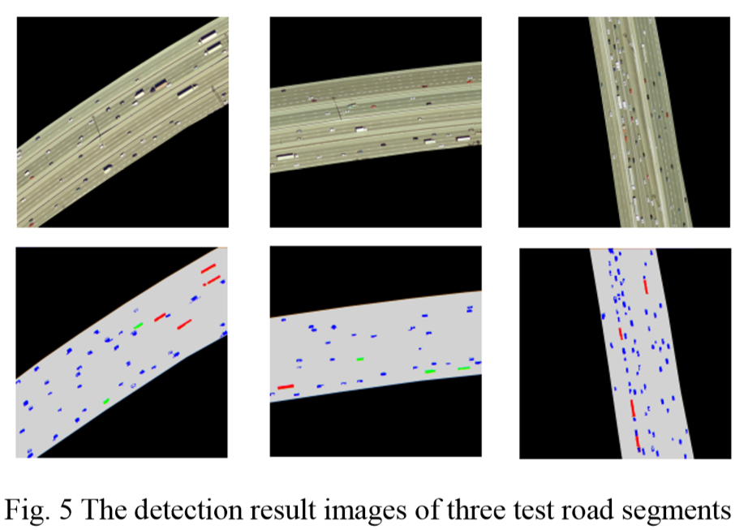

Slide 5
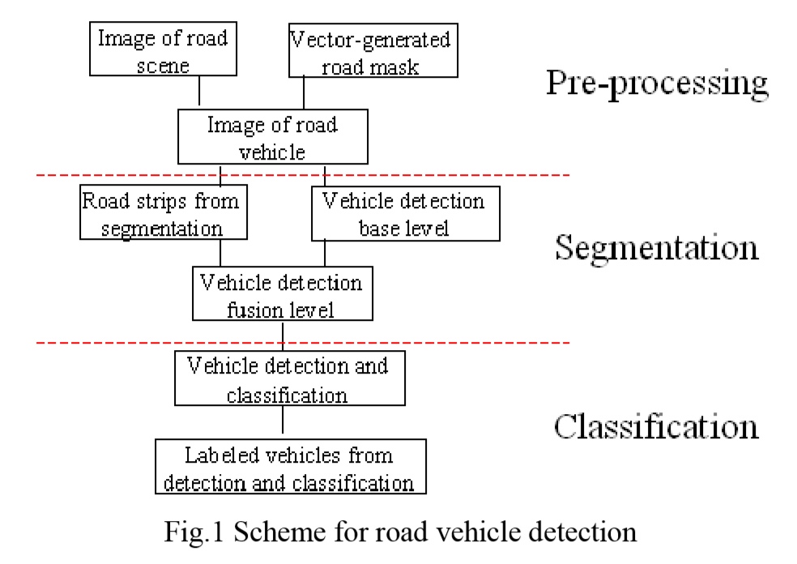

Slide 6
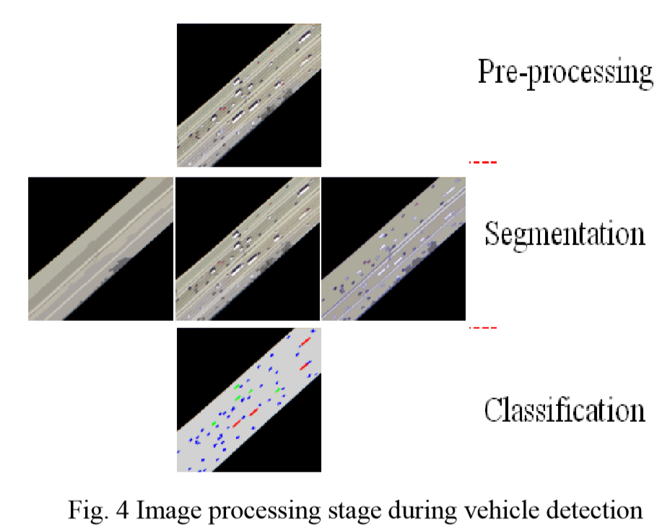

Slide 7
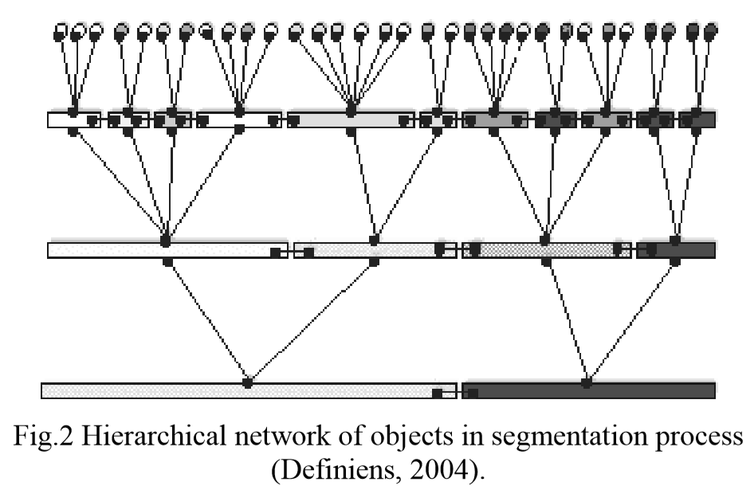

Slide 8
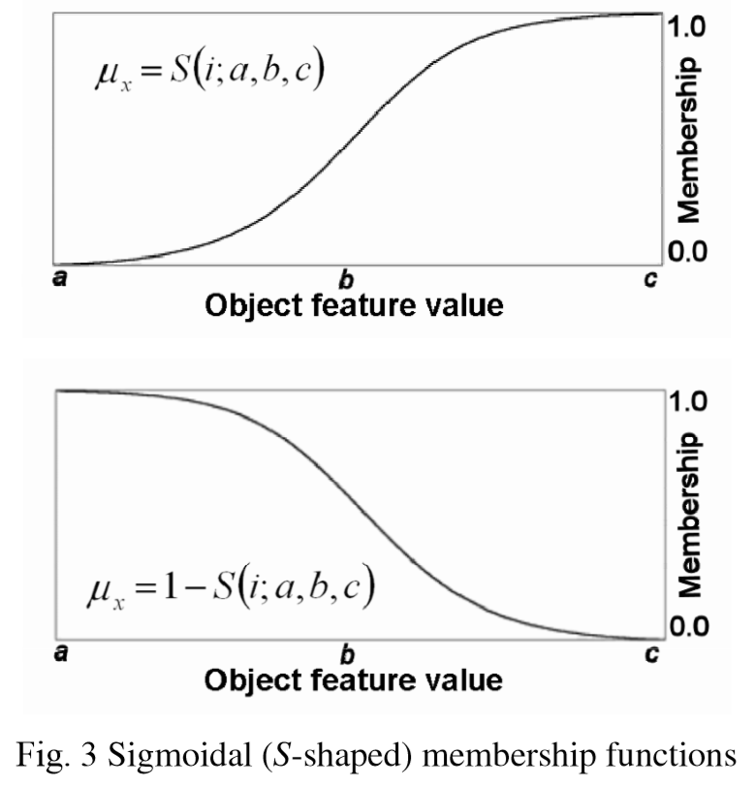

Slide 9
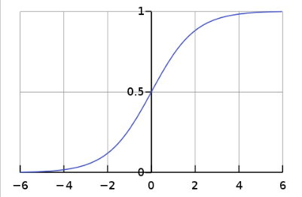

S-Shaped function

Slide 11
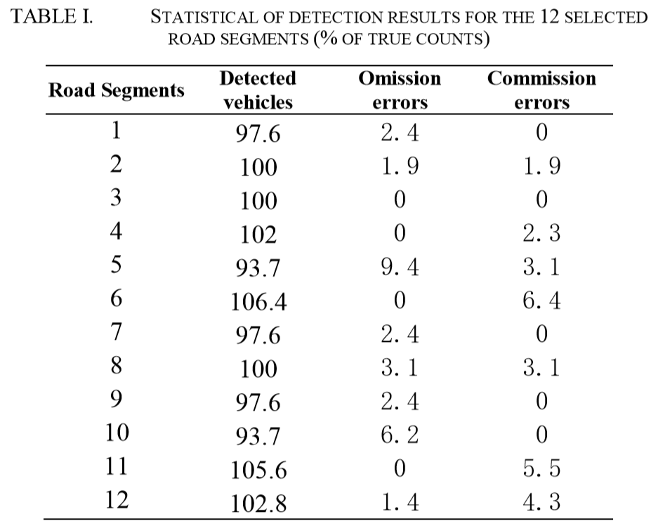

Slide 12
