Slide 1
Linear time algorithm for the longest common repeat problem
Inbok Lee, Costas S. Iliopoulos, Kunsoo Park
Journal of Discrete Algorithms 5 (2007) 243–249
Speaker: Guan-Zhi Chen
Date: March, 13, 2019

Slide 2
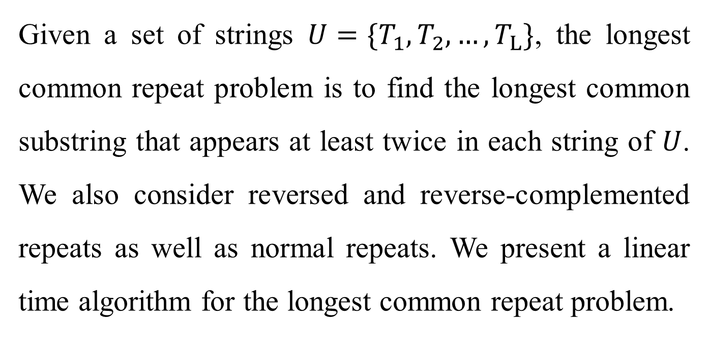
Abstract
Given a set of strings $U=\{T_{1}, T_{2}, …, T_{L}\}$, the longest common repeat problem is to find the longest common substring that appears at least twice in each string of $U$. We also consider reversed and reverse-complemented repeats as well as normal repeats. We present a linear time algorithm for the longest common repeat problem.

Slide 3
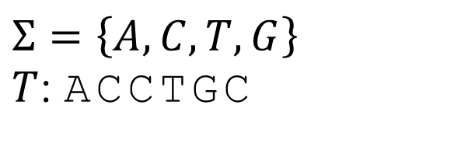
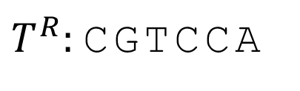
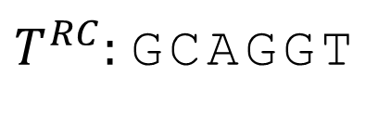
Definition - String
$$Σ=\left\{A, C, T, G\right\}$$
$T$: ACCTGC
Reverse string
$T^{R}:$CGTCCA
Reverse-complemented string
$T^{RC}:$ GCAGGT

Slide 4
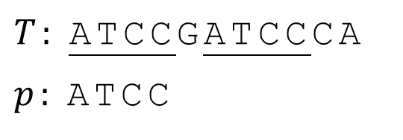
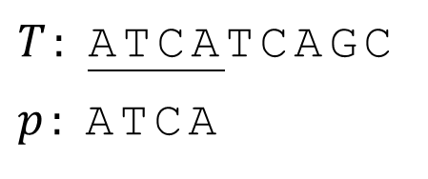
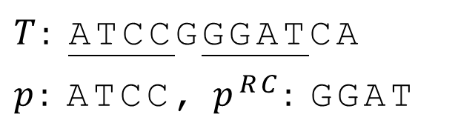
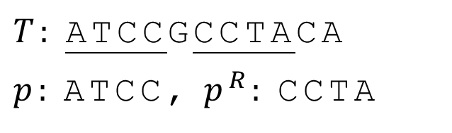
Definition – Repeat (1/2)
Normal repeat
(overlap)
$T:$ATCCGATCCCA
$p:$ATCC
$T:$ATCATCAGC
$p:$ATCA
Reversed repeat
$T:$ATCCGCCTACA
$p:$ATCC, $p^{R}:$CCTA
Reverse-complemented repeat
$T:$ATCCGGGATCA
$p:$ATCC, $p^{RC}:$GGAT

Slide 5
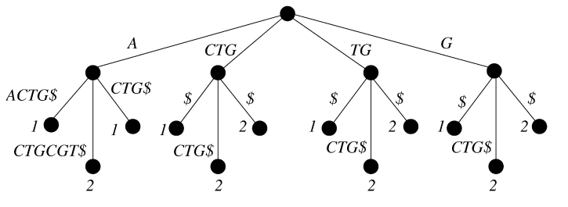
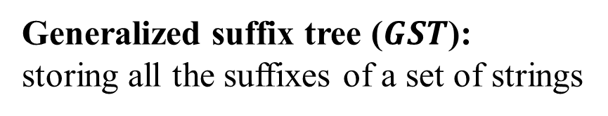
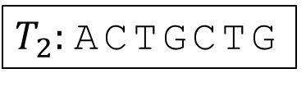
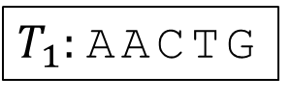
Definition – Suffix Tree
Generalized suffix tree ($GST$):
storing all the suffixes of a set of strings
$T_{1}:$AACTG
$T_{2}:$ACTGCTG
root
internal node
leaf node

Slide 6
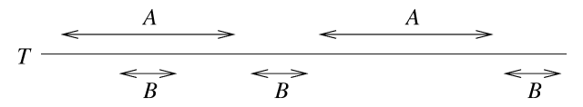

Definition – Repeat (2/2)
Maximal repeat:
cannot be extended to the left or right
Supermaximal repeat:
never occurs as a substring of any other maximal repeat
$T:$CAACGAAGGAAG

Slide 7
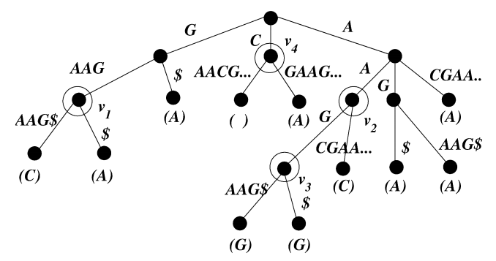
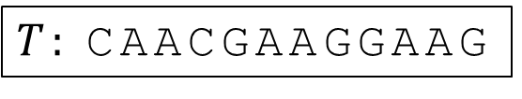
Supermaximal repeat in ST
The internal node v whose children are all leaves and each leaf has a distinct left character.
$T:$CAACGAAGGAAG
the left char
Notes:
maximal 必為 internal，因為有至少2個子葉才算repeat Supermaximal repeat 孩子須為

Slide 8
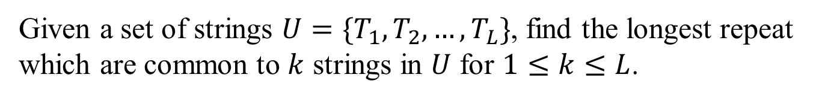

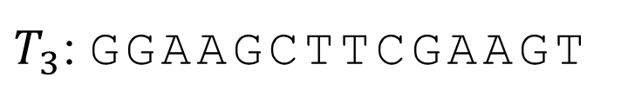
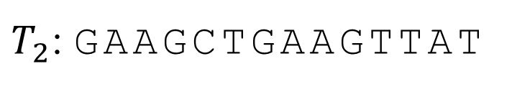
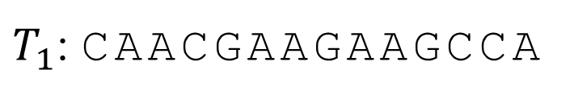
The longest common repeat problem
$$\left(k,L\right)LCR$$
Given a set of strings $U=\{T_{1}, T_{2},…,T_{L}\}$, find the longest repeat which are common to $k$ strings in $U$ for $1≤k≤L$.
$T_{1}$: CAACGAAGAAGCCA
$T_{2}$: GAAGCTGAAGTTAT
$T_{3}$: GGAAGCTTCGAAGT

Slide 9


Algo – Step 1
Let $T′$ include 3 types of repeats
(normal, reversed, and reverse-complemented)
$$all in one?$$
$$T_{i}^{′}=T_{i} \% T_{i}^{R }\# T_{i}^{RC}$$

Slide 10
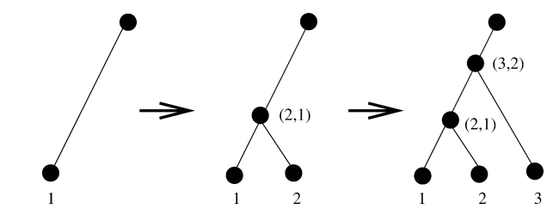
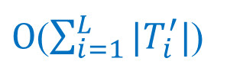
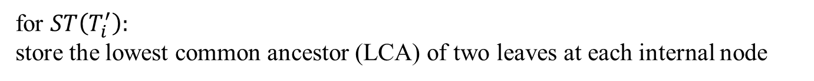
$O$($\sum_{i=1}^{L}{|T_{i}^{′}|}$)
Algo – Step 2
Build $ST(T_{i}^{′})$ and $GST(T_{1}^{′}…T_{L}^{′})$
for $ST\left(T_{i}^{′}\right):$
store the lowest common ancestor (LCA) of two leaves at each internal node
/ (3,1)

Slide 11
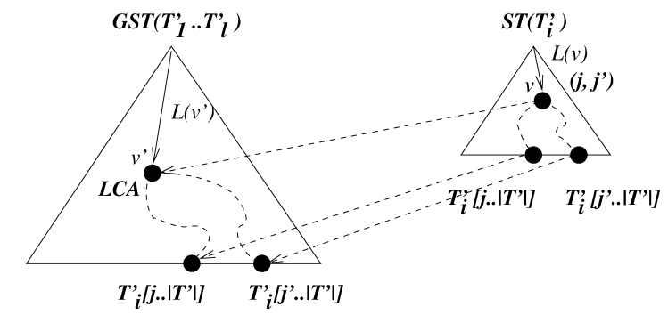
$O$($\sum_{i=1}^{L}{|T_{i}^{′}|}$)
Algo – Step 3
find supermaximal repeats from $ST(T_{i}^{′})$
use the information of $v$ from $ST(T_{i}^{′})$ , point out supermaximal repeats $v′$

Slide 12
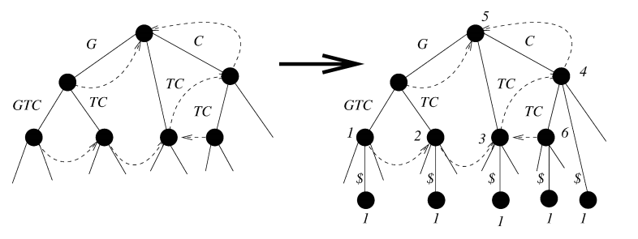
$O$($\sum_{i=1}^{L}{|T_{i}^{′}|}$)
Algo – Step 4
Build modified $GST(T_{i}^{′})$ of all the supermaximal repeats

Slide 13
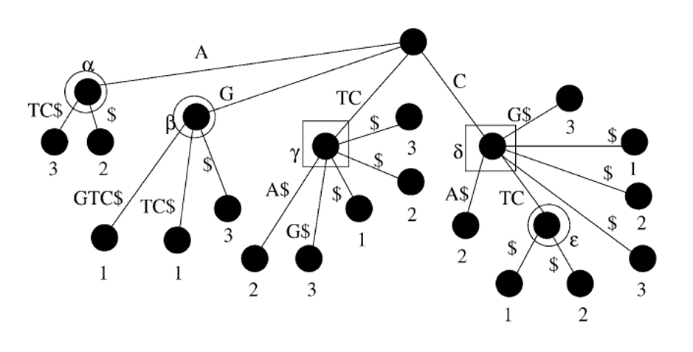
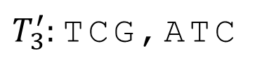
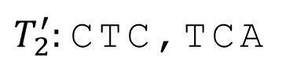
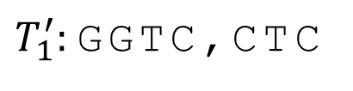
$O$($\sum_{i=1}^{L}{|T_{i}^{′}|}$)
Algo – Step 5
find the $\left(k,L\right)LCR$ from modified
$T_{1}^{′}:$GGTC,CTC
$T_{2}^{′}:$CTC,TCA
$T_{3}^{′}:$TCG,ATC

Slide 14

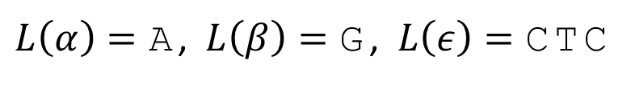


$O$($\sum_{i=1}^{L}{|T_{i}^{′}|}$)
Algo – Step 5
find the $\left(k,L\right)LCR$ from modified
$$(k,L)=(2,3)$$
$L\left(α\right)=\text{A}\text{,} L\left(β\right)=\text{G}$, $L\left(ε\right)=\text{CTC}$
$$(k,L)=(3,3)$$
$$L\left(γ\right)=\text{TC}\text{,} L\left(δ\right)=\text{C}$$

