Slide 1
Polynomial-time approximation algorithms for weighted LCS problem
M. Cygan, M. Kubica, J. Radoszewski, W. Rytter, T. Waleń
Discrete Applied Mathematics,
Volume, May. 11, 2016, pp.38-48
Presenter: Du-Cheng Wu
Date: Mar. 13, 2019
Notes:
https://www.google.com/maps/place/%E6%84%9B%E7%88%BE%E8%98%AD%E5%88%A9%E9%BB%98%E9%87%8C%E5%85%8B/@52.6451383,-8.8014936,10.46z/data=!4m5!3m4!1s0x485b5c611f545113:0xa00c7a997317330!8m2!3d52.6638367!4d-8.6267343

Slide 2
Abstract(1/2)
We consider a variant of the well-known Longest Common Subsequence (LCS) problem for weighted sequences. A weighted sequence determines the probability for each symbol to occur at a given position of the sequence (such sequences are also called Position Weighted Matrices, PWM). Two possible such versions of the problem were proposed by (Amir et al., 2009 and 2010), they are called LCWS and LCWS2 (Longest Common Weighted Subsequence 1 and 2). We solve an open problem, stated in the paper by Amir et al., of the tractability of a log-probability version of LCWS2 problem for bounded alphabets, showing that it is NP-hard already for an alphabet of size 2.

Slide 3

Abstract(2/2)
We also improve the (1/|Σ|)-approximation algorithm given by Amir et al. (where Σ is the alphabet): we show a polynomial-time approximation scheme (PTAS) for the LCWS2 problem using O($n^{5}$) space. We also give a simpler (1/2)-approximation algorithm for the same problem using only O($n^{2}$) space.

Slide 4
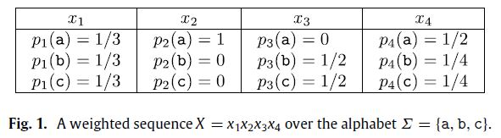


Weighted Sequence

Slide 5
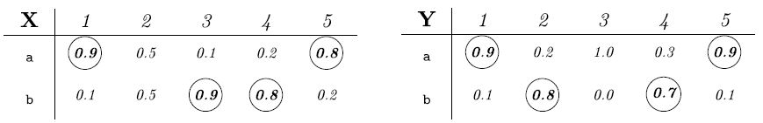
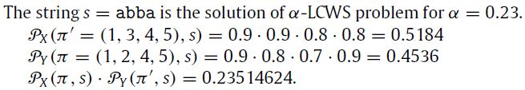
α-LCWS Problem

Slide 6
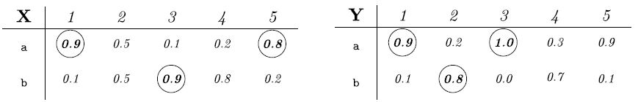

($α_{1},α_{2}$)-LCWS2 Problem

Slide 7
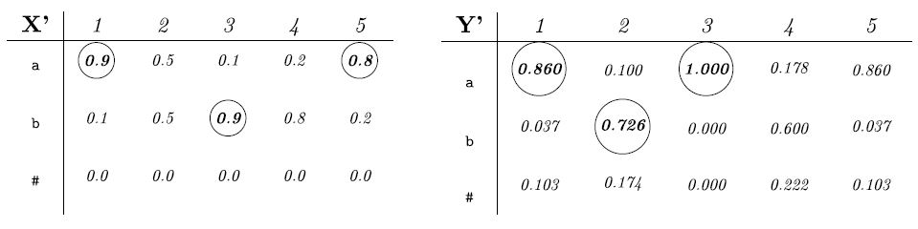
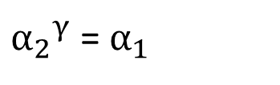
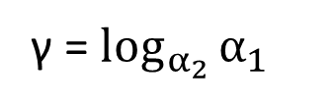

α-LCWS2 Problem
($α_{1},α_{2}$)-LCWS2 Problem$α_{1}$=0.6 and $α_{2}$=0.7
If $α_{1}$ < $α_{2}$ <1
γ = $\log_{α_{2}}{α_{1}}$
${α_{2}}^{γ}$ = $α_{1}$

Slide 8
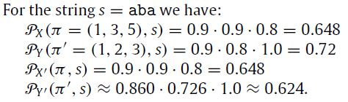
α-LCWS2 Problem

Slide 9
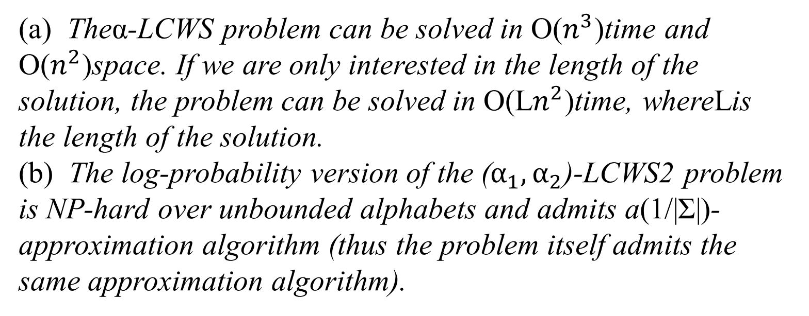
NP-hard Problem
(a) Theα-LCWS problem can be solved in O($n^{3}$)time and O($n^{2}$)space. If we are only interested in the length of the solution, the problem can be solved in O(L$n^{2}$)time, whereLis the length of the solution.
(b) The log-probability version of the ($α_{1},α_{2}$)-LCWS2 problem is NP-hard over unbounded alphabets and admits a(1/|Σ|)-approximation algorithm (thus the problem itself admits the same approximation algorithm).

Slide 10
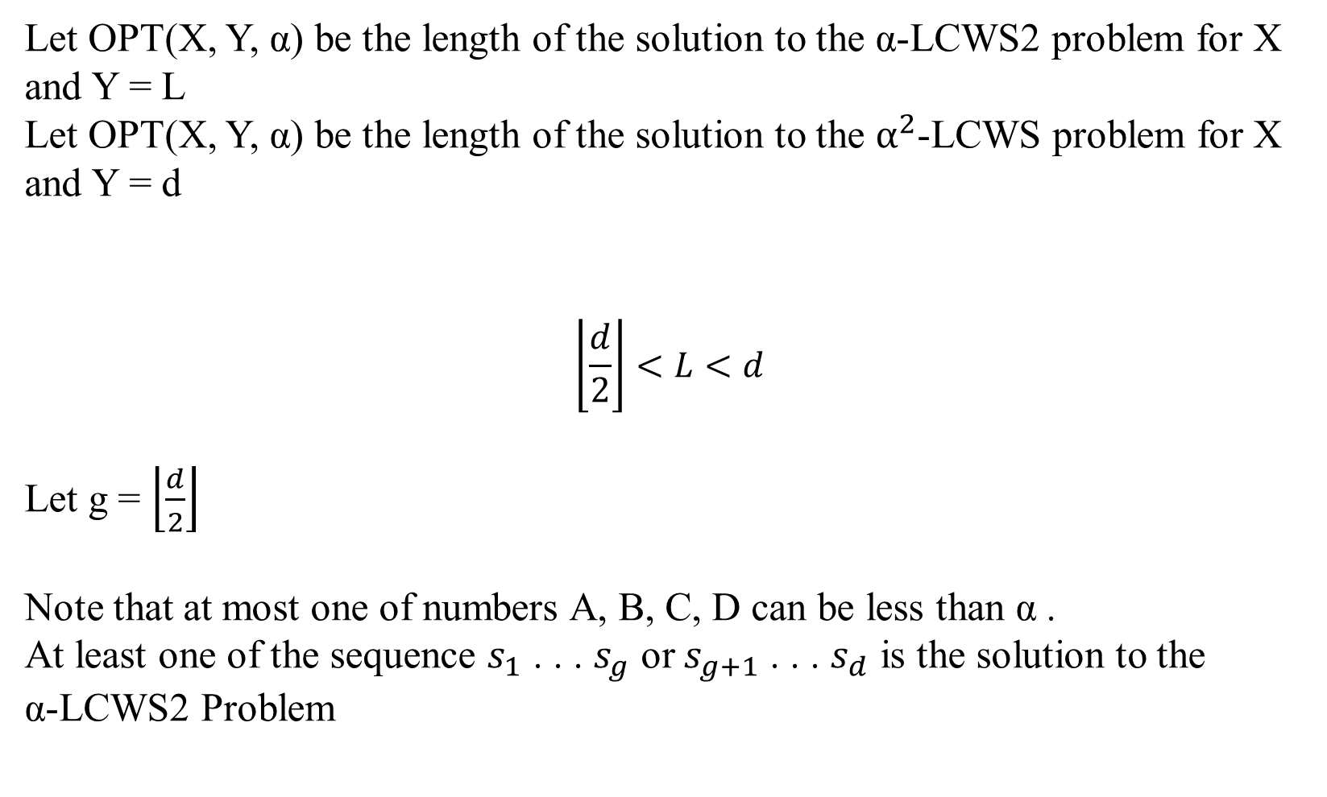
(1/2)-approximation algorithm for LCWS2
Let OPT(X, Y, α) be the length of the solution to the α-LCWS2 problem for X and Y = L
Let OPT(X, Y, α) be the length of the solution to the $α^{2}$-LCWS problem for X and Y = d
$$\left\lfloor \frac{d}{2}\right\rfloor <L<d$$
Let g = $\left\lfloor \frac{d}{2}\right\rfloor$
Note that at most one of numbers A, B, C, D can be less than α .
At least one of the sequence $s_{1}$ . . . $s_{g}$ or $s_{g+1}$ . . . $s_{d}$ is the solution to the α-LCWS2 Problem

Slide 11
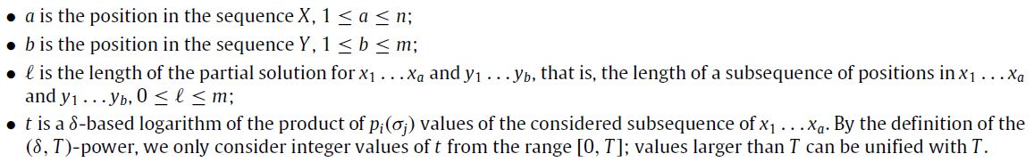
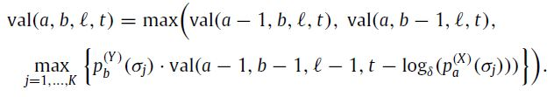
Polynomial-time approximating scheme for LCWS2

Slide 12
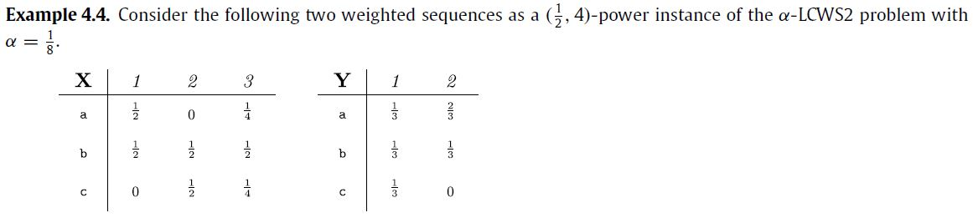
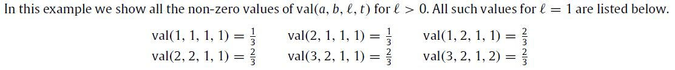
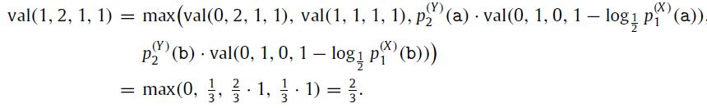
Polynomial-time approximating scheme for LCWS2

Slide 13
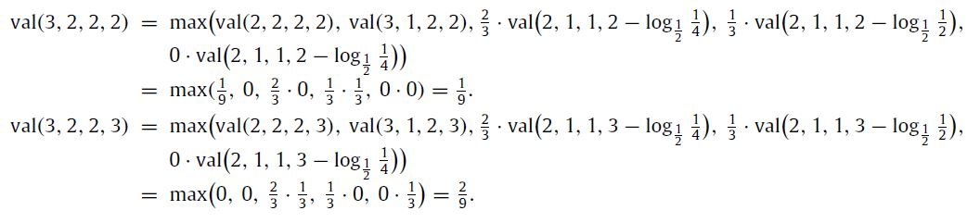
Polynomial-time approximating scheme for LCWS2

Slide 14
Polynomial-time approximating scheme for LCWS2

