Slide 1
Two-string consensus problem under non-overlapping inversion and transposition distance
Toan Thang Ta, Cheng-Yao Lin, Chin Lung Lu (盧錦隆) Information Processing Letters 130 (2018) pp. 46-51
Speaker: Kuan-Lin Lai
Date: Apr. 09, 2019

Slide 2
Abstract
For biological sequences that can be represented as strings over a finite alphabet, inversion and transposition are commonly observed mutation operations. The non-overlapping inversion and transposition distance (also simply called mutation distance) between two strings is defined as the minimum number of non-overlapping inversion and transposition operations used to transform one string into the other. Given two strings of the same length n and a constant c ≥ 0, the two-string consensus problem under mutation distance is to determine whether or not there exists a string s∗ such that the mutation distance from s∗ to each input string does not exceed c. In this study, we present an O(n⁵) time and O(n⁴) space algorithm to solve this problem.

Slide 3
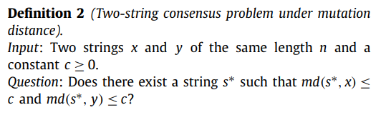

Two string consensus problem under mutation distance
Ex: x = TAGAC y = TAACG c=1 $⇒s^{∗}$= TAGAC or TAACG

Slide 4
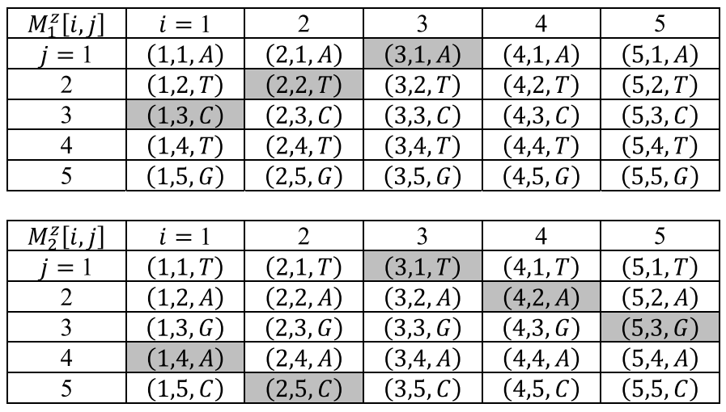
Mutation table
z = TAGAC
inversion table
tranpostion table

Slide 5
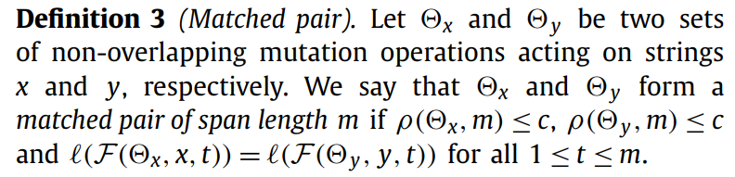

Matched pair
Ex: x = TAGAC y = TAACG c=1 $⇒s^{∗}$= TAGAC or TAACG

Slide 6
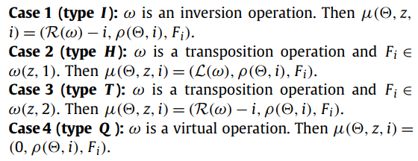
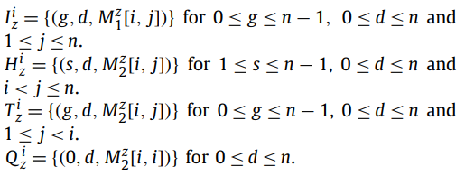
4 Status

Slide 7










Algorithm
For each i, we construct a bipartite graph $G_{i}=(U_{i},V_{i},E_{i})$ $U_{i} =$ $I_{x}^{i}∪H_{x}^{i}∪$ $T_{x}^{i}∪$ $Q_{x}^{i}$ $V_{i} =$ $I_{y}^{i}∪H_{y}^{i}∪$ $T_{y}^{i}∪$ $Q_{y}^{i}$ If $d\left(u\right)≤c$and$d\left(v\right)≤c$, then create an edge $(u,v)$ in $E_{i}$
$$I_{x}^{i}$$
$$H_{x}^{i}$$
$$T_{x}^{i}$$
$$Q_{x}^{i}$$
$$G_{i}$$
$$I_{y}^{i}$$
$$H_{y}^{i}$$
$$T_{y}^{i}$$
$$Q_{y}^{i}$$

Slide 8
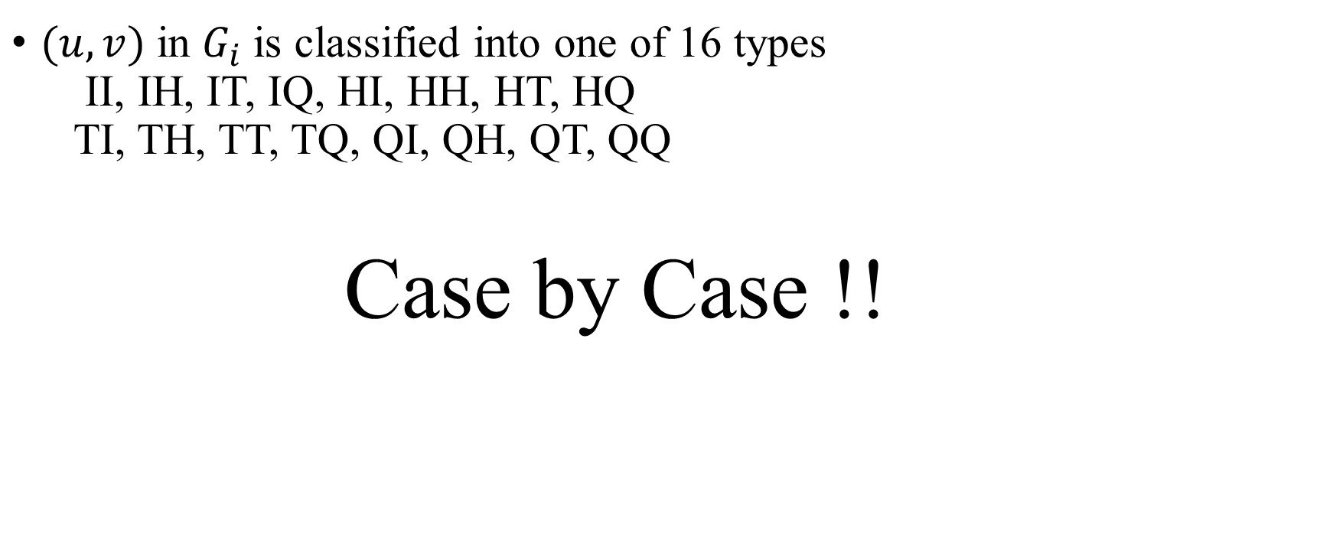
Algorithm
$(u,v)$ in $G_{i}$ is classified into one of 16 types II, IH, IT, IQ, HI, HH, HT, HQ TI, TH, TT, TQ, QI, QH, QT, QQ
Case by Case !!

Slide 9
























Algorithm
$$Q_{x}^{}A$$
$$H_{x}^{}G$$
$$I_{x}^{}G$$
$$I_{x}^{}C$$
$$H_{x}^{}C$$
$$G_{1}$$
$$I_{y}^{}T$$
$$Q_{y}^{}G$$
$$I_{y}^{}C$$
$$H_{y}^{}C$$
x=AGC y=GCT
$$Q_{x}^{}G$$
$$H_{x}^{}C$$
$$I_{x}^{}A$$
$$I_{x}^{}C$$
$$G_{2}$$
$$I_{y}^{}C$$
$$Q_{y}^{}C$$
$$I_{y}^{}G$$
$$H_{y}^{}T$$
$$Q_{x}^{}C$$
$$T_{x}^{}A$$
$$G_{3}$$
$$I_{y}^{}G$$
$$I_{y}^{}T$$

Slide 10
Algorithm
II => II, IQ, QI, QQ
IH => IH, IT, QH (Similar as HI)
IT => QT, IQ, QQ (Similar as TI)
HH => HH, HT, TH, TT
HT => HT, TT, HQ (Similar as HT)
TT => TT, QT, TQ, QQ

Slide 11
Algorithm
IQ => II, IH, IQ, QQ (Similar as QI)
HQ => HI, HH, HQ, TI, TH, TQ (Similar as QH)
TQ => TI, TH, TQ, QQ (Similar as QT)
QQ => II, IH, IQ, HI, HH, HQ, QI, QH, QQ

Slide 12
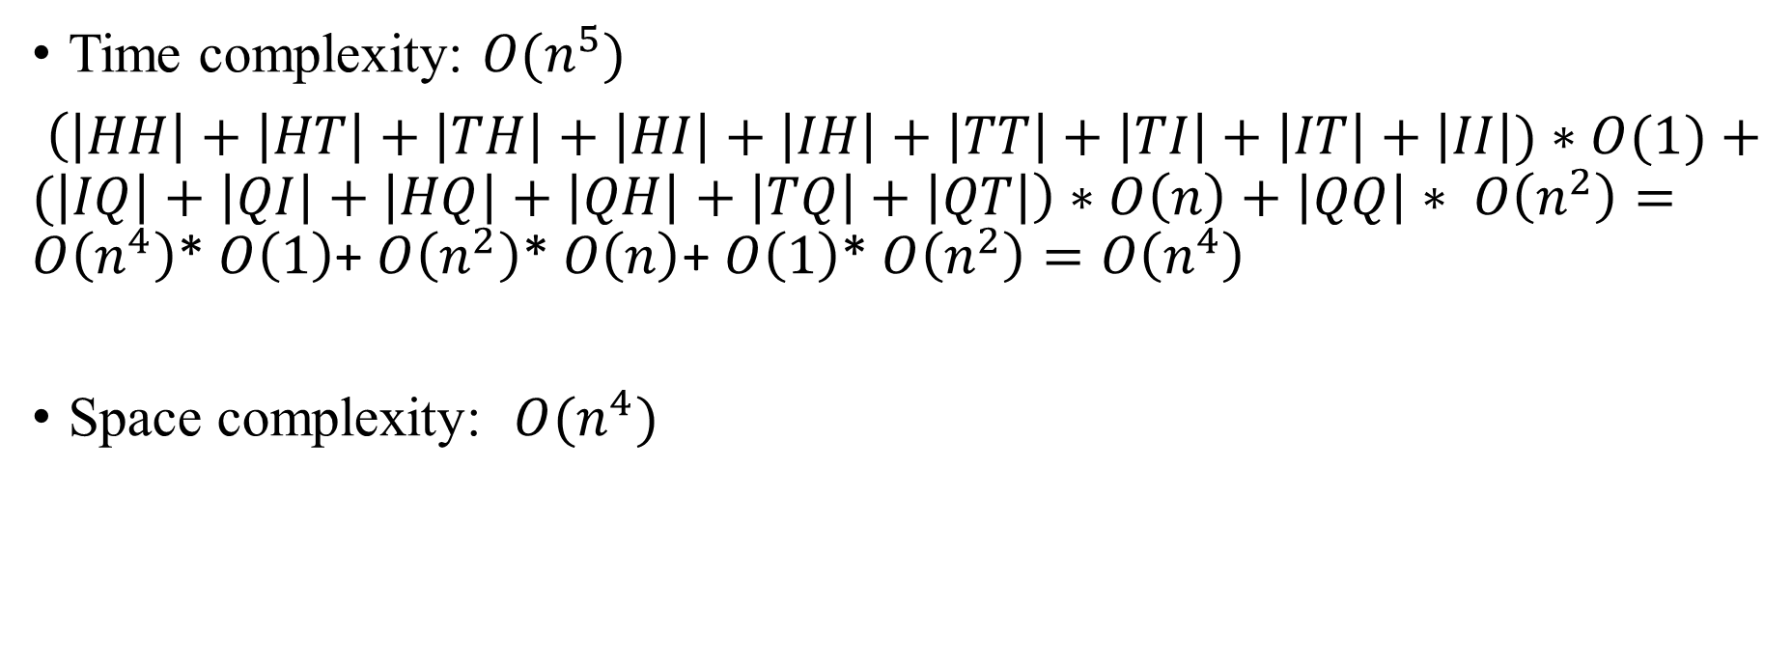
Complexity
Time complexity: $O(n^{5})$
$\left(\left|HH\right|+\left|HT\right|+\left|TH\right|+\left|HI\right|+\left|IH\right|+\left|TT\right|+\left|TI\right|+\left|IT\right|+\left|II\right|)∗O(1)+(\left|IQ\right|+\left|QI\right|+\left|HQ\right|+\left|QH\right|+\left|TQ\right|+\left|QT\right|\right)∗O\left(n\right)+\left|QQ\right|∗ O\left(n^{2}\right)=O\left(n^{4}\right)$* $O\left(1\right)$+ $O\left(n^{2}\right)$* $O\left(n\right)$+ $O\left(1\right)$* $O\left(n^{2}\right)=O\left(n^{4}\right)$
Space complexity: $O(n^{4})$

Slide 13
















Algorithm
$$1$$
$$i$$
$$j$$
$$p$$
$$r$$
$$n$$
$$x$$
$$1$$
$$i$$
$$j$$
$$p$$
$$r$$
$$n$$
$$y$$
$$IH⇒IT⇒QQ$$
$$II⇒QQ$$

Slide 14


Algorithm
$$1$$
$$i$$
$$j$$
$$p$$
$$q$$
$$r$$
$$n$$
$$x$$
$$1$$
$$i$$
$$j$$
$$p$$
$$r+1$$
$$n$$
$$y$$
$$HH⇒HT⇒TT⇒QT⇒QQ$$

