Slide 1
A Meta Decision Tree Approach for B-cell Epitope Mining
Yuh-Jyh Hu(胡毓志), Shun-Ning You
IEEE Conference on Computational Intelligence in Bioinformatics and Computational Biology (CIBCB),2016, Pages 1 - 5, Chiang Mai, Thailand
Speaker: Jheng-Yan Lyu
Date: Apr. 16, 2019

Slide 2
Abstract (1/2)
The ability of antibodies to respond to an antigen depends on the antibodies’ specific recognition of epitopes, which are sites of the antigen to which antibodies bind. An increase in the availability of protein sequences and structures has enabled the identification of conformational epitopes, using various computational methods. The meta learner, among various approaches, has proved its feasibility and comparable accuracy in B-cell epitope prediction in previous studies. Nevertheless, its performance highly depends on the classification results of its multiple epitope base predictors within the meta learning architecture.

Slide 3
Abstract (2/2)
We here propose bagging meta decision trees for epitope prediction to avoid the dependence on epitope prediction tools, and introduce 3D sphere-based attributes to improve prediction accuracy. Our experimental results demonstrate the superior performance of the bagging meta decision tree approach in comparison with single epitope predictors.

Slide 4
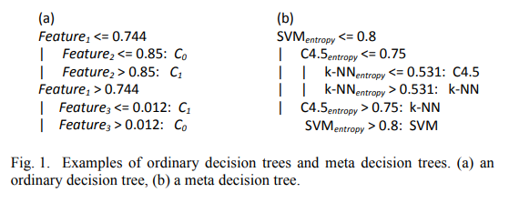
Meta Decision Tree

Slide 5
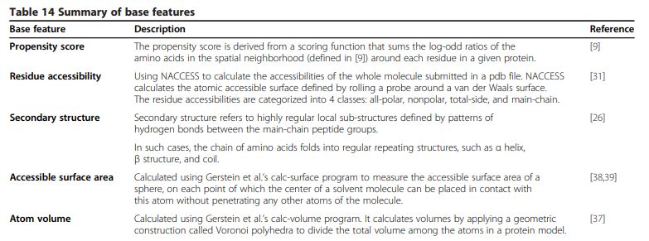
Base and Meta Attributes
surface probability , turns , accessible surface area defined by Lee and Richards , and two types of polarity defined by Ponnuswamy et al. and Grantham, respectively.

Slide 6
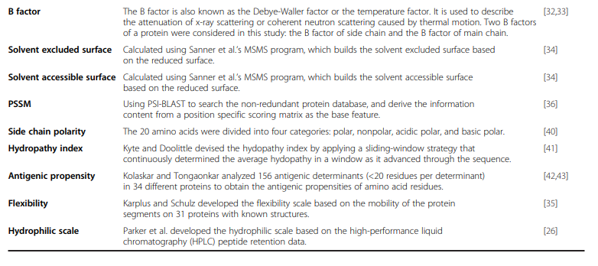
Base and Meta Attributes

Slide 7
Base and Meta Attributes
three meta attributes: epi_prob(x,B), entropy(x,B), and vote_epi_prop(x)
base classifiers :random forests (RF) , support vector machines (SVM) , C4.5 , k-NN , PART , BayesNet , JRip and VotedPerceptron.

Slide 8
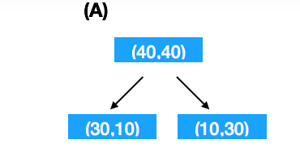
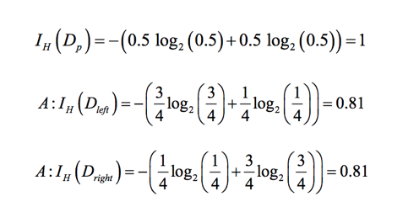

Base and Meta Attributes
entropy

Slide 9

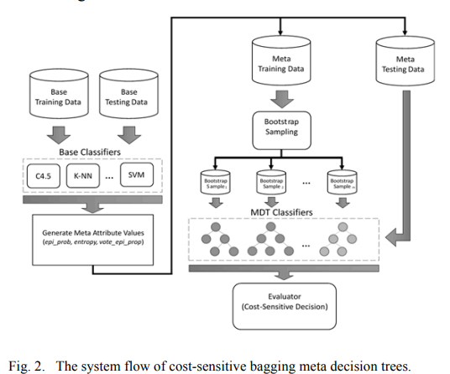
Construction of Meta Decision Trees

Slide 10

Bagging and Decision Threshold

Slide 11
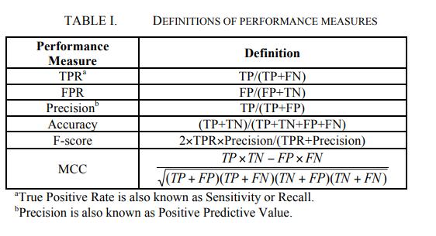
Results

Slide 12
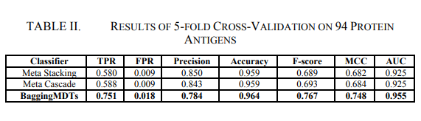
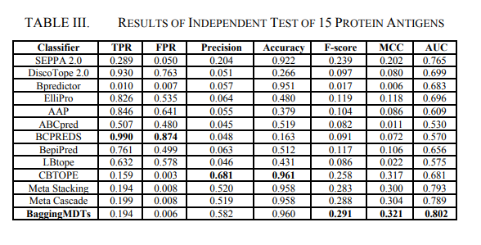
Results

Slide 13
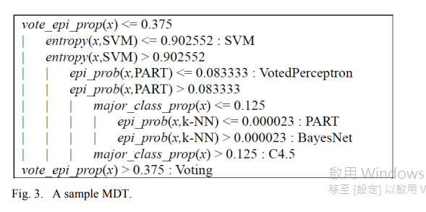
Results

