Slide 1
Using Deep Learning Neural Networks and Candlestick Chart Representation to Predict Stock Market
Rosdyana Mangir Irawan Kusuma, Trang-Thi Ho(賀耀華), Wei-Chun Kao(高偉鈞), Yu-Yen Ou(歐昱言) and Kai-Lung Hua(許佳龍)
arXiv:1903.12258v1, Feb 26, 2019
Presenter: Cheng-Han Wu
Date:2019/5/7

Slide 2
Abstract(1/2)
Stock market prediction is still a challenging problem because there are many factors effect to the stock market price such as company news and performance, industry performance, investor sentiment, social media sentiment and economic factors. This work explores the predictability in the stock market using Deep Convolutional Network and candlestick charts. The outcome is utilized to design a decision support framework that can be used by traders to provide suggested indications of future stock price direction. We perform this work using various types of neural networks like convolutional neural network, residual network and visual geometry group network. From stock market historical data, we converted it to candlestick charts.

Slide 3
Abstract(2/2)
Finally, these candlestick charts will be feed as input for training a Convolutional Neural Network model. This Convolutional Neural Network model will help us to analyze the patterns inside the candlestick chart and predict the future movements of stock market. The effectiveness of our method is evaluated in stock market prediction with a promising results 92.2% and 92.1% accuracy for Taiwan and Indonesian stock market dataset, respectively. The constructed model have been implemented as a web-based system freely available at http://140.138.155.216/deepcandle/ for predicting stock market using candlestick chart and deep learning neural networks.

Slide 4
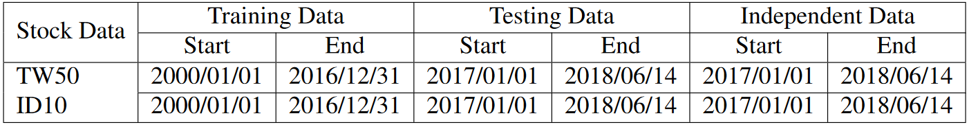
Data
Taiwan Top 50 Index (TW50)
Indonesia Top 10 index (ID10)

Slide 5
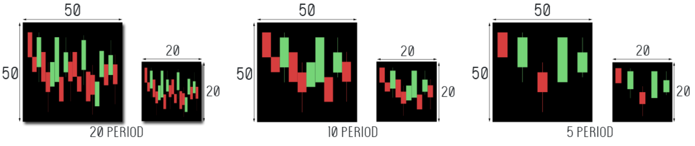
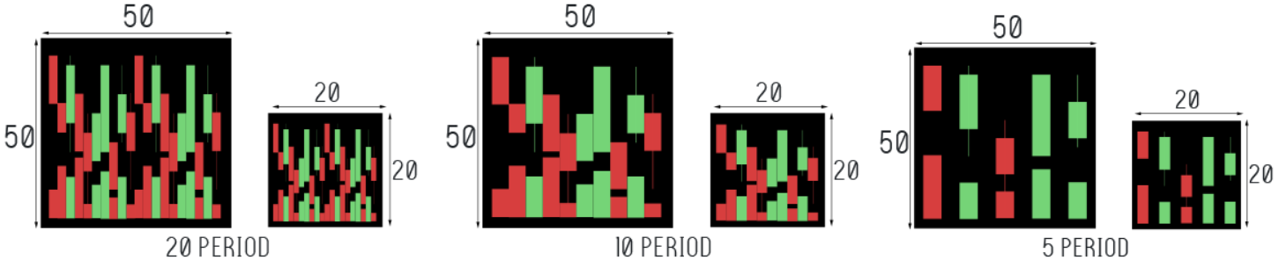
Input

Slide 6
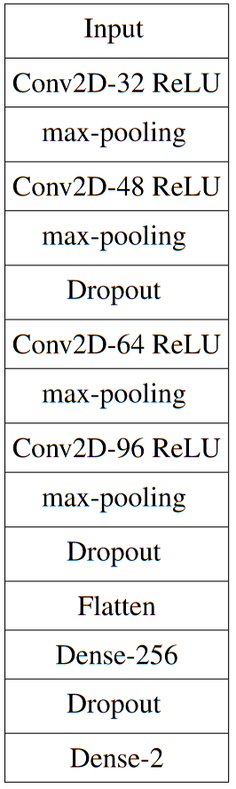
CNN

Slide 7
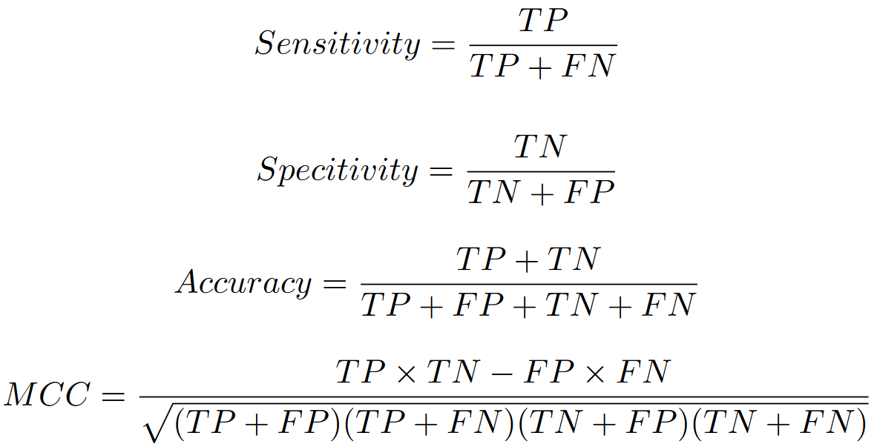
Evaluation

Slide 8
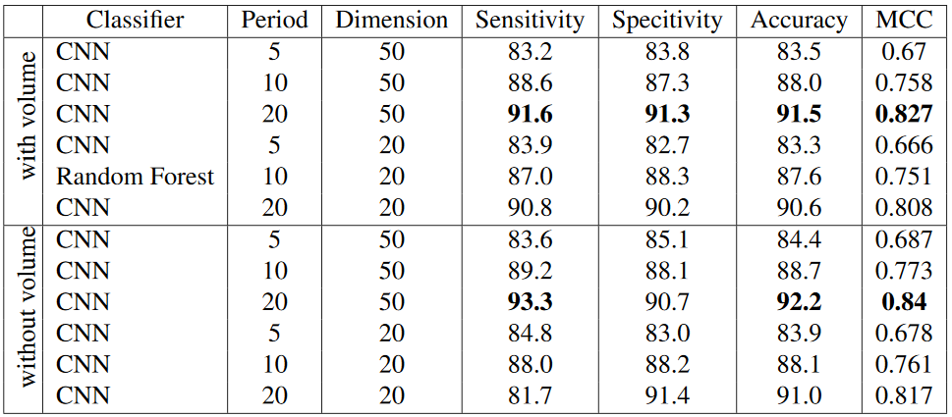
Experiment Result (TW50)

Slide 9
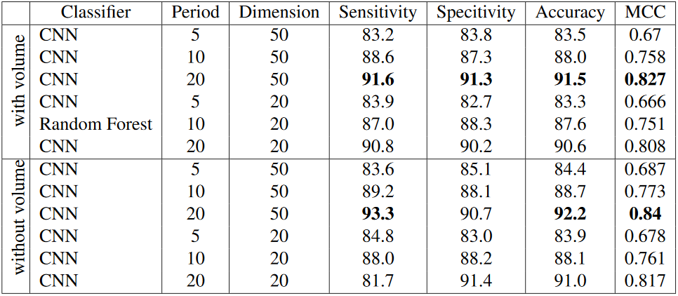
Experimental Result (ID10)

Slide 10
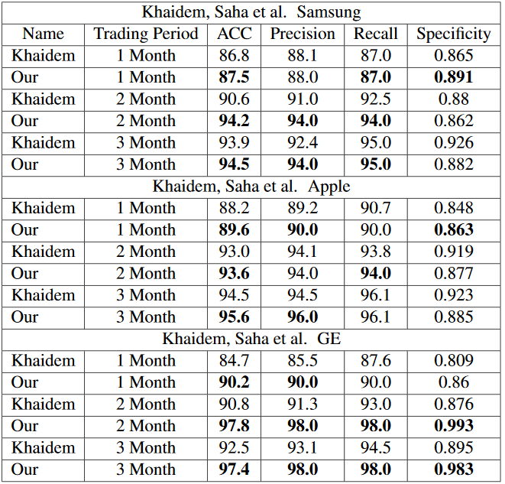
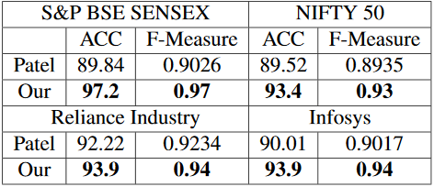
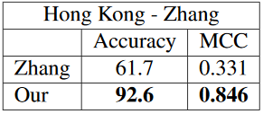
Experimental Result

