Slide 1
Longest substring palindrome after edit
Mitsuru Funakoshi, Yuto Nakashima, Shunsuke Inenaga, Hideo Bannai, and Masayuki Takeda
Annual Symposium on Combinatorial Pattern Matching (CPM 2018)
Presenter: Du-Cheng Wu
Date: May. 7, 2019

Slide 2
Abstract
It is known that the length of the longest substring palindromes (LSPals) of a given string T of length n can be computed in O(n) time by Manacher's algorithm [J. ACM '75]. In this paper, we consider the problem of finding the LSPal after the string is edited. We present an algorithm that uses O(n) time and space for preprocessing, and answers the length of the LSPals in O(log (min {sigma, log n })) time after single character substitution, insertion, or deletion, where sigma denotes the number of distinct characters appearing in T. We also propose an algorithm that uses O(n) time and space for preprocessing, and answers the length of the LSPals in O(l + log n) time, after an existing substring in T is replaced by a string of arbitrary length l.

Slide 3
Longest Substring Palindrome (LSPal)
X = bbabcbabaaba
Substring palindrome = (bb, bab, babcbab, abaaba)
Longest substring palindrome= babcbab
Find LSPal is O(n)

Slide 4
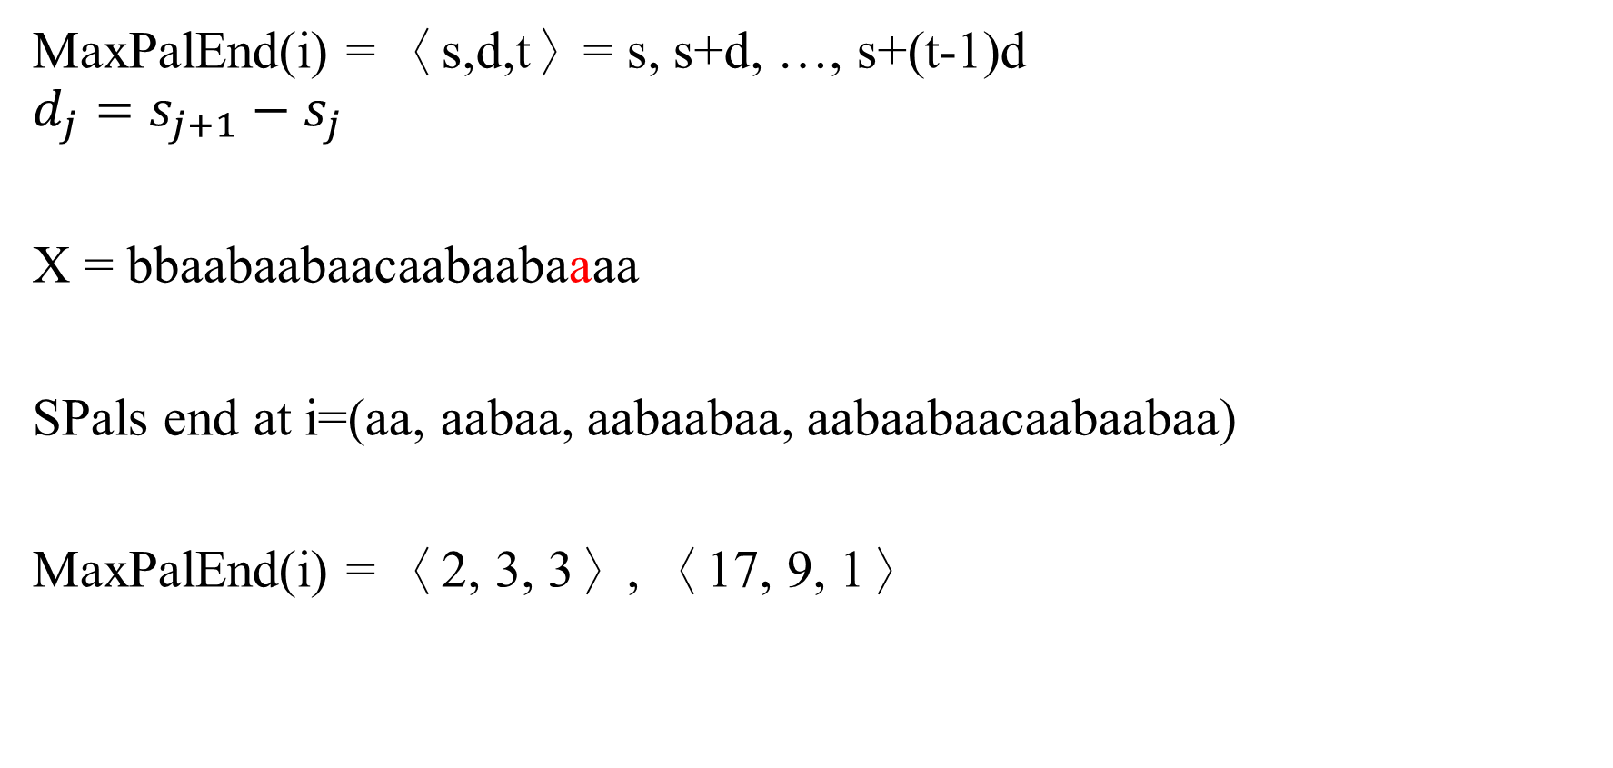
1-ELSPal
MaxPalEnd(i) = 〈s,d,t〉= s, s+d, …, s+(t-1)d
$$d_{j}=s_{j+1}−s_{j}$$
X = bbaabaabaacaabaabaaaa
SPals end at i=(aa, aabaa, aabaabaa, aabaabaacaabaabaa)
MaxPalEnd(i) = 〈2, 3, 3〉, 〈17, 9, 1〉

Slide 5
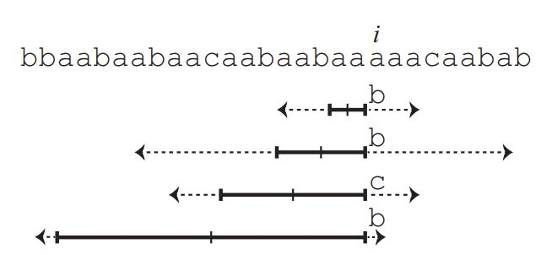

1-ELSPal substitutions
SPals end at i-1=(aa, aabaa, aabaabaa, aabaabaacaabaabaa)
MaxPalEnd(i-1) = 〈2, 3, 3〉, 〈17, 9, 1〉
LCE(${\text{i}\text{−}\text{s}\text{−(}\text{j}\text{−1)}\text{d}\text{−2}}^{R}$, i+1)
O(min{σ, $\log{n}$})

Slide 6
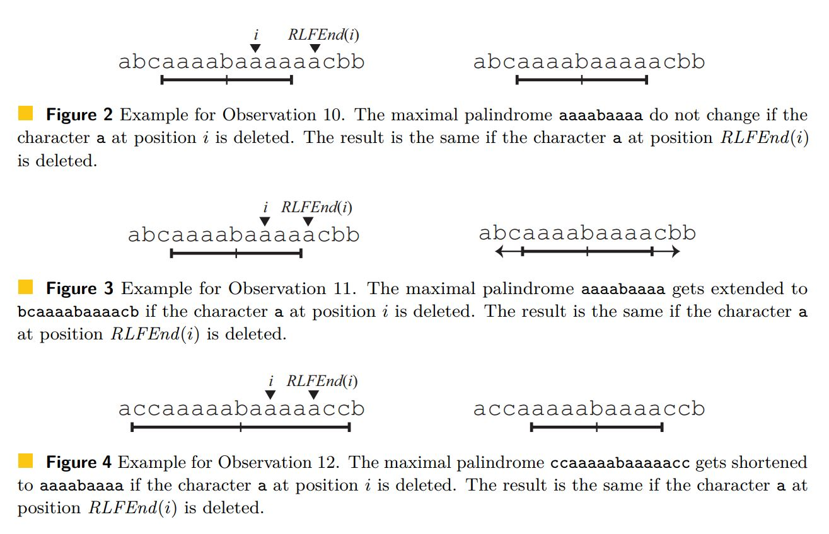
1-ELSPal deletion

Slide 7
1-ELSPal insertion
T′ = T[1…i]cT[i+1…n]
If c = T[i] or T[i+1] same as deletion
If c ≠ T[i] or T[i+1] same as substitution

Slide 8
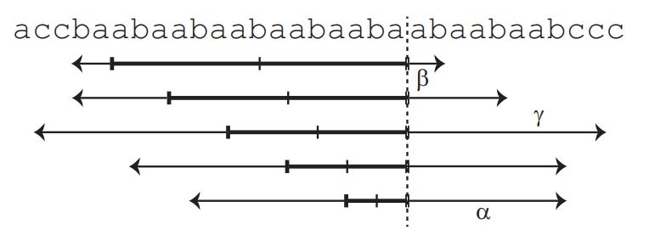
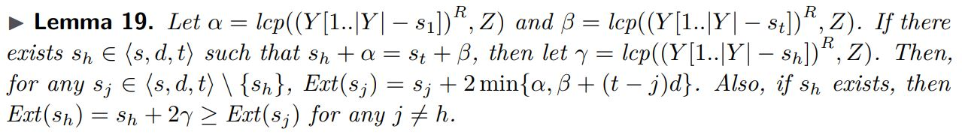
L-ELSPal
MaxPalEnd(i) =〈3, 3, 5〉

Slide 9
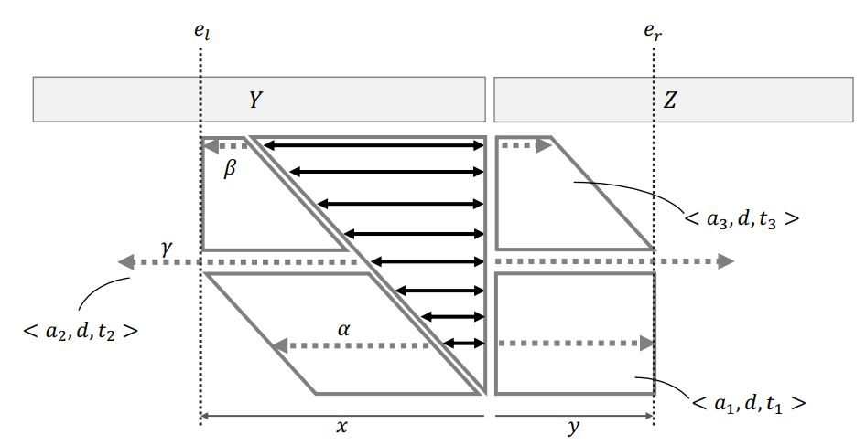

L-ELSPal
Time complexity = O(L+$\log{n}$)

Slide 10
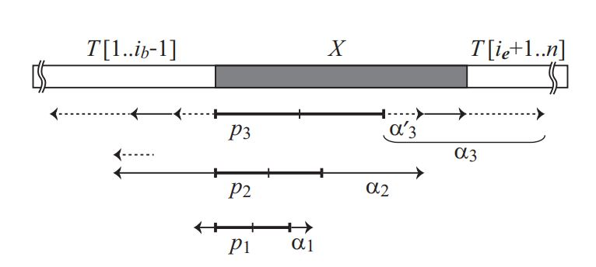
L-ELSPal center in X
Time and space complexity = O(L)

