Slide 1
Generative Adversarial Nets
Ian J. Goodfellow, Jean Pouget-Abadie, Mehdi Mirza, Bing Xu, David Warde-Farley, Sherjil Ozair, Aaron Courville, Yoshua Bengio
Advances in Neural Information Processing Systems 27 (NIPS 2014)， 2672-2680. Curran Associates, Inc.
Presenter: KeXin Zhu
Date: 2019/05/06
Notes:
https://academic.microsoft.com/conference/1127325140
https://academic.microsoft.com/conferences

Slide 2
Abstract (1/2)
We propose a new framework for estimating generative models via an adversarial process, in which we simultaneously train two models: a generative model G that captures the data distribution, and a discriminative model D that estimates the probability that a sample came from the training data rather than G. The training procedure for G is to maximize the probability of D making a mistake. This framework corresponds to a minimax two-player game.

Slide 3
Abstract (2/2)
In the space of arbitrary functions G and D, a unique solution exists, with G recovering the training data distribution and D equal to 1/2 everywhere. In the case where G and D are defined by multilayer perceptrons, the entire system can be trained with backpropagation. There is no need for any Markov chains or unrolled approximate inference networks during either training or generation of samples. Experiments demonstrate the potential of the framework through qualitative and quantitative evaluation of the generated samples.

Slide 4
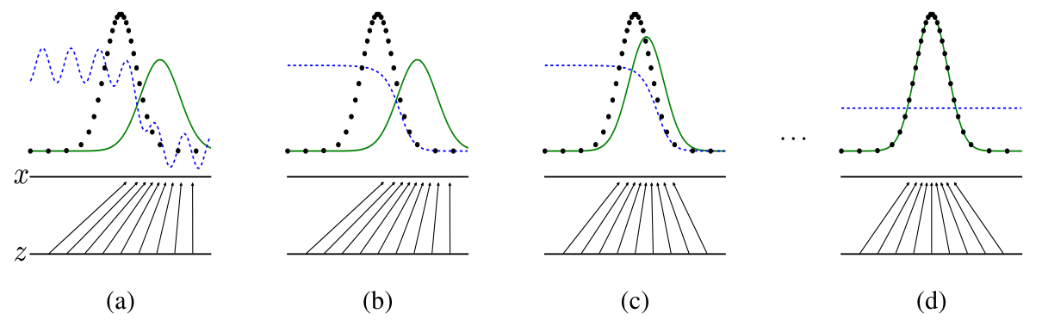
1 Generative Adversarial Nets
Notes:
.

Slide 5
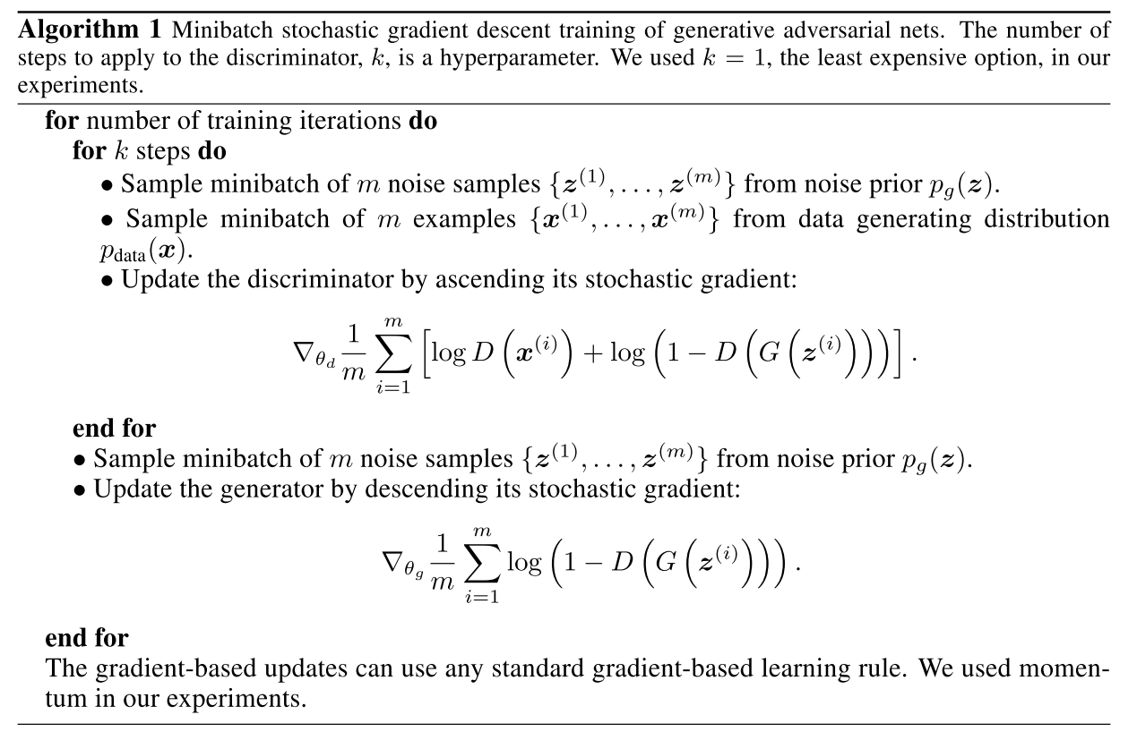
1 Generative Adversarial Nets

Slide 6
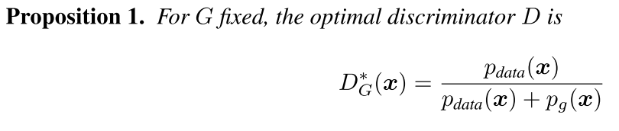
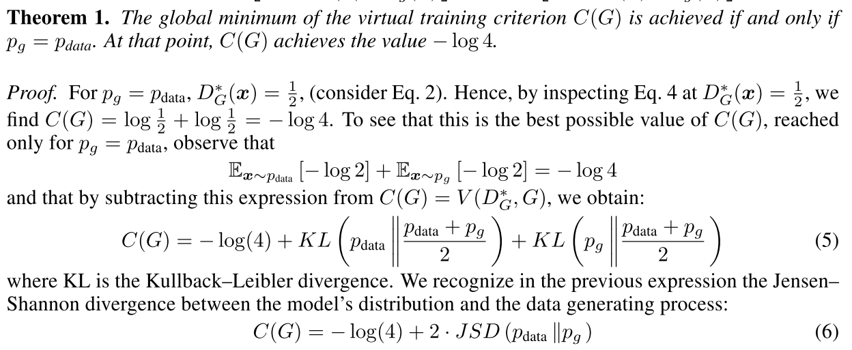
1 Generative Adversarial Nets

Slide 7
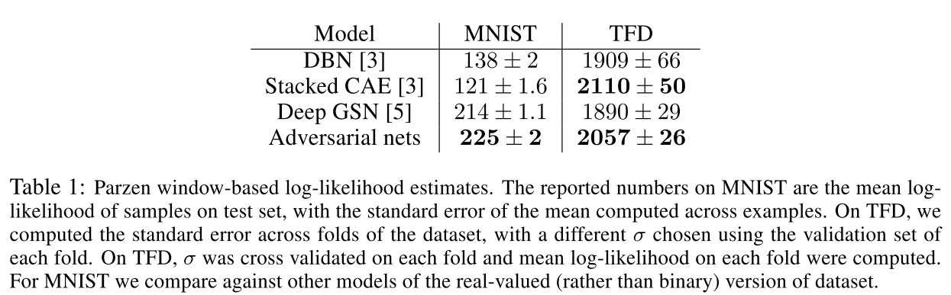
1 Generative Adversarial Nets

Slide 8
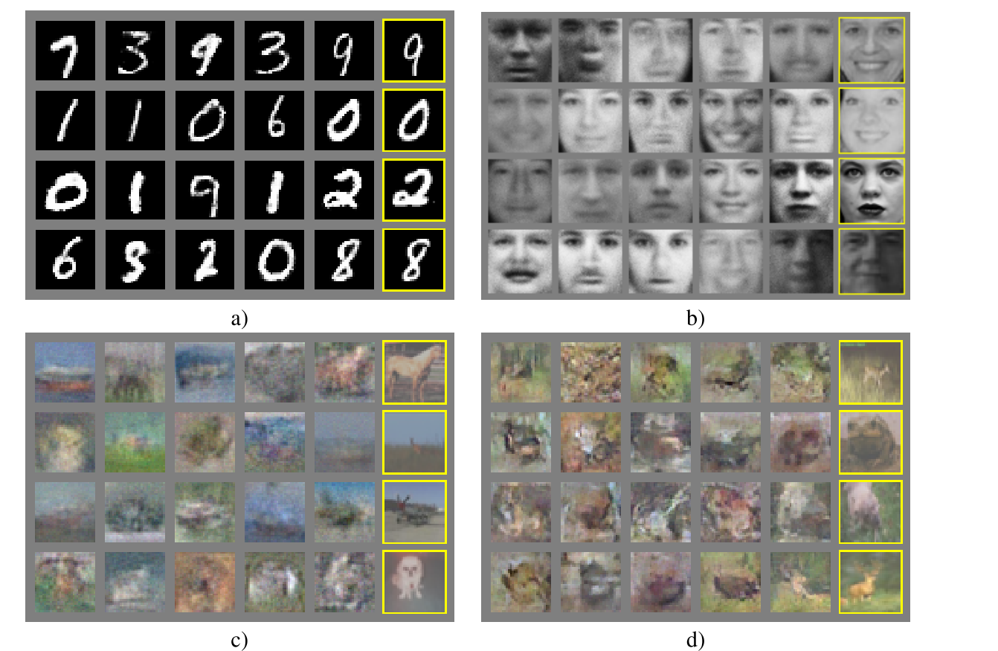
1 Generative Adversarial Nets

Slide 9
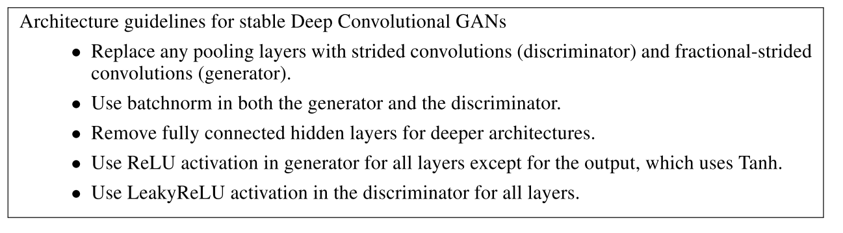
2 Deep Convolutional GANs (DCGAN)
Notes:
Radford, A., et al. (2015). "Unsupervised representation learning with deep convolutional generative adversarial networks." arXiv preprint arXiv:1511.06434.

Slide 10
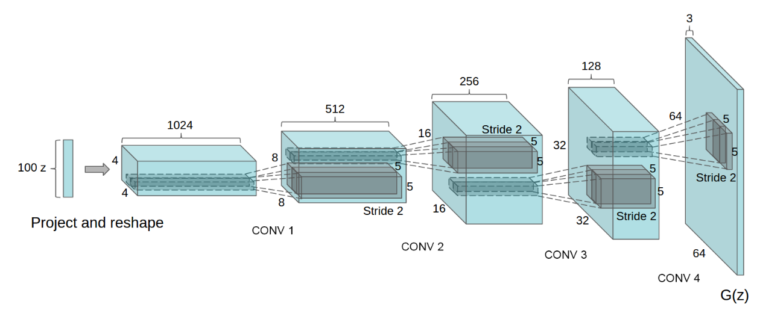
2 Deep Convolutional GANs (DCGAN)

Slide 11
2 Deep Convolutional GANs (DCGAN)

Slide 12
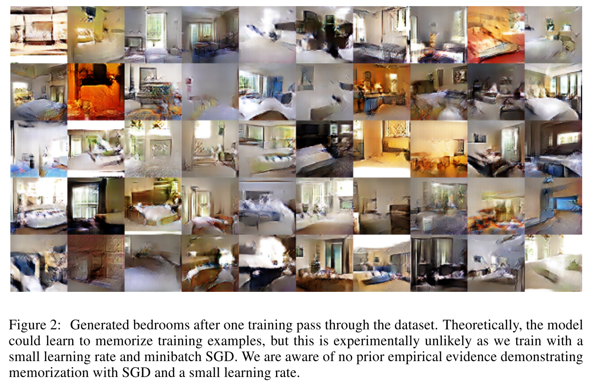
2 Deep Convolutional GANs (DCGAN)
Notes:
Radford, A., et al. (2015). "Unsupervised representation learning with deep convolutional generative adversarial networks." arXiv preprint arXiv:1511.06434.

Slide 13
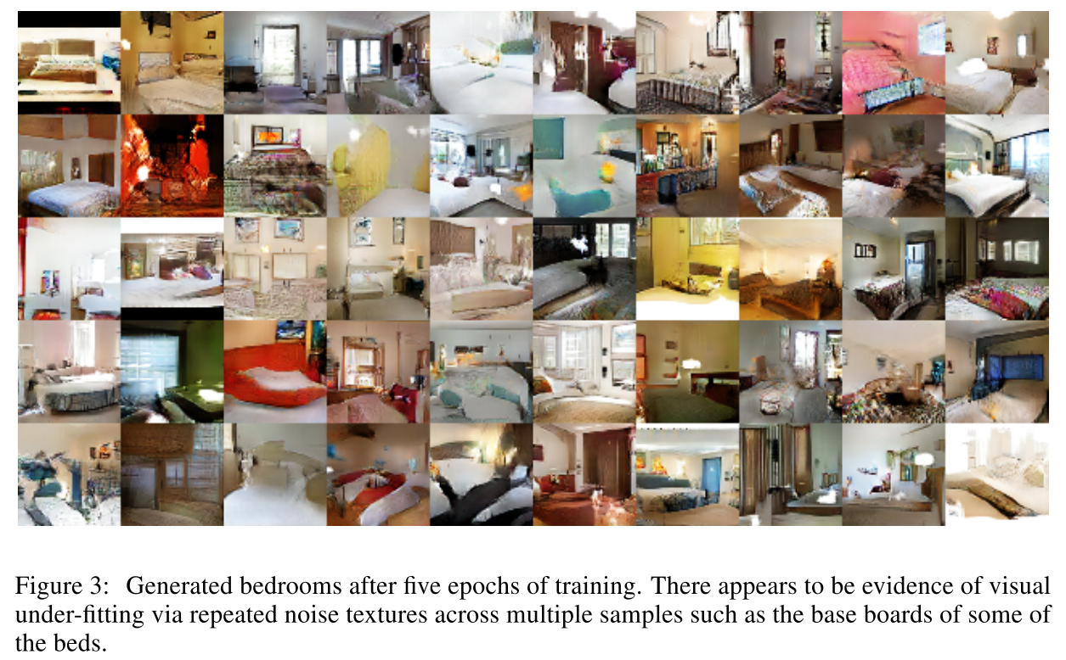
2 Deep Convolutional GANs (DCGAN)
Notes:
Radford, A., et al. (2015). "Unsupervised representation learning with deep convolutional generative adversarial networks." arXiv preprint arXiv:1511.06434.

Slide 14
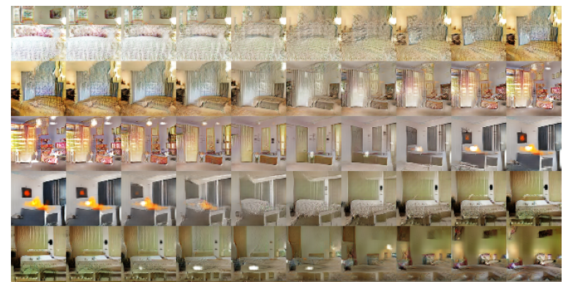
2 Deep Convolutional GANs (DCGAN)
Notes:
Radford, A., et al. (2015). "Unsupervised representation learning with deep convolutional generative adversarial networks." arXiv preprint arXiv:1511.06434.

Slide 15
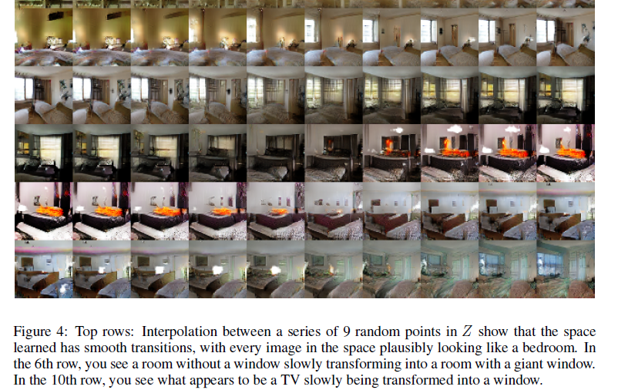
2 Deep Convolutional GANs (DCGAN)
Notes:
Radford, A., et al. (2015). "Unsupervised representation learning with deep convolutional generative adversarial networks." arXiv preprint arXiv:1511.06434.

Slide 16
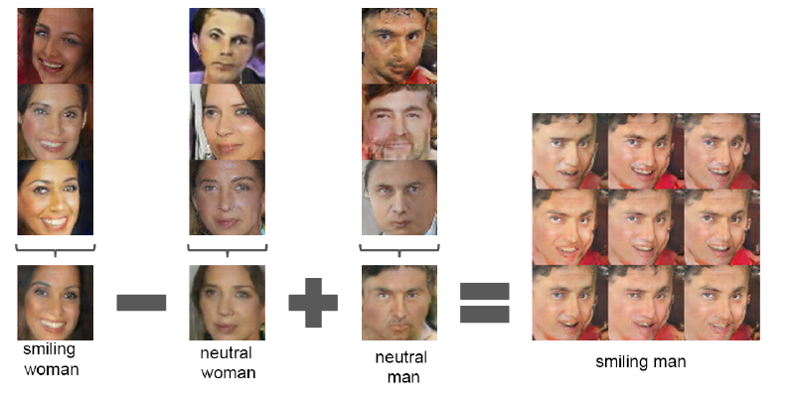
2 Deep Convolutional GANs (DCGAN)
Notes:
Radford, A., et al. (2015). "Unsupervised representation learning with deep convolutional generative adversarial networks." arXiv preprint arXiv:1511.06434.

Slide 17
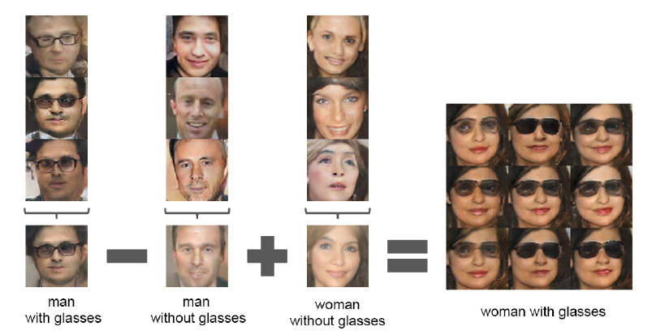
2 Deep Convolutional GANs (DCGAN)
Notes:
Radford, A., et al. (2015). "Unsupervised representation learning with deep convolutional generative adversarial networks." arXiv preprint arXiv:1511.06434.

Slide 18
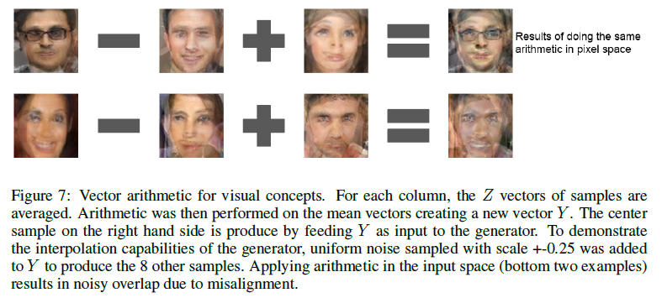
2 Deep Convolutional GANs (DCGAN)
Notes:
Radford, A., et al. (2015). "Unsupervised representation learning with deep convolutional generative adversarial networks." arXiv preprint arXiv:1511.06434.

Slide 19
2 Deep Convolutional GANs (DCGAN)
Notes:
Radford, A., et al. (2015). "Unsupervised representation learning with deep convolutional generative adversarial networks." arXiv preprint arXiv:1511.06434.

Slide 20
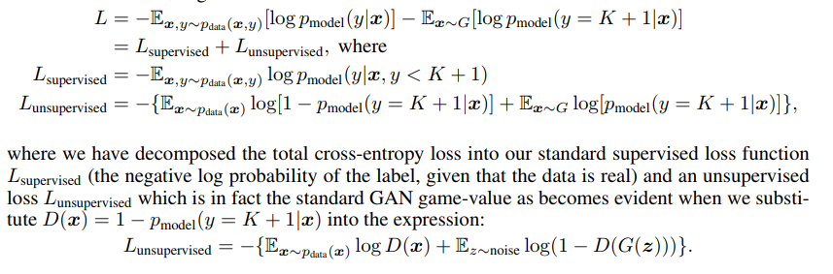
3 Semi-supervised learning
Notes:
https://www.msra.cn/zh-cn/news/features/gan-20170511

Slide 21
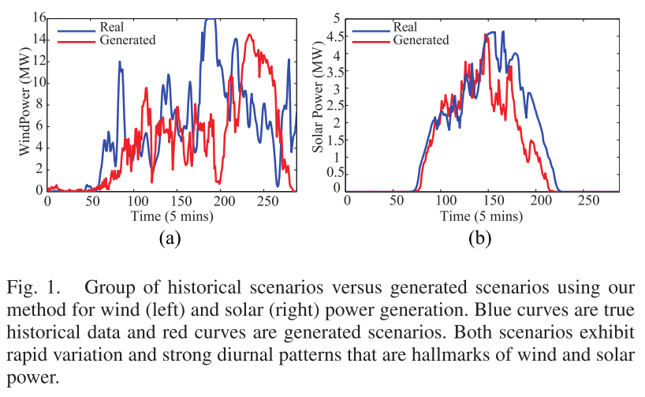
4 Scenario Generation Using Generative Adversarial Networks

Slide 22
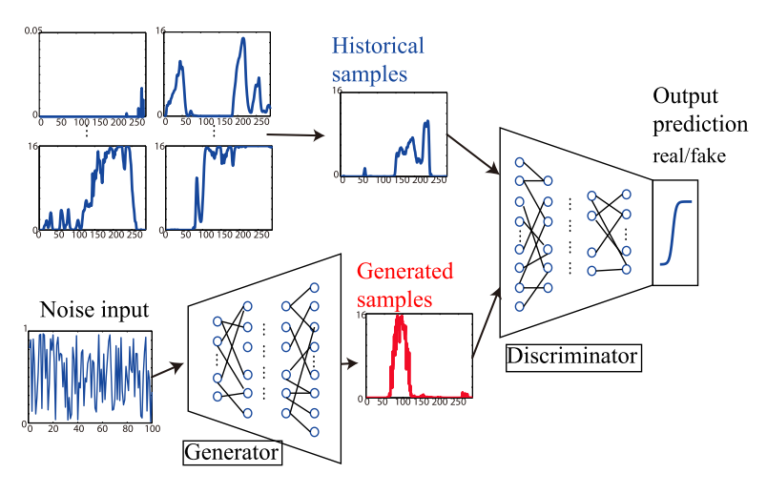
4 Scenario Generation Using Generative Adversarial Networks

Slide 23
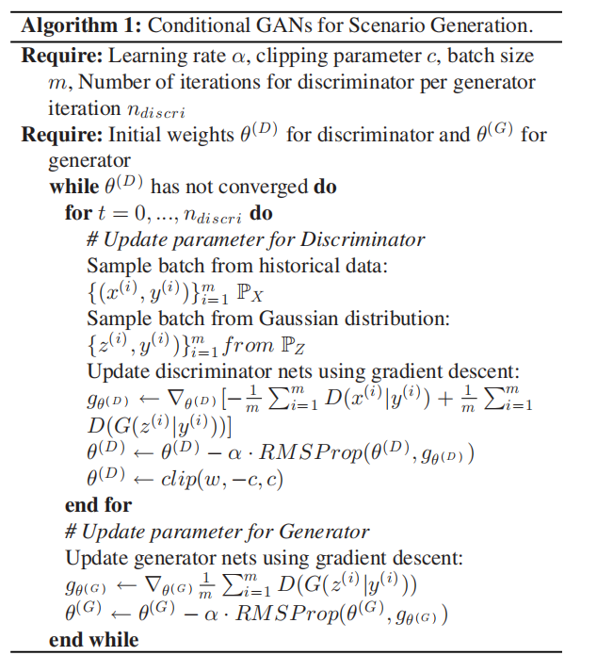
4 Scenario Generation Using Generative Adversarial Networks

Slide 24

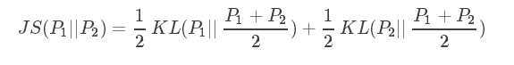

4 Scenario Generation Using Generative Adversarial Networks
KL散度：
JS散度：
Wasserstein距離：

Slide 25
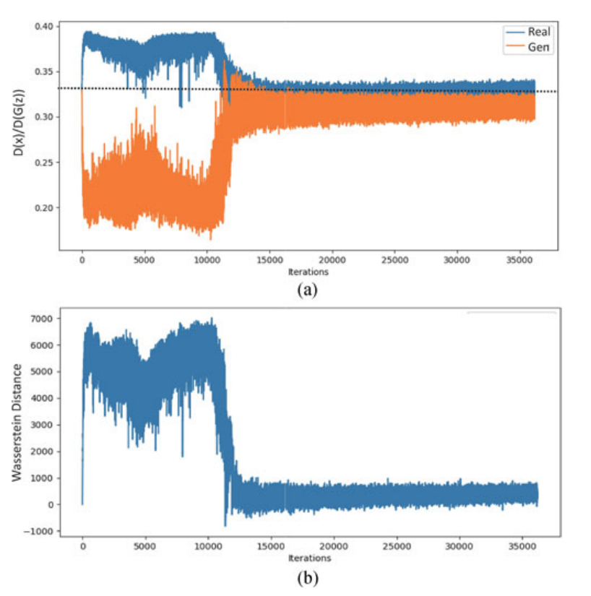
4 Scenario Generation Using Generative Adversarial Networks

Slide 26
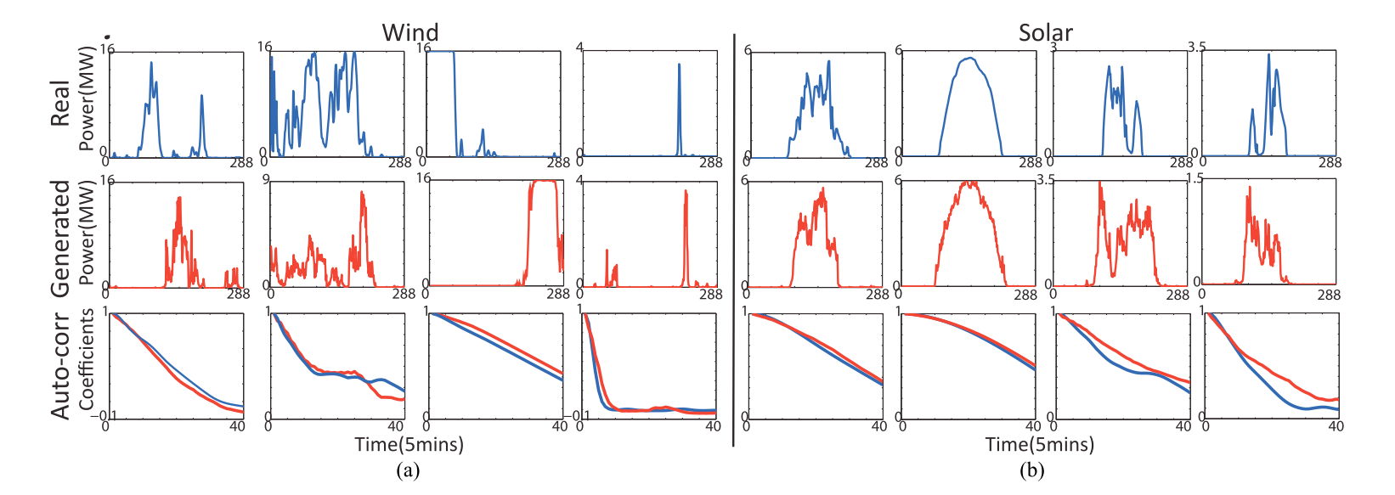
4 Scenario Generation Using Generative Adversarial Networks

