Slide 1
Batch Normalization:
Accelerating Deep Network Training by Reducing Internal Covariate Shift
Sergey Ioffe , Christian Szegedy
Submitted on 11 Feb 2015 (v1), last revised 2 Mar 2015 (this version, v3)
Presenter : Chia-Lin Chen
May 13, 2019

Slide 2
Abstract(1/3)
Training Deep Neural Networks is complicated by the fact that the distribution of each layer’s inputs changes during training, as the parameters of the previous layers change. This slows down the training by requiring lower learning rates and careful parameter initialization, and makes it notoriously hard to train models with saturating nonlinearities.
Batch Normalization:
Accelerating Deep Network Training by Reducing Internal Covariate Shift

Slide 3
Abstract(2/3)
We refer to this phenomenon as internal covariate shift, and address the problem by normalizing layer inputs. Our method draws its strength from making normalization a part of the model architecture and performing the normalization for each training mini-batch. Batch Normalization allows us to use much higher learning rates and be less careful about initialization. It also acts as a regularizer, in some cases eliminating the need for Dropout.
Batch Normalization:
Accelerating Deep Network Training by Reducing Internal Covariate Shift

Slide 4
Abstract(3/3)
Applied to a state-of-the-art image classiﬁcation model, Batch Normalization achieves the same accuracy with 14 times fewer training steps, and beats the original model by a signiﬁcant margin. Using an ensemble of batch normalized networks, we improve upon the best published result on ImageNet classiﬁcation: reaching 4.9% top-5 validation error (and 4.8% test error), exceeding the accuracy of human raters.
Batch Normalization:
Accelerating Deep Network Training by Reducing Internal Covariate Shift

Slide 5
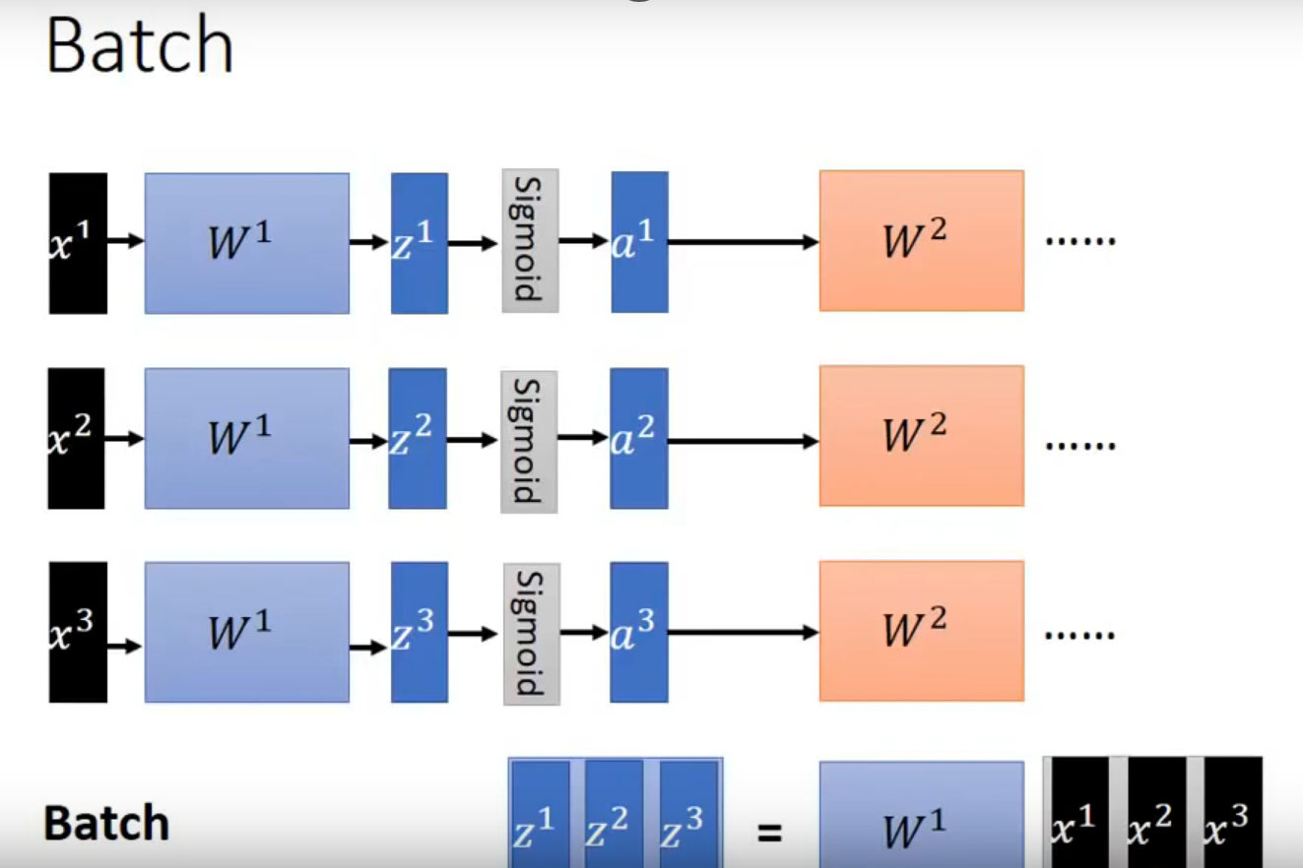

Slide 6
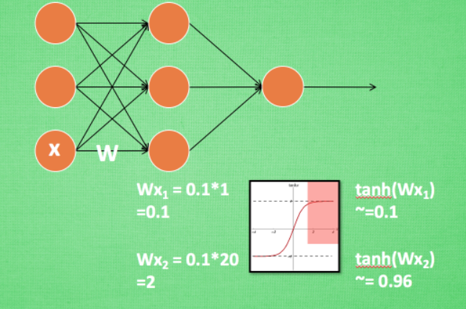
Batch Normalization:
Accelerating Deep Network Training by Reducing Internal Covariate Shift

Slide 7
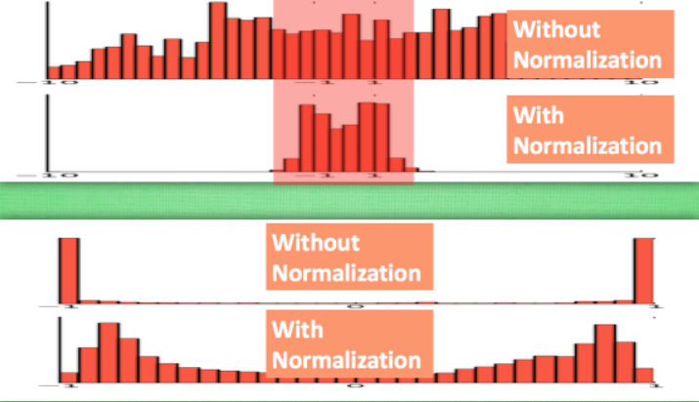

Slide 8


Slide 9
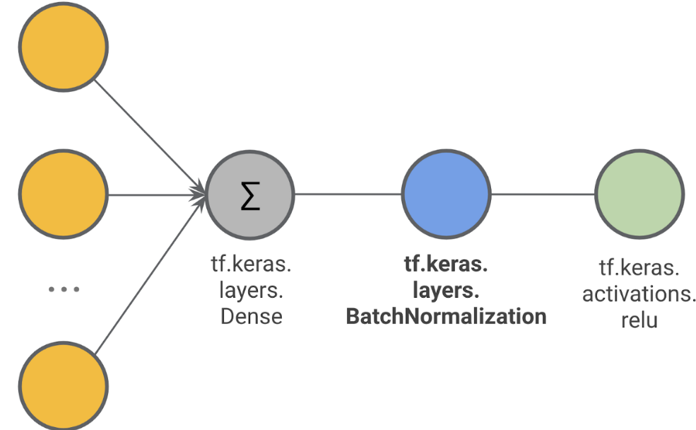

Slide 10
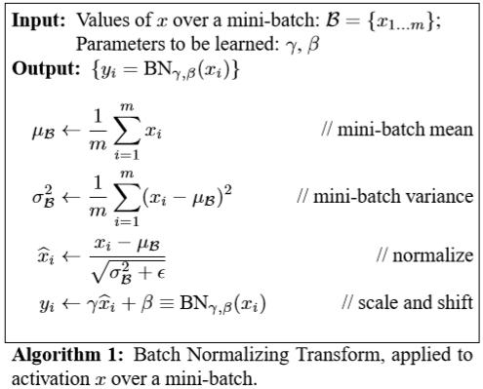
Batch Normalization:
Accelerating Deep Network Training by Reducing Internal Covariate Shift

Slide 11
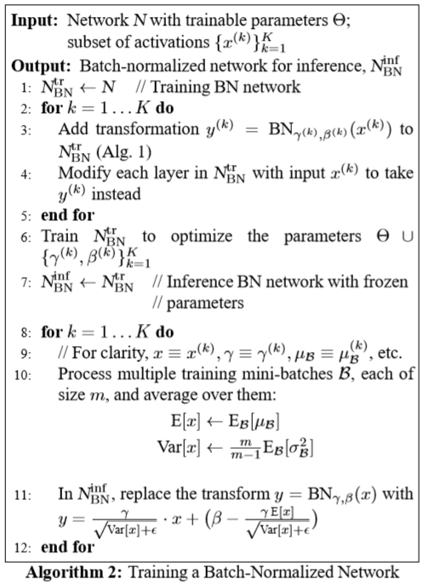
Batch Normalization:
Accelerating Deep Network Training by Reducing Internal Covariate Shift

Slide 12
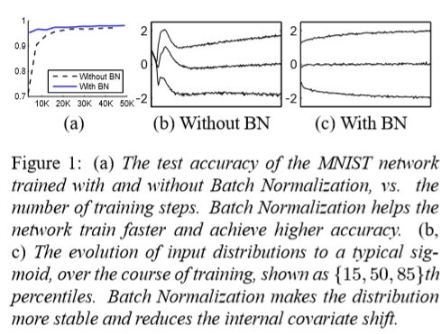
Experimental Results(1/3)
Batch Normalization:
Accelerating Deep Network Training by Reducing Internal Covariate Shift

Slide 13
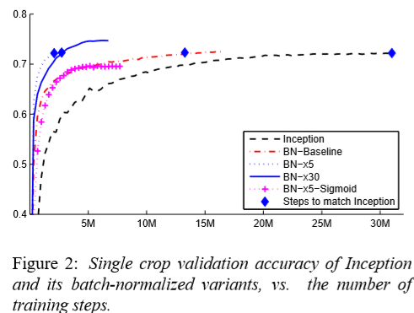
Experimental Results(2/3)
Batch Normalization:
Accelerating Deep Network Training by Reducing Internal Covariate Shift

Slide 14
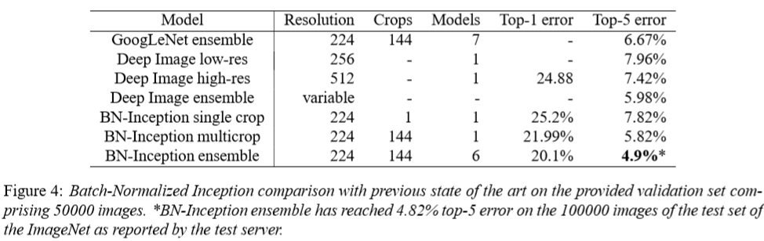
Experimental Results(3/3)
Batch Normalization:
Accelerating Deep Network Training by Reducing Internal Covariate Shift

Slide 15
Thank you!

