Slide 1
An OpenMP-based tool for finding longest common subsequence in bioinformatics
Rayhan Shikder, Parimala Thulasiraman, Pourang Irani and Pingzhao Hu
BMC Research Notes, 2019.
Presenter: Guo-Fong Huang
Date: May 13, 2019

Slide 2
Abstract
Finding the longest common subsequence (LCS) among sequences is NP-hard. This is an important problem in bioinformatics for DNA sequence alignment and pattern discovery. In this research, we propose new CPU-based parallel implementations that can provide significant advantages in terms of execution times, monetary cost, and pervasiveness in finding LCS of DNA sequences in an environment where Graphics Processing Units are not available. For general purpose use, we also make the OpenMP-based tool publicly available to end users.

Slide 3
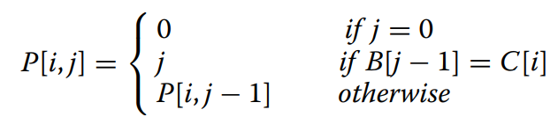
Preliminaries(1/2)
A = gtac B = cttc
LCS (A,B ) = tc
Σ={a,c,g,t} C ={3,4,1,2}
P | 0 | 1 | 2 | 3 | 4
a | 0 | 0 | 0 | 0 | 0
c | 0 | 2 | 2 | 2 | 5
g | 0 | 0 | 0 | 0 | 0
t | 0 | 0 | 3 | 4 | 4

Slide 4
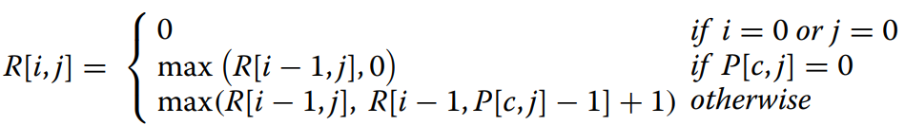
Preliminaries (2/2)
A = gtac B = cttc
LCS (A,B ) = tc C ={3,4,1,2}
R[4,4] = max(R[3,4], R[3,P[2,4]-1]+1)
B A | 0 | 1 | 2 | 3 | 4
0 | 0 | 0 | 0 | 0 | 0
1 | 0 | 0 | 0 | 0 | 0
2 | 0 | 0 | 1 | 1 | 1
3 | 0 | 0 | 1 | 1 | 1
4 | 0 | 1 | 1 | 1 | 2
P | 0 | 1 | 2 | 3 | 4
a | 0 | 0 | 0 | 0 | 0
c | 0 | 2 | 2 | 2 | 5
g | 0 | 0 | 0 | 0 | 0
t | 0 | 0 | 3 | 4 | 4

Slide 5
OpenMP
在 for 迴圈前面加上 #pragma omp parallel，
就會將裡面的東西平行化處理。
#pragma omp parallel
for (int i = 0; i < 6; i++)
{
cout << i ;
}
會輸出任意順序的0~5

Slide 6
OpenMP
Static:
根據指定的chunk size，用round-robin的方法分配
for迴圈裡面的iteration給thread。
沒指定size的話會依據thread數量做平均分配。
Dynamic:
跟static差不多，只是動態分配給各thread。
沒指定size的話chunck size是1。
Guided:
一開始會分配很大的數量，然後逐漸遞減，
負載平衡。

Slide 7
OpenMP
OpenMP:
單節點，簡單上來說就是用一台電腦中的cpu的各 個core來跑平行。
MPI-OpenMP:
使用網路連結不同電腦，用各個電腦跑平行 處 理。

Slide 8
Data sets
1: A simulated DNA sequence data, collected from University of California Riverside’s (UCR) random DNA sequence generator.
The lengths of the different pairs of sequences are between 128 base pairs to 32,768 base pairs

Slide 9
Data sets
The second data set consists of 8 virus genome sequence pairs and two entire chromosome genome sequence pairs of two eukaryotes, collected from the website of National Center for Biotechnology Information (NCBI).
The selected sequence lengths vary from 359 base pairs to 32,276 base pairs for the viruses, and from 15,05,371 base pairs to 1,61,99,981 base pairs for the eukaryotes.

Slide 10
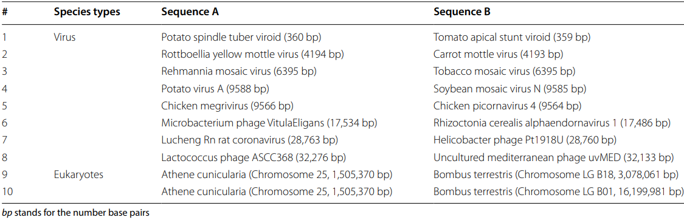
Data sets

Slide 11
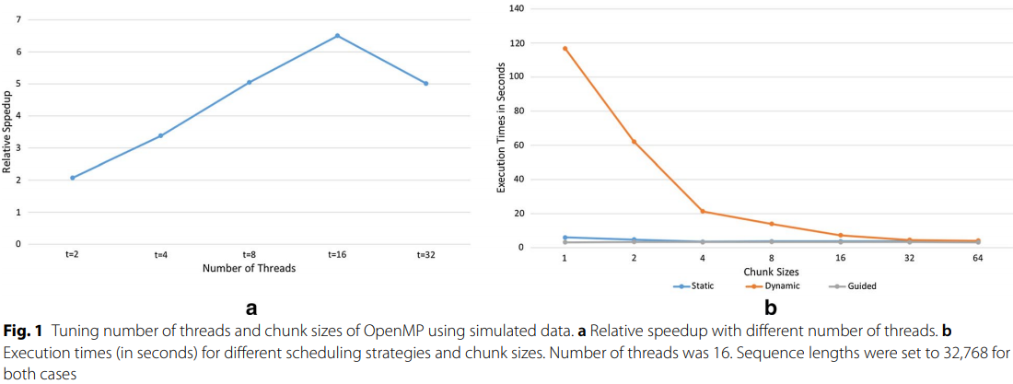
Experience result

Slide 12
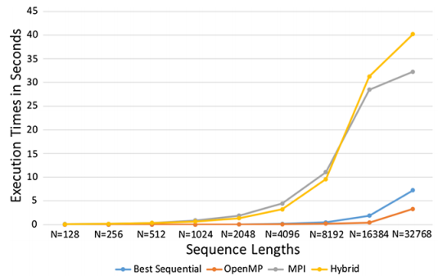
Experience result

Slide 13
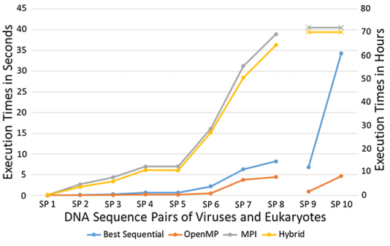
Experience result

