Slide 1
Antibody-based molecular communication for targeted drug delivery systems
Youssef Chahibi, Ian F. Akyildiz, Sang Ok Song
36th Annual International Conference of the IEEE Engineering in Medicine and Biology Society, 2014, Pages 5707 - 5710, Chicago, IL, USA
Speaker: Jheng-Yan Lyu
Date: May 13, 2019

Slide 2
Abstract (1/2)
Antibody-based drug delivery systems (ADDS) are established as the most promising therapeutic methods for the treatment of human cancers and other diseases. ADDS are composed of small molecules (antibodies) that selectively bind to receptors (antigens) expressed by the diseased cells. In this paper, the Molecular Communication (MC) paradigm, where the delivery of molecules is abstracted as the delivery of information, is extended to be applied to the design and engineering of ADDS. The authors have previously developed a straightforward framework for the modeling of Particulate Drug Delivery Systems (PDDS) using nano-sized molecules.

Slide 3
Abstract (2/2)
Here, the specificities of antibody molecules are taken into account to provide an analytical model of ADDS transport. The inputs of the MC model of PDDS are the geometric properties of the antibodies and the topology of the blood vessels where they are propagated. Numerical results show that the analytical MC model is in good agreement with finite-element simulations, and that the anisotropy is an important factor influencing ADDS.

Slide 4
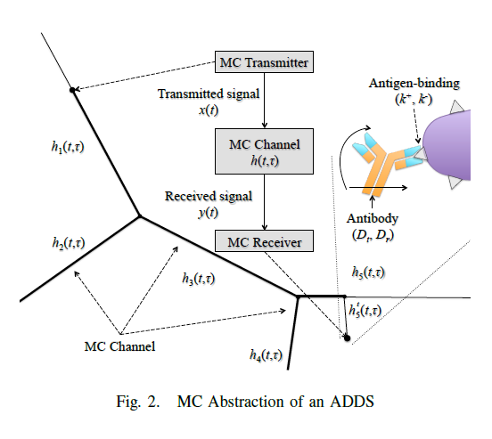
MC ADDS MODEL
MC ADDS transport model
MC ADDS diffusion parameters
translational diffusion coefficient Dt
radial diffusion coefficient Dr

Slide 5

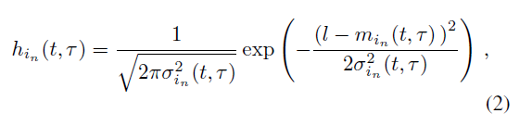
MC ADDS transport model

Slide 6



MC ADDS transport model

Slide 7

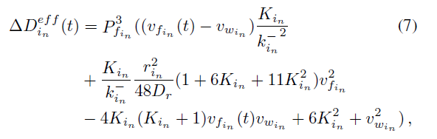
MC ADDS transport model

Slide 8
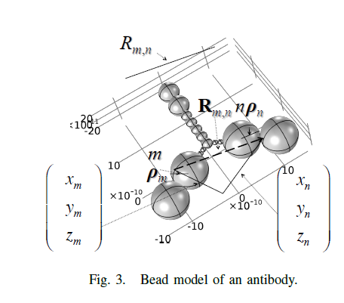


MC ADDS diffusion parameters
translational diffusion coefficient Dt
radial diffusion coefficient Dr
k_{B} is Boltzmann coefficient

Slide 9

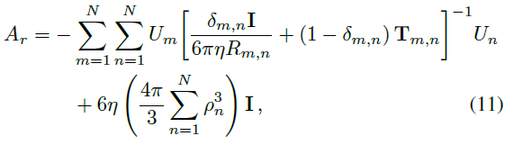
MC ADDS diffusion parameters

Slide 10
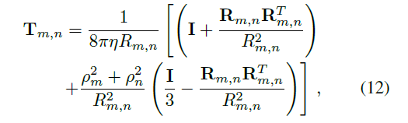
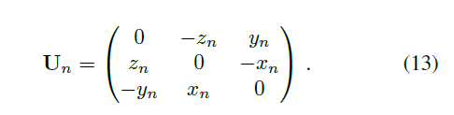
MC ADDS diffusion parameters

Slide 11
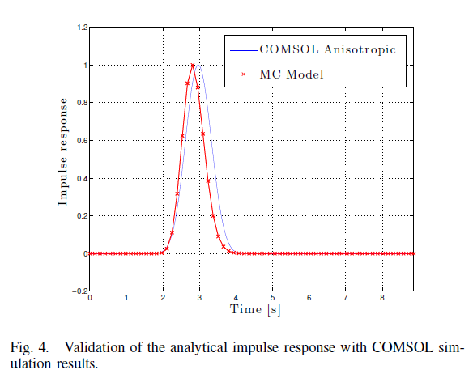
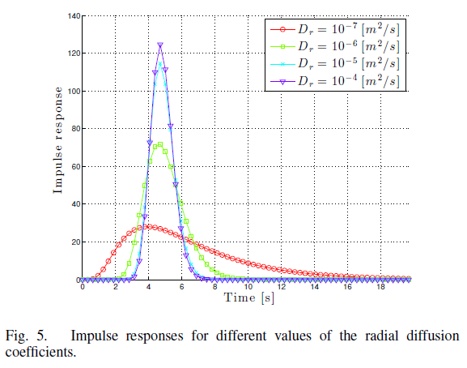
Results

Slide 12
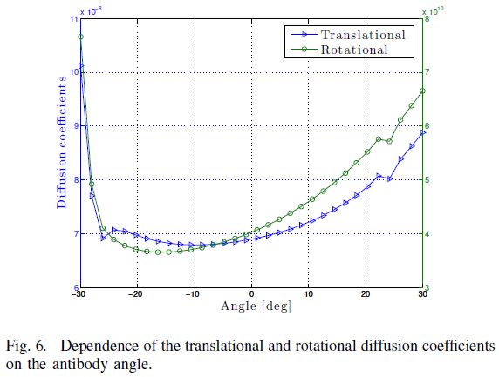
Results

