Slide 1
A Diagonal Algorithm for the Longest Common Increasing Subsequence Problem
Student: Shou-Fu Lo (羅守莆)
Advisor: Prof. Chang-Biau Yang (楊昌彪)
Date: May 20, 2019

Slide 2



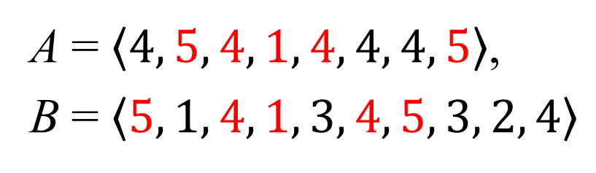
Longest Common Increasing Subsequence (LCIS) Problem
A = $\left\langle 4, 5, 4, 1, 4, 4, 4, 5\right\rangle$,
B = $\left\langle 5, 1, 4, 1, 3, 4, 5, 3, 2, 4\right\rangle$
LCS = $\left\langle \text{5, 4, 1, 4, }5\right\rangle$
LCIS =$\left\langle \text{1, 4}\text{, 5}\right\rangle$
A = $\left\langle 4, 5, 4, 1, 4, 4, 4, 5\right\rangle$,
B = $\left\langle 5, 1, 4, 1, 3, 4, 5, 3, 2, 4\right\rangle$
LCS = $\left\langle \text{5, 4, 1, 4, }5\right\rangle$
LCIS =$\left\langle \text{1, 4}\text{, 5}\right\rangle$

Slide 3
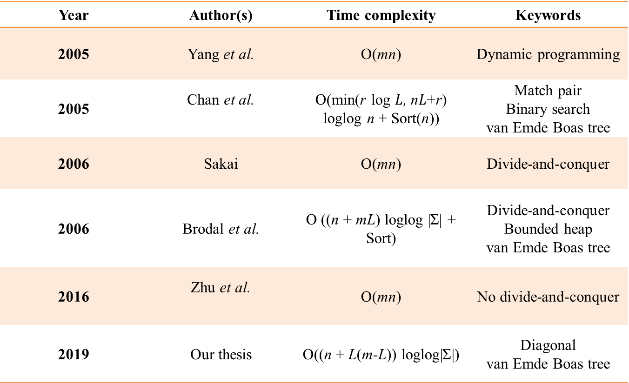
Longest Common Increasing Subsequence (LCIS) Problem
Year | Author(s) | Time complexity | Keywords
2005 | Yang et al. | O(mn) | Dynamic programming
2005 | Chan et al. | O(min(r log $L$, n$L$+r) loglog n + Sort(n)) | Match pair Binary search van Emde Boas tree
2006 | Sakai | O(mn) | Divide-and-conquer
2006 | Brodal et al. | O ((n + mL) loglog |Σ| + Sort) | Divide-and-conquer Bounded heap van Emde Boas tree
2016 | Zhu et al. | O(mn) | No divide-and-conquer
2019 | Our thesis | O((n + L(m-L)) loglog|Σ|) | Diagonal van Emde Boas tree

Slide 4
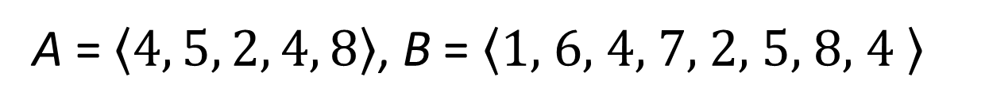
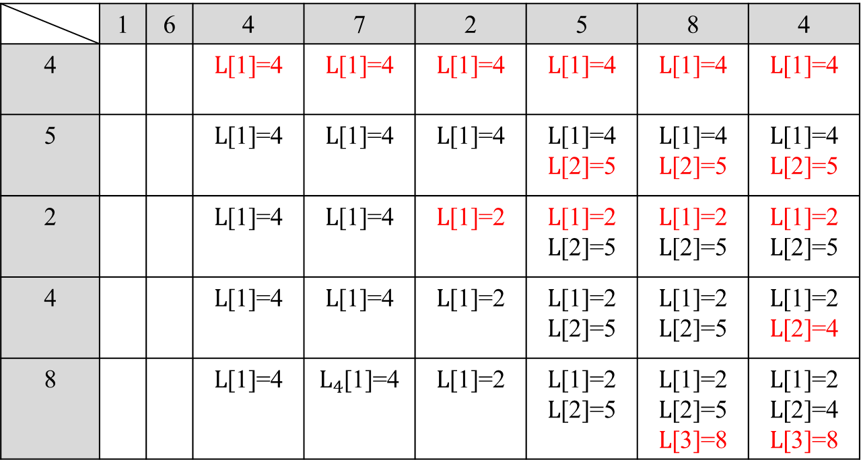
The DP Algorithm of Yang et al. (LCIS)
A = $\left\langle 4, 5, 2, 4, 8\right\rangle$, B = $\left\langle \text{1, }6\text{, }\text{4}\text{, 7, 2, 5, 8, 4} \right\rangle$
 | 1 | 6 | 4 | 7 | 2 | 5 | 8 | 4
4 |  |  | $L$[1]=4 | $L$[1]=4 | $L$[1]=4 | $L$[1]=4 | $L$[1]=4 | $L$[1]=4
5 |  |  | $L$[1]=4 | $L$[1]=4 | $L$[1]=4 | $L$[1]=4 $L$[2]=5 | $L$[1]=4 $L$[2]=5 | $L$[1]=4 $L$[2]=5
2 |  |  | $L$[1]=4 | $L$[1]=4 | $L$[1]=2 | $L$[1]=2 $L$[2]=5 | $L$[1]=2 $L$[2]=5 | $L$[1]=2 $L$[2]=5
4 |  |  | $L$[1]=4 | $L$[1]=4 | $L$[1]=2 | $L$[1]=2 $L$[2]=5 | $L$[1]=2 $L$[2]=5 | $L$[1]=2 $L$[2]=4
8 |  |  | $L$[1]=4 | $L_{4}$[1]=4 | $L$[1]=2 | $L$[1]=2 $L$[2]=5 | $L$[1]=2 $L$[2]=5 $L$[3]=8 | $L$[1]=2 $L$[2]=4 $L$[3]=8
Notes:
記錄每次掃描A的元素對應的B的位置與LCIS長度

Slide 5
The Diagonal Algorithm of Nakatsu et al. (LCS)
A = agttc, B = gtagtc
 | g | t | a | g | t | c
a |  |  | 3
g | 1 |  |  | 4
t |  | 2 |  |  | 5
t |  |  |  |  | 5
c |  |  |  |  |  | 6
length
 | 1 | 2 | 3 | 4
1 | 3 | 4 | 5
2 | 1 | 2 | 5 | 6
round

Slide 6
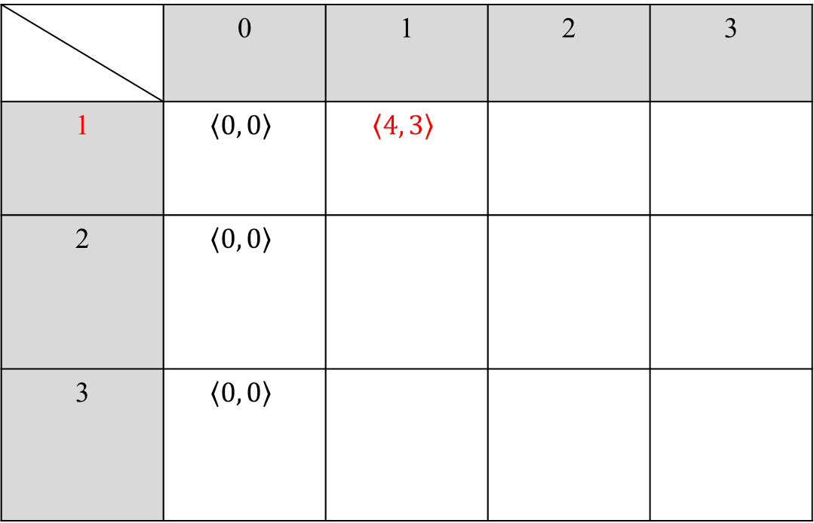
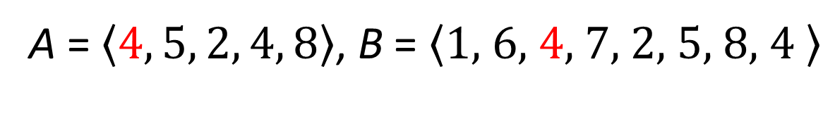
Our LCIS Algorithm (1/9)
A = $\left\langle 4, 5, 2, 4, 8\right\rangle$, B = $\left\langle \text{1, }\text{6, }\text{4}\text{, 7, 2, 5, 8, 4} \right\rangle$
s(length)
 | 0 | 1 | 2 | 3
1 | $$\left\langle 0, 0\right\rangle$$ | $$\left\langle 4, 3\right\rangle$$
2 | $$\left\langle 0, 0\right\rangle$$
3 | $$\left\langle 0, 0\right\rangle$$
r(round)

Slide 7
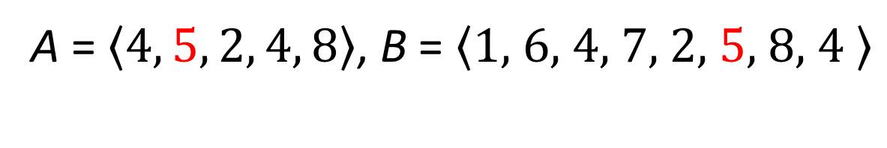
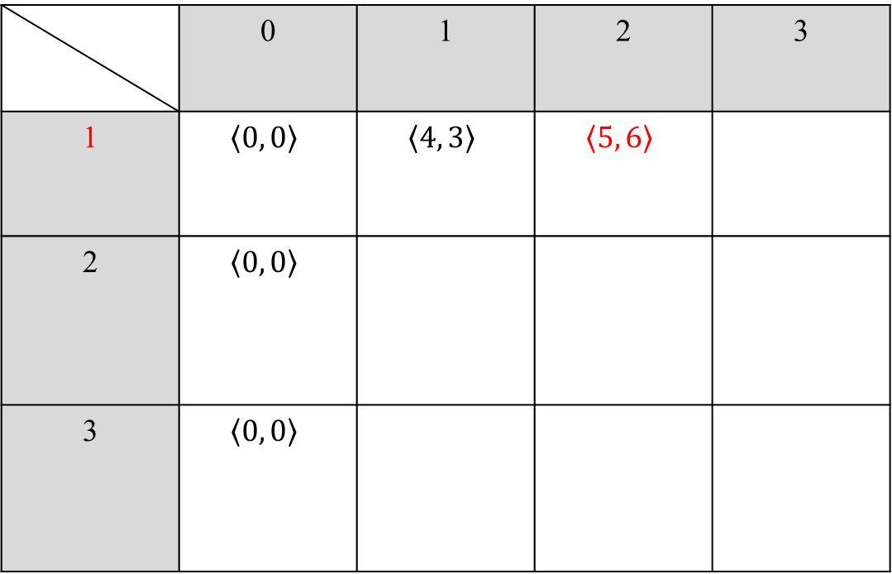
Our LCIS Algorithm (2/9)
A = $\left\langle 4, 5, 2, 4, 8\right\rangle$, B = $\left\langle \text{1, }\text{6, }\text{4}\text{, 7, 2, }\text{5}\text{, 8, 4} \right\rangle$
s(length)
 | 0 | 1 | 2 | 3
1 | $$\left\langle 0, 0\right\rangle$$ | $$\left\langle 4, 3\right\rangle$$ | $$\left\langle 5, 6\right\rangle$$
2 | $$\left\langle 0, 0\right\rangle$$
3 | $$\left\langle 0, 0\right\rangle$$
r(round)

Slide 8
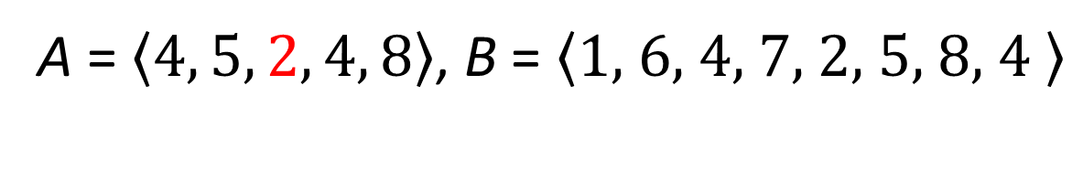
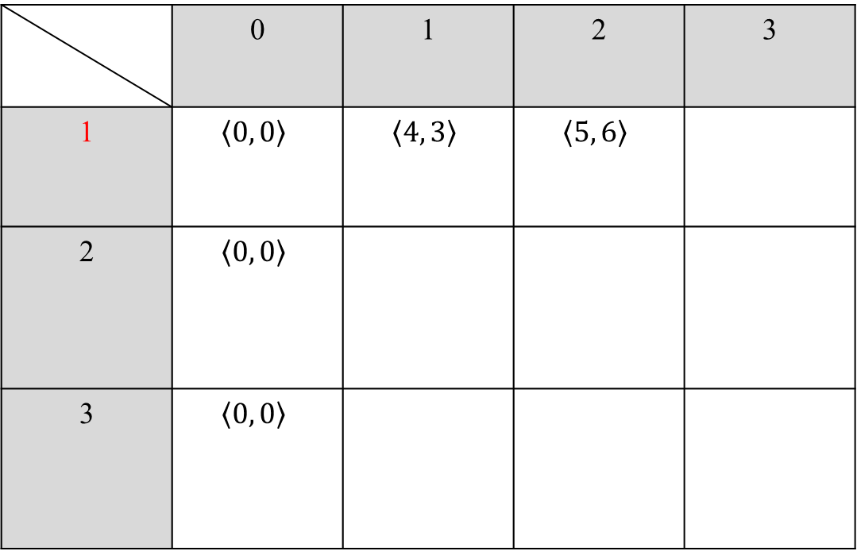
Our LCIS Algorithm (3/9)
A = $\left\langle 4, 5, 2, 4, 8\right\rangle$, B = $\left\langle \text{1, }\text{6, }\text{4}\text{, 7, 2, }\text{5}\text{, 8, 4} \right\rangle$
s(length)
 | 0 | 1 | 2 | 3
1 | $$\left\langle 0, 0\right\rangle$$ | $$\left\langle 4, 3\right\rangle$$ | $$\left\langle 5, 6\right\rangle$$
2 | $$\left\langle 0, 0\right\rangle$$
3 | $$\left\langle 0, 0\right\rangle$$
r(round)

Slide 9
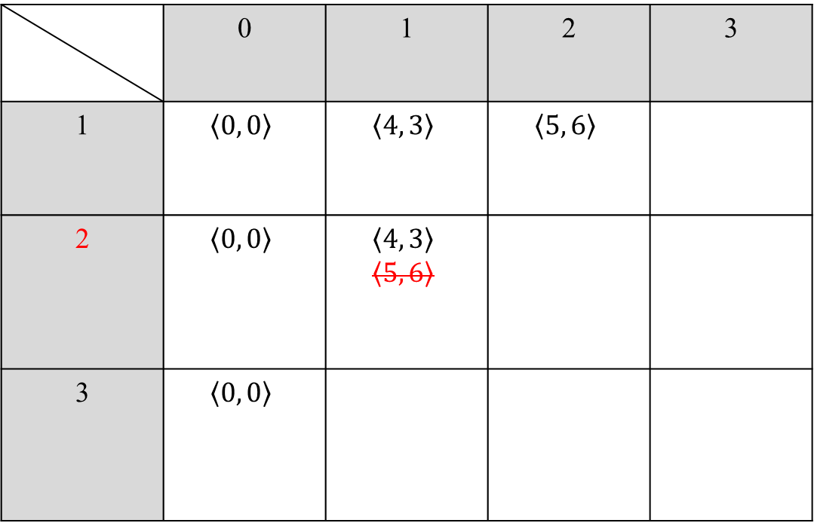
Our LCIS Algorithm (4/9)
A = $\left\langle 4, 5, 2, 4, 8\right\rangle$, B = $\left\langle \text{1, }\text{6, }\text{4}\text{, 7, 2, }\text{5}\text{, 8, 4} \right\rangle$
s(length)
 | 0 | 1 | 2 | 3
1 | $$\left\langle 0, 0\right\rangle$$ | $$\left\langle 4, 3\right\rangle$$ | $$\left\langle 5, 6\right\rangle$$
2 | $$\left\langle 0, 0\right\rangle$$ | $$\left\langle 4, 3\right\rangle$$ $$\left\langle 5, 6\right\rangle$$
3 | $$\left\langle 0, 0\right\rangle$$
r(round)

Slide 10
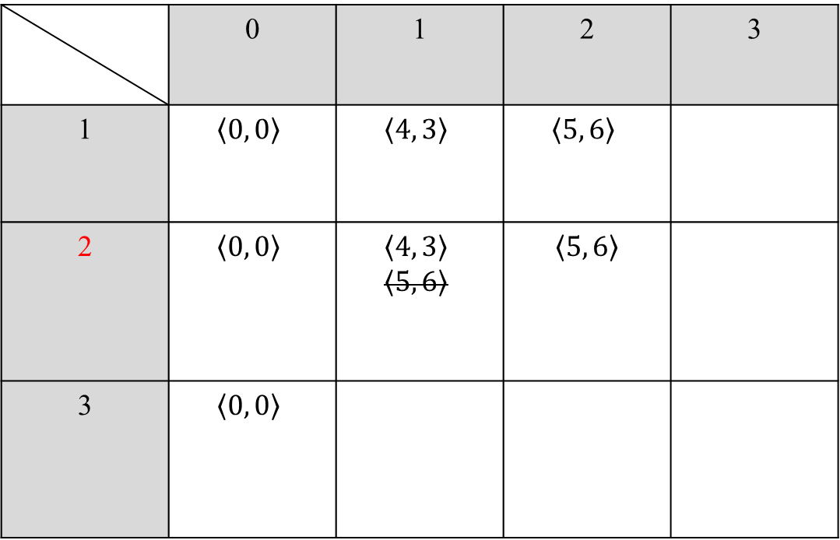
Our LCIS Algorithm (5/9)
A = $\left\langle 4, 5, 2, 4, 8\right\rangle$, B = $\left\langle \text{1, }\text{6, }\text{4}\text{, 7, 2, 5, 8, 4} \right\rangle$
s(length)
 | 0 | 1 | 2 | 3
1 | $$\left\langle 0, 0\right\rangle$$ | $$\left\langle 4, 3\right\rangle$$ | $$\left\langle 5, 6\right\rangle$$
2 | $$\left\langle 0, 0\right\rangle$$ | $$\left\langle 4, 3\right\rangle$$ $$\left\langle 5, 6\right\rangle$$ | $$\left\langle 5, 6\right\rangle$$
3 | $$\left\langle 0, 0\right\rangle$$
r(round)

Slide 11
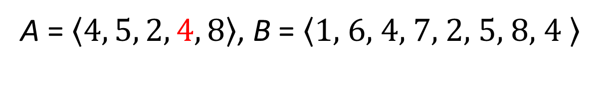
Our LCIS Algorithm (6/9)
A = $\left\langle 4, 5, 2, 4, 8\right\rangle$, B = $\left\langle \text{1, }\text{6, }\text{4}\text{, 7, 2, 5, 8, 4} \right\rangle$
s(length)
 | 0 | 1 | 2 | 3
1 | $$\left\langle 0, 0\right\rangle$$ | $$\left\langle 4, 3\right\rangle$$ | $$\left\langle 5, 6\right\rangle$$
2 | $$\left\langle 0, 0\right\rangle$$ | $$\left\langle 4, 3\right\rangle$$ $$\left\langle 5, 6\right\rangle$$ | $$\left\langle 5, 6\right\rangle$$
3 | $$\left\langle 0, 0\right\rangle$$
r(round)

Slide 12
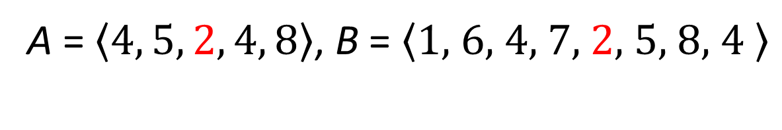
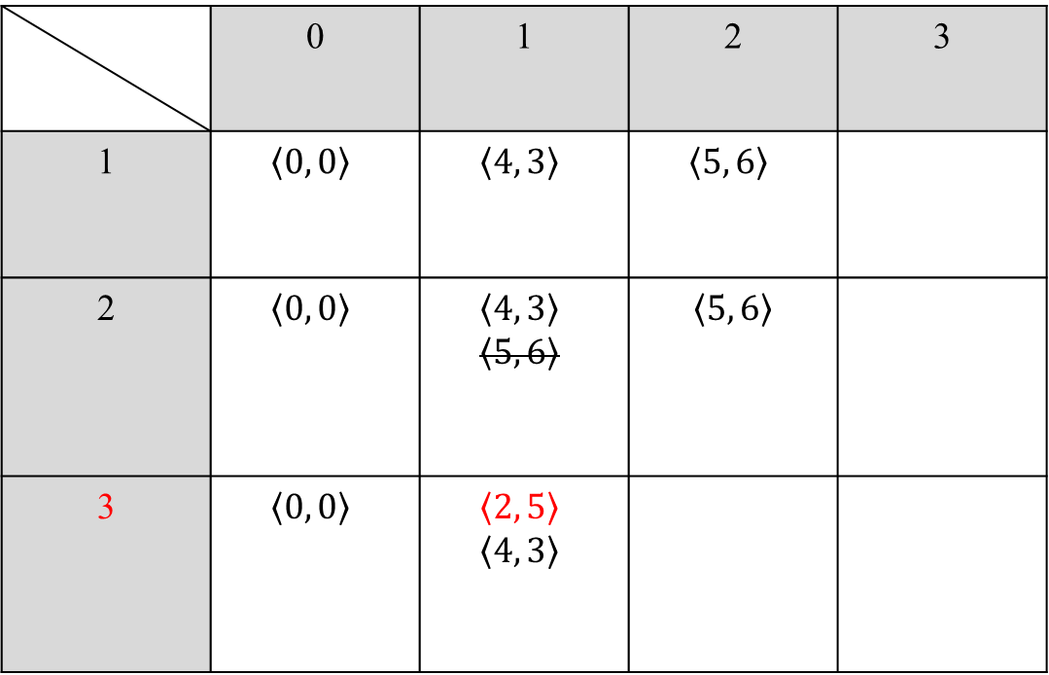
Our LCIS Algorithm (7/9)
A = $\left\langle 4, 5, 2, 4, 8\right\rangle$, B = $\left\langle \text{1, }\text{6, }\text{4}\text{, 7, }\text{2}\text{, 5, 8, 4} \right\rangle$
s(length)
 | 0 | 1 | 2 | 3
1 | $$\left\langle 0, 0\right\rangle$$ | $$\left\langle 4, 3\right\rangle$$ | $$\left\langle 5, 6\right\rangle$$
2 | $$\left\langle 0, 0\right\rangle$$ | $$\left\langle 4, 3\right\rangle$$ $$\left\langle 5, 6\right\rangle$$ | $$\left\langle 5, 6\right\rangle$$
3 | $$\left\langle 0, 0\right\rangle$$ | $$\left\langle 2, 5\right\rangle$$ $$\left\langle 4, 3\right\rangle$$
r(round)

Slide 13
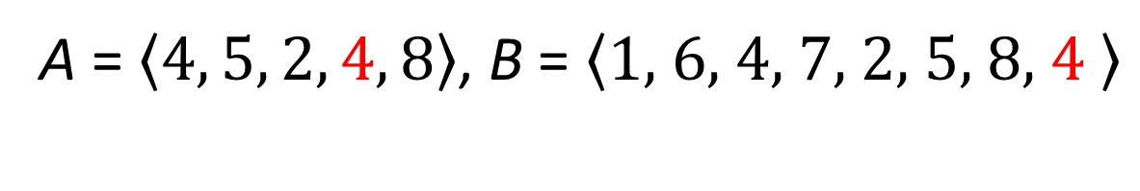
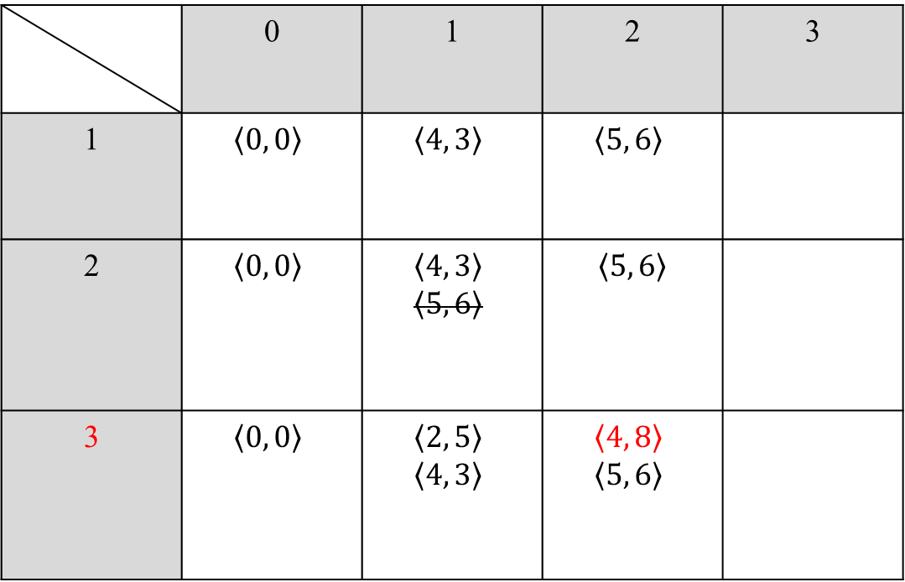
Our LCIS Algorithm (8/9)
A = $\left\langle 4, 5, 2, 4, 8\right\rangle$, B = $\left\langle \text{1, }\text{6, }\text{4}\text{, 7, 2, 5, 8, }\text{4} \right\rangle$
s(length)
 | 0 | 1 | 2 | 3
1 | $$\left\langle 0, 0\right\rangle$$ | $$\left\langle 4, 3\right\rangle$$ | $$\left\langle 5, 6\right\rangle$$
2 | $$\left\langle 0, 0\right\rangle$$ | $$\left\langle 4, 3\right\rangle$$ $$\left\langle 5, 6\right\rangle$$ | $$\left\langle 5, 6\right\rangle$$
3 | $$\left\langle 0, 0\right\rangle$$ | $$\left\langle 2, 5\right\rangle$$ $$\left\langle 4, 3\right\rangle$$ | $$\left\langle 4, 8\right\rangle$$ $$\left\langle 5, 6\right\rangle$$
r(round)

Slide 14
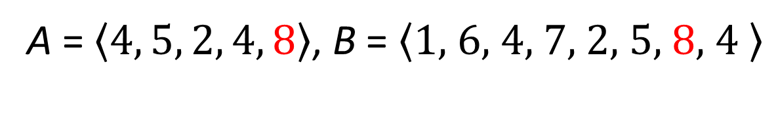
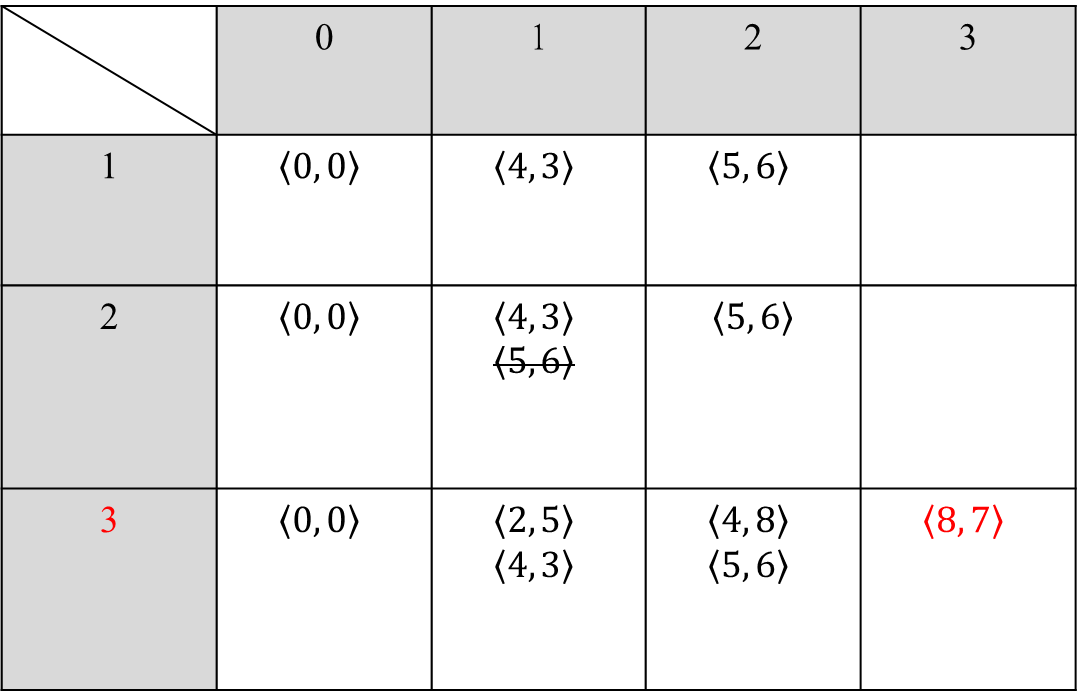
Our LCIS Algorithm (9/9)
A = $\left\langle 4, 5, 2, 4, 8\right\rangle$, B = $\left\langle \text{1, }\text{6, }\text{4}\text{, 7, 2, 5, }\text{8}\text{, 4} \right\rangle$
s(length)
 | 0 | 1 | 2 | 3
1 | $$\left\langle 0, 0\right\rangle$$ | $$\left\langle 4, 3\right\rangle$$ | $$\left\langle 5, 6\right\rangle$$
2 | $$\left\langle 0, 0\right\rangle$$ | $$\left\langle 4, 3\right\rangle$$ $$\left\langle 5, 6\right\rangle$$ | $$\left\langle 5, 6\right\rangle$$
3 | $$\left\langle 0, 0\right\rangle$$ | $$\left\langle 2, 5\right\rangle$$ $$\left\langle 4, 3\right\rangle$$ | $$\left\langle 4, 8\right\rangle$$ $$\left\langle 5, 6\right\rangle$$ | $$\left\langle 8, 7\right\rangle$$
r(round)
O(nextB + L(m − L)n)

Slide 15
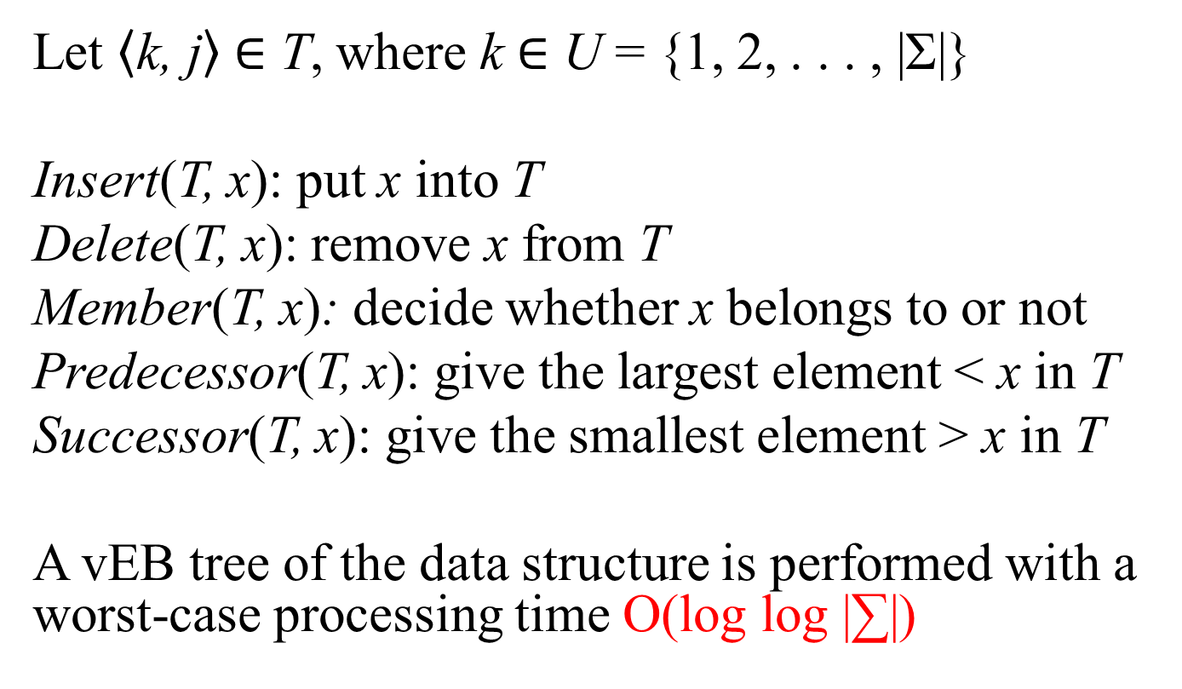
van Emde Boas Tree (1/4)
Let $\left\langle \text{k}\text{, }\text{j}\right\rangle$ ∈ T, where k ∈ U = {1, 2, . . . , |Σ|}
Insert(T, x): put x into T
Delete(T, x): remove x from T
Member(T, x): decide whether x belongs to or not
Predecessor(T, x): give the largest element < x in T
Successor(T, x): give the smallest element > x in T
A vEB tree of the data structure is performed with a worst-case processing time O(log log |∑|)

Slide 16

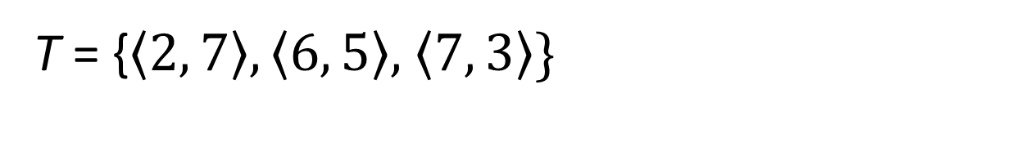
van Emde Boas Tree (2/4)
T = {$\left\langle 2, 7\right\rangle ,\left\langle 6, 5\right\rangle$, $\left\langle 7, 3\right\rangle$}
Put $\left\langle 4, 2\right\rangle into T:$ value 2 is put on position 4
Predecessor(T, 4)
and Insert(T, 4)
k | 1 | 2 | 3 | 4 | 5 | 6 | 7 | 8
j |  | 7 |  |  |  | 5 | 3
2

Slide 17
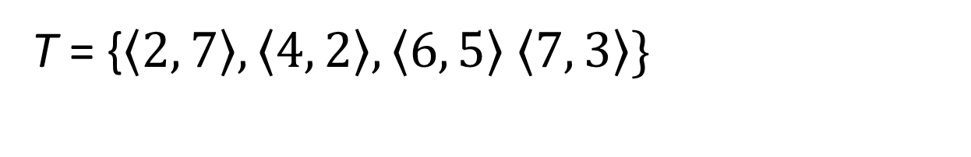
van Emde Boas Tree (3/4)
T = {$\left\langle 2, 7\right\rangle ,\left\langle 4, 2\right\rangle , \left\langle 6, 5\right\rangle$ $\left\langle 7, 3\right\rangle$}
Successor(T, 4) = 6
and Delete(T, 6)
k | 1 | 2 | 3 | 4 | 5 | 6 | 7 | 8
j |  | 7 |  | 2 |  | 5 | 3

Slide 18
van Emde Boas Tree (4/4)
T = {$\left\langle 2, 7\right\rangle ,\left\langle 4, 2\right\rangle , \left\langle 6, 5\right\rangle$ $\left\langle 7, 3\right\rangle$}
Successor(T, 4) = 7
and Delete(T, 7)
k | 1 | 2 | 3 | 4 | 5 | 6 | 7 | 8
j |  | 7 |  | 2 |  | 5 | 3
O((n+L(m−L)) log log |Σ|)

Slide 19
Experimental results (1)
(A, B, |Σ|, |LCIS|, Algorithm)

Slide 20
Experimental results (2)
(A, B, |Σ|, |LCIS|, Algorithm)

Slide 21
Experimental results (3)
(A, B, |Σ|, |LCIS|, Algorithm)

Slide 22
Experimental results (4)
(A, B, |Σ|, |LCIS|, Algorithm)

Slide 23
Conclusion
We propose a diagonal algorithm for the LCIS problem in O((n + L(m − L)) log log |Σ|)-time, where n, m and L denote the lengths of sequences A, B and the LCIS lengths, respectively.
In the future, we also hope that O(log log |Σ|) in the time complexity can be taken away. The set find-union may be used to improve the time complexity.
The bit-parallel algorithm is utilized eﬃciently in other variants of the LCS problem, such as LCS, MLCS and CLCS. In the future, it may speed up our algorithms with the bit-parallel algorithms.

Slide 24
Thank you!

Slide 25
Thank you!

