Slide 1
Position Specific Scoring Matrix and Synergistic Multiclass SVM for Identification of Genes
M. Arif Wani, Heena Farooq Bhat, and Tariq Rashid Jan
2018 17th IEEE International Conference on Machine Learning and Applications (ICMLA), Orlando, USA.
Presenter : Feng-Yang Tsai
Date: May, 20, 2019.

Slide 2
Abstract(1/2)
In genome annotation field several methods have been developed to locate the patterns of genes in genome sequence. In this paper we propose a novel method for identifying genes from protein sequences. The first step of the proposed method involves computing a position specific scoring matrix (PSSM) of protein sequences. The normalized PSSM is used to convert protein sequences into training data set. The data set is simplified by averaging the normalized values corresponding to the same amino acid that occur at more than one location of the protein sequence. The resulting training data set is used to train multiclass Support Vector Machine (SVM) classifier that relates simplified normalized values of amino acid to various genes.

Slide 3
Abstract(2/2)
The results of several multiclass SVMs are synergistically combined for improving the results. The proposed approach is tested on genome DNAset dataset. Empirical evaluation shows that the proposed new approach produces good results of identifying genes using protein sequences.

Slide 4
Proposed Approach For Identifying Genes :
1. A normalized Position Specific Scoring Matrix (PSSM) of protein sequences is computed.
2. Each protein sequence is labelled with an appropriate gene name that it represents.
3. The protein sequences are transformed into training dataset using the normalized PSSM.
4. Synergistic multiclass SVM classifier is trained with the training dataset obtained above.

Slide 5
PSSM of Protein Sequences :
NTEGEWIE
NITRGEWE
NIAGECCG
Amino Acid | 1 | 2 | 3 | 4 | 5 | 6 | 7 | 8
N | 3 | 0 | 0 | 0 | 0 | 0 | 0 | 0
T | 0 | 1 | 1 | 0 | 0 | 0 | 0 | 0
E | 0 | 0 | 1 | 0 | 2 | 1 | 0 | 2
G | 0 | 0 | 0 | 2 | 1 | 0 | 0 | 1
W | 0 | 0 | 0 | 0 | 0 | 1 | 1 | 0
I | 0 | 2 | 0 | 0 | 0 | 0 | 1 | 0
H | 0 | 0 | 0 | 0 | 0 | 0 | 0 | 0
R | 0 | 0 | 0 | 1 | 0 | 0 | 0 | 0
A | 0 | 0 | 1 | 0 | 0 | 0 | 0 | 0
C | 0 | 0 | 0 | 0 | 0 | 1 | 1 | 0
… | … | … | … | … | … | … | … | …

Slide 6
PSSM of Protein Sequences :
NTEGEWIE
NITRGEWE
NIAGECCG
Amino Acid | 1 | 2 | 3 | 4 | 5 | 6 | 7 | 8
N | 1 | 0 | 0 | 0 | 0 | 0 | 0 | 0
T | 0 | 0.33 | 0.33 | 0 | 0 | 0 | 0 | 0
E | 0 | 0 | 0.33 | 0 | 0.66 | 0.33 | 0 | 0.66
G | 0 | 0 | 0 | 0.66 | 0.33 | 0 | 0 | 0.33
W | 0 | 0 | 0 | 0 | 0 | 0.33 | 0.33 | 0
I | 0 | 0.66 | 0 | 0 | 0 | 0 | 0.33 | 0
H | 0 | 0 | 0 | 0 | 0 | 0 | 0 | 0
R | 0 | 0 | 0 | 0.33 | 0 | 0 | 0 | 0
A | 0 | 0 | 0.33 | 0 | 0 | 0 | 0 | 0
C | 0 | 0 | 0 | 0 | 0 | 0.33 | 0.33 | 0
… | … | … | … | … | … | … | … | …

Slide 7

PSSM of Protein Sequences :
Amino Acid | 1 | 2 | 3 | 4 | 5 | 6 | 7 | 8
N | 1.30 | 0 | 0 | 0 | 0 | 0 | 0 | 0
T | 0 | 0.82 | 0.82 | 0 | 0 | 0 | 0 | 0
E | 0 | 0 | 0.82 | 0 | 1.12 | 0.82 | 0 | 1.12
G | 0 | 0 | 0 | 1.12 | 0.82 | 0 | 0 | 0.82
W | 0 | 0 | 0 | 0 | 0 | 0.82 | 0.82 | 0
I | 0 | 1.12 | 0 | 0 | 0 | 0 | 0.82 | 0
H | 0 | 0 | 0 | 0 | 0 | 0 | 0 | 0
R | 0 | 0 | 0 | 0.82 | 0 | 0 | 0 | 0
A | 0 | 0 | 0.82 | 0 | 0 | 0 | 0 | 0
C | 0 | 0 | 0 | 0 | 0 | 0.82 | 0.82 | 0
… | … | … | … | … | … | … | … | …

Slide 8
Normalize the values of the PSSM score :
MaxVal:1.3
PSSM=(Score(i,j)-MinVal)/(MaxVal-MinVal)
MinVal:0.82
Amino Acid | 1 | 2 | 3 | 4 | 5 | 6 | 7 | 8
N | 1 | 0 | 0 | 0 | 0 | 0 | 0 | 0
T | 0 | 0 | 0 | 0 | 0 | 0 | 0 | 0
E | 0 | 0 | 0 | 0 | 0.625 | 0 | 0 | 0.625
G | 0 | 0 | 0 | 0.625 | 0 | 0 | 0 | 0
W | 0 | 0 | 0 | 0 | 0 | 0 | 0 | 0
I | 0 | 0.625 | 0 | 0 | 0 | 0 | 0 | 0
H | 0 | 0 | 0 | 0 | 0 | 0 | 0 | 0
R | 0 | 0 | 0 | 0 | 0 | 0 | 0 | 0
A | 0 | 0 | 0 | 0 | 0 | 0 | 0 | 0
C | 0 | 0 | 0 | 0 | 0 | 0 | 0 | 0
… | … | … | … | … | … | … | … | …

Slide 9
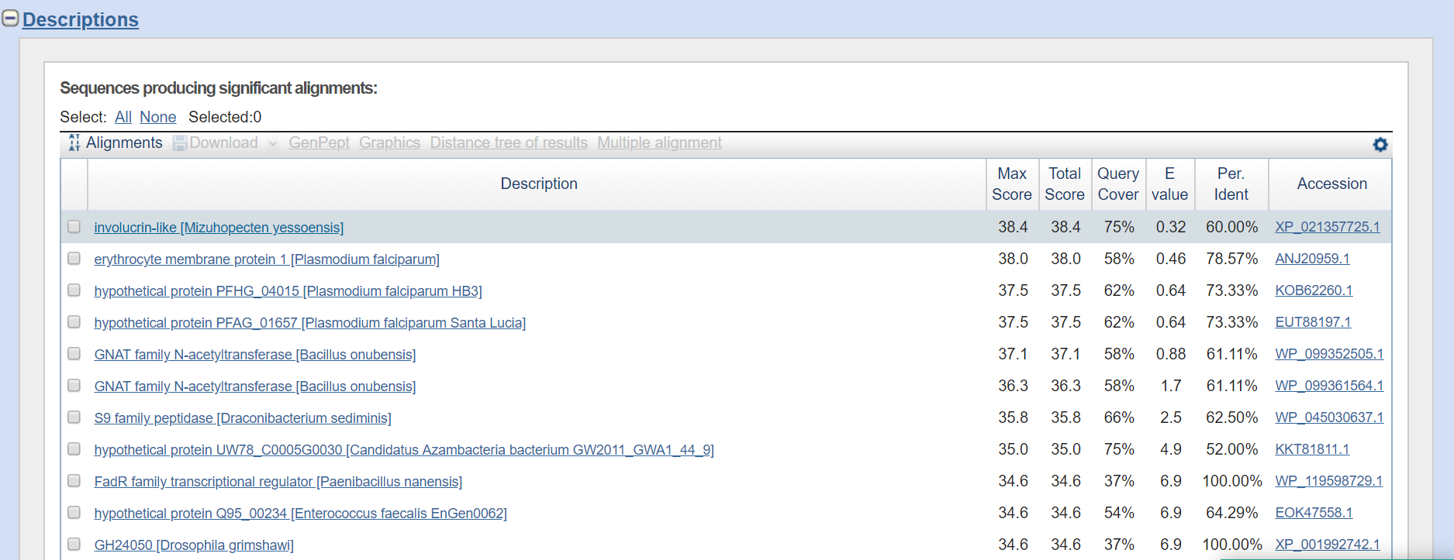
Labelling of Protein Sequences with Gene Names :
BLAST: Basic Local Alignment Search Tool
蝦夷盤扇貝（學名：Mizuhopecten yessoensis）
外皮蛋白

Slide 10
Transforming Protein Sequences into Training Data Set :
N | T | E | G | E | W | I | E
1 | 0 | 0 | 0.625 | 0.625 | 0 | 0 | 0.625
N | I | T | R | G | E | W | E
1 | 0.625 | 0 | 0 | 0 | 0 | 0 | 0.625
N | I | A | G | E | C | C | G
1 | 0.625 | 0 | 0.625 | 0.625 | 0 | 0 | 0
NTEGEWIE
NITRGEWE
NIAGECCG

Slide 11
Transforming Protein Sequences into Training Data Set :
N | T | E | G | E | W | I | E
1 | 0 | 0.416 | 0.625 | 0.416 | 0 | 0 | 0.416
N | I | T | R | G | E | W | E
1 | 0.625 | 0 | 0 | 0 | 0.3125 | 0 | 0.3125
N | I | A | G | E | C | C | G
1 | 0.625 | 0 | 0.3125 | 0.625 | 0 | 0 | 0.3125
NTEGEWIE
NITRGEWE
NIAGECCG

Slide 12
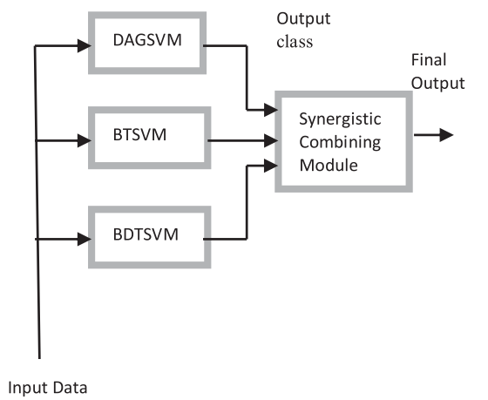
Synergistic Multiclass SVM Classifier :
Test set:
DNAset(DNA-Binding proteins).

Slide 13
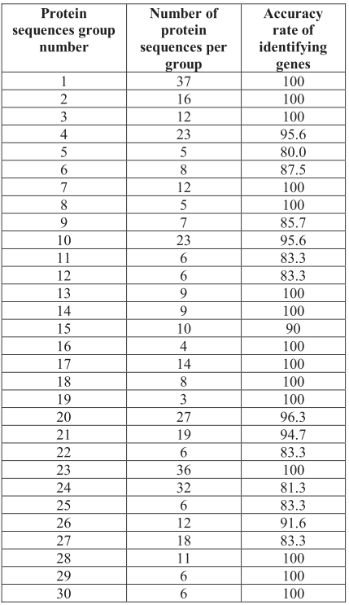
Results:

