Slide 1
An Efficient Algorithm for LCS Problem between Two Arbitrary Sequences
Yubo Li
Mathematical Problems in Engineering, 2018
Presenter: Du-Cheng Wu
Date: May 20, 2019

Slide 2
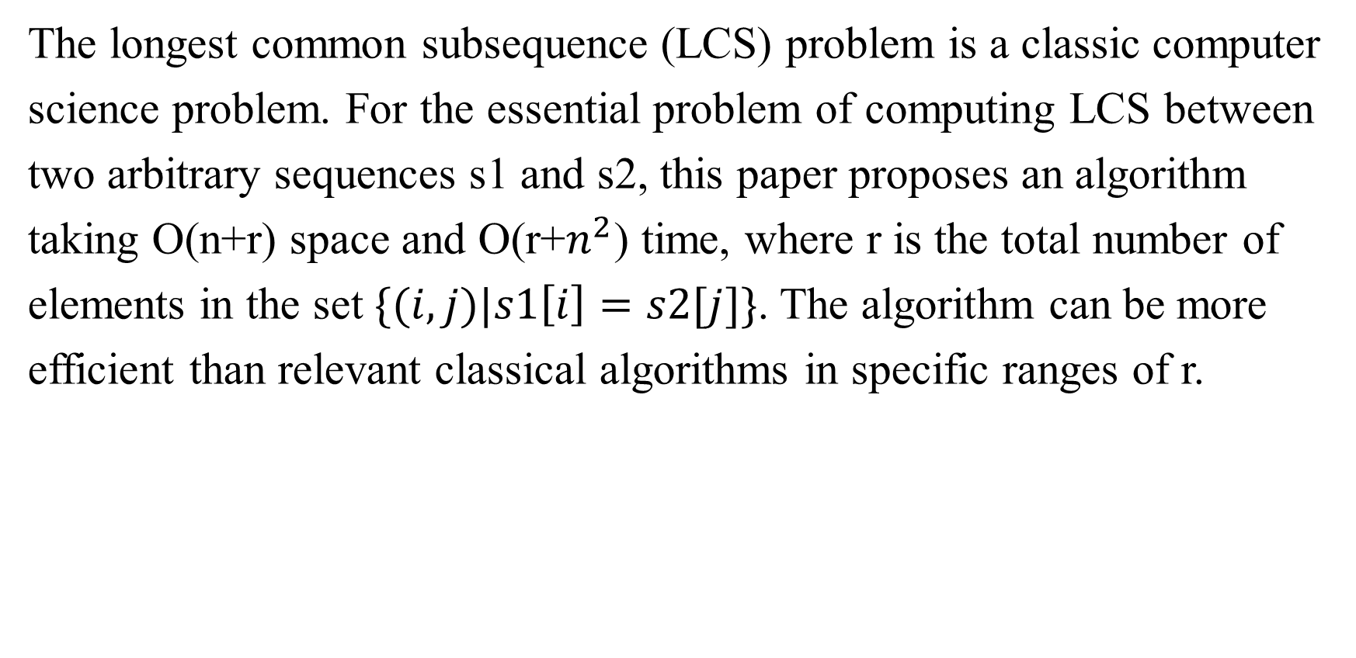
Abstract
The longest common subsequence (LCS) problem is a classic computer
science problem. For the essential problem of computing LCS between
two arbitrary sequences s1 and s2, this paper proposes an algorithm
taking O(n+r) space and O(r+$n^{2}$) time, where r is the total number of
elements in the set $\{(i,j)|s1\left[i\right]=s2[j]\}$. The algorithm can be more
efficient than relevant classical algorithms in specific ranges of r.

Slide 3
Longest Common Subsequence
X = xnfafa
Y = yfanfa
LCS = fafa

Slide 4
Longest Common Subsequence
X =
Y =
L =
0 | 1 | 2 | 3 | 4 | 5
x | n | f | a | f | a
0 | 1 | 2 | 3 | 4 | 5
y | f | a | n | f | a
n | f |  | a |  | f |  | a
0 | 1 | 2 | 3 | 4 | 5 | 6 | 7 | 8
(1, 3) | (2, 4) | (2, 1) | (3, 5) | (3, 2) | (4, 4) | (4, 1) | (5, 5) | (5, 2)

Slide 5
Longest Common Subsequence
L =
s2′=
L[0]=(1, 3)
s2′=
pre =
n | f |  | a |  | f |  | a
0 | 1 | 2 | 3 | 4 | 5 | 6 | 7 | 8
(1, 3) | (2, 4) | (2, 1) | (3, 5) | (3, 2) | (4, 4) | (4, 1) | (5, 5) | (5, 2)
 | y | f | a | n | f | a
0 | 1 | 2 | 3 | 4 | 5 | 6
(0, -) | (0, -) | (0, -) | (0, -) | (0, -) | (0, -) | (0, -)
end
1 | 0
 | y | f | a | n | f | a
0 | 1 | 2 | 3 | 4 | 5 | 6
(0, -) | (0, -) | (0, -) | (0, -) | (1, 0) | (1, 0) | (1, 0)
0 | 1 | 2 | 3 | 4 | 5 | 6 | 7 | 8
-

Slide 6
Longest Common Subsequence
L =
L[0]=(1, 3)
s2′=
L[1]=(2, 4)
s2′=
pre =
n | f |  | a |  | f |  | a
0 | 1 | 2 | 3 | 4 | 5 | 6 | 7 | 8
(1, 3) | (2, 4) | (2, 1) | (3, 5) | (3, 2) | (4, 4) | (4, 1) | (5, 5) | (5, 2)
 | y | f | a | n | f | a
0 | 1 | 2 | 3 | 4 | 5 | 6
(0, -) | (0, -) | (0, -) | (0, -) | (1, 0) | (1, 0) | (1, 0)
end
1 | 0
2 | 1
 | y | f | a | n | f | a
0 | 1 | 2 | 3 | 4 | 5 | 6
(0, -) | (0, -) | (0, -) | (0, -) | (1, 0) | (2, 1) | (2, 1)
0 | 1 | 2 | 3 | 4 | 5 | 6 | 7 | 8
- | 0

Slide 7
Longest Common Subsequence
L =
L[1]=(2, 4)
s2′=
L[2]=(2, 1)
s2′=
pre =
n | f |  | a |  | f |  | a
0 | 1 | 2 | 3 | 4 | 5 | 6 | 7 | 8
(1, 3) | (2, 4) | (2, 1) | (3, 5) | (3, 2) | (4, 4) | (4, 1) | (5, 5) | (5, 2)
 | y | f | a | n | f | a
0 | 1 | 2 | 3 | 4 | 5 | 6
(0, -) | (0, -) | (0, -) | (0, -) | (1, 0) | (2, 1) | (2, 1)
end
1 | 0, 2
2 | 1
 | y | f | a | n | f | a
0 | 1 | 2 | 3 | 4 | 5 | 6
(0, -) | (0, -) | (1, 2) | (1, 2) | (1, 0) | (2, 1) | (2, 1)
0 | 1 | 2 | 3 | 4 | 5 | 6 | 7 | 8
- | 0 | -

Slide 8
Longest Common Subsequence
L =
L[2]=(2, 1)
s2′=
L[3]=(3, 5)
s2′=
pre =
n | f |  | a |  | f |  | a
0 | 1 | 2 | 3 | 4 | 5 | 6 | 7 | 8
(1, 3) | (2, 4) | (2, 1) | (3, 5) | (3, 2) | (4, 4) | (4, 1) | (5, 5) | (5, 2)
 | y | f | a | n | f | a
0 | 1 | 2 | 3 | 4 | 5 | 6
(0, -) | (0, -) | (1, 2) | (1, 2) | (1, 0) | (2, 1) | (2, 1)
end
1 | 0, 2
2 | 1
3 | 3
 | y | f | a | n | f | a
0 | 1 | 2 | 3 | 4 | 5 | 6
(0, -) | (0, -) | (1, 2) | (1, 2) | (1, 0) | (2, 1) | (3, 3)
0 | 1 | 2 | 3 | 4 | 5 | 6 | 7 | 8
- | 0 | - | 1

Slide 9
Longest Common Subsequence
L =
L[3]=(3, 5)
s2′=
L[4]=(3, 2)
s2′=
pre =
n | f |  | a |  | f |  | a
0 | 1 | 2 | 3 | 4 | 5 | 6 | 7 | 8
(1, 3) | (2, 4) | (2, 1) | (3, 5) | (3, 2) | (4, 4) | (4, 1) | (5, 5) | (5, 2)
 | y | f | a | n | f | a
0 | 1 | 2 | 3 | 4 | 5 | 6
(0, -) | (0, -) | (1, 2) | (1, 2) | (1, 0) | (2, 1) | (3, 3)
end
1 | 0, 2
2 | 1, 4
3 | 3
 | y | f | a | n | f | a
0 | 1 | 2 | 3 | 4 | 5 | 6
(0, -) | (0, -) | (1, 2) | (2, 4) | (2, 4) | (2, 1) | (3, 3)
0 | 1 | 2 | 3 | 4 | 5 | 6 | 7 | 8
- | 0 | - | 1 | 2

Slide 10
Longest Common Subsequence
L =
L[4]=(3, 2)
s2′=
L[5]=(4, 4)
s2′=
pre =
n | f |  | a |  | f |  | a
0 | 1 | 2 | 3 | 4 | 5 | 6 | 7 | 8
(1, 3) | (2, 4) | (2, 1) | (3, 5) | (3, 2) | (4, 4) | (4, 1) | (5, 5) | (5, 2)
 | y | f | a | n | f | a
0 | 1 | 2 | 3 | 4 | 5 | 6
(0, -) | (0, -) | (1, 2) | (2, 4) | (2, 4) | (2, 1) | (3, 3)
end
1 | 0, 2
2 | 1, 4
3 | 3, 5
 | y | f | a | n | f | a
0 | 1 | 2 | 3 | 4 | 5 | 6
(0, -) | (0, -) | (1, 2) | (2, 4) | (2, 4) | (3, 5) | (3, 3)
0 | 1 | 2 | 3 | 4 | 5 | 6 | 7 | 8
- | 0 | - | 1 | 2 | 4

Slide 11
Longest Common Subsequence
L =
L[4]=(3, 2)
s2′=
L[5]=(4, 4)
s2′=
pre =
n | f |  | a |  | f |  | a
0 | 1 | 2 | 3 | 4 | 5 | 6 | 7 | 8
(1, 3) | (2, 4) | (2, 1) | (3, 5) | (3, 2) | (4, 4) | (4, 1) | (5, 5) | (5, 2)
 | y | f | a | n | f | a
0 | 1 | 2 | 3 | 4 | 5 | 6
(0, -) | (0, -) | (1, 2) | (2, 4) | (2, 4) | (3, 5) | (3, 3)
end
1 | 0, 2, 6
2 | 1, 4
3 | 3, 5
 | y | f | a | n | f | a
0 | 1 | 2 | 3 | 4 | 5 | 6
(0, -) | (0, -) | (1, 6) | (2, 4) | (2, 4) | (3, 5) | (3, 3)
0 | 1 | 2 | 3 | 4 | 5 | 6 | 7 | 8
- | 0 | - | 1 | 2 | 4 | -

Slide 12
Longest Common Subsequence
L =
L[4]=(3, 2)
s2′=
L[5]=(4, 4)
s2′=
pre =
n | f |  | a |  | f |  | a
0 | 1 | 2 | 3 | 4 | 5 | 6 | 7 | 8
(1, 3) | (2, 4) | (2, 1) | (3, 5) | (3, 2) | (4, 4) | (4, 1) | (5, 5) | (5, 2)
 | y | f | a | n | f | a
0 | 1 | 2 | 3 | 4 | 5 | 6
(0, -) | (0, -) | (1, 6) | (2, 4) | (2, 4) | (3, 5) | (3, 3)
end
1 | 0, 2, 6
2 | 1, 4
3 | 3, 5
4 | 7
 | y | f | a | n | f | a
0 | 1 | 2 | 3 | 4 | 5 | 6
(0, -) | (0, -) | (1, 6) | (2, 4) | (2, 4) | (3, 5) | (4, 7)
0 | 1 | 2 | 3 | 4 | 5 | 6 | 7 | 8
- | 0 | - | 1 | 2 | 4 | - | 5

Slide 13
Longest Common Subsequence
L =
L[4]=(3, 2)
s2′=
L[5]=(4, 4)
s2′=
pre =
n | f |  | a |  | f |  | a
0 | 1 | 2 | 3 | 4 | 5 | 6 | 7 | 8
(1, 3) | (2, 4) | (2, 1) | (3, 5) | (3, 2) | (4, 4) | (4, 1) | (5, 5) | (5, 2)
 | y | f | a | n | f | a
0 | 1 | 2 | 3 | 4 | 5 | 6
(0, -) | (0, -) | (1, 6) | (2, 4) | (2, 4) | (3, 5) | (4, 7)
end
1 | 0, 2, 6
2 | 1, 4, 8
3 | 3, 5
4 | 7
 | y | f | a | n | f | a
0 | 1 | 2 | 3 | 4 | 5 | 6
(0, -) | (0, -) | (1, 6) | (2, 8) | (2, 4) | (3, 5) | (4, 7)
0 | 1 | 2 | 3 | 4 | 5 | 6 | 7 | 8
- | 0 | - | 1 | 2 | 4 | - | 5 | 6

Slide 14
Longest Common Subsequence
L =
pre =
L[7] = (5, 5) and pre[7] = 5
L[5] = (4, 4) and pre[5] = 4
L[4] = (3, 2) and pre[4] = 2
L[2] = (2, 1) and pre[2] = -
LCS(s1, s2) = s1[2][3][4][5] = s2[1][2][4][5] = fafa
n | f |  | a |  | f |  | a
0 | 1 | 2 | 3 | 4 | 5 | 6 | 7 | 8
(1, 3) | (2, 4) | (2, 1) | (3, 5) | (3, 2) | (4, 4) | (4, 1) | (5, 5) | (5, 2)
0 | 1 | 2 | 3 | 4 | 5 | 6 | 7 | 8
- | 0 | - | 1 | 2 | 4 | - | 5 | 6

Slide 15
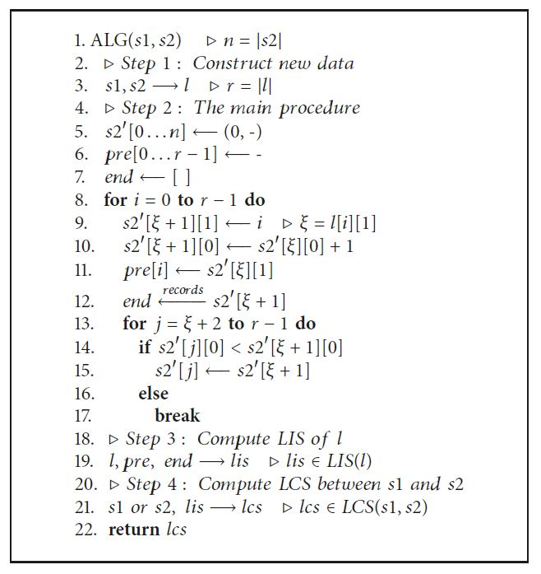
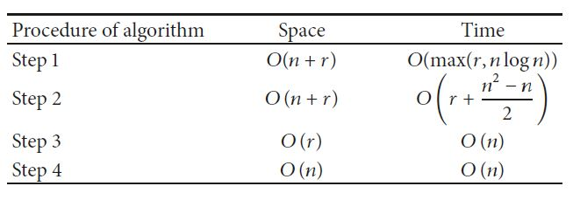
Algorithm

Slide 16

Complexity
$$r+\frac{n^{2}−n}{2}< n^{2} ⇒0≤r < \frac{n^{2}+n}{2}$$

