Slide 1
Direct Linear Time Construction of Parameterized Suffix and LCP Arrays for Constant Alphabets
Noriki Fujisato, Yuto Nakashima, Shunsuke Inenaga, Hideo Bannai and Masayuki Takeda
26th International Symposium, SPIRE 2019:
String Processing and Information Retrieval,
Segovia, Spain, October 7–9, 2019
Presenter: Shin-Cheng Lin
Date: Jan. 18, 2022

Slide 2
Abstract
We present the first worst-case linear time algorithm that directly computes the parameterized suffix and LCP arrays for constant sized alphabets. Previous algorithms either required quadratic time or the parameterized suffix tree to be built first. More formally, for a string over static alphabet Σ and parameterized alphabet Π , our algorithm runs in O(nπ) time and O(n) words of space, where π is the number of distinct symbols of Π in the string.

Slide 3
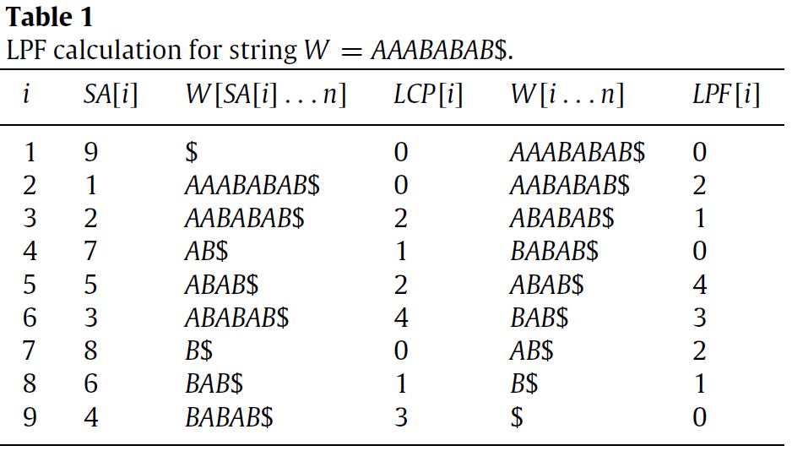
SA
Suffix array

Slide 4
Parameterized matching (p-match)
Σ = {A, B}
Π = {w, x, y, z}
S = AxByABxy$
U = AwBzABwz$
V = AyByAByy$

Slide 5
Previous (prev) encoding
S = AxByABxy$
prev(S) = A0B0AB54$
U = AwBzABwz$
prev(U) = A0B0AB54$
V = AyByAByy$
prev(V) = A0B2AB31$

Slide 6
pSA
T=AAAwBxyyAAAzwwB$
T[7…n], yyAAAzwwB$
Prev(T[7…n]) = 01AAA001B$
T[8…n], yAAAzwwB$
Prev(T[8…n]) = 0AAA001B$

Slide 7
S = AxByABxy$
prev(S) = A0 B0 AB54$
At most | Π | ＋ 1 segments
C_{i,j}
C_{1,1} = A0, C_{1,2} = B0, C_{1,3} = AB540
C_{2,1} = 0, C_{2,2} = B0, C_{2,3} = AB540
C_{3,1} = B0, C_{3,2} = AB0, C_{3,3} = 40
D_{i,j}
D_{i,j} is rank of C_{i,j} in C_{j}
D_{i} = D_{i,1} D_{i,2} … D_{i,z}

Slide 8
pSA
T=AAAwBxyyAAAzwwB$
T[3…n], AwBxyyAAAzwwB$
Prev(T[3…n]) = A0B001AAA091B$
T[4…n], wBxyyAAAzwwB$
Prev(T[4…n]) = 0B001AAA091B$

Slide 9
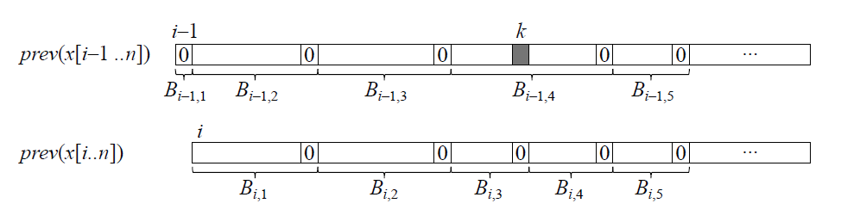
pSA
T=AAAwBxyyAAAzwwB$
T[4…n], wBxyyAAAzwwB$
Prev(T[4…n]) = 0B001AAA091B$
T[5…n], BxyyAAAzwwB$
Prev(T[5…n]) = B001AAA001B$

Slide 10
S = AxByABxy$
prev(S) = A0 B0 AB54$
At most | Π | ＋ 1 segments
C_{i,j}
C_{1,1} = A0, C_{1,2} = B0, C_{1,3} = AB540
C_{2,1} = 0, C_{2,2} = B0, C_{2,3} = AB540
C_{3,1} = B0, C_{3,2} = AB0, C_{3,3} = 40
D_{i,j}
D_{i,j} is rank of C_{i,j} in C_{j}
D_{i} = D_{i,1} D_{i,2} … D_{i,z}

Slide 11
For any j, there exists a set of strings S_{j} such that B_{i,j} is a suffix of some string in S_{j}.

Slide 12
prev(S) = A0 B0 AB54$
C_{i,j}
C_{1,1} = A0
C_{2,1} = 0
C_{3,1} = B0
C_{4,1} = 0
C_{5,1} = AB00
C_{6,1} = B00
O(n)

Slide 13
prev(S) = A0 B0 AB54$
C_{i,j}
C_{1,3} = AB540 (A0B0AB54)
C_{2,3} = AB540 (0B0AB54)
C_{3,3} = 40 (B0AB04)
O(n)

Slide 14
C_{i,j}
Suffix array O(n), at most | Π | ＋ 1 segments
O(nπ)
D_{i,j}
D_{i,j} is rank of C_{i,j} in C_{j}
D_{i} = D_{i,1} D_{i,2} … D_{i,z}
z at most | Π |, radix sort => O(nπ)

