Slide 1
List Scheduling Algorithm Based on Pre-scheduling for Heterogeneous Computing
Yi Zhao, Suzhi Cao and Lei Yan
2019 IEEE Intl Conf on Parallel & Distributed Processing with Applications, Big Data & Cloud Computing, Sustainable Computing & Communications, Social Computing & Networking
Presenter: Chih-Hsuan Chien​
Date: Feb. 8, 2022

Slide 2
Abstract
Efficient application scheduling algorithms are important for heterogeneous computing systems to achieve high performance. List scheduling is a type of classical and widely used algorithm for static application scheduling, with low time complexity but limited result optimization. In this paper, we proposed a novel pre-scheduling-based list scheduling (PSLS) algorithm for heterogeneous computing systems. The PSLS algorithm has the same low time complexity with classical list scheduling algorithms HEFT and PEFT, but significantly reduces the makespans of applications. The PSLS algorithm consists of three phases: pre-scheduling phase, task prioritizing phase and processor selection phase. The simulation results based on randomly generated graphs and graphs of real-world applications show that the PSLS algorithm has obvious optimizations in terms of schedule length, efficiency and robustness compared with classical list scheduling algorithms.

Slide 3
List Scheduling
two phases:
task prioritizing phase
processor selection phase

Slide 4
PSLS algorithm
Pre-scheduling Phase
Task Prioritizing Phase
Processor Selection Phase

Slide 5
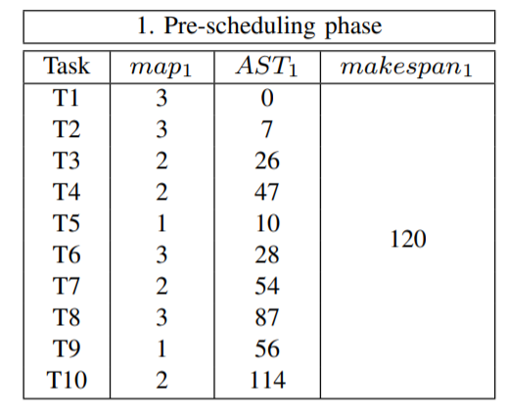
Pre-scheduling Phase
Choose an existing scheduling algorithm as pre-scheduling algorithm
Obtain AST, makespan
Notes:
因為我們要降低時間複雜度，所以要選一個時間複雜度比較低的演算法來跑一遍

Slide 6
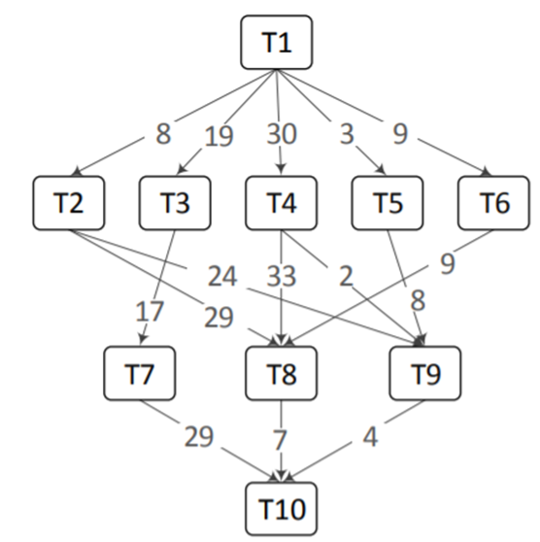
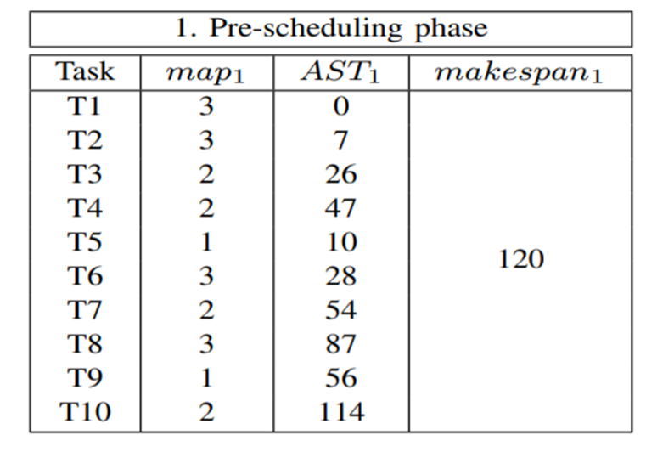
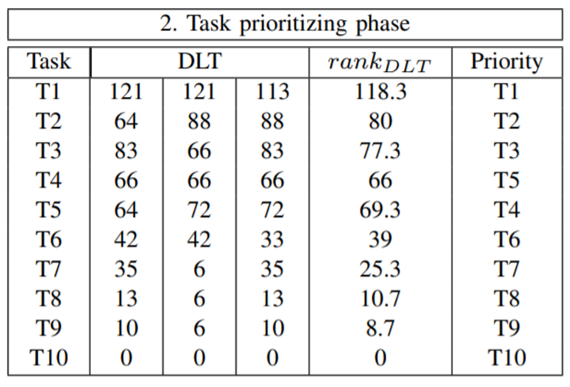

Task Prioritizing Phase
DLT( $n_{i},p_{k})=makespan −\max_{n_{j}∈succ\left(n_{i}\right)}\{AST\left(n_{j}\right)−\overline{c_{ij}}\}$
${rank}_{DLT}$($n_{i}$)= $\frac{1}{ m}\sum_{k=1}^{∞}{\text{DLT}\text{( }n_{i},p_{k})}$
Notes:
前一個演算法的makespan和task ni 在 processor pk上最晚完成時間的差

Slide 7
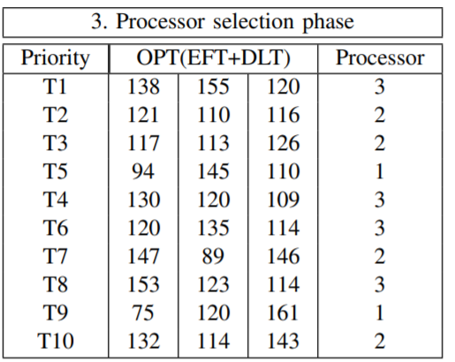

Processor Selection Phase
Select processors for tasks in priority queue in turn by minimizing ${OPT}_{PSLS}$($n_{i},p_{k})$.
${OPT}_{PSLS}$($n_{i},p_{k})=\text{EFT}\text{( }n_{i},p_{k})+\text{DLT}\text{( }n_{i},p_{k})$

Slide 8
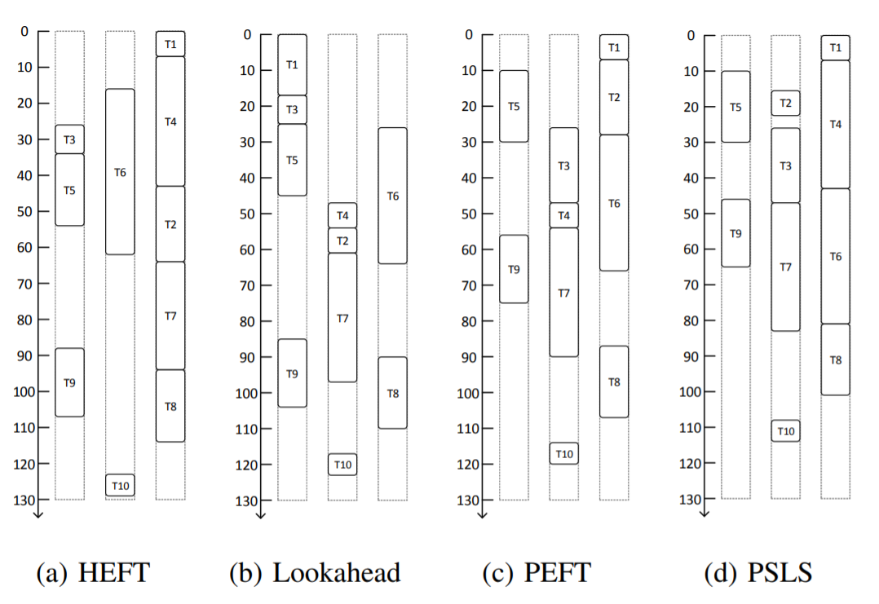

Slide 9
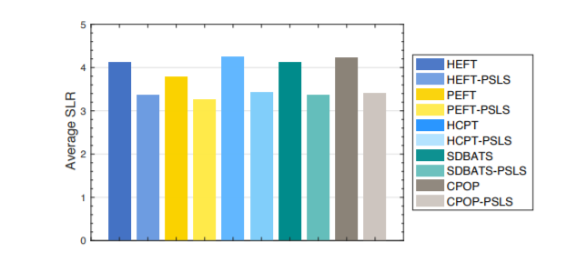

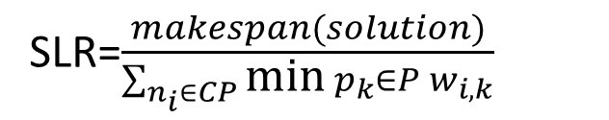
SLR=$\frac{makespan(solution)}{\sum_{n_{i}∈CP}{\text{min} }p_{k}∈P w_{i,k}}$
Notes:
其他演算法本身和放到psls後的比較
Slr=makeapan除critical path 的執行時間

