Slide 1
A Novel Efficient Graph Model for the Multiple Longest Common Subsequences (MLCS) Problem ​
Zhan peng, Yuping Wang
Frontiers in Genetics, August 2017
Presenter:Chien-Ting LEE
Date: Feb. 08, 2022

Slide 2
Abstract(1/2)
Searching for the Multiple Longest Common Subsequences (MLCS) of multiple sequences is a classical NP-hard problem, which has been used in many applications. One of the most effective exact approaches for the MLCS problem is based on dominant point graph, which is a kind of directed acyclic graph (DAG). However, the time and space efficiency of the leading dominant point graph based approaches is still unsatisfactory: constructing the dominated point graph used by these approaches requires a huge amount of time and space, which hinders the applications of these approaches to large-scale and long sequences. To address this issue, in this paper, we propose a new time and space efficient graph model called the Leveled-DAG for the MLCS problem.

Slide 3
Abstract(2/2)
The Leveled-DAG can timely eliminate all the nodes in the graph that cannot contribute to the construction of MLCS during constructing. At any moment, only the current level and some previously generated nodes in the graph need to be kept in memory, which can greatly reduce the memory consumption. Also, the final graph contains only one node in which all of the wanted MLCS are saved, thus, no additional operations for searching the MLCS are needed. The experiments are conducted on real biological sequences with different numbers and lengths respectively, and the proposed algorithm is compared with three state-of-the-art algorithms. The experimental results show that the time and space needed for the Leveled-DAG approach are smaller than those for the compared algorithms especially on large-scale and long sequences.
Notes:
MLCS這個問題:主要有dynamic programming方法與dominant point方法
這篇論文主要想改善dominant point方法

Slide 4
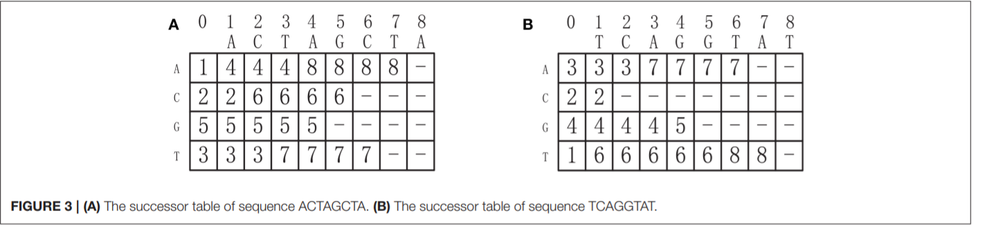
Successor Table
Notes:
O(d|Σ|n)

Slide 5
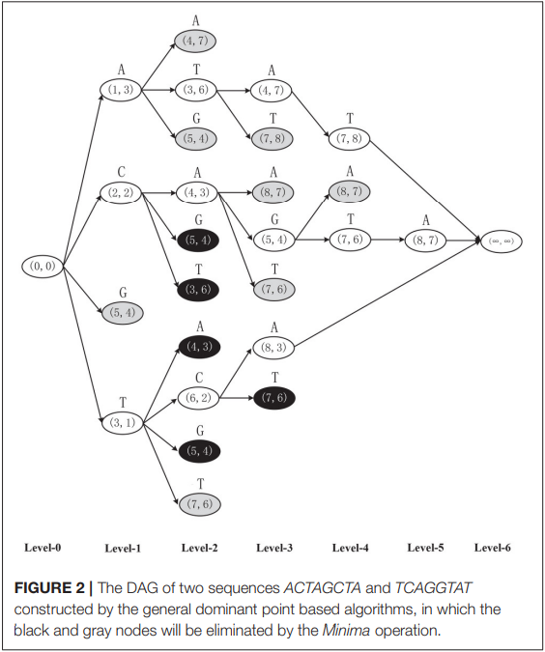
Dominant point based approaches
ACTAGCTA
TCAGGTAT
Notes:
Dominate的方法就是建立一個這種的有向無環圖
那這個圖是依照這兩個字串所建立的
A(1,3)、C、G、T
那我們再找字母出現的位置，我們要找位置盡量前面的
因為像是A(1,3)後面接還可以接一個(5,4)，如果直接找(5,4)，那找出來的就會是錯誤的，所以我們在每一層還需比較不同字母出現位置
1.大量重複點與支配點 ，浪費記憶體
2.在圖中，找到重複的節點與被支配的節點是很耗費時間的，因為需要做多維度向量的比較。
灰色部分為被支配的點
黑色為重複的點

Slide 6
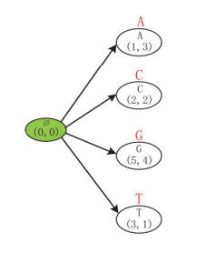
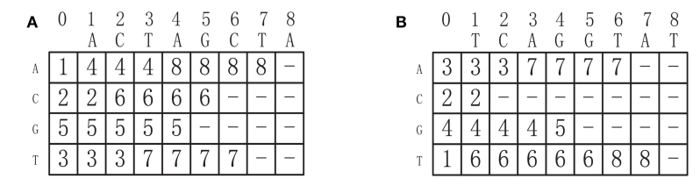
Leveled-DAG(1)
Notes:
一開始僅有(0,0)的點，然後依照Successor Table 找到 ACTG這四個字的位置
僅會更新綠色所指向的點，然後因為(0,0)這個點沒有其它的點指向它，所以下一個步驟會將它刪除
綠色為沒用的點
白色為新 CREATE
紅色為先前就已經存在的
僅需更新綠色所指向的點

Slide 7
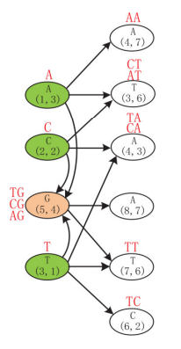
Leveled-DAG (2)
Notes:
綠色為outdated
白色為new create
紅色為先前就已經存在的
僅需更新綠色所指向的點

Slide 8
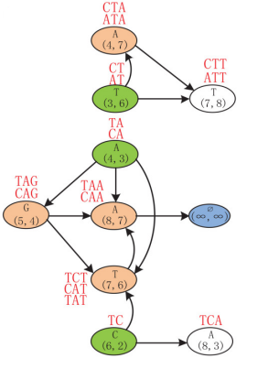
Leveled-DAG (3)
Notes:
綠色為outdated
白色為new create
紅色為先前就已經存在的
僅需更新綠色所指向的點

Slide 9
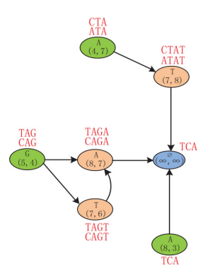
Leveled-DAG (4)
Notes:
綠色為outdated
白色為new create
一開始會依照
紅色為先前就已經存在的
僅需更新綠色所指向的點

Slide 10
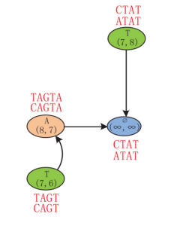
Leveled-DAG (5)
Notes:
綠色為outdated
白色為new create
一開始會依照
紅色為先前就已經存在的
僅需更新綠色所指向的點

Slide 11
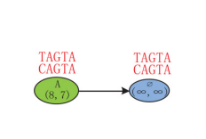
Leveled-DAG (6)
Notes:
我們可以發現
一旦沒有新的節點創建後，節點數開始減少，直到只剩下一個節點。在這個過程中，只有新的創建的節點和具有傳入邊的節點保存在Leveled-DAG，大大降低了memory消耗。

Slide 12
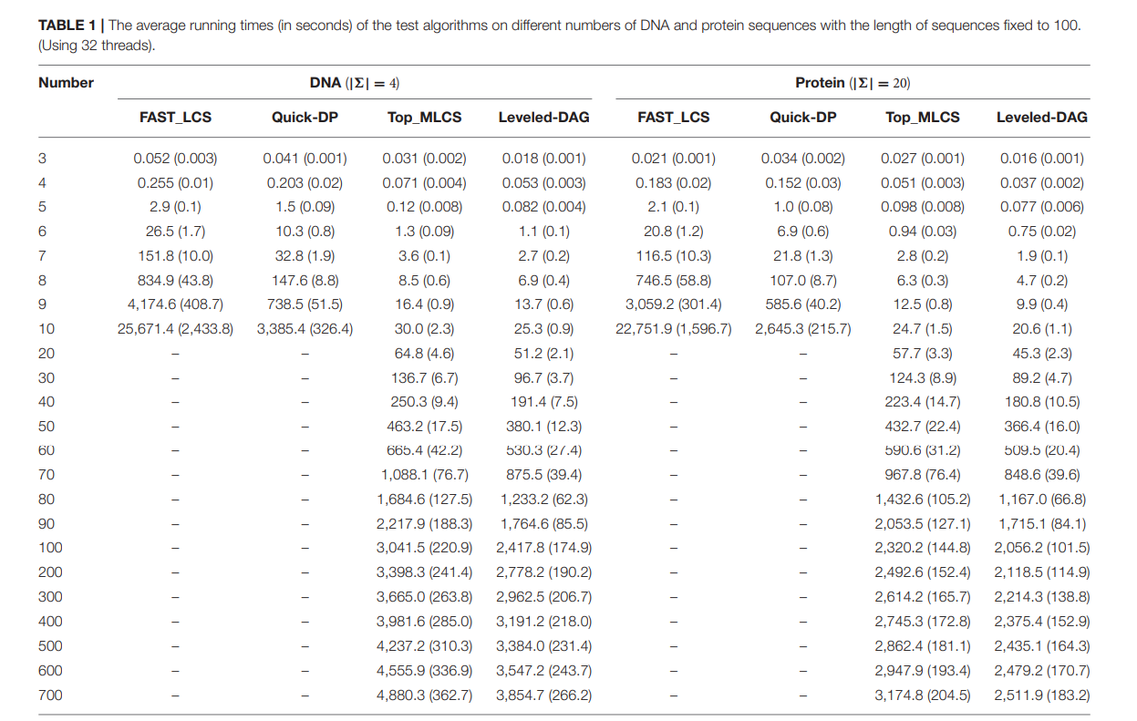
EXPERIMENTAL RESULTS
Notes:
序列長度固定 序列數量由3-700遞增
單位秒
Top_MLCS與本文提出的算法相比 小的資料集(10以下)會慢10 趴 大的資料集慢10-20趴
needs two topological sorting operations
在相同長度下，字母越多，代表下一個相同的字出現的距離就有可能會越遠

Slide 13
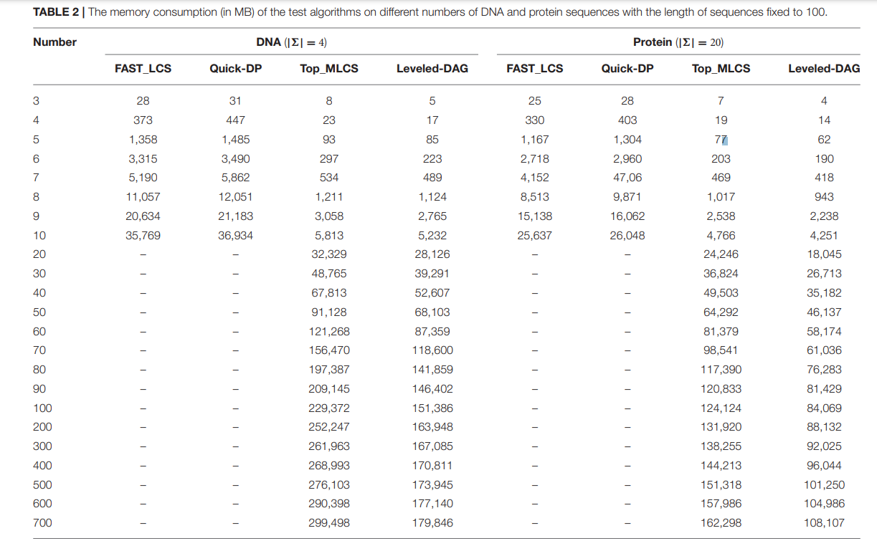
EXPERIMENTAL RESULTS
Notes:
序列長度固定 序列數量由3-700遞增
單位MB
FAST_LCS、QUICK-DP記憶體消耗成指數成長

Slide 14
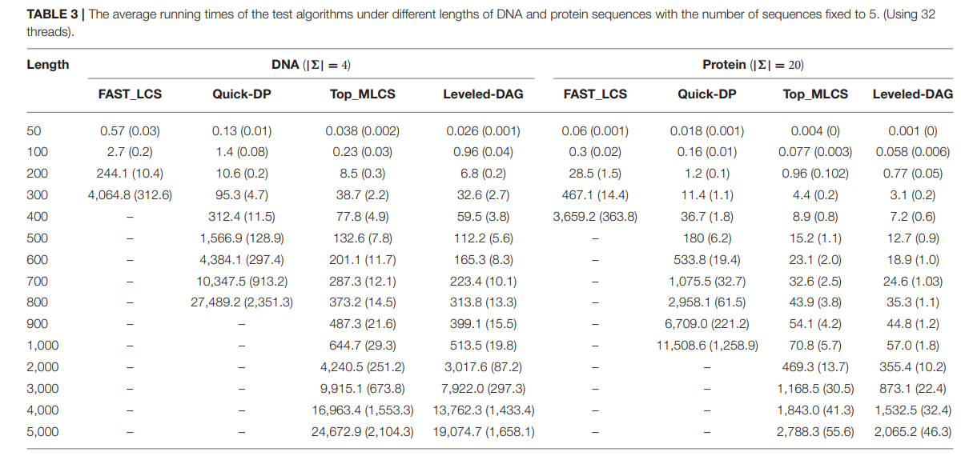
EXPERIMENTAL RESULTS
Notes:
序列數量固定為5 序列長度由50-5000遞增
Fast_Lcs與Quick-DP無法處理 因為Memory不夠
sequence長度增加，Minima operation for the levels is very

Slide 15
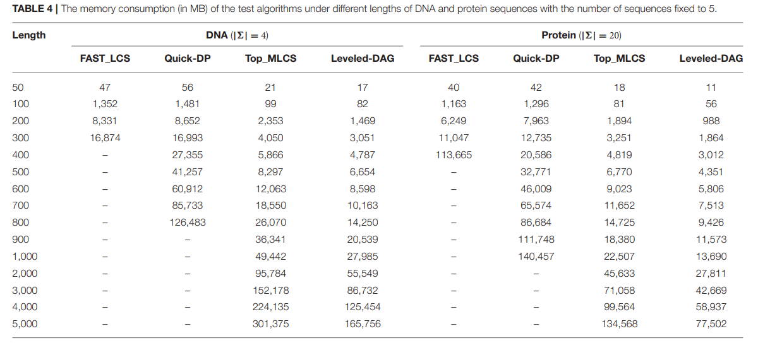
EXPERIMENTAL RESULTS
Notes:
序列數量固定為5 序列長度由50-5000遞增

