Slide 1
Contract Bridge Bidding by Learning
Chun-Yen Ho and Hsuan-Tien Lin
AAAI Workshop: Computer Poker and Imperfect Information, 2015
Presenter: Ying-Yu Lin
Date: Feb.8, 2022

Slide 2
Abstract:
Contract bridge is an example of an incomplete information game for which computers typically do not perform better than expert human bridge players. In particular, the typical bidding decisions of human bridge players are difficult to mimic with a computer program, and thus automatic bridge bidding remains to be a challenging research problem. Currently, the possibility of automatic bidding without mimicking human players has not been fully studied. In this work, we take an initiative to study such a possibility for the specific problem of bidding without competition. We propose a novel learning framework to let a computer program learn its own bidding decisions. The framework transforms the bidding problem into a learning problem, and then solves the problem with a carefully designed model that consists of cost-sensitive classifiers and upper-confidence-bound algorithms. We validate the proposed model and find that it performs competitively to the champion computer bridge program that mimics human bidding decisions.

Slide 3



Baseline method
let g(x_{s},b¹) = PASS , x _{s} is not needed
objective function is reduced to minimize
Lower bound
Cost-sensitive classification:
Upper bound
Cost-sensitive classification:

Slide 4
The multi-layer bandit model
extending the base- line methods to produce sequences b of length two
South player can now improve her strategy g_{s} with ((x_{s} , b[1]), b[2], c)
g_{n} can improve his strategy with ((x_{n} , ∅), b[1], c)

Slide 5
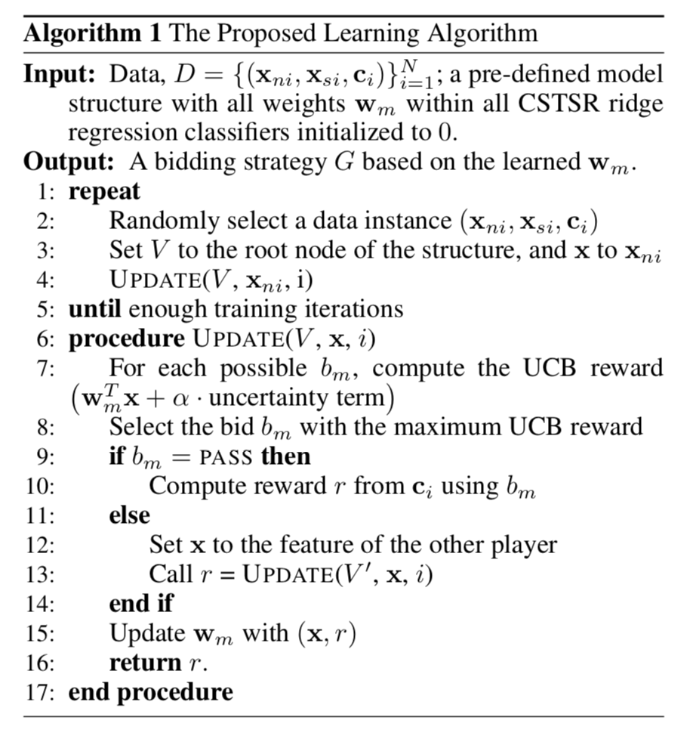
The Proposed Learning Algorithm
weight vector w_{m} = (X^{T}_{m} X_{m} + λI )⁻¹ (X^{T}_{m} r_{m} )
cost vector c = best score - those score
reward r = maximum possible cost - cost

Slide 6
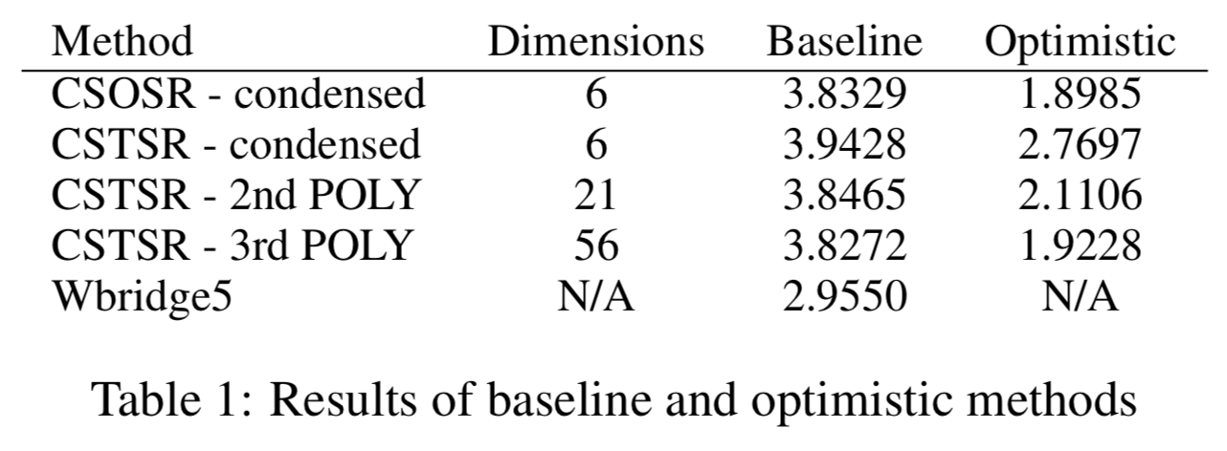
Experiments

Slide 7
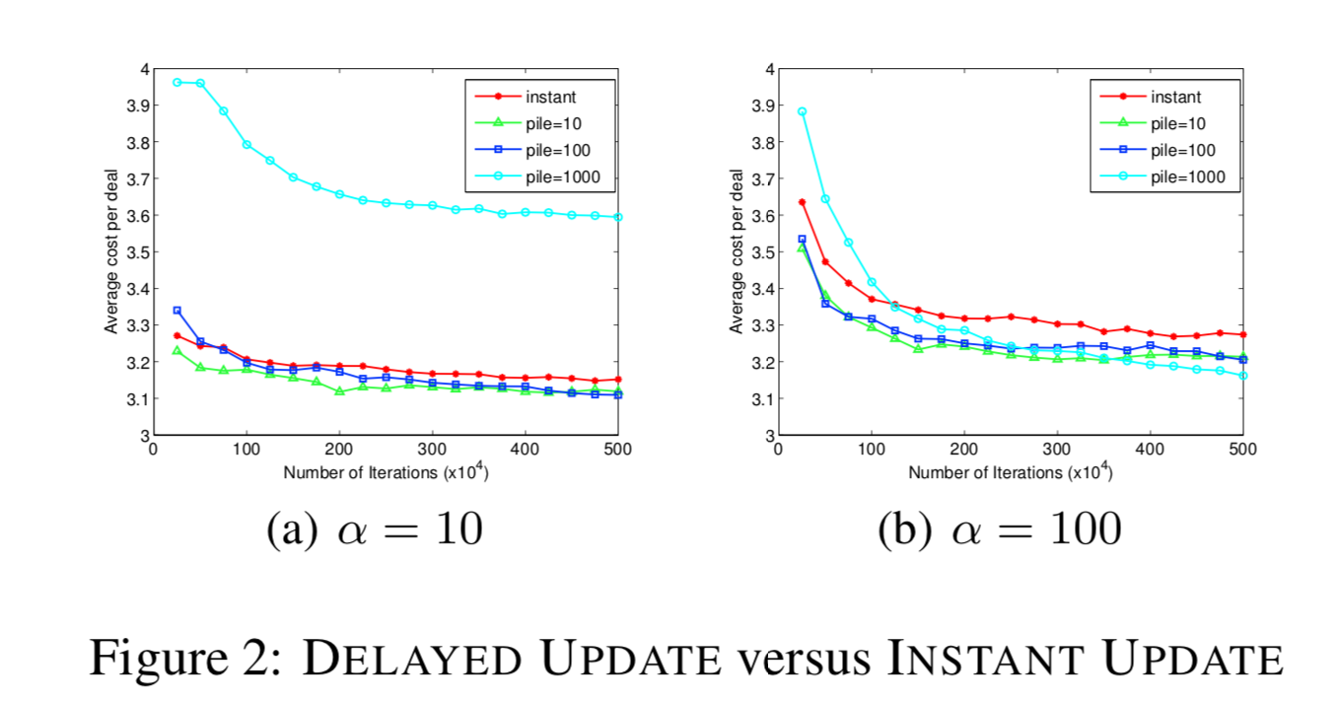
Experiments

Slide 8
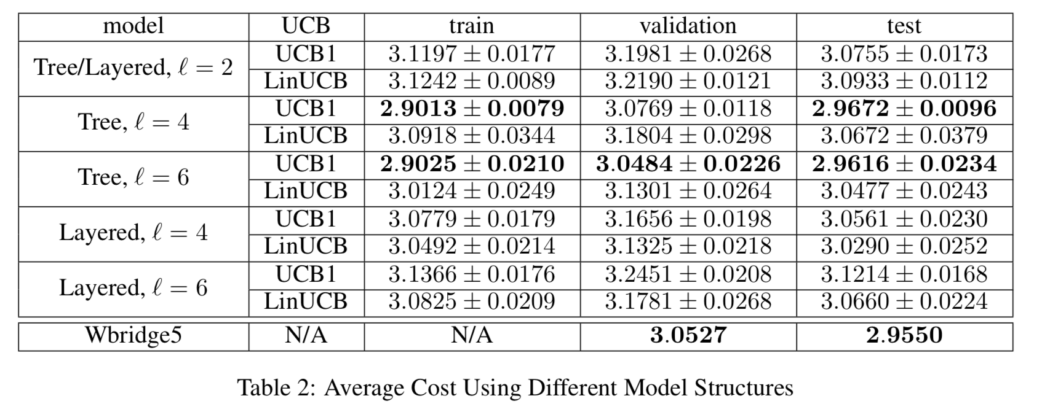
Experiments

Slide 9
Recursive Monte Carlo Search for Bridge Card Play
Bruno Bouzy, Alexis Rimbaud and Véronique Ventos
2020 IEEE Conference on Games (CoG), Aug.24-27, 2020
Presenter: Ying-Yu Lin
Date: Feb.8, 2022

Slide 10
Abstract:
Computer Bridge remains a challenging obstacle for Artificial Intelligence. For the last twenty years, the state-of-the- art playing programs have been using a depth-one Monte Carlo (MC) search approach, associated with an open card solver called Double Dummy Solver (DDS). When increasing the computing resources, the MC approach reaches a plateau, and its playing level cannot be improved. In this work, we study Recursive MC (RMC) for Bridge card play. We show that, with more computing resources, this approach performs better than MC. Rather than using DDS or any domain-dependent simulator, a level N + 1 RMC consists in using a level N RMC playing program as simulator, level-zero RMC being MC.

Slide 11
Abstract:
This recursion mechanism can be iterated several times at the cost of increasing the computing time, each time a recursion level is added. This work focusses on card play with no trump in duplicate with either 13 cards per player or 5 cards per player. With 13 cards per player, level-one RMC is superior to MC with a margin of 0.5 trick per card distribution on average, which is statistically significant. This is the first time RMC is applied with success to computer Bridge card play.

Slide 12
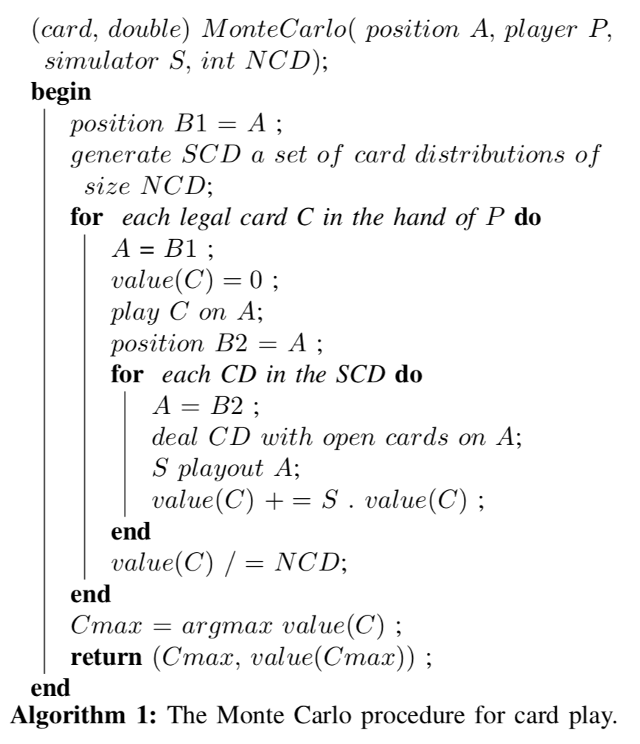
The Monte Carlo procedure for card play
NCD is the number of card distributions used.
S playout A : play the game starting on A until the end with simulator S and give the end value

Slide 13
Two issue about MC-D approach:
(1)non-locality
the value of a given node in the game tree depends not only on the nodes in the sub-tree below this node, but also on a huge number of nodes external to this sub-tree
(2)Strategy fusion
because it plays with open cards, for states belonging to the same infoset, DDS may find a state-dependent strategy to compute the value of a card. This behaviour does not respect the principle of playing the same action for all states of the same infoset when playing with hidden cards.

Slide 14
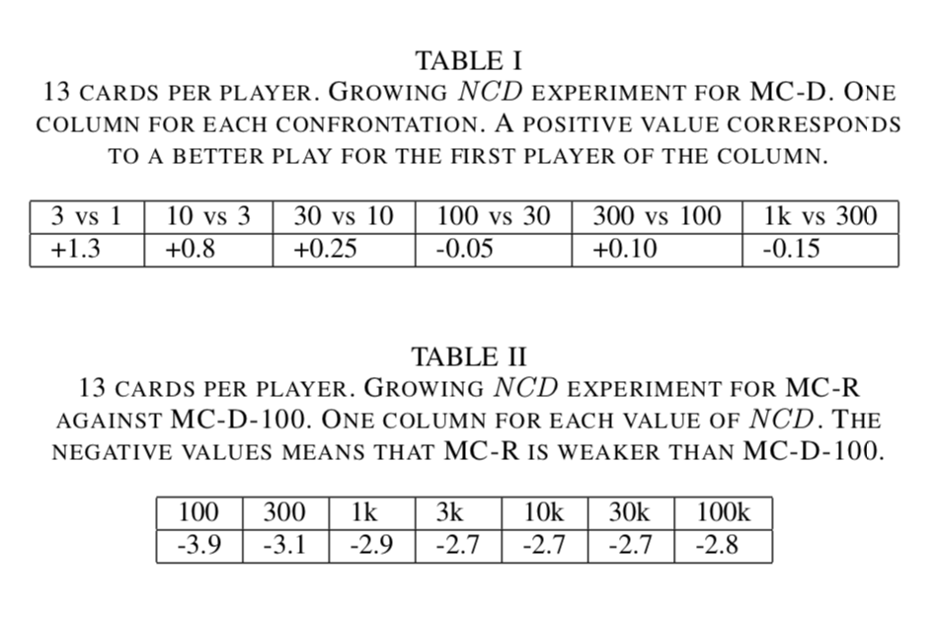
Experiment - No recursion
Plateau = 100
Plateau = 3000

Slide 15
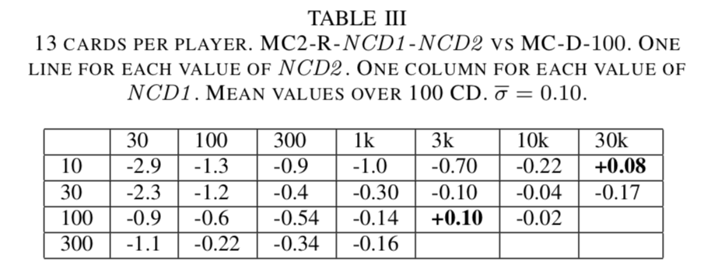
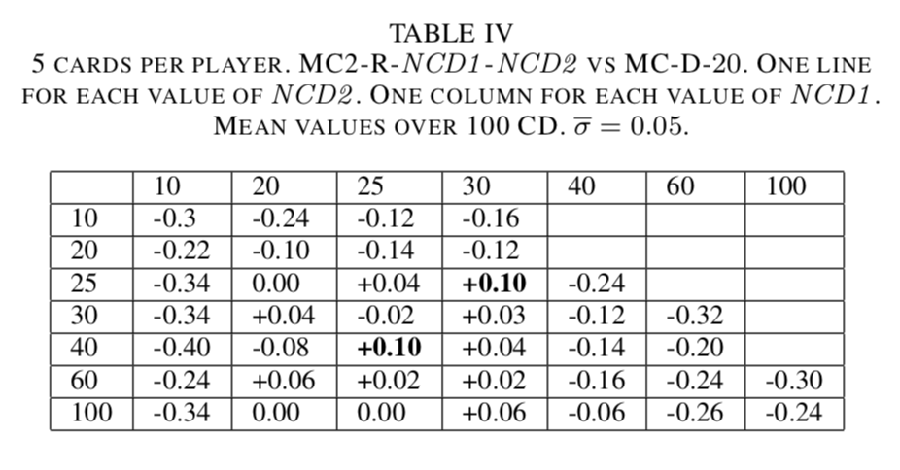
Experiment - One recursion
20 ≤ NCD1 ≤ 30 and 25 ≤ NCD2
100 CD of the (20, 20) experiment lasts about 1 hour

Slide 16
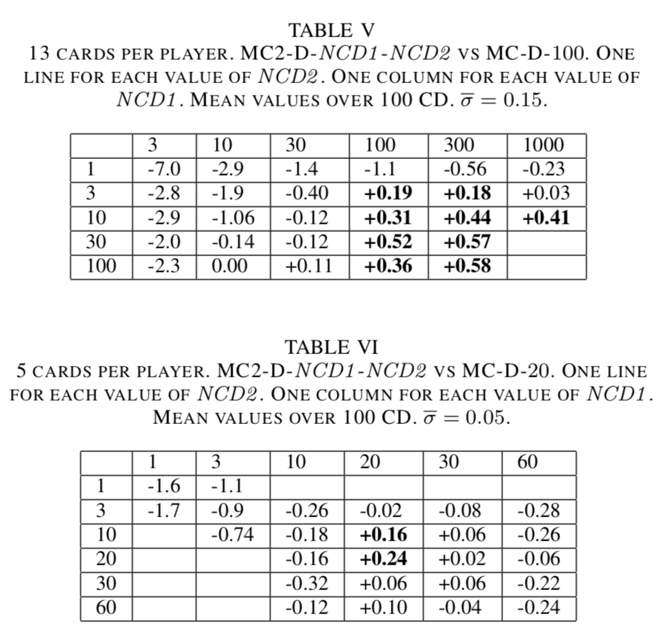
Experiment - One recursion v.s No recursion

Slide 17
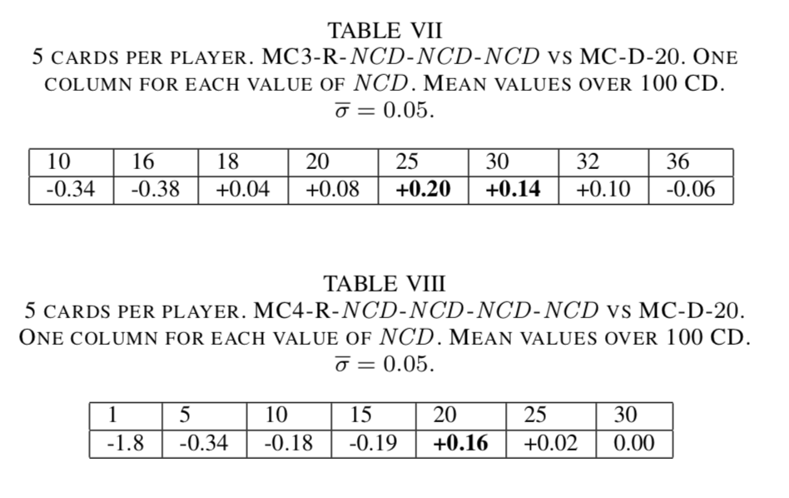
Experiment - Two recursion & Three recursion
100 CD of the (20, 20,20) experiment lasts about 2 hour
100 CD of the (20, 20,20,20) experiment lasts about 4 days

Slide 18
Conclusion
Novelty :
first time, MC-D is surpassed very significantly by MC2-D.Second novelty is that MC2-R is on a par with MC-D
(2)Significance :
with sufficient computing time, MC-D can be surpassed in a statistically significant way by RMC-D.
(3) Zero-knowledge approaches are possible :
First, a level-one RMC approach using the random player as simulator is far better than the simple MC approach using the random player as simulator
Second, a level-one RMC approach using the random player as simulator plays on a par with the current MC-D approach

