Slide 1
Application of Grey Wolf Optimization for Solving Combinatorial Problems: Job Shop and Flexible Job Shop Scheduling Cases
Tianhua Jiang and Chao Zhang
IEEE Access, vol. 6, no. 4, pp. 26231 - 26240, May. 2018
Presenter: Chih-Hsuan Chien​
Date: Feb. 22, 2022

Slide 2
Abstract(1/2)
Grey wolf optimization (GWO) algorithm is a new population-oriented intelligence algorithm, which is originally proposed to solve continuous optimization problems inspired from the social hierarchy and hunting behaviors of grey wolves. It has been proved that GWO can provide competitive results compared with some well-known meta-heuristics. This paper aims to employ the GWO to deal with two combinatorial optimization problems in the manufacturing field: job shop and flexible job shop scheduling cases. The effectiveness of GWO algorithm on the two problems can give an idea about its possible application on solving other scheduling problems. For the discrete characteristics of the scheduling solutions, we developed a kind of discrete GWO algorithm with the objective of minimizing the maximum completion time (makespan).

Slide 3
Abstract(2/2)
In the proposed algorithm, searching operator is designed based on the crossover operation to maintain the algorithm work directly in a discrete domain. Then an adaptive mutation method is introduced to keep the population diversity and avoid premature convergence. In addition, a variable neighborhood search method is embedded to further enhance the exploration. To evaluate the effectiveness, the discrete GWO algorithm is compared with other published algorithms in the literature for the two scheduling cases. Experimental results demonstrate that our algorithm outperforms other algorithms for the scheduling problems under study

Slide 4
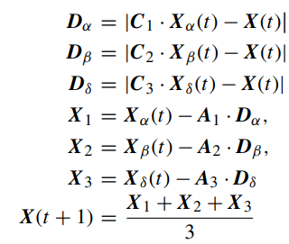
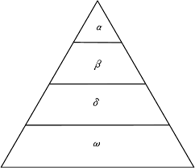
Grey Wolf Optimization

Slide 5
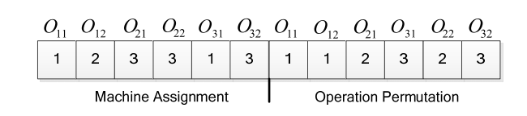
Flexible Job Shop Scheduling Encode

Slide 6
Population Initialization
global selection
local selection
random selection

Slide 7
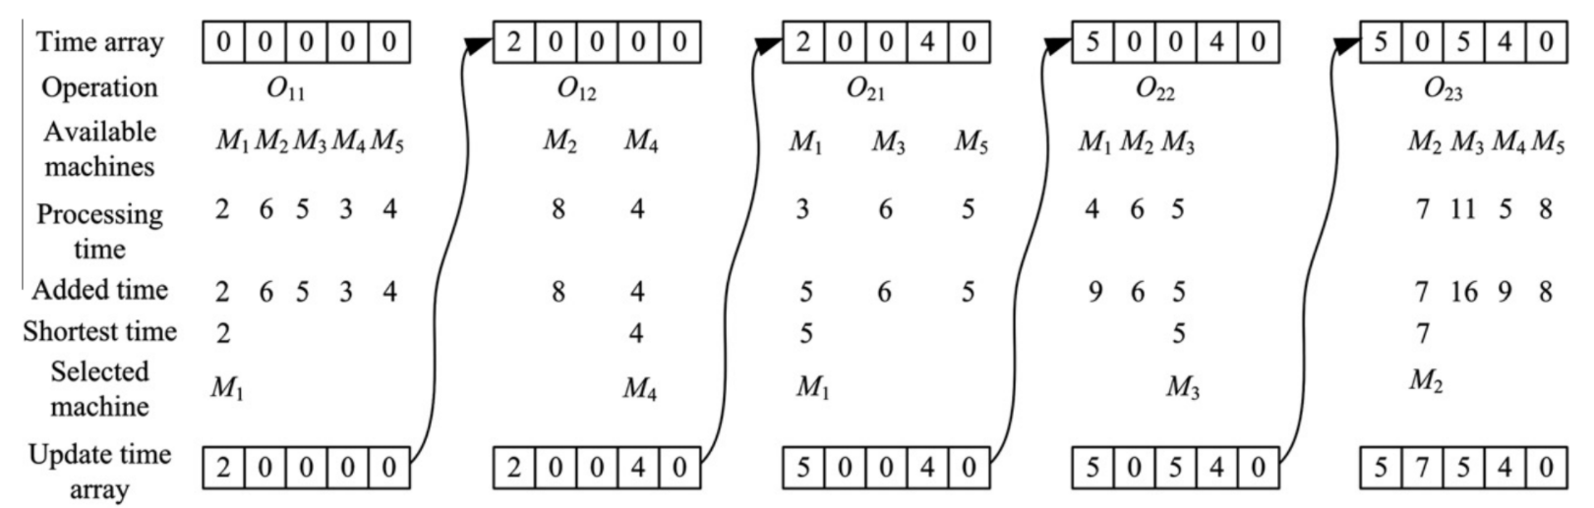
Global Selection

Slide 8
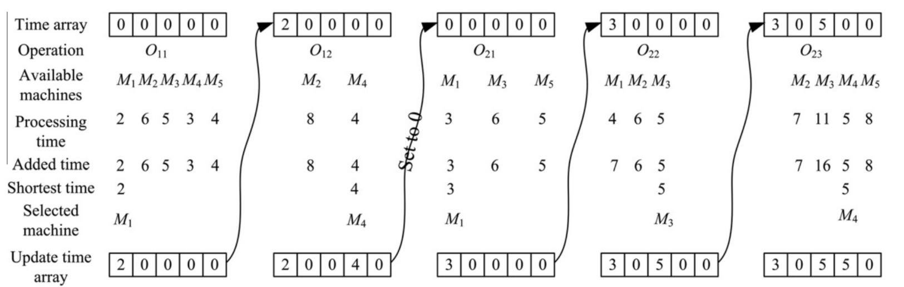
Local Selection

Slide 9

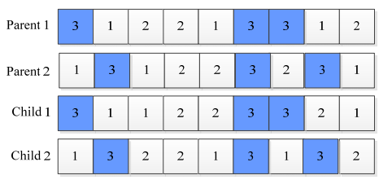
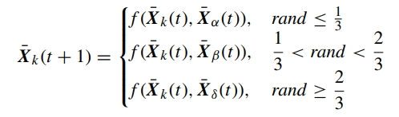

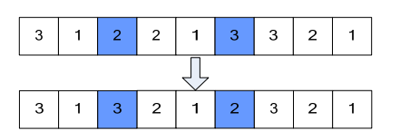
Discrete Search Operator For The Prey
Notes:
上圖operation permutation
下圖machine assignment

Slide 10

Adaptive Mutation Operator

Slide 11
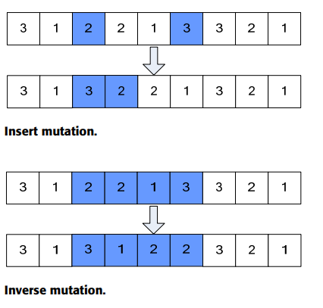
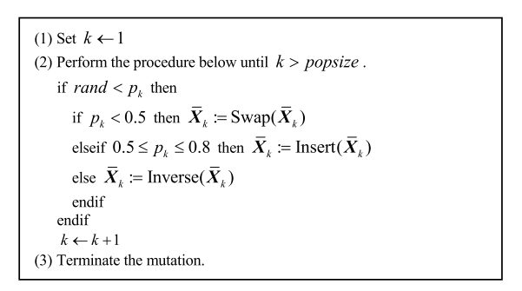
Mutation Process For JSP

Slide 12
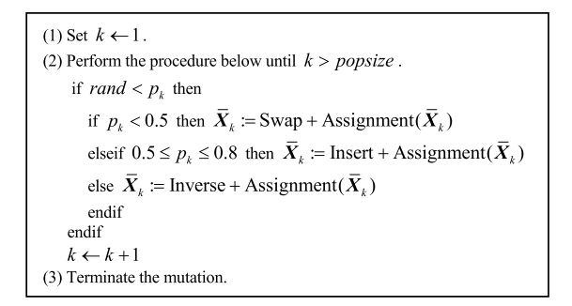
Mutation Process For FJSP
Assignment: Randomly choose an operation with more than one alternative machine.

Slide 13
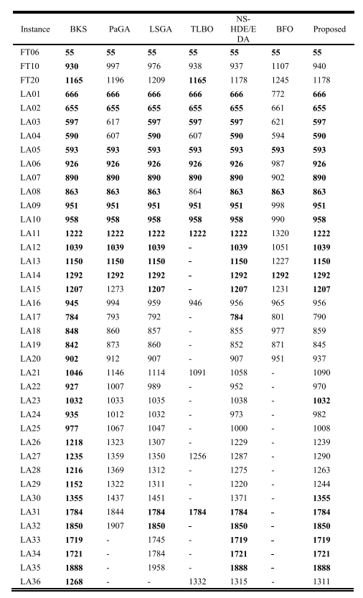
Results
Notes:
the symbol ‘-’ means that the value was not listed in the corresponding literature.
our proposed GWO obtained the best-known results for 23 out of 39 instances

