Slide 1
A Novel Fast and Memory Efficient Parallel MLCS Algorithm for Long and Large-Scale Sequences Alignments ​
Yanni Li, Yuping Wang, Zhensong Zhang, Yaxin Wang, Ding Ma and Jianbin Huang
2016 IEEE 32nd International Conference on Data Engineering (ICDE)
16-20 May 2016, Helsinki, Finland
Presenter: Chien-Ting Lee
Date: Feb. 22, 2022

Slide 2
Abstract(1/2)
Information usually can be abstracted as a character sequence over a
finite alphabet. With the advent of the era of big data, the increasing
length and size of the sequences from various application fields (e.g.,
biological sequences) result in the classical NP-hard problem, searching
for the Multiple Longest Common Subsequences of multiple sequences
becoming a research hotspot and facing severe challenges. In this paper,
we firstly reveal that the leading dominant-point-based MLCS
algorithms are very hard to apply to long and large-scale sequences
alignments. To overcome their defects, based on the proposed problem-
solving model and parallel topological sorting strategies, we present a
novel efficient parallel MLCS algorithm.

Slide 3
Abstract(2/2)
The comprehensive experiments on the benchmark datasets of both
random and biological sequences demonstrate that both the time and
space complexities of the proposed algorithm are only linearly related
to the dominants from aligned sequences, and that the proposed
algorithm greatly outperforms the existing state-of-the-art dominant-
point-based MLCS algorithms, and hence it is very suitable for long
and large-scale sequences alignments.

Slide 4
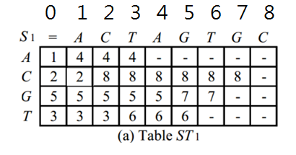
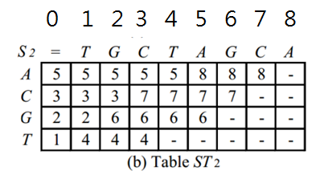
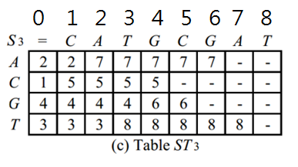
Top_MLCS(1)
Step 1: Preparation of successor tables
時間複雜度:O(d|Σ|n)
Notes:
時間複雜度:sequence數量*字母種類*sequence長度

Slide 5
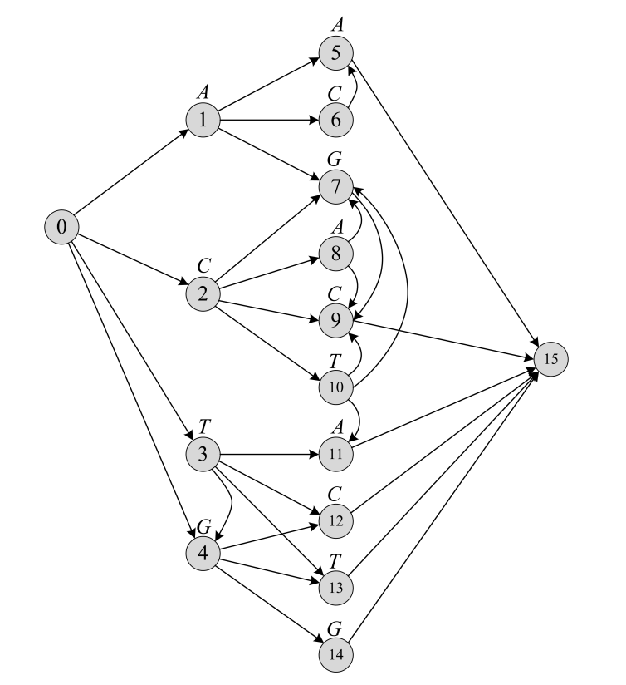
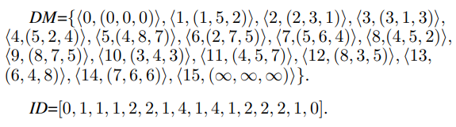
Top_MLCS(2)
Step 2: Construction of ICSG.
時間複雜度:O(E)
Notes:
主要是用一個hash table 紀錄總共有哪些點與一個陣列紀錄這些點的in-degree
從起點開始的拓樸
利用前面的indegree與successor tables做完這個步驟我們可以得到每個點屬於哪一個level與他的precursor
講解範例

Slide 6
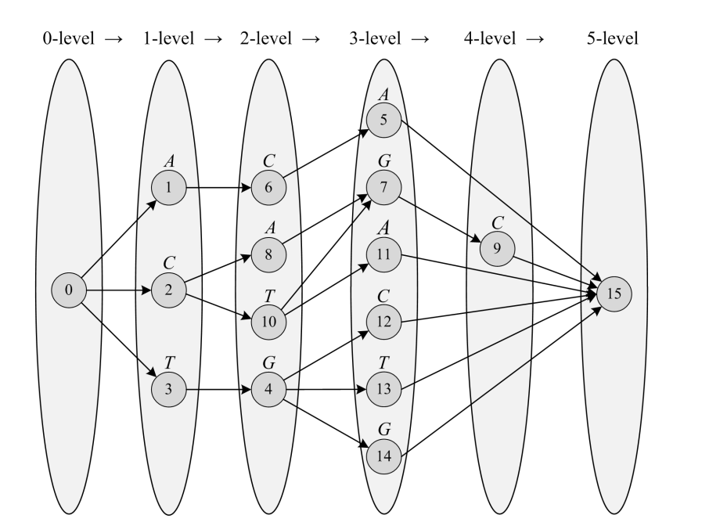
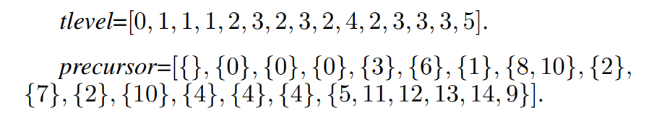
Top_MLCS(3)
Step 3-1: Optimization of the ICSG.
時間複雜度:O(V)
Notes:
從起點開始的拓樸
利用前面的indegree與successor tables做完這個步驟我們可以得到每個點屬於哪一個level與他的precursor
從終點開始的拓樸
我們知道每個點的前一個是誰再加上知道每一個點是屬於哪一層來
找到哪些才是critical points (使用level-1=|MLCS|的性質來求ex:level2要連接level3，level4要連level5，所以看點5直接連到15就是有問題的可被刪除。)

Slide 7
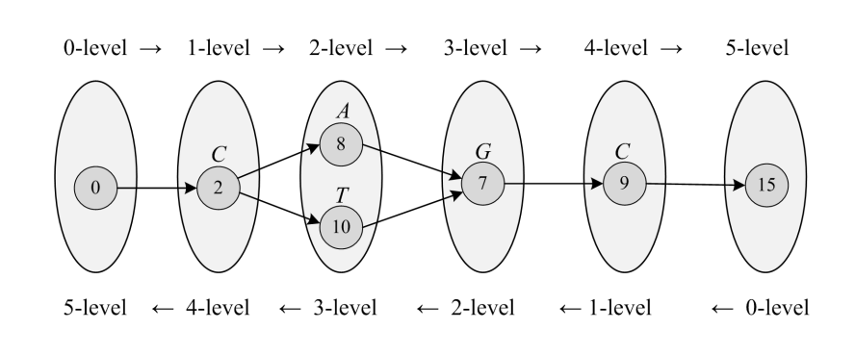
Top_MLCS(4)
Step 3-2: Optimization of the ICSG.
Step 4: Obtaining all the MLCSs of T
時間複雜度:O(V)
Notes:
從終點開始的拓樸
我們知道每個點的前一個是誰再加上知道每一個點是屬於哪一層來
找到哪些才是critical points (使用level-1=|MLCS|的性質來求ex:level2要連接level3，level4要連level5，所以看點5直接連到15就是有問題的可被刪除。)

Slide 8
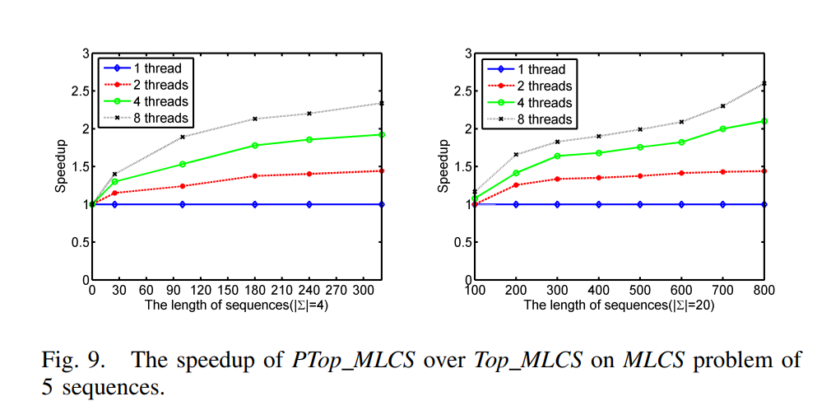
EXPERIMENTAL RESULTS

Slide 9
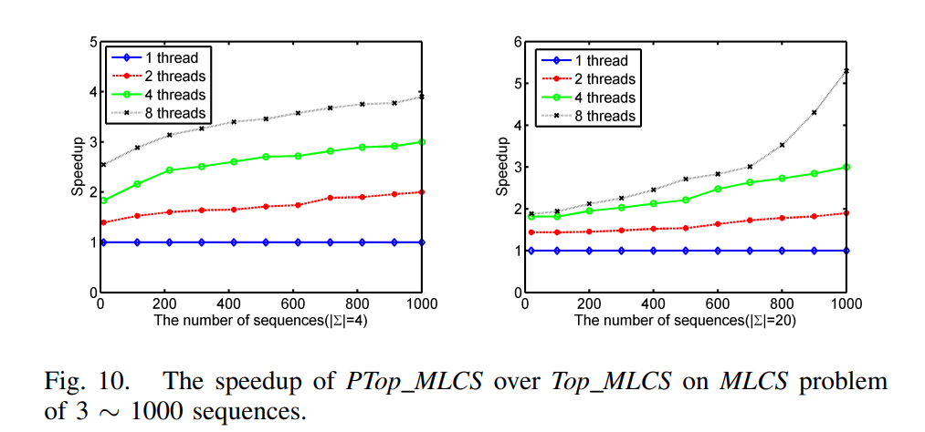
EXPERIMENTAL RESULTS

Slide 10
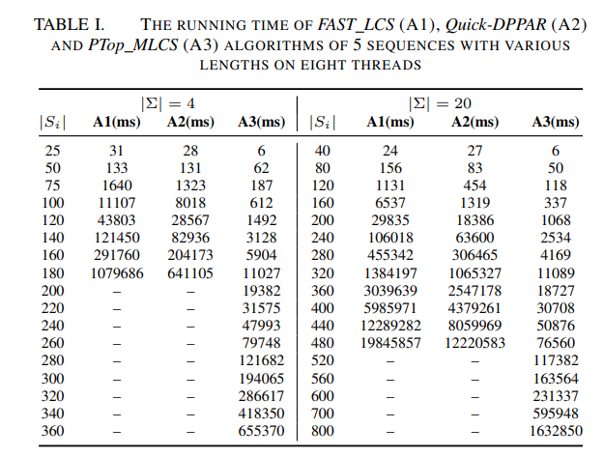
EXPERIMENTAL RESULTS
Notes:
5 SEQUENCES
字母種類分別為4個與20個
sequence長度不固定
- 運行時間超過24小時

Slide 11
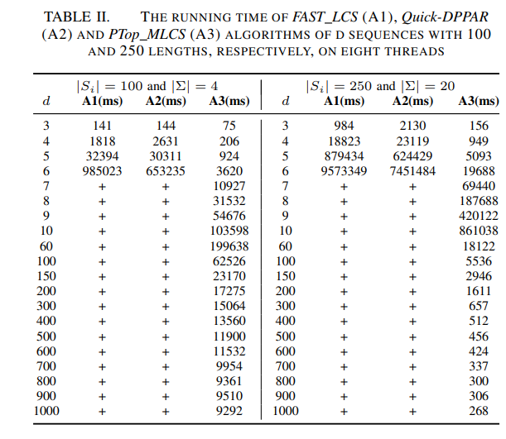
EXPERIMENTAL RESULTS
Notes:
sequence長度100 與 250
字母種類分別為4個與20個
Sequence數量不固定
+ 代表 memory overflow
這篇論文提出的方法明顯更適合大規模的MLCS

