Slide 1
Object Detection for Graphical User Interface: Old Fashioned or Deep Learning or a Combination?
Jieshan Chen, Mulong Xie, Zhenchang Xing, Chunyang Chen, Xiwei Xu, Liming Zhu, Guoqiang Li
ESEC/FSE 2020: Proceedings of the 28th ACM Joint Meeting on European Software Engineering Conference and Symposium on the Foundations of Software Engineering, November 2020, Pages 1202–1214
Presenter : Yu-Ju Liao
Date : Feb. 22, 2022

Slide 2
Abstract(1/2)
Detecting Graphical User Interface (GUI) elements in GUI images is a domain-specific object detection task. It supports many software engineering tasks, such as GUI animation and testing, GUI search and code generation. Existing studies for GUI element detection directly borrow the mature methods from computer vision (CV) domain, including old fashioned ones that rely on traditional image processing features (e.g., canny edge, contours), and deep learning models that learn to detect from large-scale GUI data. Unfortunately, these CV methods are not originally designed with the awareness of the unique characteristics of GUIs and GUI elements and the high localization accuracy of the GUI element detection task.

Slide 3
Abstract(2/2)
We conduct the first large-scale empirical study of seven representative GUI element detection methods on over 50k GUI images to understand the capabilities, limitations and effective designs of these methods. This study not only sheds the light on the technical challenges to be addressed but also informs the design of new GUI element detection methods. We accordingly design a new GUI-specific old-fashioned method for non-text GUI element detection which adopts a novel top-down coarse-to-fine strategy, and incorporate it with the mature deep learning model for GUI text detection. Our evaluation on 25,000 GUI images shows that our method significantly advances the start-of-the-art performance in GUI element detection.

Slide 4
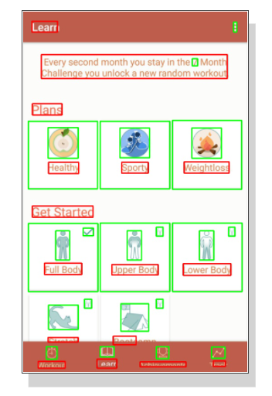
User Interface Element Detection (UIED)

Slide 5
User Interface Element Detection (UIED)
Application
UI2Code
robotic GUI automatic testing

Slide 6
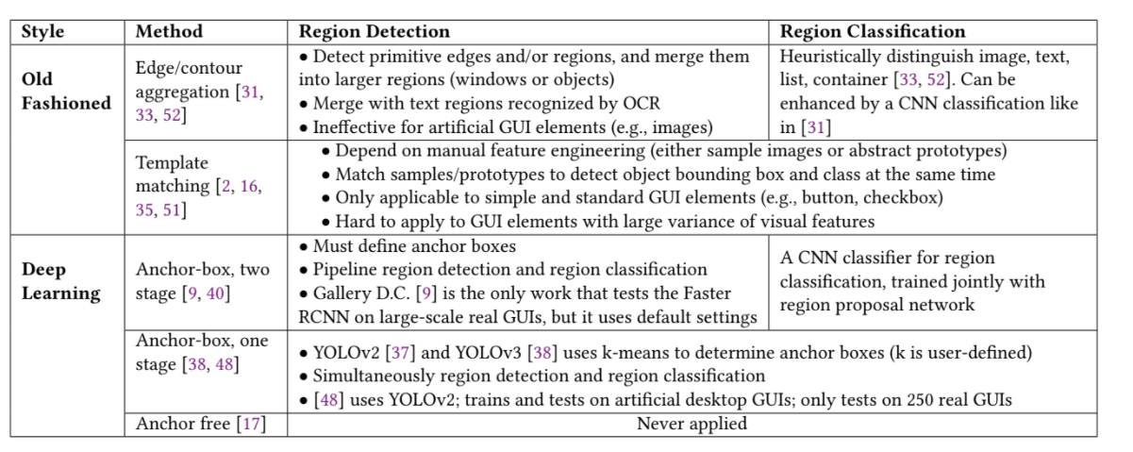
Methods in UIED

Slide 7

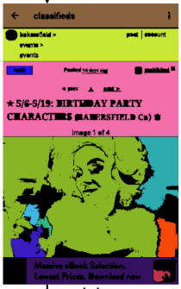
GUI element detection
block map
(flood-filling algorithm)
shape recognition algorithm

Slide 8
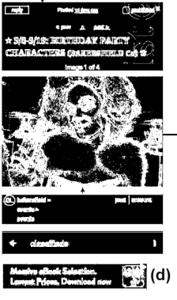

GUI element detection
binary map
(gradient map)
ResNet 50

Slide 9

GUI element detection

Slide 10
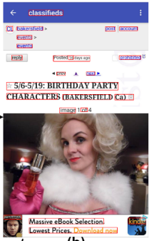
GUI Text Element Detection
EAST (deep learning)

Slide 11
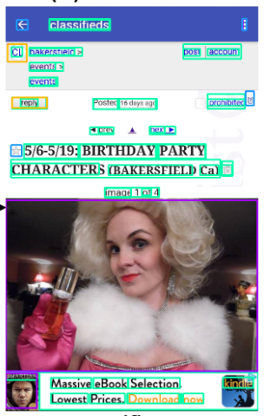
GUI Text Element Detection

Slide 12
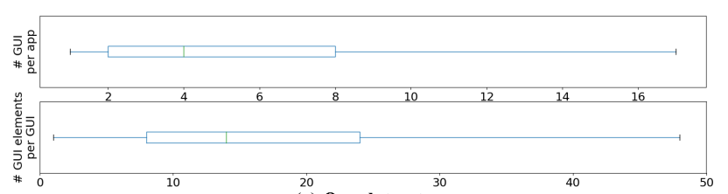
Dataset
Experimental dataset : Rico
GUIs : 50,524
8,018 Android mobile applications
GUI elements type : 15
GUI elements : 923,404

Slide 13
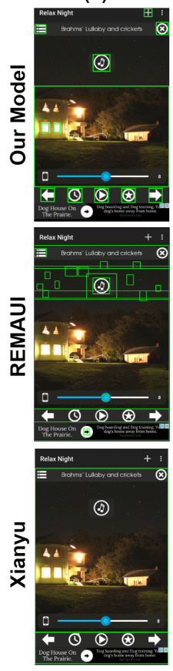
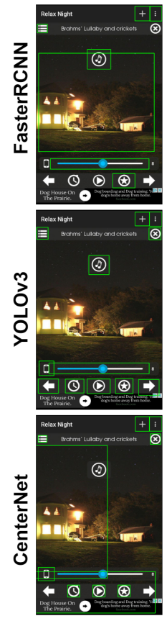
Result

Slide 14
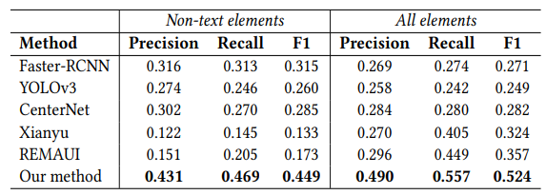
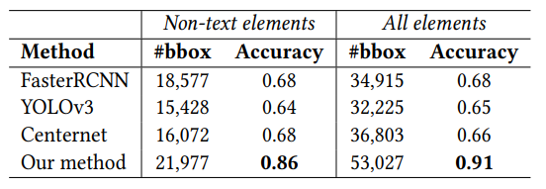
Result
Precision : 𝑇𝑃/(𝑇𝑃 +𝐹𝑃)
Recall : 𝑇𝑃 /(𝑇𝑃 + 𝐹𝑁 )
𝐹1 = (2×𝑃𝑟𝑒𝑐𝑖𝑠𝑖𝑜𝑛×𝑅𝑒𝑐𝑎𝑙𝑙)
/ (𝑃𝑟𝑒𝑐𝑖𝑠𝑖𝑜𝑛+ 𝑅𝑒𝑐𝑎𝑙𝑙)
Overall results of object detection (IoU > 0.9)
Region classification results for TP regions

