Slide 1
Combinatorics of minimal absent words
for a sliding window
Tooru Akagi, Yuki Kuhara, Takuya Mieno,
Yuto Nakashima, Shunsuke Inenaga, Hideo Bannai
and Masayuki Takeda
ArXiv, abs/2105.08496, 2021
Presenter: Shin-Cheng Lin
Date: Mar. 16, 2022

Slide 2
Abstract
A string w is called a minimal absent word (MAW) for another string T if w does not occur in T but the proper substrings of w occur in T. For example, let Σ = {a,b,c} be the alphabet. Then, the set of MAWs for string w = abaab is {aaa, aaba, bab, bb, c}.In this paper, we study combinatorial properties of MAWs in the sliding window model, namely, how the set of MAWs changes when a sliding window of fixed length d is shifted over the input string T of length n, where 1 ≦ d ＜ n.

Slide 3
Abstract
We present tight upper and lower bounds on the maximum number of changes in the set of MAWs for a sliding window over T, both in the cases of general alphabets and binary alphabets. Our bounds improve on the previously known best bounds.

Slide 4
MAW(minimal absent word)
w does not occur in T
w[2..] occurs in T
w[..|w|－1] occurs in T

Slide 5
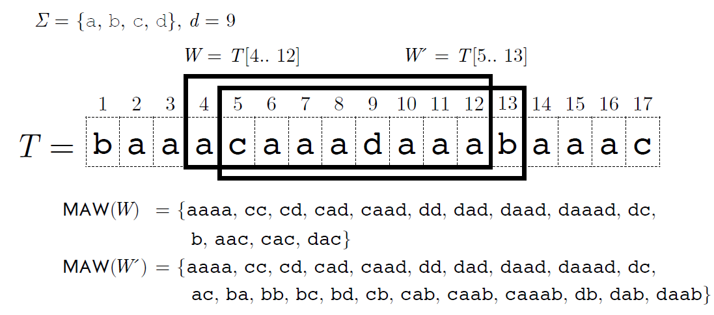
MAWs for a sliding window
appending a letter to the right
removing the leftmost letter

Slide 6
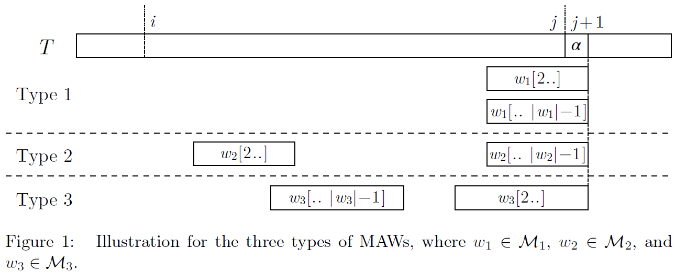
MAWs for a sliding window

Slide 7
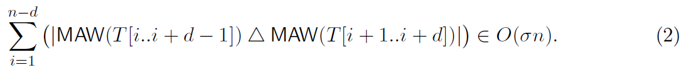
Bounds for the numbers of changes
Crochemore et al.
this paper

Slide 8
|M₁|≦1
|M₂|≦σ’
|M₃|≦d－1

Slide 9
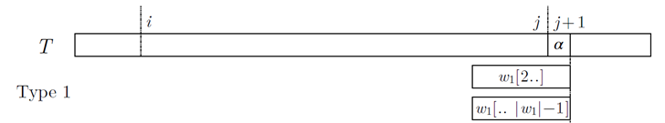
|M₁|≦1
α^{k}, α ∈ Σ
w₁=w_{|w|}= α

Slide 10
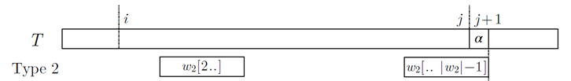
|M₂|≦σ’
w[..|w|-1] in T[i..j+1]
w[2..] in T[i..j]
=> w=w₁,w₂,w₃, …, w_{|w|-2}, w_{|w|-1}, w_{|w|}
w_{|w|-2} ∈ Σ

Slide 11
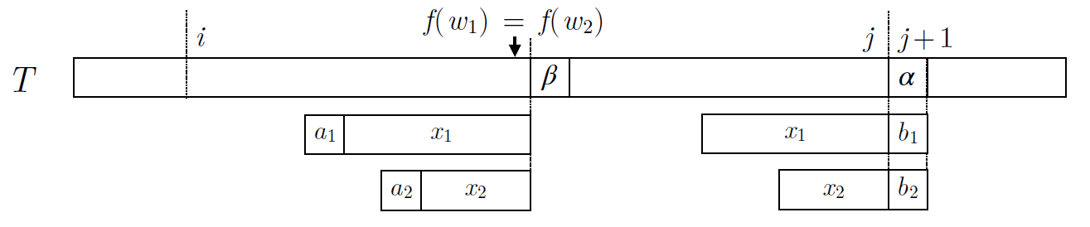
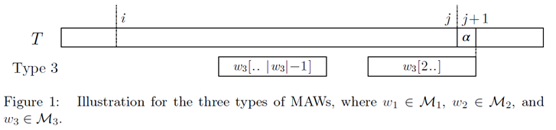
|M₃|≦d－1
w_{|w|}= T_{j+1} = α
w=w[..|w|－1] + α

Slide 12
O(d+ σ’+1)
O(d)

