Slide 1
Association Rule Mining Based Parameter Adaptive Strategy for Differential Evolution Algorithms
Chuan Wang, Yancheng Liu, Qinjin Zhang, Haohao Guo, Xiaoling Liang, Yang Chen, Minyi Xu and Yi Wei
Expert Systems With Applications, 2019
Volume 123, pp. 54-69
Presenter: Tsung-Lin Lu
Date: Mar. 16, 2022

Slide 2
Abstract (1/2)
It is a very challenging and important task to adaptively adjust the scale factor F and the crossover rate Cr for Differential Evolutionary (DE) algorithms. Most recent adaptive techniques were designed to generate parameters randomly based on successful trial values during the previous evolving process, lacking explicit guidelines to generate appropriate values. This paper proposes a novel parameter adaption strategy, which could incorporate promising F and Cr pairs extracted by using Association Rule Mining (ARM) into DE algorithms. First, all successful F and Cr values generated by their original methods are recorded during the whole evolution, resulting in an increasing dataset. Second, we discretize the dataset and extract the most frequent itemset of parameters by using a modified version of the widely used Apriori algorithm.

Slide 3
Abstract (2/2)
Third, a greedy operator is developed to generate new parameters in the next generation by comparing the presented ARM-based and original-method-based fitness values. The presented technique provides an additional pair of F and Cr values to be evaluated, without replacing existing strategies for the control parameters. The main contribution of this paper is that we propose a novel way, which utilizes information generated during the evolutionary process, to enhance exploration capabilities by adjusting control parameters. Experimental results demonstrate that the proposed ARM-based parameter adaptive strategy is able to enhance performances of some state-of-the-art DE variants. Further, this methodology might be helpful for other control parameters of Evolutionary Algorithms (EA).

Slide 4
Outline
Differential Evolution (DE)
Initialization
Mutation
Crossover
Selection
Association Rule Mining (ARM)
Apriori Algorithm
ARM-Based Parameter Adaptive Strategy
Results

Slide 5
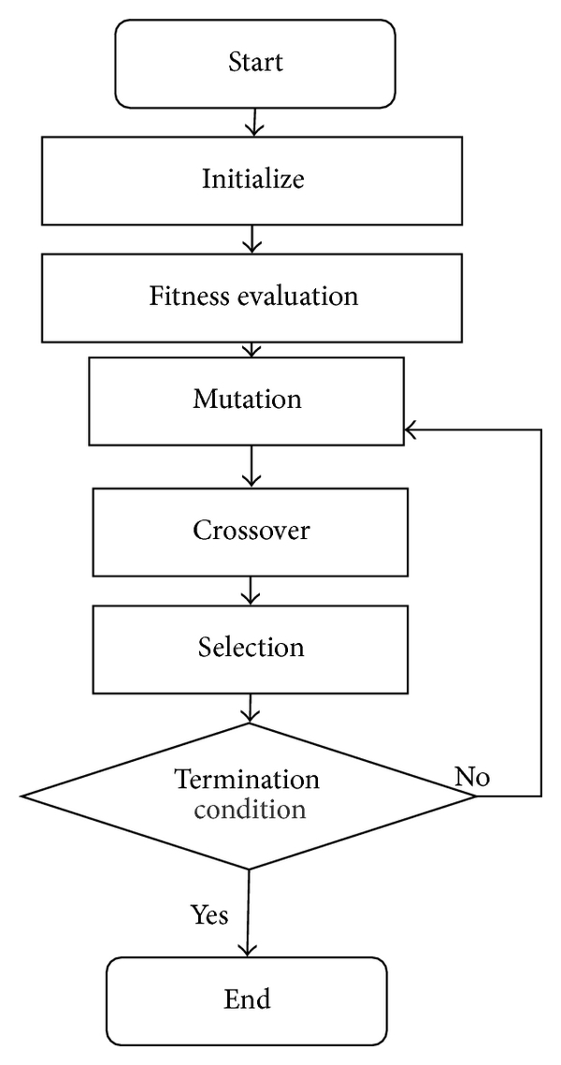
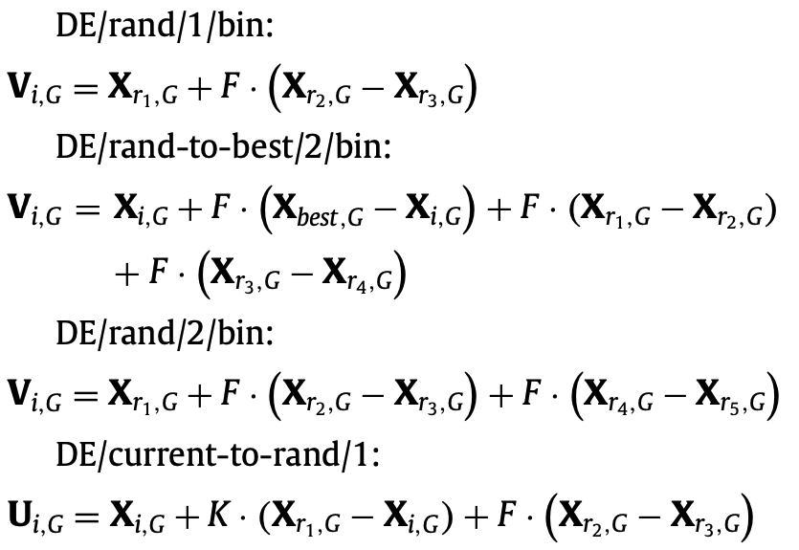
Differential Evolution (DE) Algorithm (1/3)
Initialization : Random
Mutation : F = 0.3
r\i | 1 | 2 | 3 | 4 | 5
1 | 3 | 4 | 9 | 2 | 3
2 | 3 | 7 | 2 | 5 | 7
3 | 2 | 7 | 3 | 8 | 2
4 | 4 | 5 | 8 | 3 | 2
r = 1
2.4
6.1
7.5
3.9
7
3 + 0.3 * (2 - 4) = 2.4
7 + 0.3 * (4 - 7) = 6.1
9 + 0.3 * (3 - 8) = 7.5
3 + 0.3 * (5 - 2) = 3.9
7 + 0.3 * (2 - 2) = 7
Green : r1
Orange : r2
Blue : r3

Slide 6
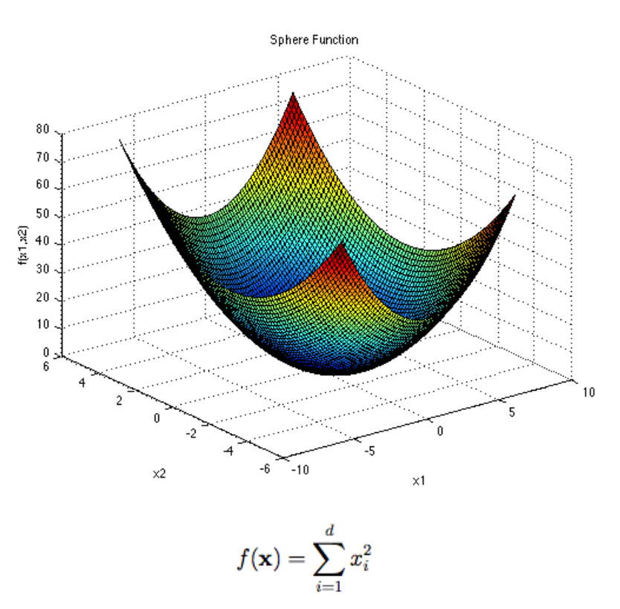

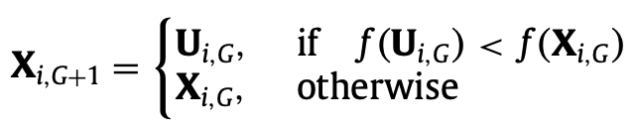

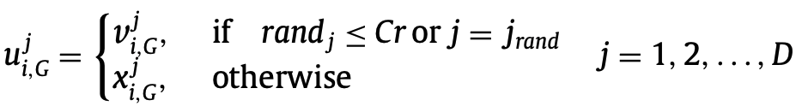
Differential Evolution (DE) Algorithm (2/3)
Crossover : Cr = 0.5
Fitness function :
Selection
 | 1 | 2 | 3 | 4 | 5
X₁ | 3 | 4 | 9 | 2 | 3
V₁ | 2.4 | 6.1 | 7.5 | 3.9 | 7
U₁ | 3 | 6.1 | 7.5 | 3.9 | 3
Cr | 0.7 | 0.2 | 0.8 | 0.5 | 0.9
f(X₁) = 9 + 16 + 81 + 4 + 9 = 119
f(U₁) = 9 + 37.21 + 56.25 + 15.21 + 9 = 126.67
j_{rand}

Slide 7
Differential Evolution (DE) Algorithm (3/3)
Mutation
Crossover
Selection
X_{i, G} : target vector
V_{i, G} : mutant vector
U_{i, G} : trial vector
G : generation
r : random index
F : scale factor
Cr : crossover rate
D : dimension

Slide 8
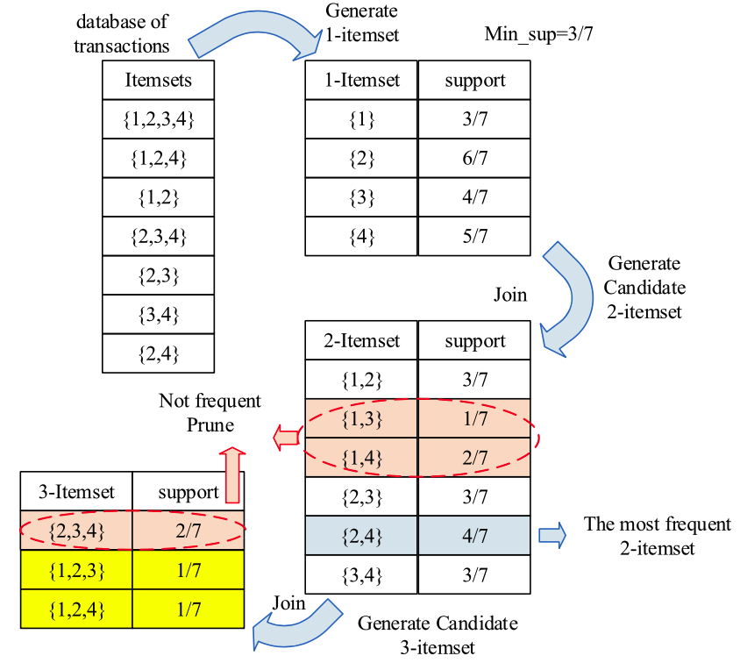
Association Rule Mining (ARM)
Discover interesting relations between variables in large databases.
Apriori Algorithm
(a) An example of how Apriori algorithm works.

Slide 9
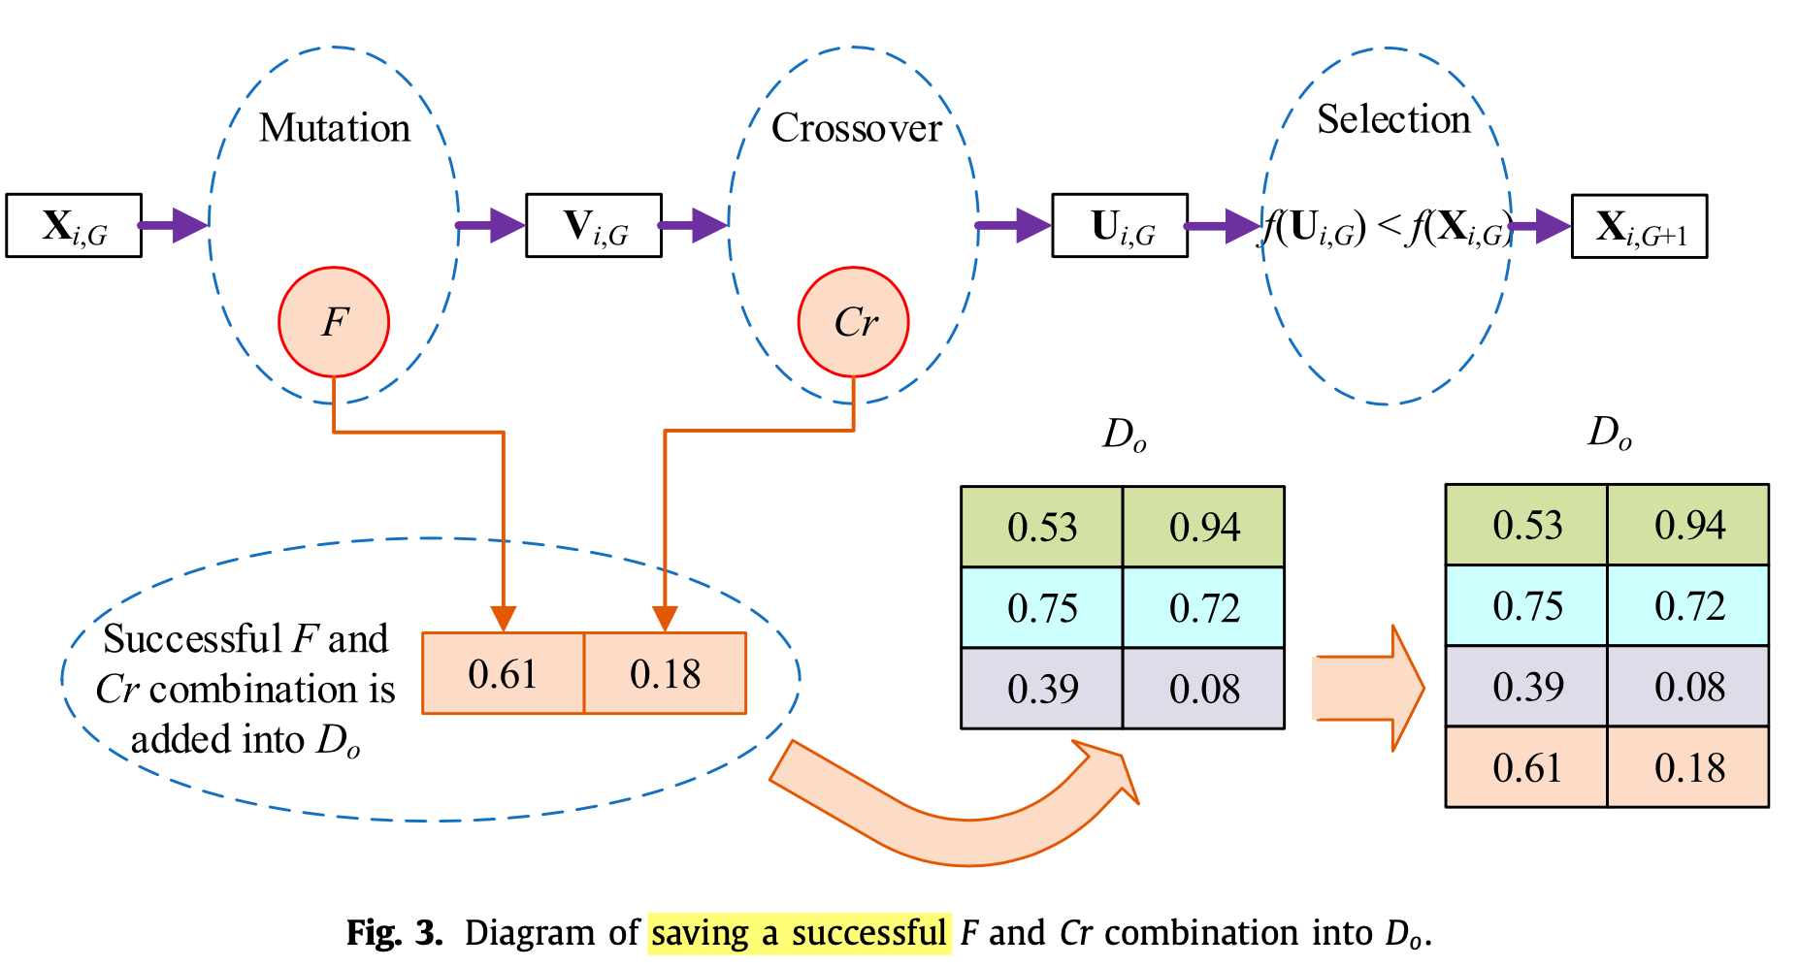
ARM-Based Parameter Adaptive Strategy (1/4)

Slide 10
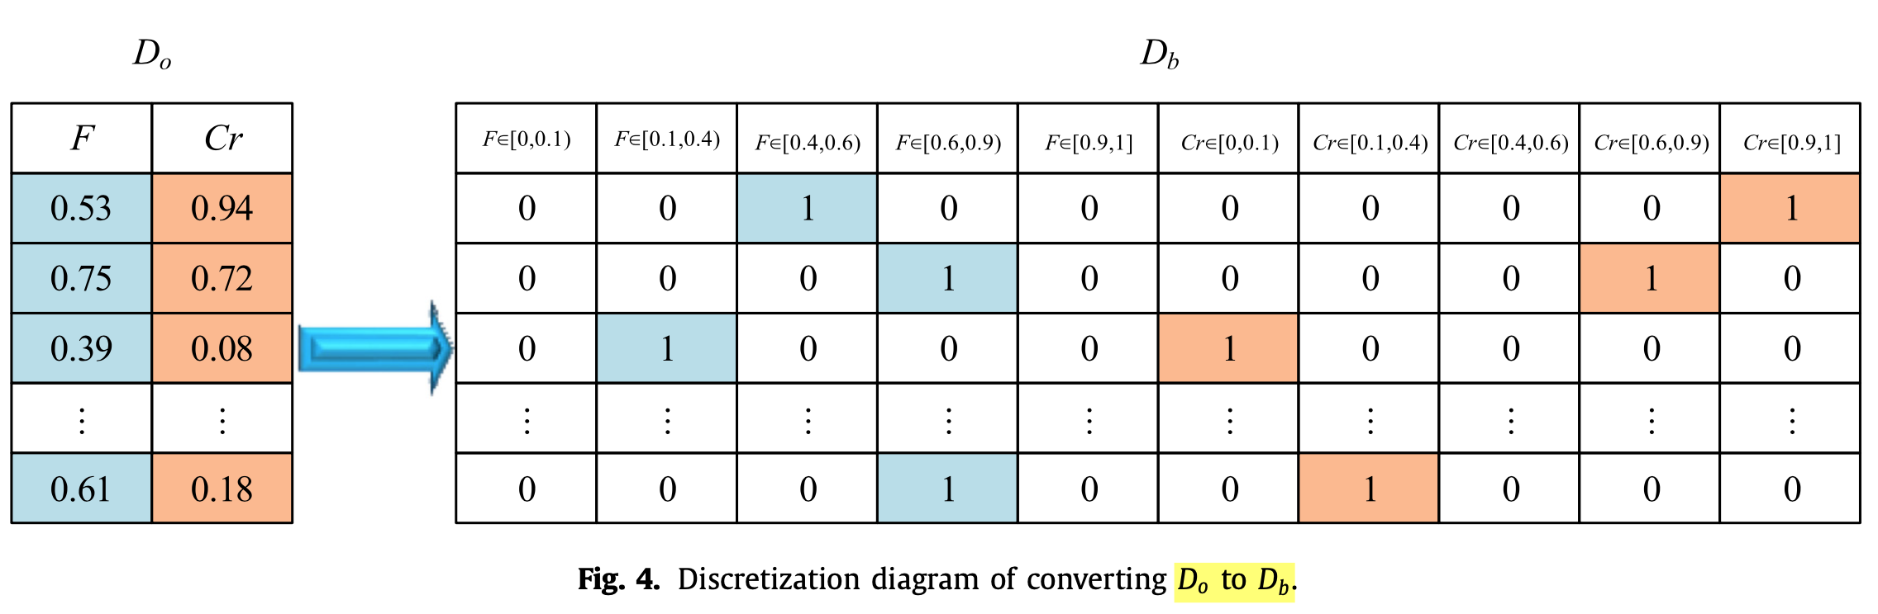
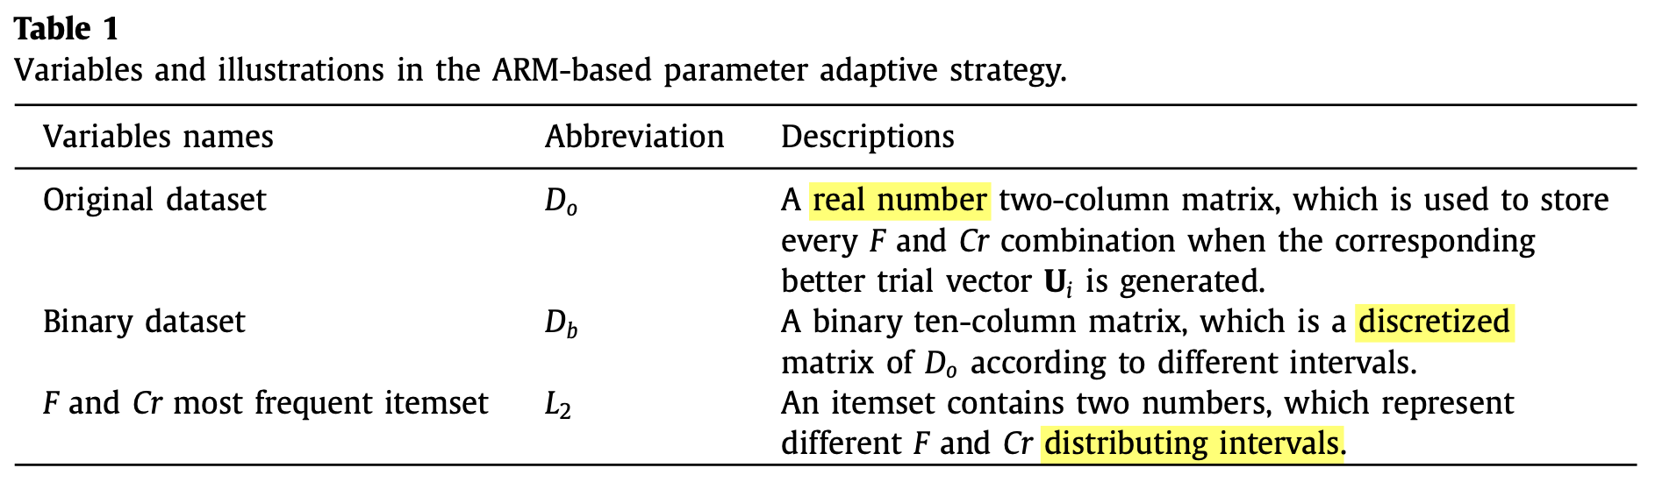
ARM-Based Parameter Adaptive Strategy (2/4)

Slide 11
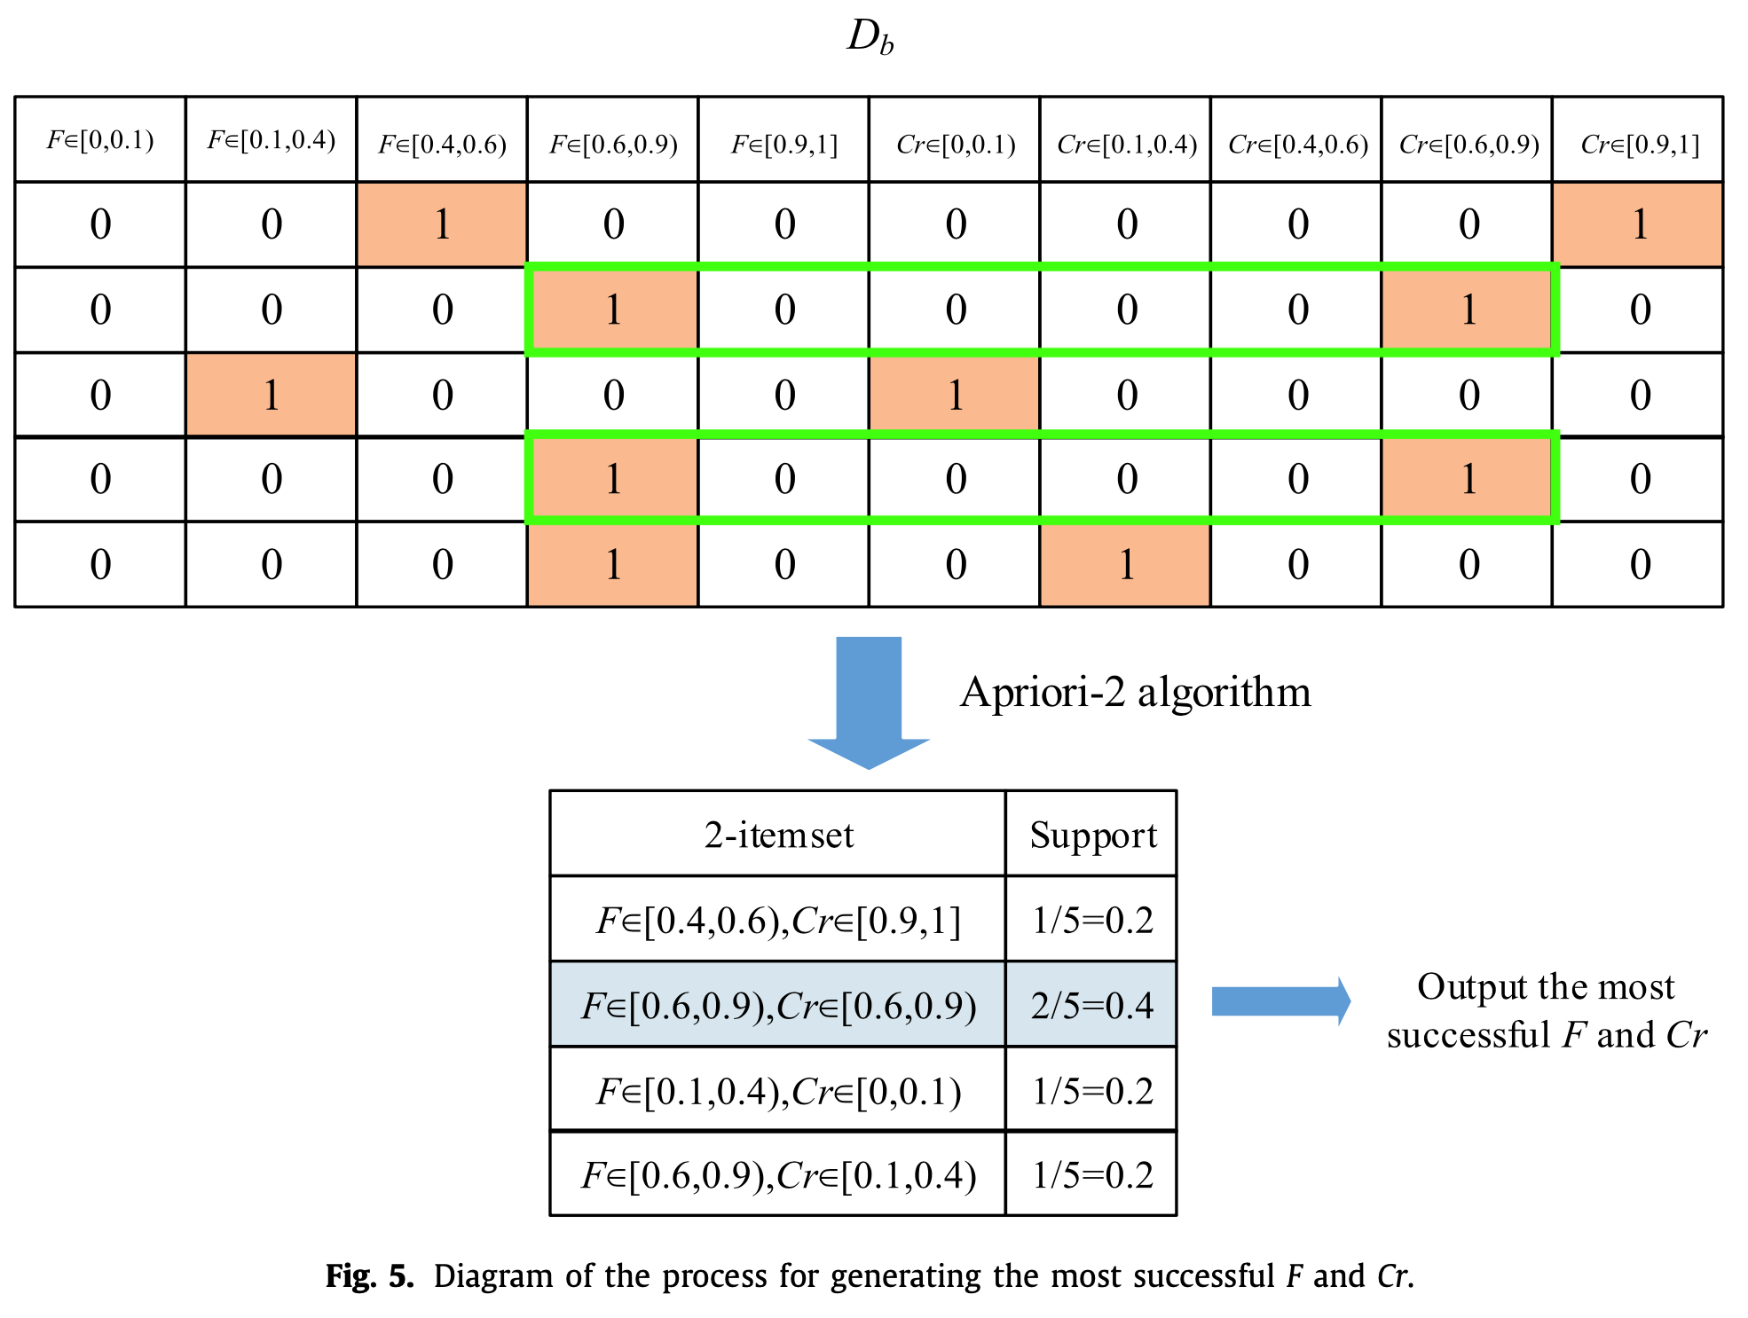
ARM-Based Parameter Adaptive Strategy (3/4)

Slide 12
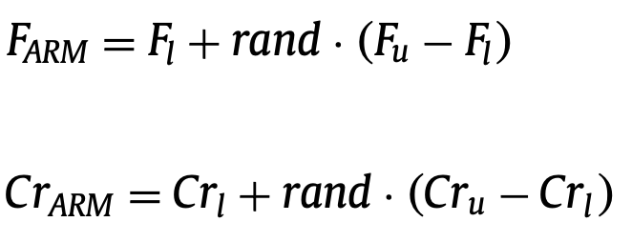
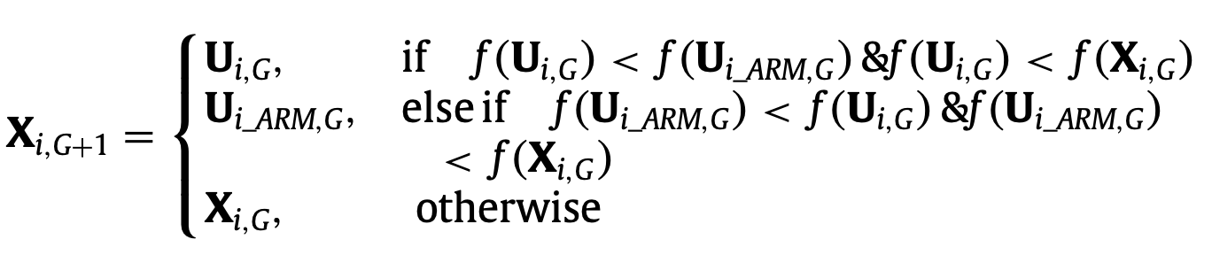
ARM-Based Parameter Adaptive Strategy (4/4)
Step 1. Record every successful F and Cr into original dataset D_{o}.
Step 2. Discretize D_{o}.
Step 3. Find the most frequent 2-itemset by using Apriori algorithm.
Step 4. Generate new values based on the above association rule.
Step 5. Select better candidate parameters by using a greedy operator.
Step4.
Step5.

Slide 13
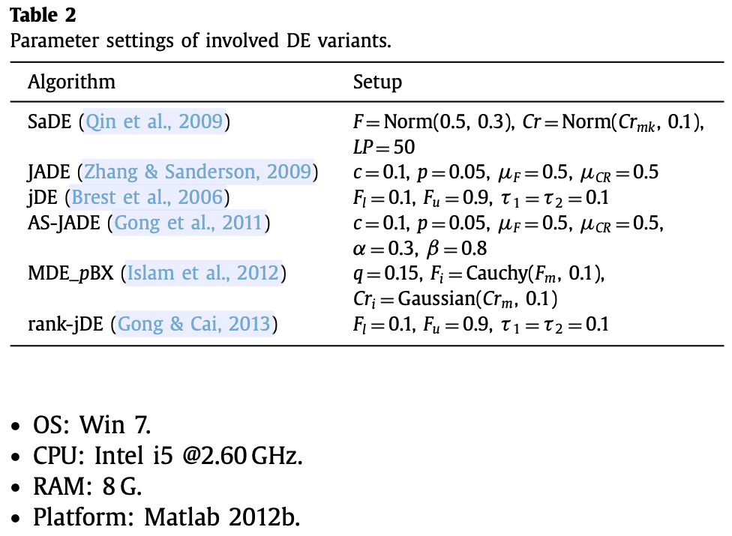
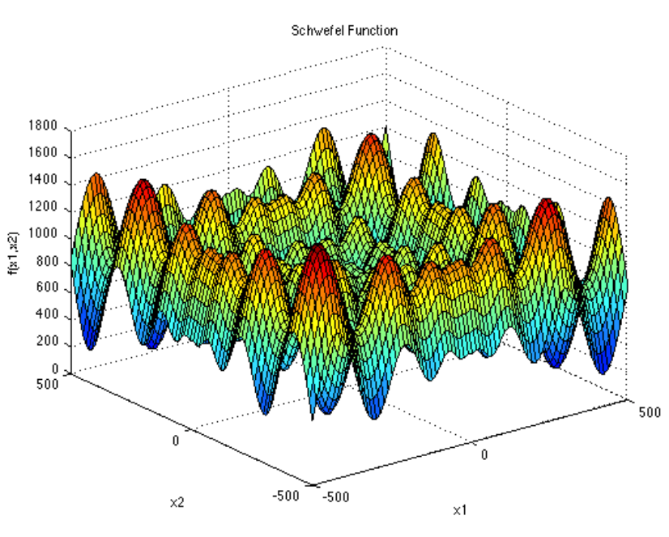
Results (1/5)
Benchmark : CEC2005
f₁ - f₅ : unimodal functions
f₆ - f₁₄ : multimodal functions
f₁₅ - f₂₅ : composition functions

Slide 14
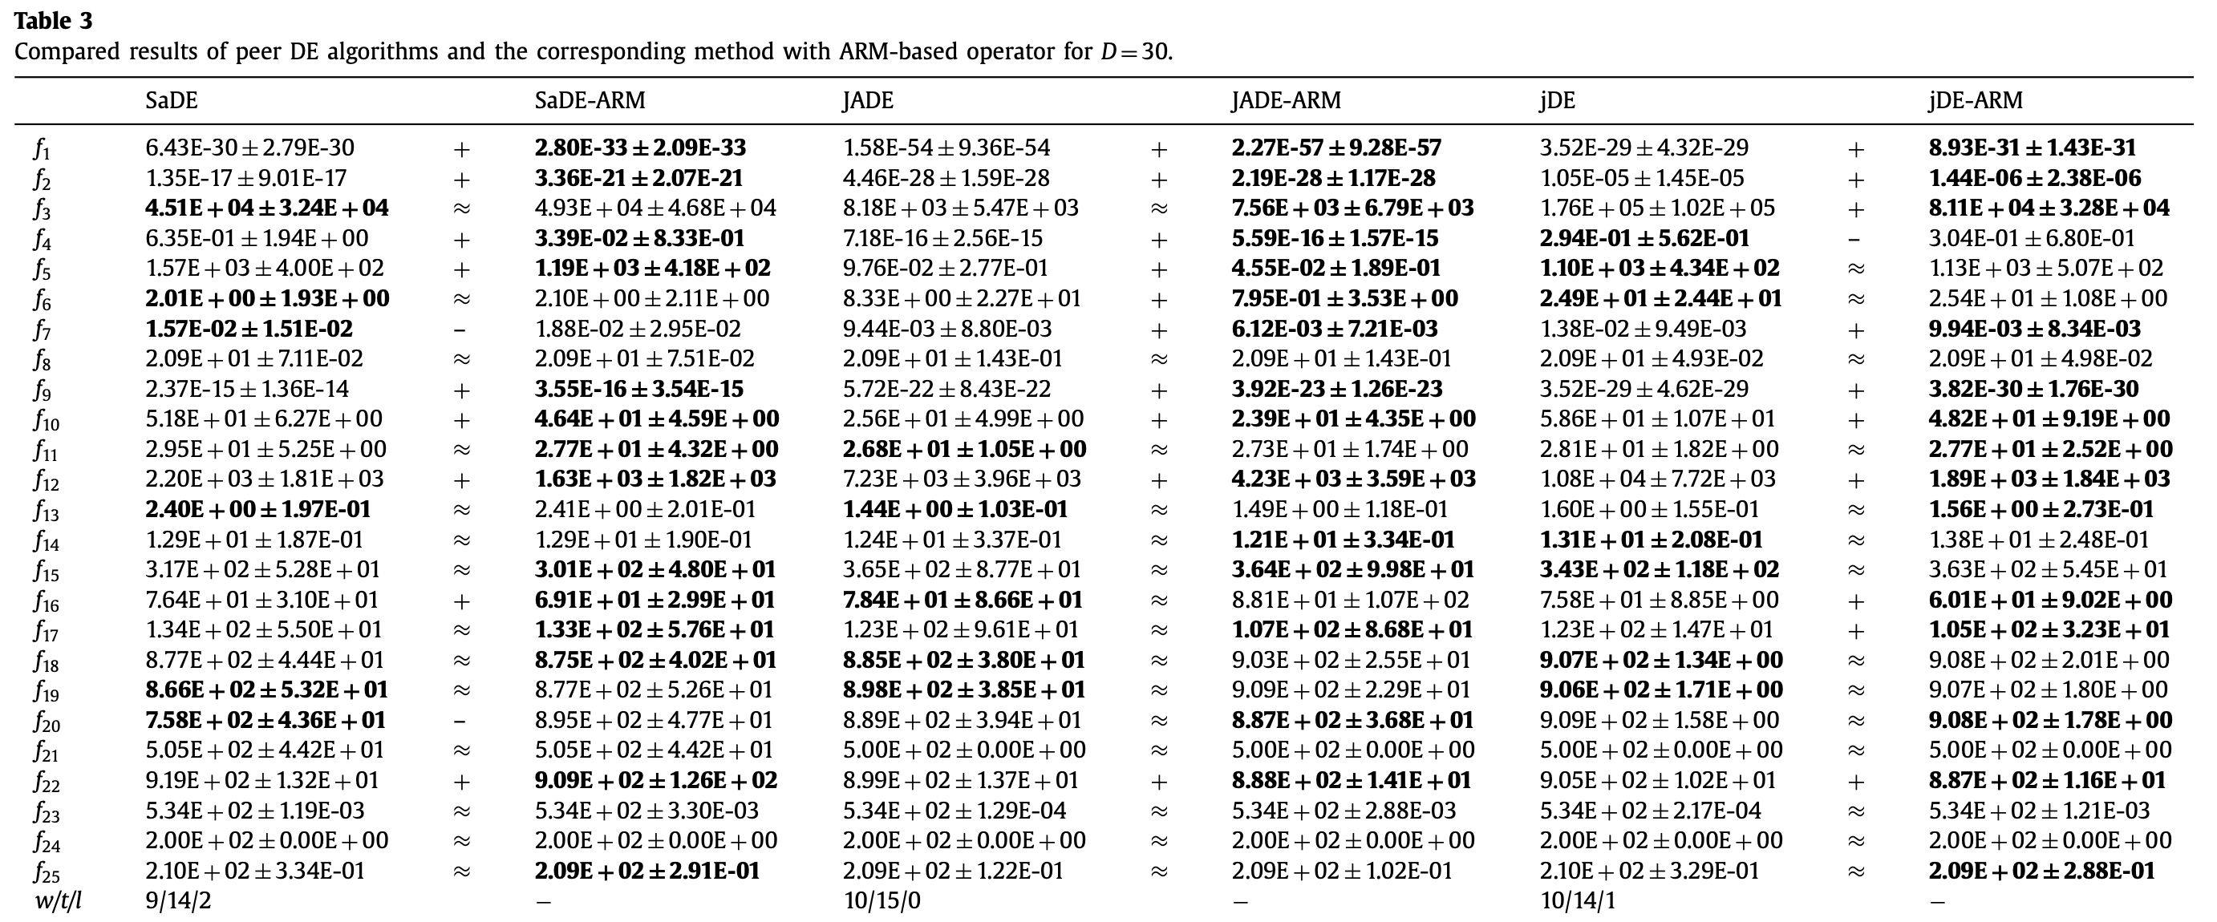
Results (2/5)
Simple unimodal functions : higher frequency.
Some complicated multimodal functions : lower frequency.

Slide 15
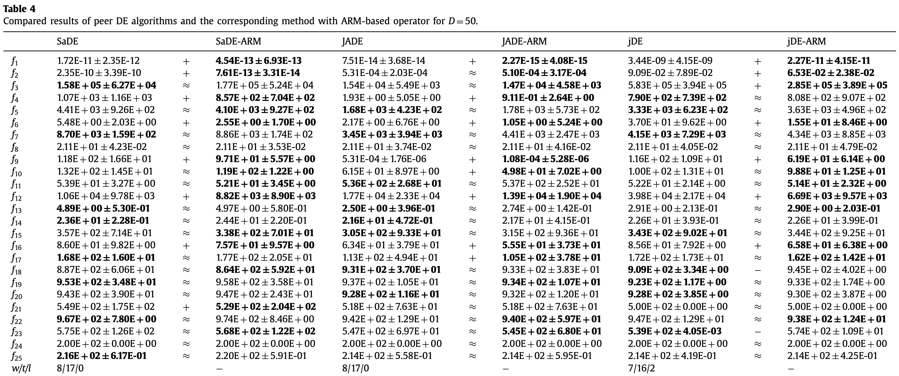
Results (3/5)
Simple unimodal functions : higher frequency.
Some complicated multimodal functions : lower frequency.
s

Slide 16
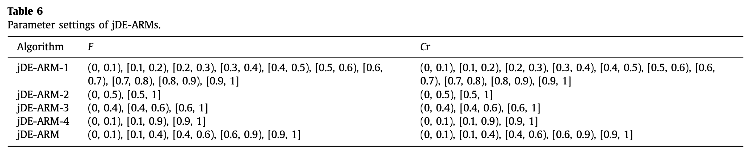
Results (4/5)
Influence of different discretized ranges for F and Cr

Slide 17
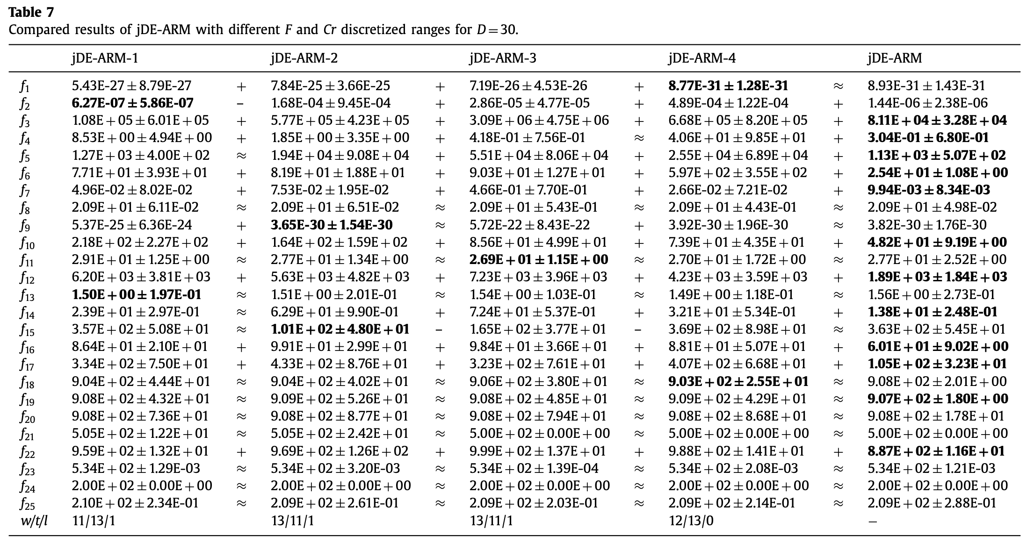
Results ()

Slide 18
Thank you for listening

Slide 19
Abstract
s

