Slide 1
Scheduling for heterogeneous systems using constrained critical paths
Minhaj Ahmad Khan
Parallel Computing Volume 38, Issues 4–5, April–May 2012, pp 175-193
Date: Mar. 16, 2022
Presenter: Jue-Jun, Wu

Slide 2
Abstract
A complex computing problem may be efficiently solved on a system with multiple processing elements by dividing its implementation code into several tasks or modules that execute in parallel. The modules may then be assigned to and scheduled on the processing elements so that the total execution time is minimum. Finding an optimal schedule for parallel programs is a non-trivial task and is considered to be NP-complete.
For heterogeneous systems having processors with different characteristics, most of the scheduling algorithms use greedy approach to assign processors to the modules. This paper suggests a novel approach called constrained earliest finish time (CEFT) to provide better schedules for heterogeneous systems using the concept of the constrained critical paths (CCPs). In contrast to other approaches used for heterogeneous systems, the CEFT strategy takes into account a broader view of the input task graph. Furthermore, the statically generated CCPs may be efficiently scheduled in comparison with other approaches.The experimentation results show that the CEFT scheduling strategy outperforms the well-known HEFT, DLS and LMT strategies by producing shorter schedules for a diverse collection of task graphs.

Slide 3
對於 CCP 中的所有任務，分配一個處理器。考慮 CCP 中的所有任務不僅可以降低通信成本，還可以從更廣泛的任務圖視圖中受益。這就是為什麼與用於異構系統的其他調度方法相比，它產生更好的調度結果
For all the tasks in a CCP, a single processor is assigned. Consideration of all the tasks in a CCP not only reduces the com- munication cost, but also benefits from a broader view of the task graph. This is why, it produces better scheduling results as compared to other scheduling approaches being used for heterogeneous syste

Slide 4

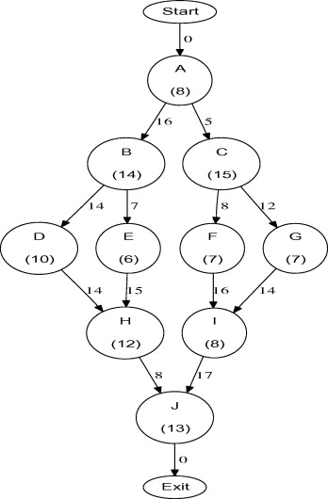
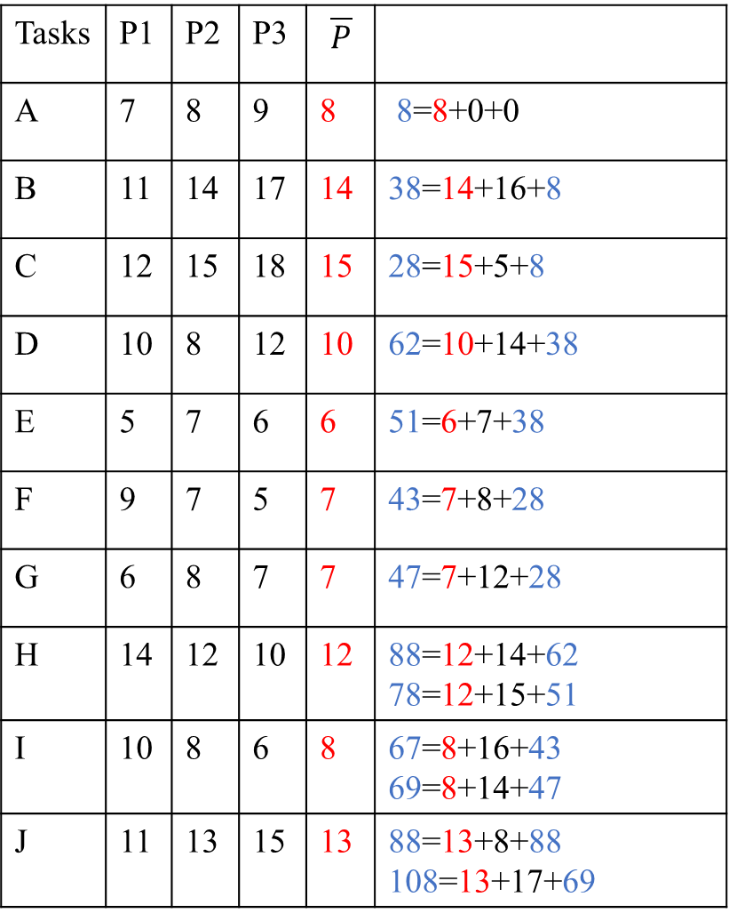
Tasks | P1 | P2 | P3 | $$\overline{P}$$
A | 7 | 8 | 9 | 8 | 8=8+0+0
B | 11 | 14 | 17 | 14 | 38=14+16+8
C | 12 | 15 | 18 | 15 | 28=15+5+8
D | 10 | 8 | 12 | 10 | 62=10+14+38
E | 5 | 7 | 6 | 6 | 51=6+7+38
F | 9 | 7 | 5 | 7 | 43=7+8+28
G | 6 | 8 | 7 | 7 | 47=7+12+28
H | 14 | 12 | 10 | 12 | 88=12+14+62 78=12+15+51
I | 10 | 8 | 6 | 8 | 67=8+16+43 69=8+14+47
J | 11 | 13 | 15 | 13 | 88=13+8+88 108=13+17+69
Critical Paths
A-B-D-H-J

Slide 5
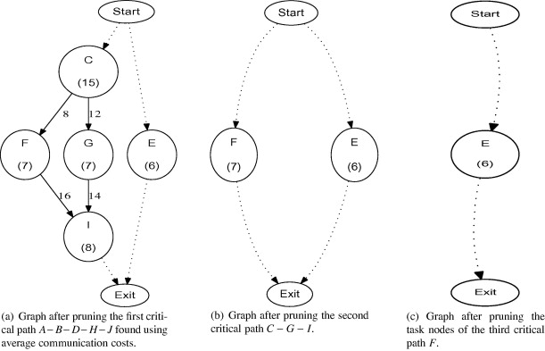
Tasks | P1 | P2 | P3 | $$\overline{P}$$
A | 7 | 8 | 9 | 8 | 8=8+0+0
B | 11 | 14 | 17 | 14 | 38=14+16+8
C | 12 | 15 | 18 | 15 | 28=15+5+8
D | 10 | 8 | 12 | 10 | 62=10+14+38
E | 5 | 7 | 6 | 6 | 51=6+7+38
F | 9 | 7 | 5 | 7 | 43=7+8+28
G | 6 | 8 | 7 | 7 | 47=7+12+28
H | 14 | 12 | 10 | 12 | 88=12+14+62 78=12+15+51
I | 10 | 8 | 6 | 8 | 67=8+16+43 69=8+14+47
J | 11 | 13 | 15 | 13 | 88=13+8+88 108=13+17+69
Critical Paths
A-B-D-H-J
C-G-I
F
E
Notes:
原本的node都被移走了~更新table~看剩下的edge~~

Slide 6
Critical Paths
A-B-D-H-J
C-G-I
F
E
Round Robin
Constrainted Critical Paths
A-B-D
C-G
F
E
H
I
J

Slide 7
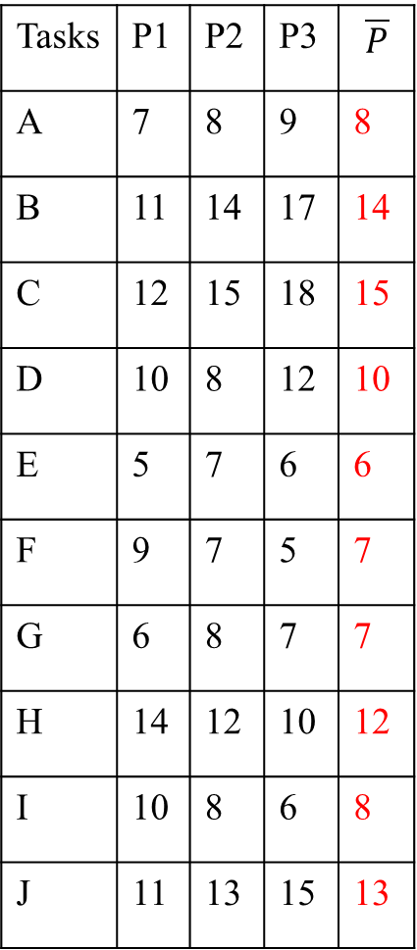
Tasks | P1 | P2 | P3 | $$\overline{P}$$
A | 7 | 8 | 9 | 8
B | 11 | 14 | 17 | 14
C | 12 | 15 | 18 | 15
D | 10 | 8 | 12 | 10
E | 5 | 7 | 6 | 6
F | 9 | 7 | 5 | 7
G | 6 | 8 | 7 | 7
H | 14 | 12 | 10 | 12
I | 10 | 8 | 6 | 8
J | 11 | 13 | 15 | 13
CCP | P1 | P2 | P3
A-B-D | 28 | 30 | 38
C-G
F
E
H
I
J

Slide 8
Tasks | P1 | P2 | P3
A | 7 | 8 | 9
B | 11 | 14 | 17
C | 12 | 15 | 18
D | 10 | 8 | 12
E | 5 | 7 | 6
F | 9 | 7 | 5
G | 6 | 8 | 7
H | 14 | 12 | 10
I | 10 | 8 | 6
J | 11 | 13 | 15
CCP | P1 | P2 | P3
A-B-D | 28 | 30 | 38
C-G | 28+18=46 | 7+5+23=35 | 7+5+25=37
F
E
H
I
J

Slide 9
Tasks | P1 | P2 | P3
A | 7 | 8 | 9
B | 11 | 14 | 17
C | 12 | 15 | 18
D | 10 | 8 | 12
E | 5 | 7 | 6
F | 9 | 7 | 5
G | 6 | 8 | 7
H | 14 | 12 | 10
I | 10 | 8 | 6
J | 11 | 13 | 15
CCP | P1 | P2 | P3
A-B-D | 28 | 30 | 38
C-G | 28+18=46 | 7+5+23=35 | 7+5+25=37
F | 27+8+9=44 | 35+7=42 | 27+8+5=40
E
H
I
J

Slide 10
Tasks | P1 | P2 | P3
A | 7 | 8 | 9
B | 11 | 14 | 17
C | 12 | 15 | 18
D | 10 | 8 | 12
E | 5 | 7 | 6
F | 9 | 7 | 5
G | 6 | 8 | 7
H | 14 | 12 | 10
I | 10 | 8 | 6
J | 11 | 13 | 15
CCP | P1 | P2 | P3
A-B-D | 28 | 30 | 38
C-G | 28+18=46 | 7+5+23=35 | 7+5+25=37
F | 27+8+9=44 | 35+7=42 | 27+8+5=40
E | 28+5=33 | 18+7+7=32 35+7=42 | 18+7+6=31 40+6=46
H
I
J

Slide 11
Tasks | P1 | P2 | P3
A | 7 | 8 | 9
B | 11 | 14 | 17
C | 12 | 15 | 18
D | 10 | 8 | 12
E | 5 | 7 | 6
F | 9 | 7 | 5
G | 6 | 8 | 7
H | 14 | 12 | 10
I | 10 | 8 | 6
J | 11 | 13 | 15
CCP | Check | P1 | P2 | P3
A-B-D |  | 28 | 30 | 38
C-G | A | 28+18=46 | 7+5+23=35 | 7+5+25=37
F | C | 27+8+9=44 | 35+7=42 | 27+8+5=40
E | B | 28+5=33 | 18+7+7=32 35+7=42 | 18+7+6=31 40+6=46
H | DE | 28+14=42 31+15+14=60 | 28+14+12=54 31+15+12=58 35+12=47 | 28+14+10=52 31+10=41 40+10=50
I | FG
J | HI

Slide 12
Tasks | P1 | P2 | P3
A | 7 | 8 | 9
B | 11 | 14 | 17
C | 12 | 15 | 18
D | 10 | 8 | 12
E | 5 | 7 | 6
F | 9 | 7 | 5
G | 6 | 8 | 7
H | 14 | 12 | 10
I | 10 | 8 | 6
J | 11 | 13 | 15
CCP | Check | P1 | P2 | P3
A-B-D |  | 28 | 30 | 38
C-G | A | 28+18=46 | 7+5+23=35 | 7+5+25=37
F | C | 27+8+9=44 | 35+7=42 | 27+8+5=40
E | B | 28+5=33 | 18+7+7=32 35+7=42 | 18+7+6=31 40+6=46
H | DE | 28+14=42 31+15+14=60 | 28+14+12=54 31+15+12=58 35+12=47 | 28+14+10=52 31+10=41 40+10=50
I | FG | 40+16+10=66 35+14+10=59 | 40+16+8=64 35+8=43 | 40+6=46 35+16+6=57 52+6=58
J | HI

Slide 13
Tasks | P1 | P2 | P3
A | 7 | 8 | 9
B | 11 | 14 | 17
C | 12 | 15 | 18
D | 10 | 8 | 12
E | 5 | 7 | 6
F | 9 | 7 | 5
G | 6 | 8 | 7
H | 14 | 12 | 10
I | 10 | 8 | 6
J | 11 | 13 | 15
CCP | Check | P1 | P2 | P3
A-B-D |  | 28 | 30 | 38
C-G | A | 28+18=46 | 7+5+23=35 | 7+5+25=37
F | C | 27+8+9=44 | 35+7=42 | 27+8+5=40
E | B | 28+5=33 | 18+7+7=32 35+7=42 | 18+7+6=31 40+6=46
H | DE | 28+14=42 31+15+14=60 | 28+14+12=54 31+15+12=58 35+12=47 | 28+14+10=52 31+10=41 40+10=50
I | FG | 40+16+10=66 35+14+10=59 | 40+16+8=64 35+8=43 | 40+6=46 35+16+6=57 52+6=58
J | HI | 52+8+11=71 58+17+11=86 | 52+8+13=73 58+17+13=88 | 52+15=67 58+15=73

Slide 14
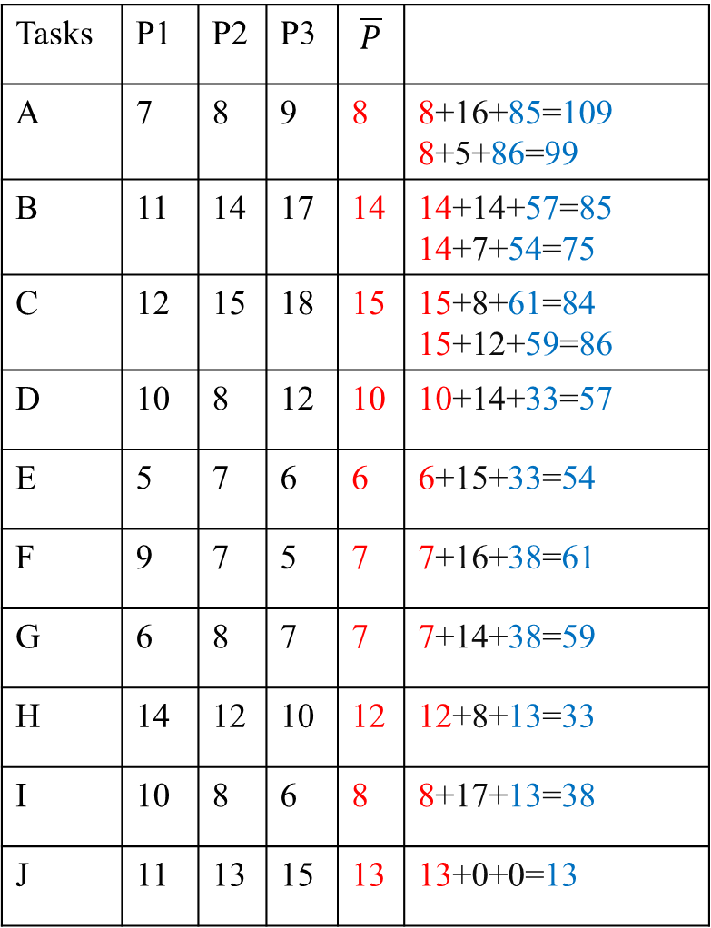
HEFT
Tasks | P1 | P2 | P3 | $$\overline{P}$$
A | 7 | 8 | 9 | 8 | 8+16+85=109 8+5+86=99
B | 11 | 14 | 17 | 14 | 14+14+57=85 14+7+54=75
C | 12 | 15 | 18 | 15 | 15+8+61=84 15+12+59=86
D | 10 | 8 | 12 | 10 | 10+14+33=57
E | 5 | 7 | 6 | 6 | 6+15+33=54
F | 9 | 7 | 5 | 7 | 7+16+38=61
G | 6 | 8 | 7 | 7 | 7+14+38=59
H | 14 | 12 | 10 | 12 | 12+8+13=33
I | 10 | 8 | 6 | 8 | 8+17+13=38
J | 11 | 13 | 15 | 13 | 13+0+0=13
J
H
I
D
E
G
G
B
C
A

Slide 15
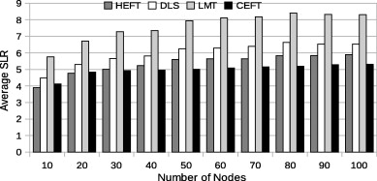
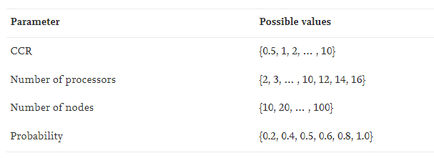
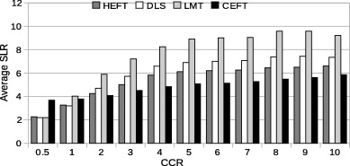
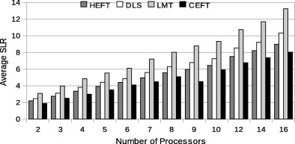
Ramdon

Slide 16
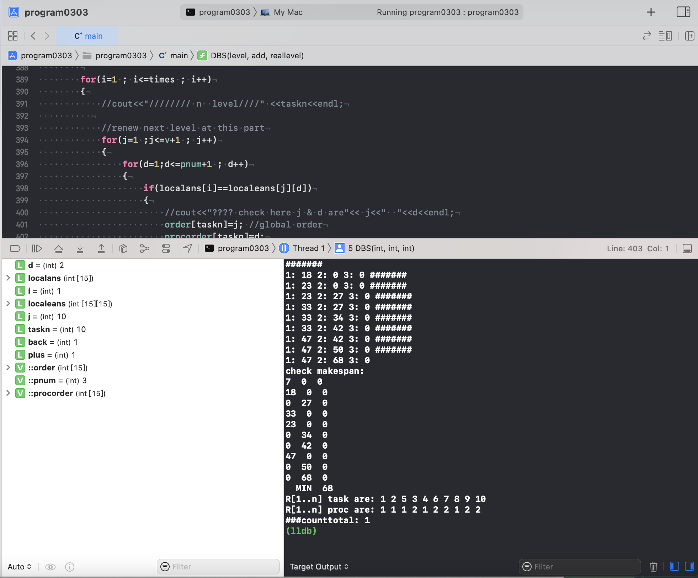
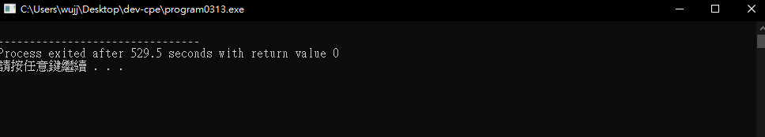

Slide 17
Thanks for listening.

Slide 18
As future work, we intend to adapt this strategy for various groups of machines. It would require multiple CCPs being considered for assignment to a subset of machines instead of taking into account all the existing machines.

Slide 19
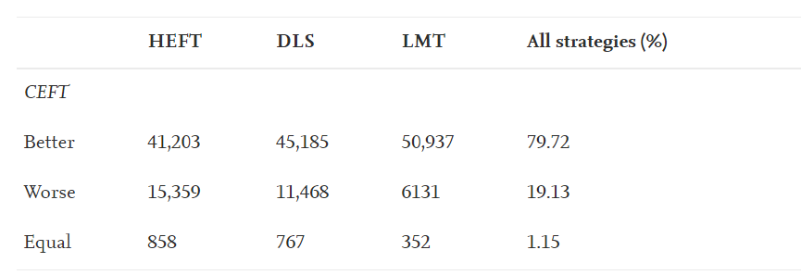

Slide 20
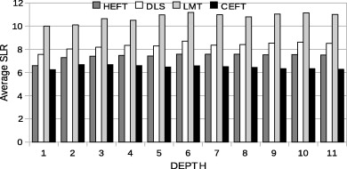
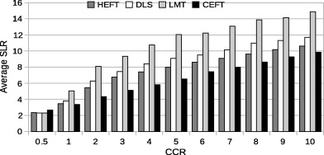
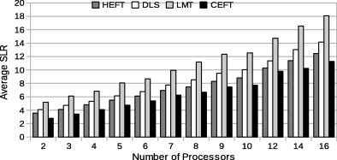
Fork join graph

Slide 21
Critical Paths
Constrainted Critical Paths

