Slide 1
A Fast Algorithm for Order-Preserving Pattern Matching
Sukhyeun Cho, Joong Chae Na, Kunsoo Park, Jeong Seop Sim
Information Processing Letters 115 (2015) pp.397 - 402
Presenter: Guan-Ting Chen
Date: Apr. 12, 2022

Slide 2
Abstract
Given a text T and a pattern P, the order-preserving pattern matching (OPPM) problem is to ﬁnd all substrings in T which have the same relative orders as P. The OPPM has been studied in the ﬁelds of ﬁnding some patterns affected by relative orders, not by their absolute values. In this paper, we present a method of deciding the order-isomorphism between two strings even when there are same characters. Then, we show that the bad character rule of the Horspool algorithm for generic pattern matching problems can be applied to the OPPM problem and we present a space-eﬃcient algorithm for computing shift tables for text search. Finally, we combine our bad character rule with the KMP-based algorithm to improve the worst-case running time. We give experimental results to show that our algorithm is about 2 to 6 times faster than the KMP-based algorithm in reasonable cases.

Slide 3
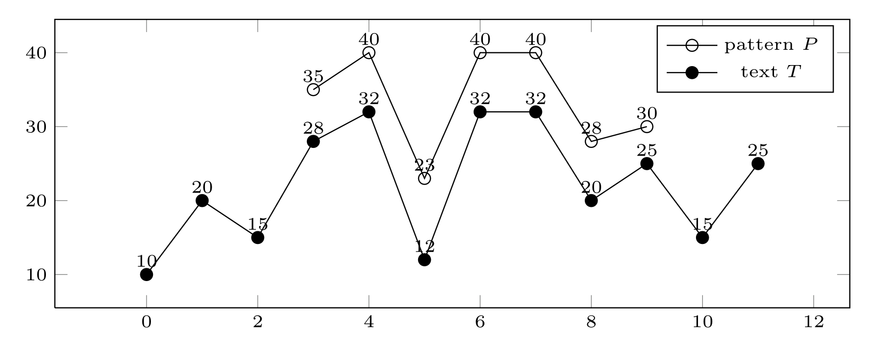
Order-Preserving Pattern Matching

Slide 4
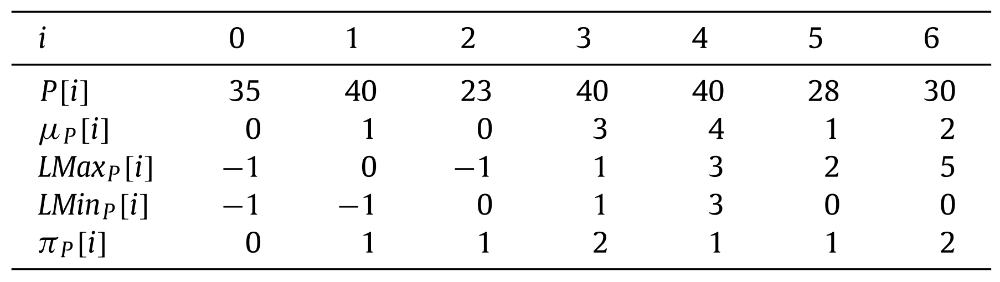
Preliminaries
≤
LMaxp[i]
Predecessor
Lminp[i]
Successor
x ≈ y
x[i] ≤ x[j] ⇔ y[i] ≤ y[j]
μ_{x} = μ_{y}

Slide 5
Algorithm
Horspool algorithm
Pattern: A T A T A
Shift Table
A | C | G | T
2 | 5 | 5 | 1
T | A | G | A | T | A | C | G | A | T | A | T | A | T | A | C
1 | A | T | A | T | A
2 |  |  | A | T | A | T | A
3 |  |  |  |  |  |  |  | A | T | A | T | A

Slide 6
Algorithm
q-Grams
The orders of characters
Overlapping 3-grams
P = 35 40 23 40 40 28 30 → 35 40 23, 23 40 40, 40 28 30
Consecutive 3-grams
P = 35 40 23 40 40 28 30 → 35, 40 23 40, 40 28 30
l_{x}
i | 0 | 1 | 2 | 3 | 4 | 5 | 6
P | 35 | 40 | 23 | 40 | 40 | 28 | 30
x |  |  |  | 30 | 30 | 19
μ_{x} = μ_{P} |  |  |  | 0 | 1 | 0

Slide 7
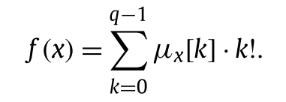
Algorithm
Factorial number system
Example:
Shift Table D
D[ f(x) ]
min(|P| – q + 1, |P| – l_{x} – 1)
x | 40 | 28 | 30
μ_{x} | 0 | 0 | 1
= 0 * 0! + 0 * 1! + 1 * 2!
= 2

Slide 8
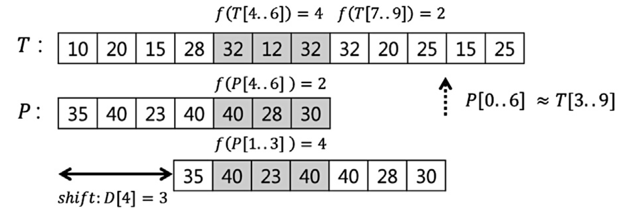
Example

Slide 9
Time Complexity
Step 1
Location Tables
O(mlogm)
All the q-grams of P
O(mqlogq)
Shift Table
O(q! + mqlogq)
Step 2
O(nm + nqlogq)
Sum
O(nm + nq + q! )

